Slide 1

04.09 LC: Conversation Summary Memory
Peter H. Chen

Slide 2
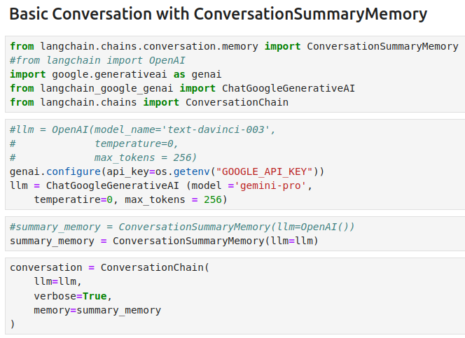
04.09 LC: Conversation Summary Memory
https://www.youtube.com/watch?v=X550Zbz_ROE&list=PL8motc6AQftk1Bs42EW45kwYbyJ4jOdiZ&index=4
LC: Conversation Summary Memory (09:31-10:00/20:27)

Slide 3
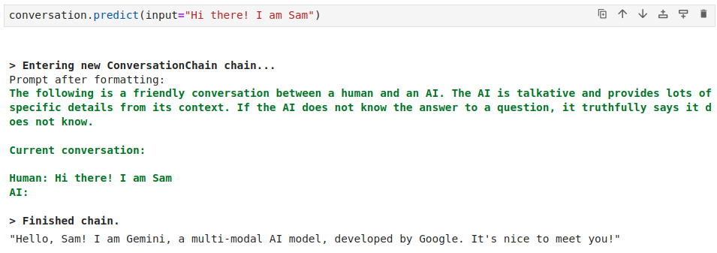
04.09 LC: Conversation Summary Memory
https://www.youtube.com/watch?v=X550Zbz_ROE&list=PL8motc6AQftk1Bs42EW45kwYbyJ4jOdiZ&index=4
LC: Conversation Summary Memory (10:01-10:30/20:27)

Slide 4
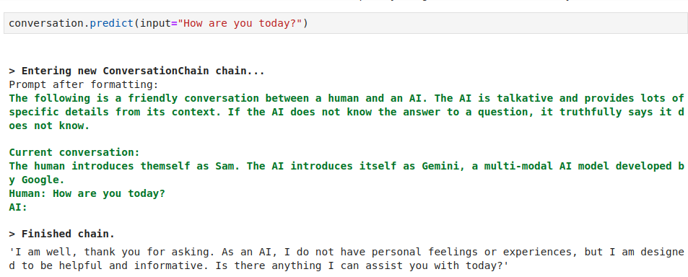
04.09 LC: Conversation Summary Memory
https://www.youtube.com/watch?v=X550Zbz_ROE&list=PL8motc6AQftk1Bs42EW45kwYbyJ4jOdiZ&index=4
LC: Conversation Summary Memory (10:31-11:00/20:27)

Slide 5
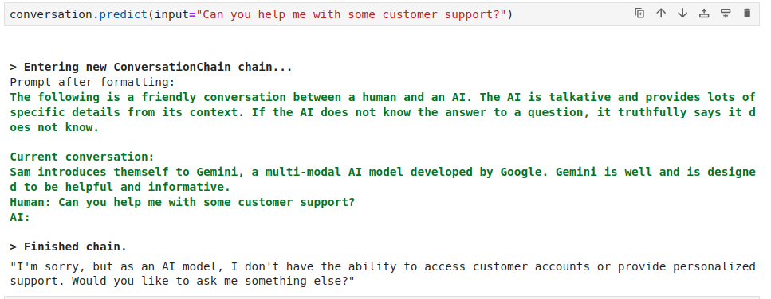
04.09 LC: Conversation Summary Memory
https://www.youtube.com/watch?v=X550Zbz_ROE&list=PL8motc6AQftk1Bs42EW45kwYbyJ4jOdiZ&index=4
LC: Conversation Summary Memory (11:01-11:30/20:27)

Slide 6
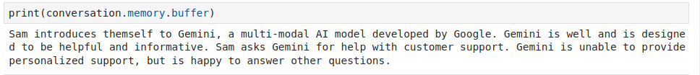
04.09 LC: Conversation Summary Memory
https://www.youtube.com/watch?v=X550Zbz_ROE&list=PL8motc6AQftk1Bs42EW45kwYbyJ4jOdiZ&index=4
LC: Conversation Summary Memory (11:31-12:30/20:27)

Slide 7
End

