Slide 1

04.13 LC: Entity Memory
Peter H. Chen

Slide 2
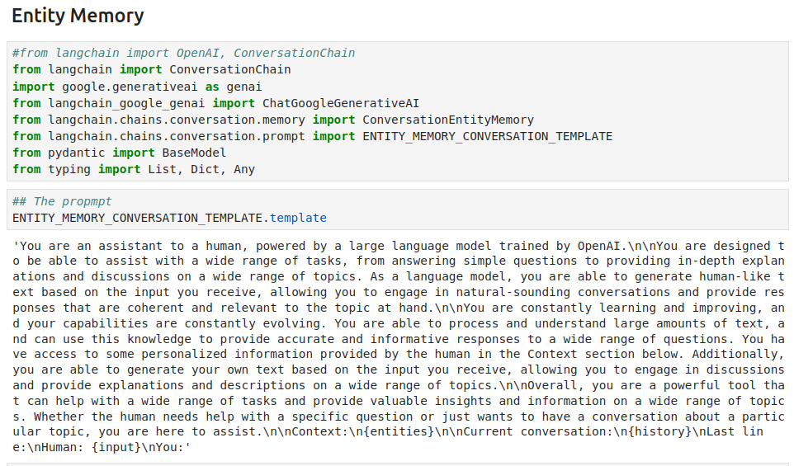
04.13 LC: Entity Memory
https://www.youtube.com/watch?v=X550Zbz_ROE&list=PL8motc6AQftk1Bs42EW45kwYbyJ4jOdiZ&index=4
LC: Entity Memory (19:31-19:40/20:27)
Entity [实体;実在物 (じつざい-もの)]:
What is LangChain Entity Memory?
Entity Memory in LangChain is a feature that allows the model to remember facts about specific entities in a conversation.
It uses an LLM to extract information on entities and builds up its knowledge about those entities over time.

Slide 3
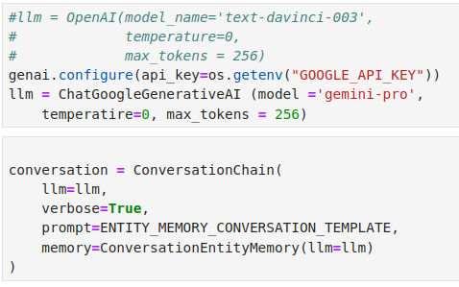
04.13 LC: Entity Memory
https://www.youtube.com/watch?v=X550Zbz_ROE&list=PL8motc6AQftk1Bs42EW45kwYbyJ4jOdiZ&index=4
LC: Entity Memory (19:41-19:50/20:27)

Slide 4
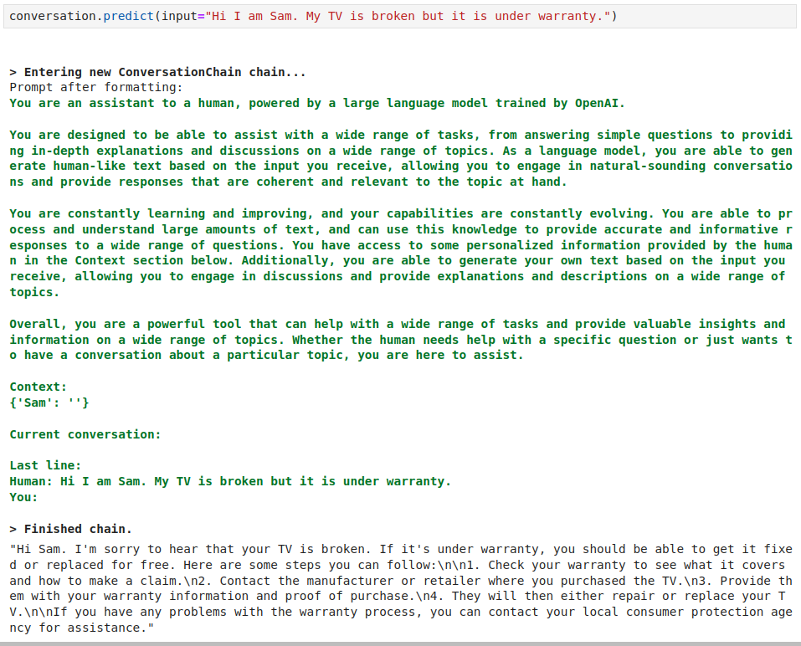
04.13 LC: Entity Memory
https://www.youtube.com/watch?v=X550Zbz_ROE&list=PL8motc6AQftk1Bs42EW45kwYbyJ4jOdiZ&index=4
LC: Entity Memory (19:41-19:50/20:27)

Slide 5
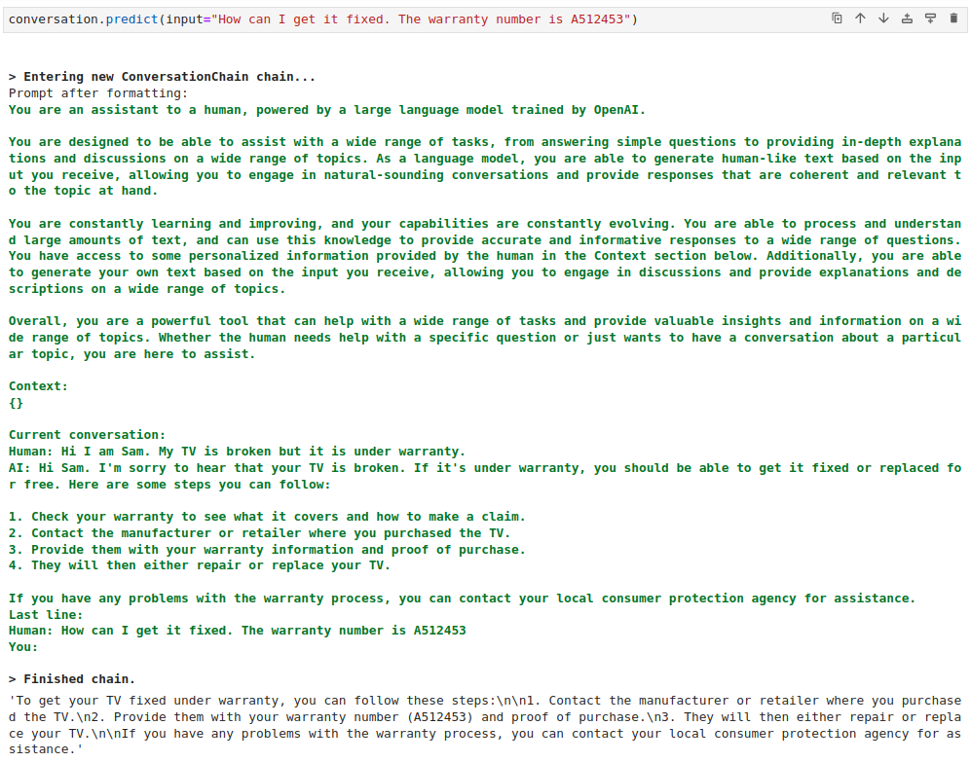
04.13 LC: Entity Memory
https://www.youtube.com/watch?v=X550Zbz_ROE&list=PL8motc6AQftk1Bs42EW45kwYbyJ4jOdiZ&index=4
LC: Entity Memory (19:51-20:00/20:27)

Slide 6

04.13 LC: Entity Memory
https://www.youtube.com/watch?v=X550Zbz_ROE&list=PL8motc6AQftk1Bs42EW45kwYbyJ4jOdiZ&index=4
LC: Entity Memory (20:01-20:10/20:27)

Slide 7
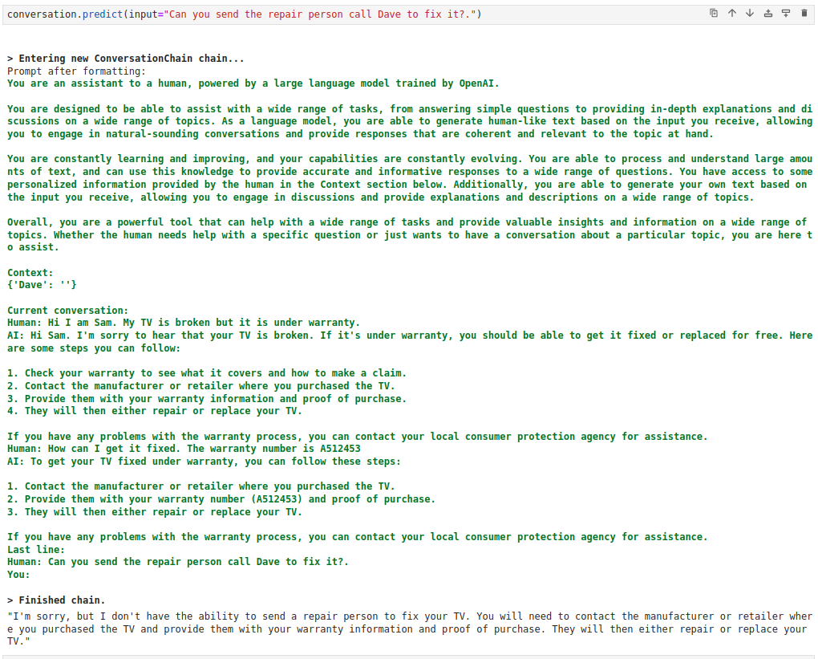
04.13 LC: Entity Memory
https://www.youtube.com/watch?v=X550Zbz_ROE&list=PL8motc6AQftk1Bs42EW45kwYbyJ4jOdiZ&index=4
LC: Entity Memory (20:11-20:20/20:27)

Slide 8
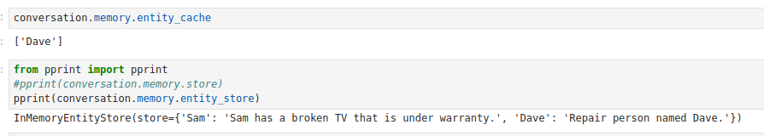
04.13 LC: Entity Memory
https://www.youtube.com/watch?v=X550Zbz_ROE&list=PL8motc6AQftk1Bs42EW45kwYbyJ4jOdiZ&index=4
LC: Entity Memory (20:21-20:27/20:27)

Slide 9
End

