Slide 1

7.04 PDFs ChatBot
Peter H. Chen

Slide 2
7.04 PDFs ChatBot
https://www.youtube.com/watch?v=1ICRLYtkmNU&list=PLZoTAELRMXVNbDmGZlcgCA3a8mRQp5axb&index=7
DFS ChatBot (1:08:21-1:09:30/2:16:34)
We create a chatBot with input multiple PDF documents using Google Gemini.
We will also use LangChain for PDFs and Gemini.
We will understand how important of LangChain integration with Gemini to develop the AI applications.
We have two main features of this projects:
1. Vector Embedding technique: There are many vector embedding techniques. We will use FAISS (Facebook AI Similarity Search) for
2. langchain: We use langchain to Integrate embedding and Gemini.

Slide 3
7.04.01 PDFs ChatBot Demo

Slide 4
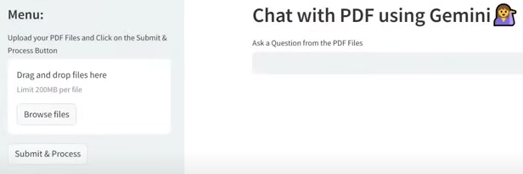
7.04.01 PDFs ChatBot Demo
https://www.youtube.com/watch?v=1ICRLYtkmNU&list=PLZoTAELRMXVNbDmGZlcgCA3a8mRQp5axb&index=7
DFS ChatBot Demo (1:08:21-1:09:30/2:16:34)
We create a chatBot with input multiple PDF documents using Google Gemini.
We will also use LangChain for PDFs and Gemini.
We will understand how important of LangChain integration with Gemini to develop the AI applications.
We have two main features of this projects:
1. Vector Embedding technique: There are many vector embedding techniques. We will use FAISS (Facebook AI Similarity Search) for
2. langchain: We use langchain to Integrate embedding and Gemini.
We have the “ChatBot with Multiple PDF Documents using Gemini”

Slide 5
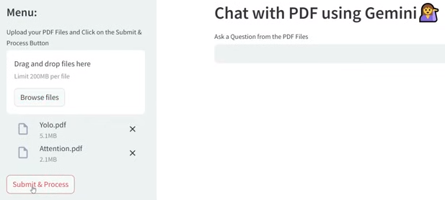
7.04.01 PDFs ChatBot Demo
https://www.youtube.com/watch?v=1ICRLYtkmNU&list=PLZoTAELRMXVNbDmGZlcgCA3a8mRQp5axb&index=7
DFS ChatBot Demo (1:09:31-1:10:50/2:16:34)
In the application, we uploaded the “Attention.pdf” and “YOLO.pdf”

Slide 6
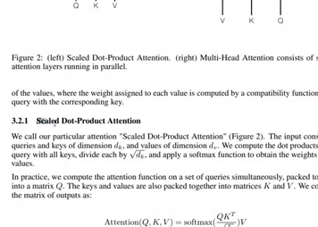
7.04.01 PDFs ChatBot Demo
https://www.youtube.com/watch?v=1ICRLYtkmNU&list=PLZoTAELRMXVNbDmGZlcgCA3a8mRQp5axb&index=7
DFS ChatBot Demo (1:10:51-1:09:00/2:16:34)
View the Attention.pdf, we picked up topic “Scaled Dot-Product Attention”

Slide 7
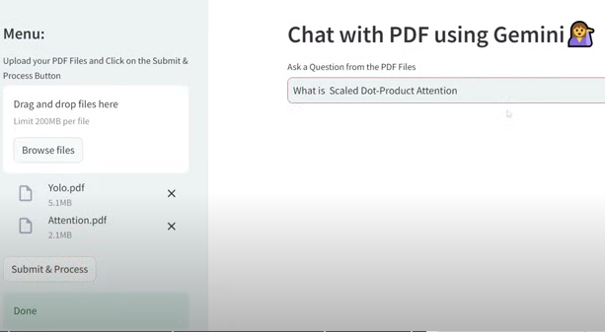
7.04.01 PDFs ChatBot Demo
https://www.youtube.com/watch?v=1ICRLYtkmNU&list=PLZoTAELRMXVNbDmGZlcgCA3a8mRQp5axb&index=7
DFS ChatBot Demo (1:10:51-1:11:00/2:16:34)
In the PDF ChatBot Application, we ask “Scaled Dot-Product Attention”

Slide 8
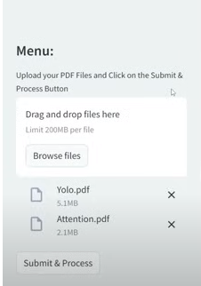
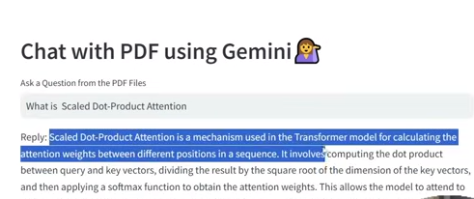
7.04.01 PDFs ChatBot Demo
https://www.youtube.com/watch?v=1ICRLYtkmNU&list=PLZoTAELRMXVNbDmGZlcgCA3a8mRQp5axb&index=7
DFS ChatBot Demo (1:11:01-1:11:20/2:16:34)
Response.

Slide 9
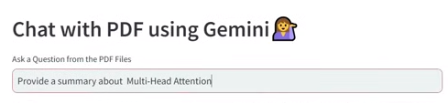
7.04.01 PDFs ChatBot Demo
https://www.youtube.com/watch?v=1ICRLYtkmNU&list=PLZoTAELRMXVNbDmGZlcgCA3a8mRQp5axb&index=7
DFS ChatBot Demo (1:11:21-1:11:30/2:16:34)
Ask: Provide a summary of Multi-Head Attention

Slide 10
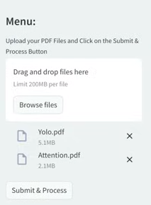
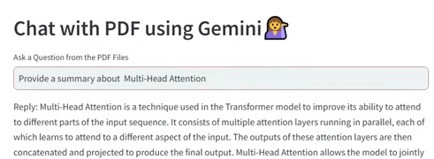
7.04.01 PDFs ChatBot Demo
https://www.youtube.com/watch?v=1ICRLYtkmNU&list=PLZoTAELRMXVNbDmGZlcgCA3a8mRQp5axb&index=7
DFS ChatBot Demo (1:11:31-1:12:10/2:16:34)
Ask: Provide a summary of Multi-Head Attention

Slide 11

7.04.01 PDFs ChatBot Demo
https://www.youtube.com/watch?v=1ICRLYtkmNU&list=PLZoTAELRMXVNbDmGZlcgCA3a8mRQp5axb&index=7
DFS ChatBot Demo (1:12:11-1:12:20/2:16:34)
Ask: Provide a detailed summary about VOC 2007 Error Analysis

Slide 12
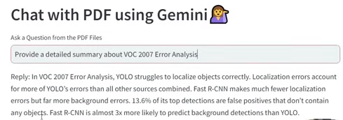
7.04.01 PDFs ChatBot Demo
https://www.youtube.com/watch?v=1ICRLYtkmNU&list=PLZoTAELRMXVNbDmGZlcgCA3a8mRQp5axb&index=7
DFS ChatBot Demo (1:12:21-1:12:40/2:16:34)
Response

Slide 13
End

