Slide 1

7.04.02 Langchain/FAISS
Peter H. Chen

Slide 2
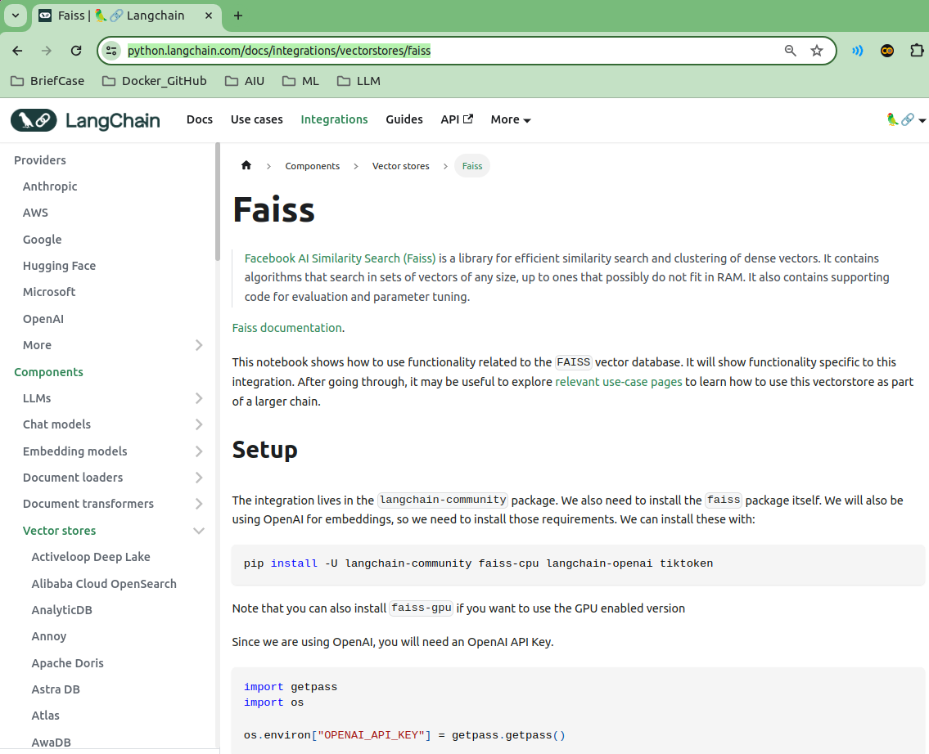
7.04.02 Langchain/FAISS
https://www.youtube.com/watch?v=1ICRLYtkmNU&list=PLZoTAELRMXVNbDmGZlcgCA3a8mRQp5axb&index=7
Langchain/FAISS (1:12:45-1:13:30/2:16:34)
We are going to use langchain to integrate the FAISS (Facebook AI Similarity Search) for Vector Embeddings. Google search “Python Langchain FAISS”. The technologies include: LangChain, ChromaDB, and FAISS. We will see how to create FAISS vector embeddings and stores locally.
https://python.langchain.com/docs/integrations/vectorstores/faiss

Slide 3
7.04.03 Conda Environment

Slide 4
7.04.03 Conda Environment
https://www.youtube.com/watch?v=1ICRLYtkmNU&list=PLZoTAELRMXVNbDmGZlcgCA3a8mRQp5axb&index=7
Conda Environment (1:13:31-1:14:30/2:16:34)
Create conda environment and activate:
> conda create –name gemini
> conda activate gemini

Slide 5
7.04.04 Create API Key

Slide 6
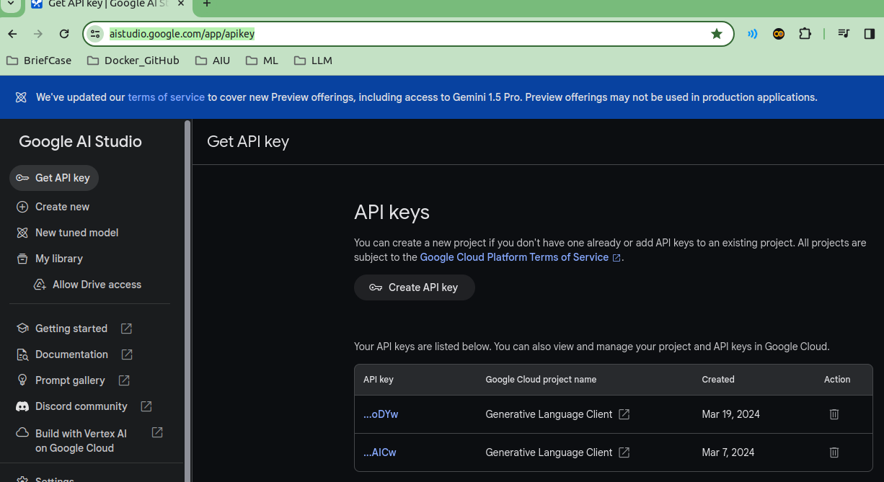
7.04.04 Create API Key
https://www.youtube.com/watch?v=1ICRLYtkmNU&list=PLZoTAELRMXVNbDmGZlcgCA3a8mRQp5axb&index=7
Create API Key (1:14:31-1:15:30/2:16:34)
Create Google API Key for Gemini Model.
https://aistudio.google.com/app/apikey

Slide 7
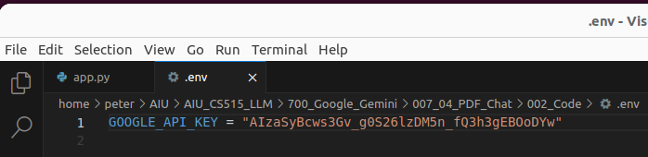
7.04.04 Create API Key
https://www.youtube.com/watch?v=1ICRLYtkmNU&list=PLZoTAELRMXVNbDmGZlcgCA3a8mRQp5axb&index=7
Create API Key (1:15:31-1:16:00/2:16:34)
Copy and Paste the API Key into the “.env” file.

Slide 8
7.04.05 Install requirements.txt

Slide 9
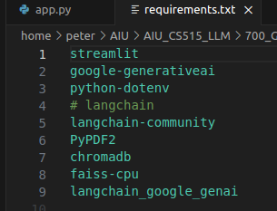
7.04.05 Install requirements.txt
https://www.youtube.com/watch?v=1ICRLYtkmNU&list=PLZoTAELRMXVNbDmGZlcgCA3a8mRQp5axb&index=7
Install requirements.txt (1:16:01-1:17:20/2:16:34)
Which libraries are required?
> code requirements.txt
1. streamlit: GUI
2. Google Generative AI: Gemini Model
3. python-dotenv: Read all environment variables defined in “.env” file.
4. langchain (langchain-community): There are a lot of langchain functionalities that integrate FAISS (Facebook AI Similarity Search) for Vector Database Embeddings and Gemini Model.
5. PyPDF2: Python PDF reader.
6. chromaDB: Database server.
7. faiss-cpu: FAISS (Facebook AI Similarity Search) library. Right now, only few files. If we have a lot of files, we need to to faiss-gpu for better performance.
8. langchain google genai: Langchain/Gemini Model library to help access the API of Generative AI.

Slide 10
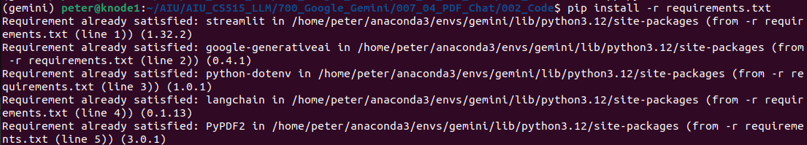
7.04.05 Install requirements.txt
https://www.youtube.com/watch?v=1ICRLYtkmNU&list=PLZoTAELRMXVNbDmGZlcgCA3a8mRQp5axb&index=7
Install requirements.txt (1:17:21-1:17:50/2:16:34)
We install all the libraries specified in the requirements.txt.
> pip install -r requirements.txt

Slide 11
End

