Slide 1

7.04.06 Import Library
Peter H. Chen

Slide 2
7.04.06 Import Library
https://www.youtube.com/watch?v=1ICRLYtkmNU&list=PLZoTAELRMXVNbDmGZlcgCA3a8mRQp5axb&index=7
Import Library (1:17:51-1:18:20/2:16:34)
Now, we start the coding.
First, we import the libraries.

Slide 3
7.04.07 Import Library

Slide 4
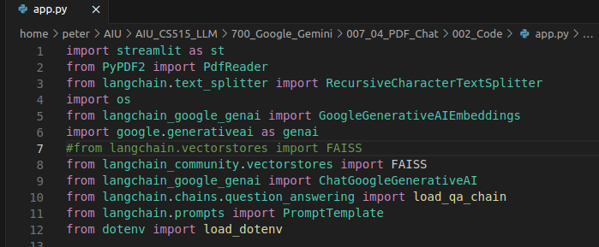
7.04.07 Import Library
https://www.youtube.com/watch?v=1ICRLYtkmNU&list=PLZoTAELRMXVNbDmGZlcgCA3a8mRQp5axb&index=7
Import Library (1:17:51-1:21:00/2:16:34)
1. Streamlit
2. PyPDF2
3. text_splitter
4. langchain Vector Embedding
5. generative AI: Gemini Model
6. Google Chat Generative AI
7. load_qa_chain: Question and Answer chain:
8. Google chat: PromptTemplate
Note:
“langchain.vectores” is changed into “langchain_community.vectores”

Slide 5
7.04.08 Load API Key

Slide 6

7.04.08 Load API Key
https://www.youtube.com/watch?v=1ICRLYtkmNU&list=PLZoTAELRMXVNbDmGZlcgCA3a8mRQp5axb&index=7
Load API Key (1:21:01-1:21:10/2:16:34)
Load Google API Key from “.env” file.

Slide 7
7.04.09 Configure Gemini Model

Slide 8
7.04.09 Configure Gemini Model
https://www.youtube.com/watch?v=1ICRLYtkmNU&list=PLZoTAELRMXVNbDmGZlcgCA3a8mRQp5axb&index=7
Configure Gemini Model (1:21:01-1:18:20/2:16:34)
We configure Gemini Model with API Key.

Slide 9
7.04.10 PDF to Text

Slide 10
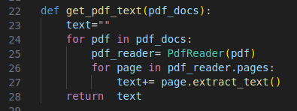
7.04.10 PDF to Text
https://www.youtube.com/watch?v=1ICRLYtkmNU&list=PLZoTAELRMXVNbDmGZlcgCA3a8mRQp5axb&index=7
PDF to Text (1:18:21-1:24:00/2:16:34)
Read PDF and convert into Text.
Extract all the pages inside the PDF.

Slide 11
7.04.11 Text to Chunk

Slide 12
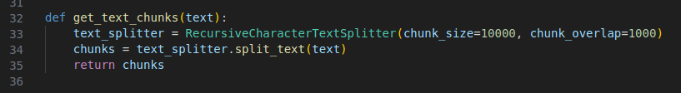
7.04.11 Text to Chunk
https://www.youtube.com/watch?v=1ICRLYtkmNU&list=PLZoTAELRMXVNbDmGZlcgCA3a8mRQp5axb&index=7
Text to Chunk (1:22:51-1:26:00/2:16:34)
Split the Text into chunks.
Chunk size = 10000 and chunk overlap = 1000
Split texts into chunks.

Slide 13
7.04.12 Store Vector Embedding

Slide 14
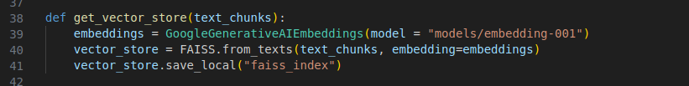
7.04.12 Store Vector Embedding
https://www.youtube.com/watch?v=1ICRLYtkmNU&list=PLZoTAELRMXVNbDmGZlcgCA3a8mRQp5axb&index=7
Store Vector Embedding (1:26:01-1:28:00/2:16:34)
1. Get Embedding of Gemini Model.
2. Use FAISS to translate into Gemini Vector Embedding for Chunks of Text.
3. Store Vector Embedding: Store Vector Embedding with name “faiss_index”.

Slide 15
7.04.13 Get Conversational Chain

Slide 16
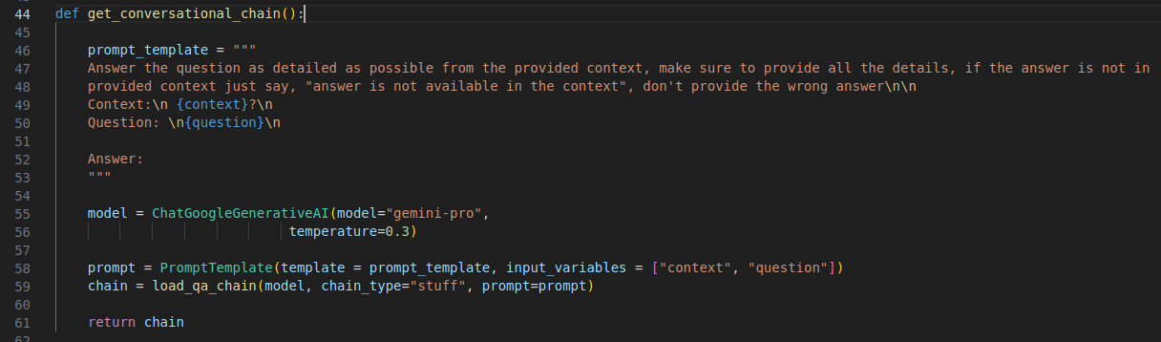
7.04.13 Get Conversational Chain
https://www.youtube.com/watch?v=1ICRLYtkmNU&list=PLZoTAELRMXVNbDmGZlcgCA3a8mRQp5axb&index=7
Get Conversational Chain (1:26:01-1:31:00/2:16:34)
1. Define the prompt template (prompt format for variables {context} and {question}).
2. Get Gemini Model
3. Get the prompt
4. Load QA Chain with prompt.
5. Return the chain.
What is {context} in prompt template?
A prompt contains any of the following elements:
a. Instruction: a specific task or instruction you want the model to perform.
b. Context: external information or additional context that can steer the model to better responses.
c. Input question: the input or question that we are interested to find a response for.

Slide 17
7.04.14 User Input and Response

Slide 18
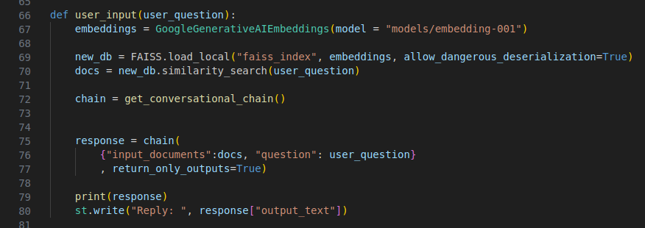
7.04.14 User Input and Response
https://www.youtube.com/watch?v=1ICRLYtkmNU&list=PLZoTAELRMXVNbDmGZlcgCA3a8mRQp5axb&index=7
User Input and Response (1:31:01-1:33:10/2:16:34)
User input:
1. Load the Gemini embedding
2. Combine the local FAISS embedding for PDF document with Gemini embedding.
3. Find user quesiton from FAISS similarity search.
4. Get conversational chain
5. chain response
6, Write the response.

Slide 19
7.04.15 Main Function

Slide 20
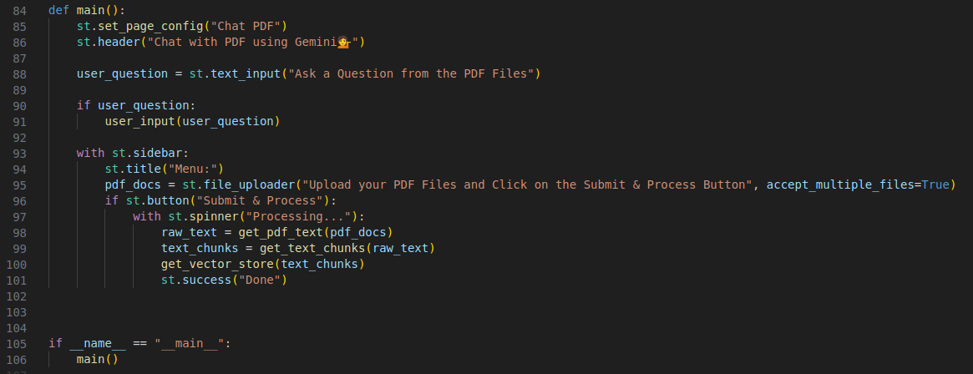
7.04.15 Main Function
https://www.youtube.com/watch?v=1ICRLYtkmNU&list=PLZoTAELRMXVNbDmGZlcgCA3a8mRQp5axb&index=7
Main Function (1:33:11-1:35:00/2:16:34)
1. Define main() function
1.1. Main Input
1.2 Side bar and
2. Python call main( function main().

Slide 21
End

