Slide 1

7.04.16 Test PDF ChatBot
Peter H. Chen

Slide 2
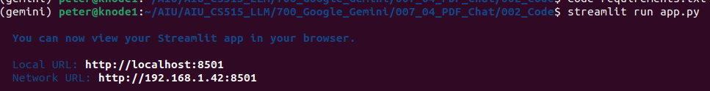
7.04.16 Test PDF ChatBot
https://www.youtube.com/watch?v=1ICRLYtkmNU&list=PLZoTAELRMXVNbDmGZlcgCA3a8mRQp5axb&index=7
Test PDF ChatBot (1:35:01-1:35:10/2:16:34)
Start app.py
> streamlit run app.py

Slide 3
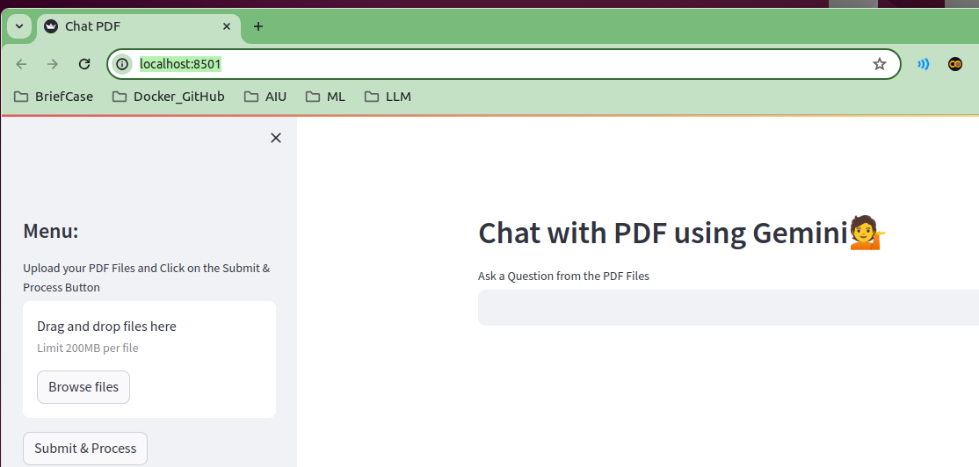
7.04.16 Test PDF ChatBot
https://www.youtube.com/watch?v=1ICRLYtkmNU&list=PLZoTAELRMXVNbDmGZlcgCA3a8mRQp5axb&index=7
Test PDF ChatBot (1:35:11-1:35:20/2:16:34)
Due to insufficient GPU VRAM, I use very simple PDF.

Slide 4
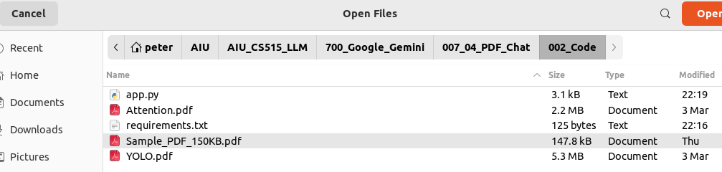
7.04.16 Test PDF ChatBot
https://www.youtube.com/watch?v=1ICRLYtkmNU&list=PLZoTAELRMXVNbDmGZlcgCA3a8mRQp5axb&index=7
Test PDF ChatBot (1:35:21-1:35:30/2:16:34)
Due to insufficient GPU VRAM, I use small Sample_PDF_150KB.pdf.

Slide 5
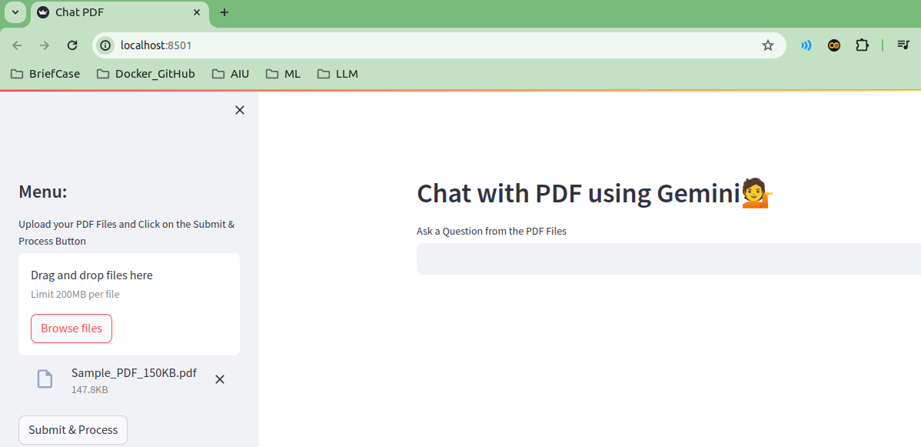
7.04.16 Test PDF ChatBot
https://www.youtube.com/watch?v=1ICRLYtkmNU&list=PLZoTAELRMXVNbDmGZlcgCA3a8mRQp5axb&index=7
Test PDF ChatBot (1:35:31-1:36:00/2:16:34)
Uploaded Sample_PDF_150KB.pdf.

Slide 6
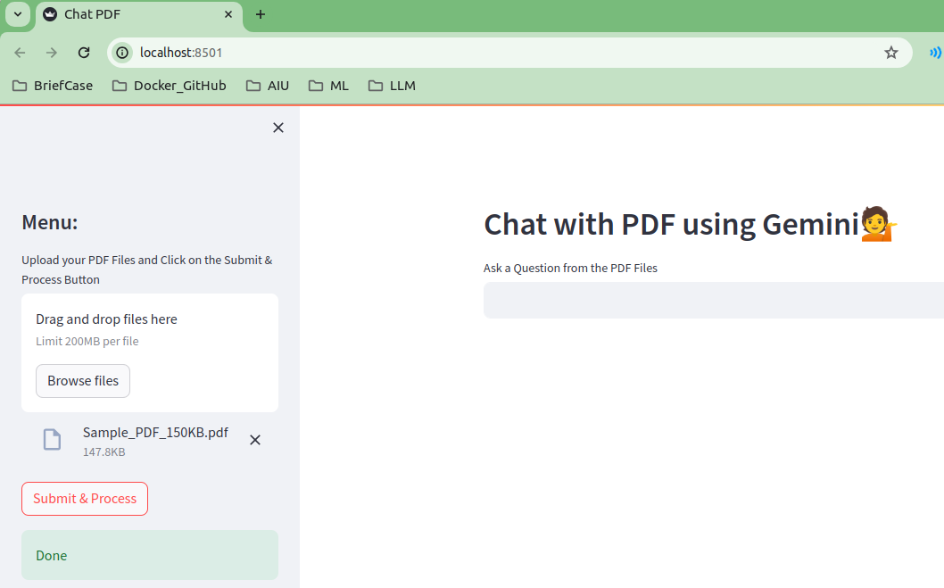
7.04.16 Test PDF ChatBot
https://www.youtube.com/watch?v=1ICRLYtkmNU&list=PLZoTAELRMXVNbDmGZlcgCA3a8mRQp5axb&index=7
Test PDF ChatBot (1:36:01-1:37:00/2:16:34)
Submitted Sample_PDF_150KB.pdf to generate faiss_index

Slide 7
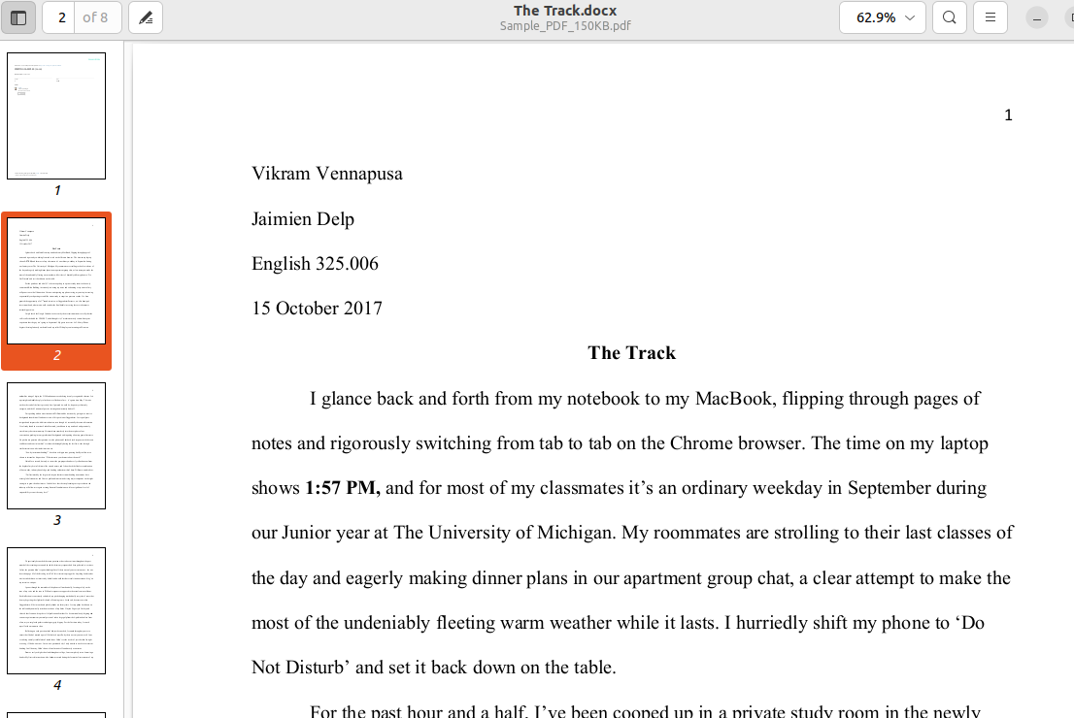
7.04.16 Test PDF ChatBot
https://www.youtube.com/watch?v=1ICRLYtkmNU&list=PLZoTAELRMXVNbDmGZlcgCA3a8mRQp5axb&index=7
Test PDF ChatBot (1:37:01-1:37:30/2:16:34)
Check the content of Sample_PDF_150KB.pdf

Slide 8
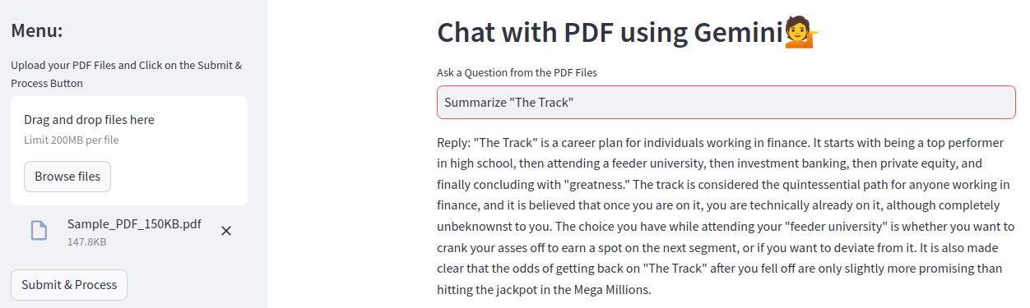
7.04.16 Test PDF ChatBot
https://www.youtube.com/watch?v=1ICRLYtkmNU&list=PLZoTAELRMXVNbDmGZlcgCA3a8mRQp5axb&index=7
Test PDF ChatBot (1:37:31-1:37:35/2:16:34)
Ask: Summarize “The Track”.

Slide 9
End

