Slide 1

03.12 Chat Vision
Peter H. Chen

Slide 2
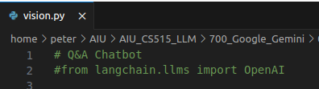
03.12 Chat Vision
https://www.youtube.com/watch?v=CC6qMpqgUMU&list=PLZoTAELRMXVNbDmGZlcgCA3a8mRQp5axb&index=3
Chat Vision (14:37-15:00/26:27)
We create another application “chatVision” with file name vision.py.

Slide 3
03.13 Import Library and Get API Key

Slide 4
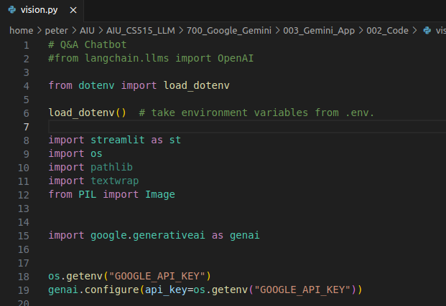
03.13 Import Library and Get API Key
https://www.youtube.com/watch?v=CC6qMpqgUMU&list=PLZoTAELRMXVNbDmGZlcgCA3a8mRQp5axb&index=3
Import Library and Get API Key (15:01-15:20/26:27)
We
1. import load_dotenv
2. import streamlit library
3. import python os module.
4. from PIL (Python Image Library) import image package.
5. import generative AI framework.
6. Get Google API Key.

Slide 5
03.14 Create Gemini-pro-vision Model

Slide 6
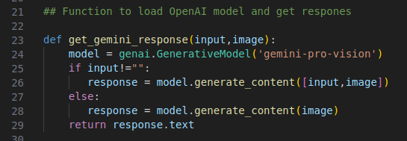
03.14 Create Gemini-pro-vision Model
https://www.youtube.com/watch?v=CC6qMpqgUMU&list=PLZoTAELRMXVNbDmGZlcgCA3a8mRQp5axb&index=3
Create Gemini-pro-vision Model (15:21-17:00/26:27)
Now, instead of create gemini-pro model, we create the gemini-pro-vision model.
In function get_gemini_response (), instead of passing in question, we passed in input and image.
If input != “”, then we passed in two parameters to model.generate_content([input, image])
If input == “”, then we passed in two parameters to model.generate_content([image)

Slide 7
03.15 Create GUI for gemini-pro-vision Model

Slide 8
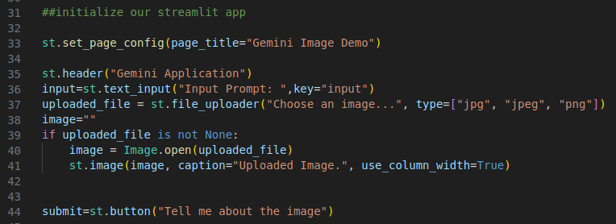
03.15 Create GUI for gemini-pro-vision Model
https://www.youtube.com/watch?v=CC6qMpqgUMU&list=PLZoTAELRMXVNbDmGZlcgCA3a8mRQp5axb&index=3
Create GUI for Gemini-pro-vision Model (15:21-18:30/26:27)
1. Create web page title
2. Create header
3. Create input
4. Create file loader
5. Load image.
6. Create submit button.

Slide 9
03.16 Submit Input Text and Image

Slide 10
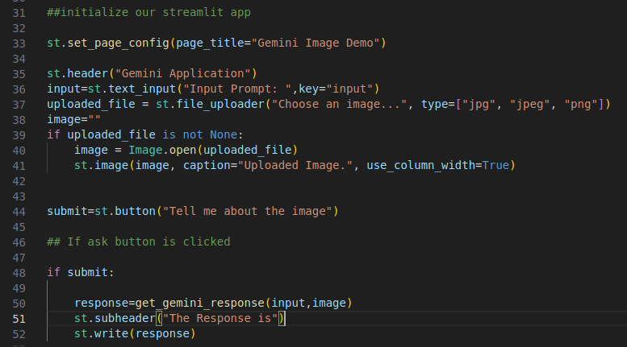
03.16 Submit Input Text and Image
https://www.youtube.com/watch?v=CC6qMpqgUMU&list=PLZoTAELRMXVNbDmGZlcgCA3a8mRQp5axb&index=3
Submit Input Text and Image (18:31-19:20/26:27)
1. Submit the Input Text and Image
2. Display the response.

Slide 11
03.17 Download Image

Slide 12
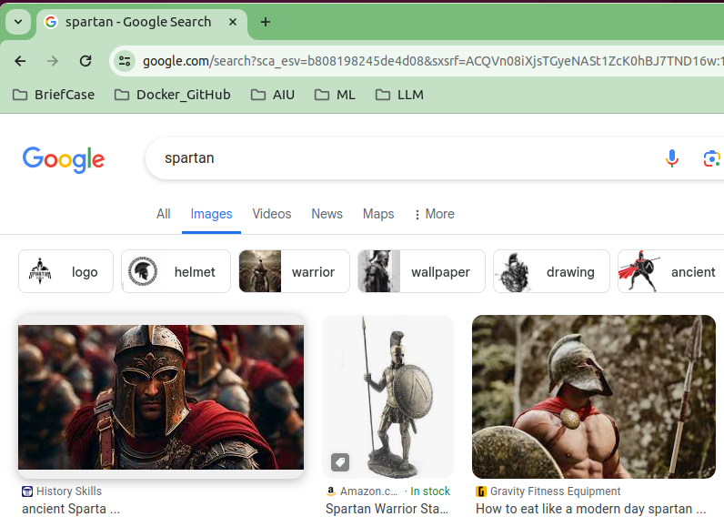
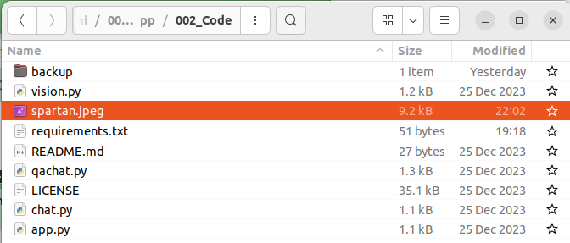
03.17 Download Image
https://www.youtube.com/watch?v=CC6qMpqgUMU&list=PLZoTAELRMXVNbDmGZlcgCA3a8mRQp5axb&index=3
Submit Input Text and Image (19:21-19:40/26:27)
Google search “Spartan” and save in current folder.

Slide 13
03.18 Streamlit run vision.py

Slide 14
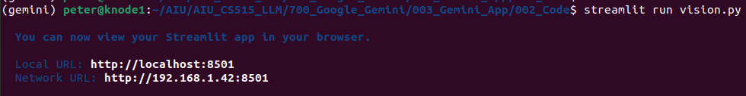
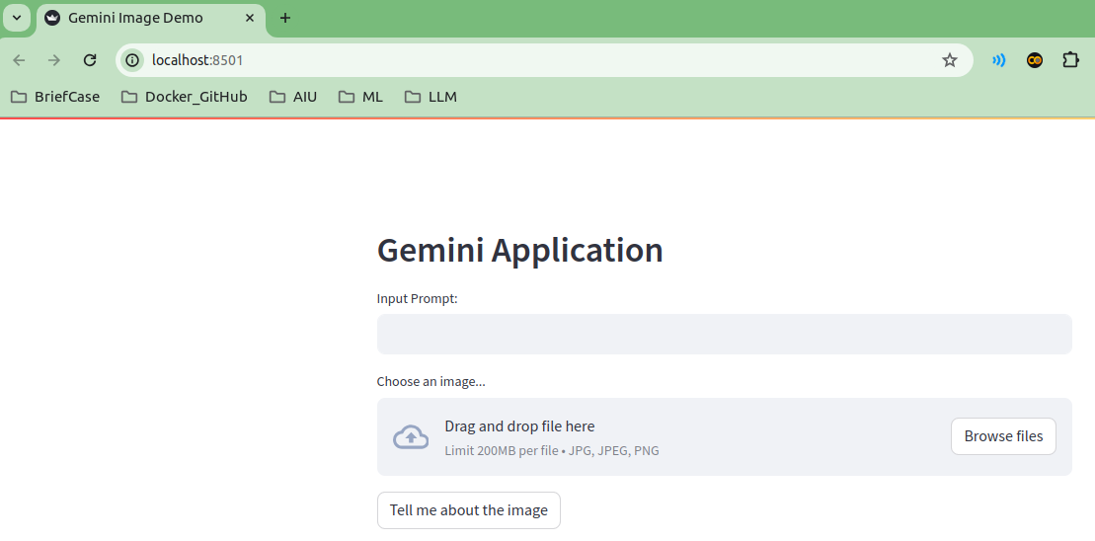
03.18 Streamlit run vision.py
https://www.youtube.com/watch?v=CC6qMpqgUMU&list=PLZoTAELRMXVNbDmGZlcgCA3a8mRQp5axb&index=3
Streamlit run vision.py (19:41-20:00/26:27)
> streamlit run vision.py

Slide 15
03.19 Test Spartan Image

Slide 16
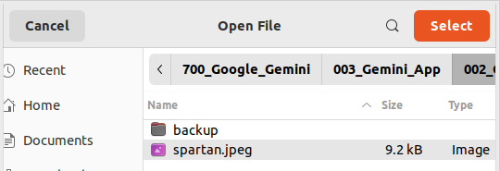
03.19 Test Spartan Image
https://www.youtube.com/watch?v=CC6qMpqgUMU&list=PLZoTAELRMXVNbDmGZlcgCA3a8mRQp5axb&index=3
Test Spartan Image (20:41-20:50/26:27)
1. Click “Browse Files” button.
2. Select “Spartan.jpeg”
1
2

Slide 17
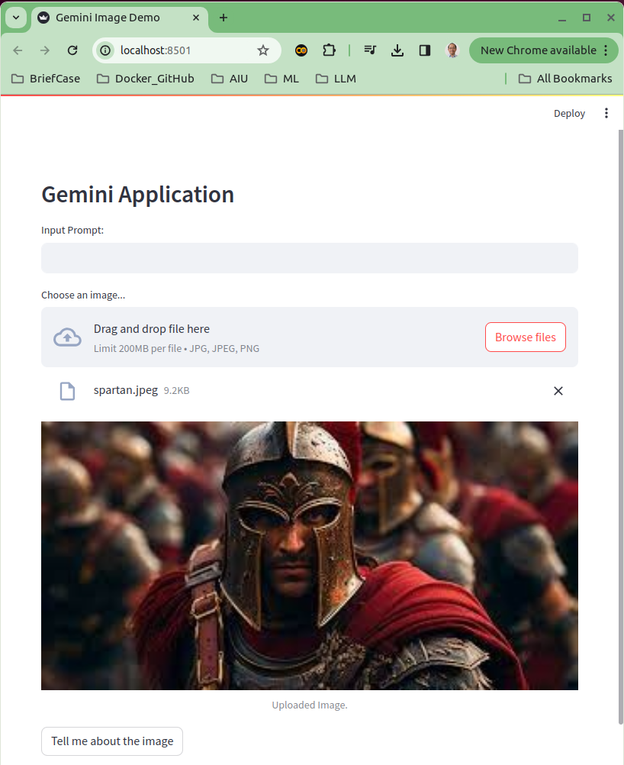
03.19 Test Spartan Image
https://www.youtube.com/watch?v=CC6qMpqgUMU&list=PLZoTAELRMXVNbDmGZlcgCA3a8mRQp5axb&index=3
Test Spartan Image (20:51-21:20/26:27)
At this test, we do not give the input text.
We want to know Gemini AI know this image or not.

Slide 18
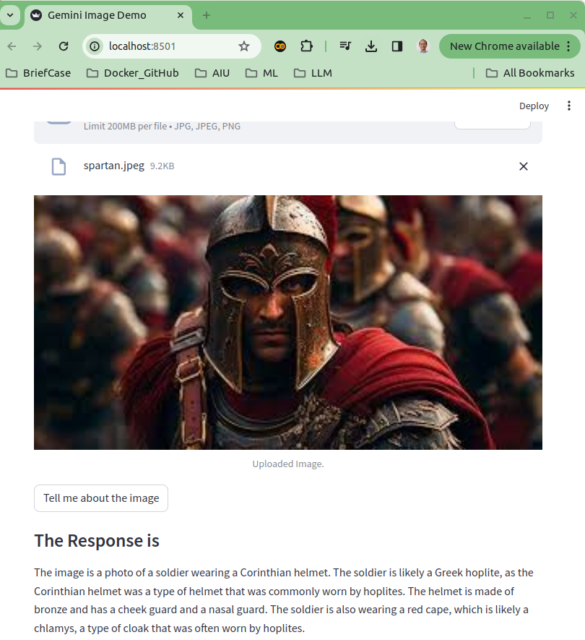
03.19 Test Spartan Image
https://www.youtube.com/watch?v=CC6qMpqgUMU&list=PLZoTAELRMXVNbDmGZlcgCA3a8mRQp5axb&index=3
Test Spartan Image (21:21-24:10/26:27)
Gemini AI read this image as the Corinthian (科林斯式) Helmet.
The soldier is a Greek Hoplite (希臘重裝步兵)
Note: Spartan is a Greek soldier.

Slide 19
03.20 Test Input Text and Image

Slide 20
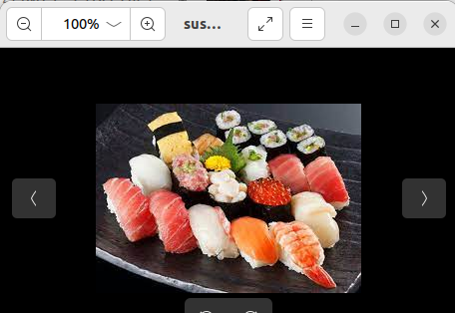
03.20 Test Sushi Image
https://www.youtube.com/watch?v=CC6qMpqgUMU&list=PLZoTAELRMXVNbDmGZlcgCA3a8mRQp5axb&index=3
Test Sushi Image (24:11-24:30/26:27)
Google search and download “sushi” images.

Slide 21
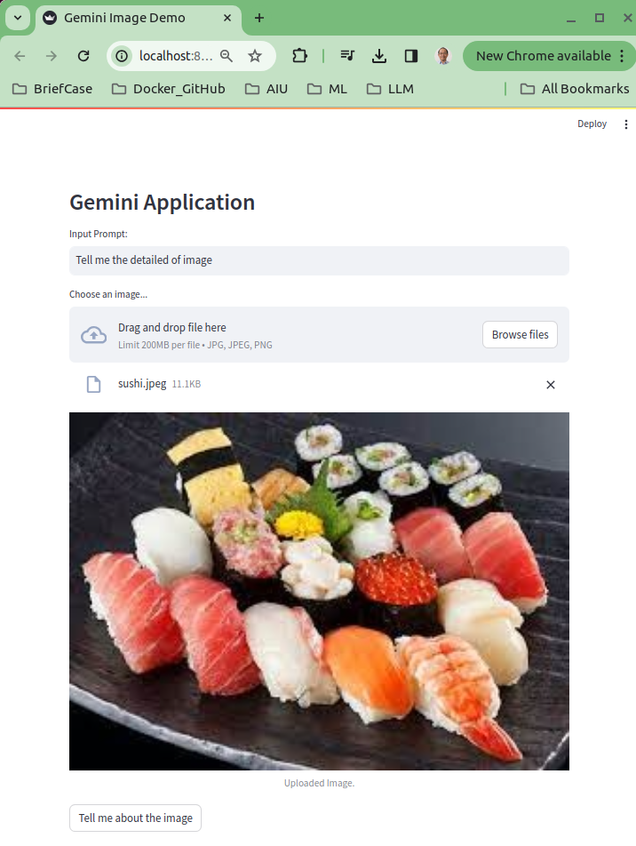
03.20 Test Sushi Image
https://www.youtube.com/watch?v=CC6qMpqgUMU&list=PLZoTAELRMXVNbDmGZlcgCA3a8mRQp5axb&index=3
Test Sushi Image (24:31-25:30/26:27)
1. Type “Tell me the detailed of image”
2. click “Tell me about the image” button.

Slide 22
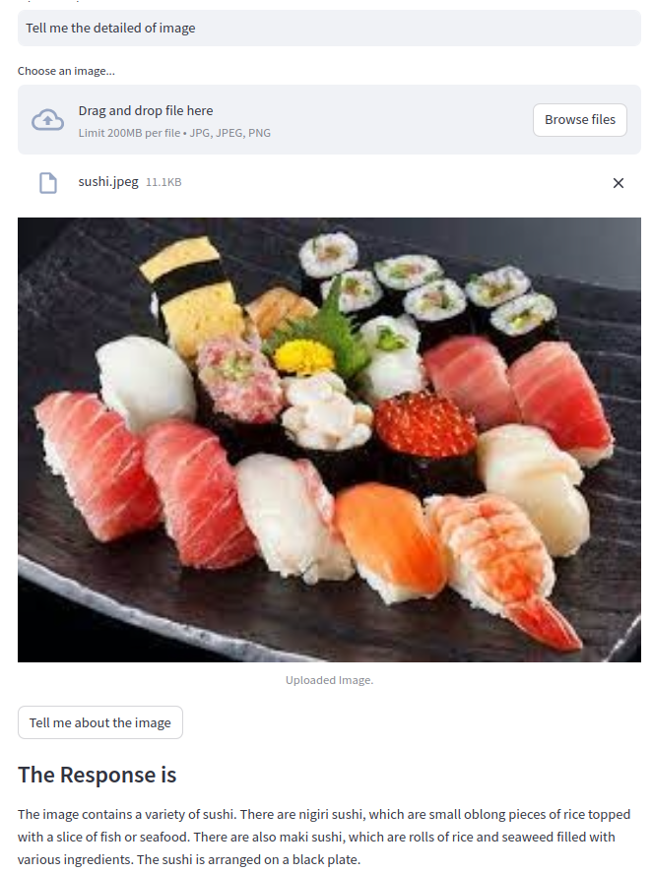
03.20 Test Sushi Image
https://www.youtube.com/watch?v=CC6qMpqgUMU&list=PLZoTAELRMXVNbDmGZlcgCA3a8mRQp5axb&index=3
Test Sushi Image (25:31-26:00/26:27)
1. Type “Tell me the detailed of image”
2. click “Tell me about the image” button.

Slide 23
03.21 Test Detailed of Items

Slide 24
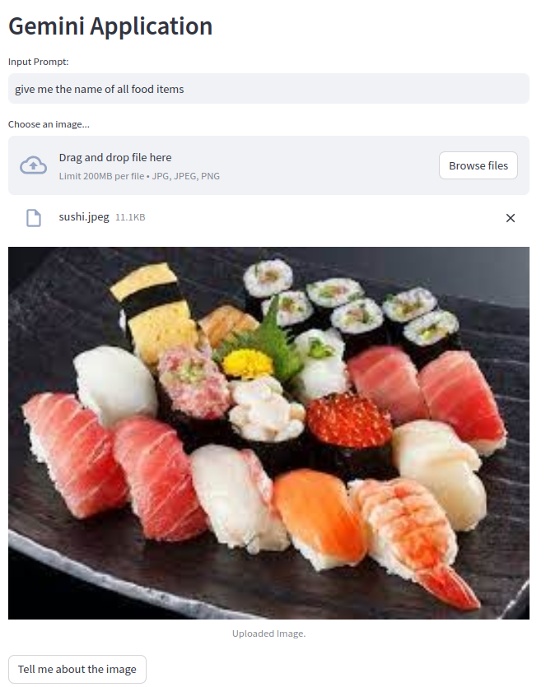
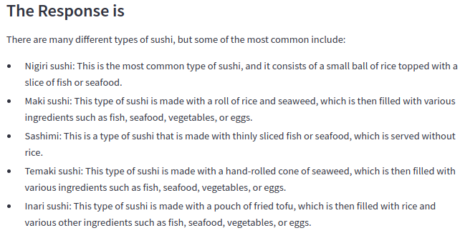
03.21 Test Detailed of Items
https://www.youtube.com/watch?v=CC6qMpqgUMU&list=PLZoTAELRMXVNbDmGZlcgCA3a8mRQp5axb&index=3
Test Detailed of Items (24:11-24:30/26:27)
Input text “Give me the detailed of food items”
The response is amazing:
Gemini can list of all the sushi names.
1. Nigiri sushi
2. Maki Sushi
3. Sashimi
4. Temaki sushi
5. Inari Sushi

Slide 25
End

