Slide 1

4.15 Prompt, LLM, and Output
Peter H. Chen

Slide 2
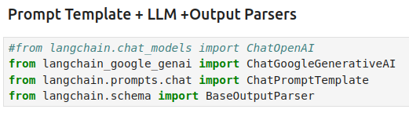
4.15 Prompt, LLM, and Output
https://www.youtube.com/watch?v=qMIM7dECAkc&list=PLZoTAELRMXVORE4VF7WQ_fAl0L1Gljtar&index=5
Prompt, LLM, and Output (53:11-55:00/1:18:23)
We combined Prompt, LLM, and Output together.
1. ChatGoogleGenerativeAI: LangChain Chat for LLM (Google Gemini) Model
2. ChatPromptTemplate: LangChain Chat for Prompt Template for LLM (Google Gemini) Model.
3. BaseOutputParser: LangChain for Output Parser for LLM (Google Gemini) Model.

Slide 3

4.15 Prompt, LLM, and Output
https://www.youtube.com/watch?v=qMIM7dECAkc&list=PLZoTAELRMXVORE4VF7WQ_fAl0L1Gljtar&index=5
Prompt, LLM, and Output (55:01-56:10/1:18:23)
For LLM model AI Message output, we need to parse the output message.
1. We create a class Commaseparateoutput (Comma-Separate-Output) and we passed in inherited class BaseOutputParser for class Commaseparateoutput.
2. Inside the class class Commaseparateoutput (self is the class itself). We have private data text (string).
3. text.strip().split(“,”): We strip out the spaces and split into tokens with comma with “,”
This is to parse the AI Message (output from LLM Model) with comma separator.

Slide 4
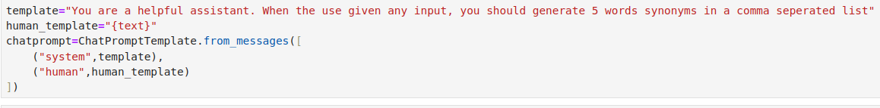
4.15 Prompt, LLM, and Output
https://www.youtube.com/watch?v=qMIM7dECAkc&list=PLZoTAELRMXVORE4VF7WQ_fAl0L1Gljtar&index=5
Prompt, LLM, and Output (56:11-58:50/1:18:23)
Now, we define the
1. system template: define the LangChain Tool, “… Define 5 words synonyms...”
2. human template: Input from user, {text}”
We have to define the chat prompt from the user input and Lang Chain tool: We Pass to the
1. System message and
2. Human message.

Slide 5

4.15 Prompt, LLM, and Output
https://www.youtube.com/watch?v=qMIM7dECAkc&list=PLZoTAELRMXVORE4VF7WQ_fAl0L1Gljtar&index=5
Prompt, LLM, and Output (58:51-1:00:00/1:18:23)
Now, how do we combine inputs (User prompt, LangChain prompt), chat LLM, and output into a chain.
1. chat prompt (user and langchain tool)
2. chat LLM: LangChain chat for Google gemini LLM
3. Comma Separator Output: Output text to string to parsing.

Slide 6
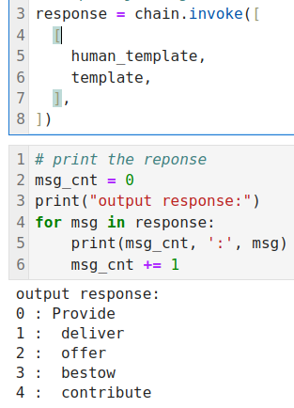
4.15 Prompt, LLM, and Output
https://www.youtube.com/watch?v=qMIM7dECAkc&list=PLZoTAELRMXVORE4VF7WQ_fAl0L1Gljtar&index=5
Prompt, LLM, and Output (1:00:01-1:02:00/1:18:23)
How to use the chain for the user input?
> chain.invoke ( [ [human_template, template],])
https://js.langchain.com/docs/integrations/chat/google_generativeai

Slide 7
End

