Slide 1

7.02 Gemini LLM App
Peter H. Chen

Slide 2
7.02 Gemini LLM App
https://www.youtube.com/watch?v=1ICRLYtkmNU&list=PLZoTAELRMXVNbDmGZlcgCA3a8mRQp5axb&index=7
Gemini LLM App (0:28:51-0:32:30/2:16:34)
We implement LLM App with Gemini.

Slide 3
7.02.01 Install requirements.txt

Slide 4
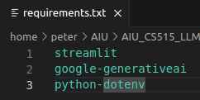
7.02.01 Install requirements.txt
https://www.youtube.com/watch?v=1ICRLYtkmNU&list=PLZoTAELRMXVNbDmGZlcgCA3a8mRQp5axb&index=7
Install requirements.txt (0:32:31-0:33:20/2:16:34)
1. Create/Activate conda environment
> conda create –name gemini
> conda activate gemini
2. Install requirements.txt
> pip install -r requirements.txt
a. streamlit: GUI
b. google-generativeai: Gemini Model
c. python-dotenv: Load Google API Key environment variable from “.env” file.

Slide 5
7.02.02 Get Google API Key

Slide 6
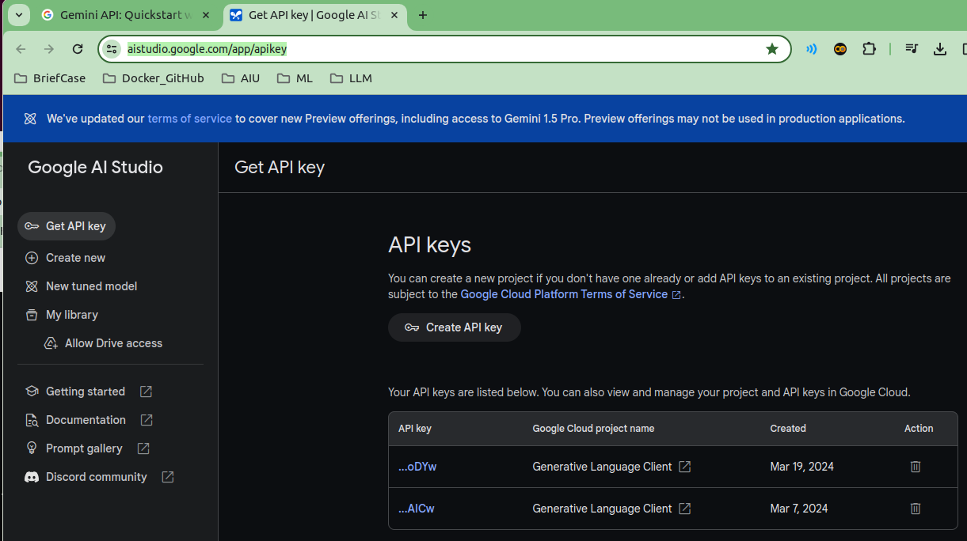

7.02.02 Get Google API Key
https://www.youtube.com/watch?v=1ICRLYtkmNU&list=PLZoTAELRMXVNbDmGZlcgCA3a8mRQp5axb&index=7
Get Google API Key (0:33:21-0:34:30/2:16:34)
Search for “Get Google API Key”.
1. Generate the Google API Key if you don’t have one.
2. Copy the Google API Key.
https://aistudio.google.com/app/apikey
1. Open .env file
> code .env
2. Create GOOGLE_API_KEY environment variable and paste google API Key.
3. Save “.env” file.

Slide 7
7.02.03 Load Google API Key

Slide 8
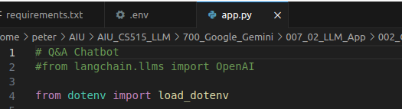
7.02.03 Load Google API Key
https://www.youtube.com/watch?v=1ICRLYtkmNU&list=PLZoTAELRMXVNbDmGZlcgCA3a8mRQp5axb&index=7
Load Google API Key (0:34:59-0:35:30/2:16:34)
Load the Google API Key.

Slide 9
7.02.04 Load Google API Key

Slide 10
7.02.04 Load Google API Key
https://www.youtube.com/watch?v=1ICRLYtkmNU&list=PLZoTAELRMXVNbDmGZlcgCA3a8mRQp5axb&index=7
Load Google API Key (0:34:59-0:35:30/2:16:34)
Load the Google API Key.

Slide 11
7.02.05 Import Libraries

Slide 12
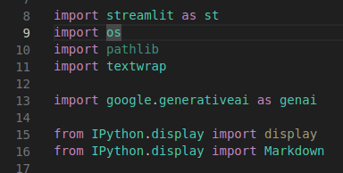
7.02.05 Import Libraries
https://www.youtube.com/watch?v=1ICRLYtkmNU&list=PLZoTAELRMXVNbDmGZlcgCA3a8mRQp5axb&index=7
Import Libraries (0:35:31-0:36:00/2:16:34)
1. streamlit: GUI
2. os: os.getenv(“GOOGLE_API_KEY”s)
3. pathlib
4. textwrap
5. google.generativeai: Gemini Model
6. display
7. Markdown: text format display

Slide 13
7.02.06 Configure Gemini

Slide 14

7.02.06 Configure Gemini
https://www.youtube.com/watch?v=1ICRLYtkmNU&list=PLZoTAELRMXVNbDmGZlcgCA3a8mRQp5axb&index=7
Configure Gemini (0:36:01-0:36:30/2:16:34)
Configure Gemini with Google API Key.

Slide 15
7.02.07 Load Gemini Model

Slide 16
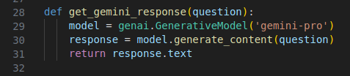
7.02.07 Load Gemini Model
https://www.youtube.com/watch?v=1ICRLYtkmNU&list=PLZoTAELRMXVNbDmGZlcgCA3a8mRQp5axb&index=7
Load Gemini Model (0:36:31-0:38:30/2:16:34)
Define a function: get_gemini_response(quesiton)
1. Load Gemini Model: model = genai.GenerativeModel (‘gemini-pro’)
2. get response from model.generate_content(question)
You can load model outside the function
> model = genai.GenerativeModel (‘gemini-pro’)
> def get_gemini_response(quesiton):
> response = model.generate_content(question)
> return response.text

Slide 17
7.02.08 Create Streamlit GUI

Slide 18
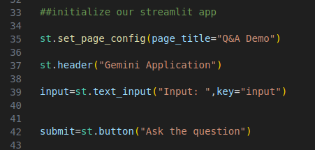
7.02.08 Create Streamlit GUI
https://www.youtube.com/watch?v=1ICRLYtkmNU&list=PLZoTAELRMXVNbDmGZlcgCA3a8mRQp5axb&index=7
Create Streamlit GUI (0:38:31-0:39:00/2:16:34)
We create GUI: Page title, header, Input Text and one submit button.
1. Page title: “Q&A Demo” and Header: “Gemini LLM Application”
2. Input: Input Text Question
3. Create Submit button “Ask for Question”

Slide 19
7.02.09 Process Submission

Slide 20
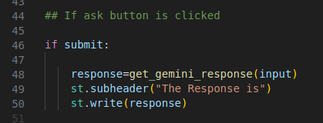
7.02.09 Process Submission
https://www.youtube.com/watch?v=1ICRLYtkmNU&list=PLZoTAELRMXVNbDmGZlcgCA3a8mRQp5axb&index=7
Process Submission (0:39:01-0:39:30/2:16:34)
If submit button is clicked, then we
1. response = get_gemini_response (input)
2. display response.

Slide 21
7.02.10 Test Gemini App

Slide 22
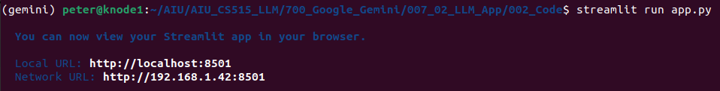
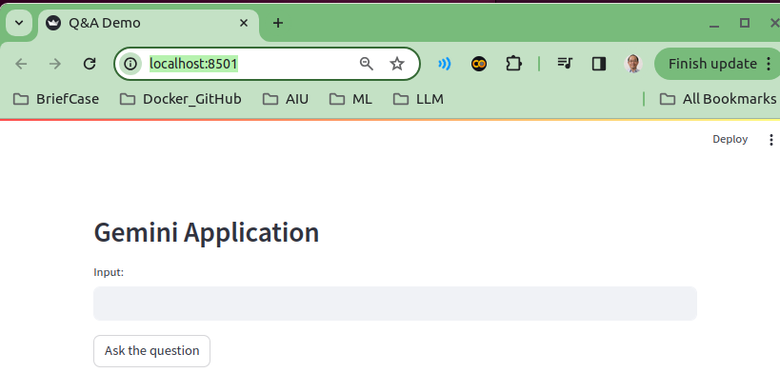
7.02.10 Test Gemini App
https://www.youtube.com/watch?v=1ICRLYtkmNU&list=PLZoTAELRMXVNbDmGZlcgCA3a8mRQp5axb&index=7
Test Gemini App (0:40:31-0:41:00/2:16:34)
> streamlit run app.py

Slide 23
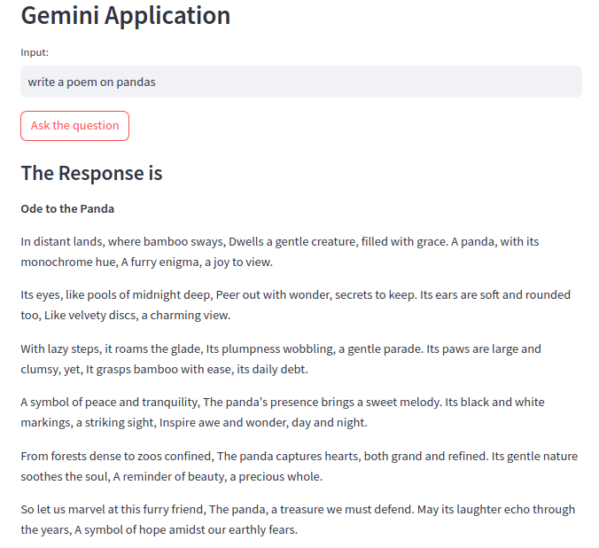
7.02.10 Test Gemini App
https://www.youtube.com/watch?v=1ICRLYtkmNU&list=PLZoTAELRMXVNbDmGZlcgCA3a8mRQp5axb&index=7
Test Gemini App (0:41:01-0:41:50/2:16:34)
1. Input: Write a poem on pandas
2. click button “Ask the question”
We are successfully implement the Gemini LLM Application.

Slide 24
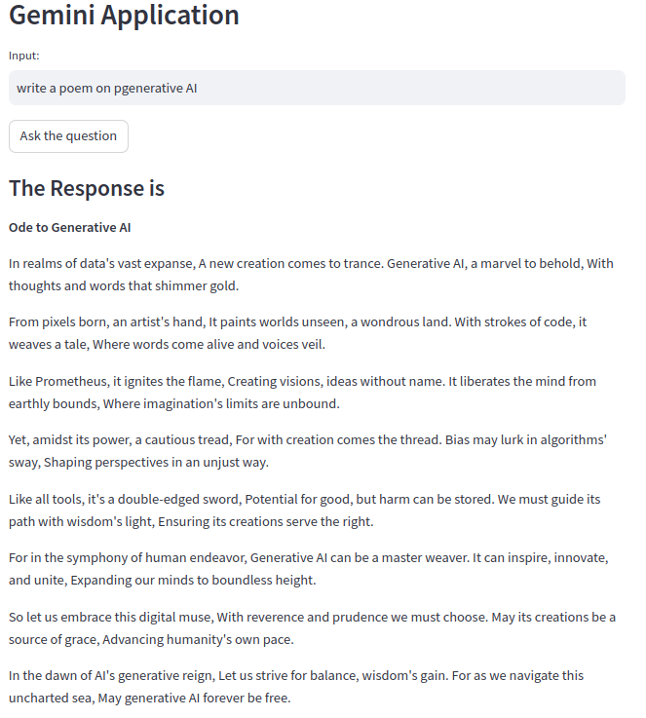
7.02.10 Test Gemini App
https://www.youtube.com/watch?v=1ICRLYtkmNU&list=PLZoTAELRMXVNbDmGZlcgCA3a8mRQp5axb&index=7
Test Gemini App (0:41:51-0:42:45/2:16:34)
1. Input: Write a poem on generative AI
2. click button “Ask the question”

Slide 25
End

