Slide 1

7.02.11 Gemini Vision App
Peter H. Chen

Slide 2
7.02.11 Gemini LLM Vision App
https://www.youtube.com/watch?v=1ICRLYtkmNU&list=PLZoTAELRMXVNbDmGZlcgCA3a8mRQp5axb&index=7
Gemini LLM Vision App (0:42:46-0:42:10/2:16:34)
Now, we implement LLM Vision App with Gemini.

Slide 3
7.02.12 Load Vision Model

Slide 4
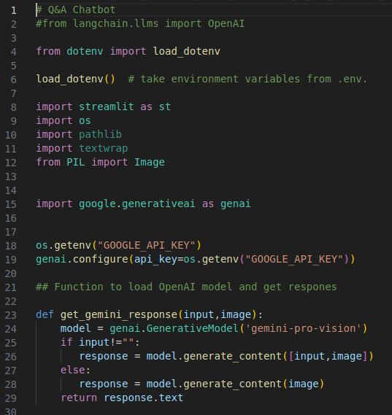
7.02.12 Load Vision Model
https://www.youtube.com/watch?v=1ICRLYtkmNU&list=PLZoTAELRMXVNbDmGZlcgCA3a8mRQp5axb&index=7
Load Vision Model (0:43:11-0:44:30/2:16:34)
We have some change from previous app.py.
1. To load Gemini Vision Model, we use ‘gemini-pro-vision’
> model = genai.GenerativeModel (‘gemini-pro-vision’)
2. We check input ==”” or input != “” , then pass to generate_content(), we use ‘[input, image]’ instead of ‘input’.

Slide 5
7.02.13 Modify Streamlit GUI

Slide 6
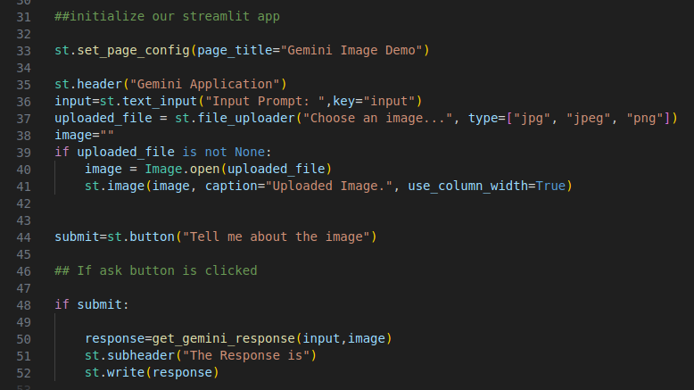
7.02.13 Modify Streamlit GUI
https://www.youtube.com/watch?v=1ICRLYtkmNU&list=PLZoTAELRMXVNbDmGZlcgCA3a8mRQp5axb&index=7
Modify Streamlit GUI (0:43:11-0:47:00/2:16:34)
Modify Streamlit GUI:
1. page title: Gemini Image Demo
2. Create uploader for Image format: “jpg”, ‘”jpeg”, “png”
3. Display image
4. Create submit button “Tell me about the image”
# If submit is clicked:
5. get_gemini_response (input, image)
6. Display response.

Slide 7
7.02.14 Download Image Files

Slide 8
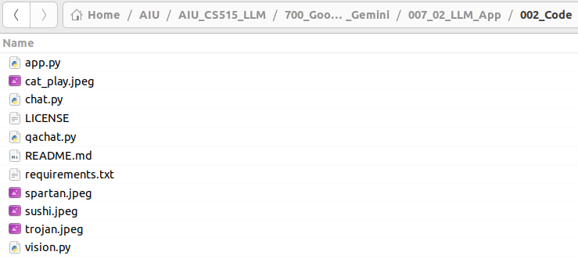
7.02.14 Download Image Files
https://www.youtube.com/watch?v=1ICRLYtkmNU&list=PLZoTAELRMXVNbDmGZlcgCA3a8mRQp5axb&index=7
Download Image File (0:47:11-0:48:00/2:16:34)
We google search “Spartan”, “cat play”, “Trojans”, “sushi”, etc. and download into the local drive.

Slide 9
7.02.15 Test Gemini Image App

Slide 10
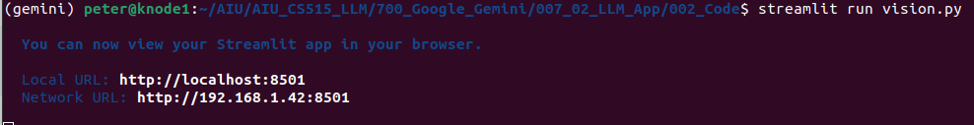
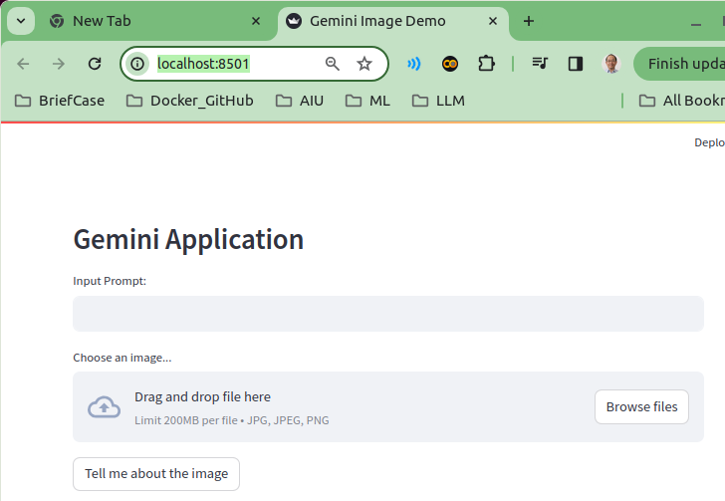
7.02.15 Test Gemini Image App
https://www.youtube.com/watch?v=1ICRLYtkmNU&list=PLZoTAELRMXVNbDmGZlcgCA3a8mRQp5axb&index=7
Test Gemini Image App (0:48:01-0:48:30/2:16:34)
> streamlit run vision.py

Slide 11
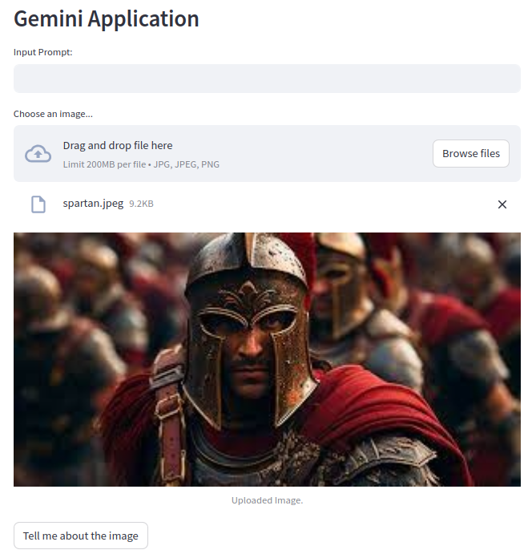
7.02.15 Test Gemini Image App
https://www.youtube.com/watch?v=1ICRLYtkmNU&list=PLZoTAELRMXVNbDmGZlcgCA3a8mRQp5axb&index=7
Test Gemini Image App (0:48:01-0:49:20/2:16:34)
Load Spartan picture.

Slide 12
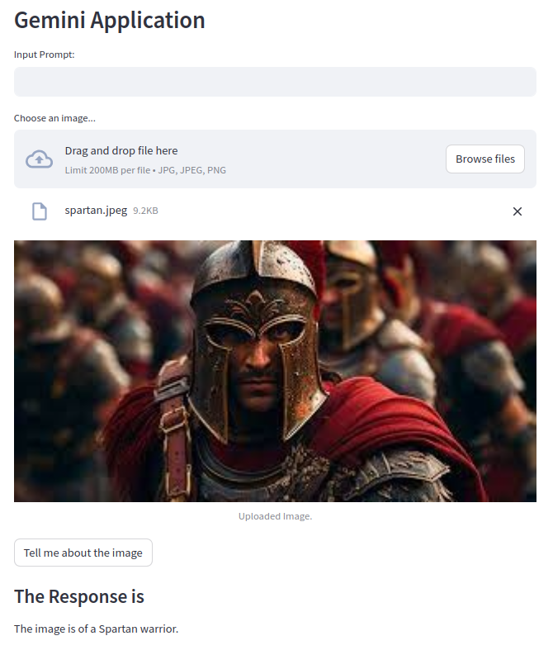
7.02.15 Test Gemini Image App
https://www.youtube.com/watch?v=1ICRLYtkmNU&list=PLZoTAELRMXVNbDmGZlcgCA3a8mRQp5axb&index=7
Test Gemini Image App (0:48:51-0:49:20/2:16:34)
Test for no input (Image only)
Click button “Tell me about image”
Response: “This image is of a Spartan Warrior.

Slide 13
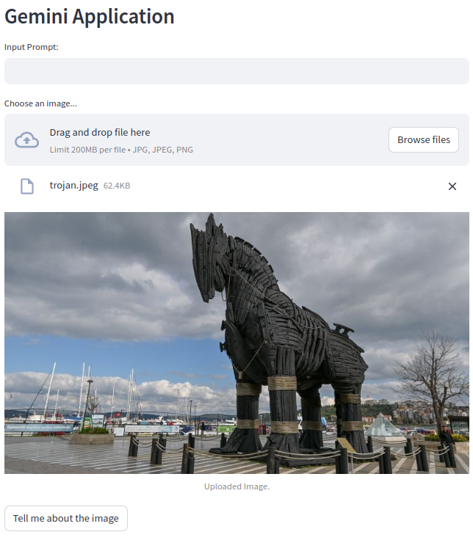
7.02.15 Test Gemini Image App
https://www.youtube.com/watch?v=1ICRLYtkmNU&list=PLZoTAELRMXVNbDmGZlcgCA3a8mRQp5axb&index=7
Test Gemini Image App (0:49:21-0:49:30/2:16:34)
We load the “trojan.jpeg”

Slide 14
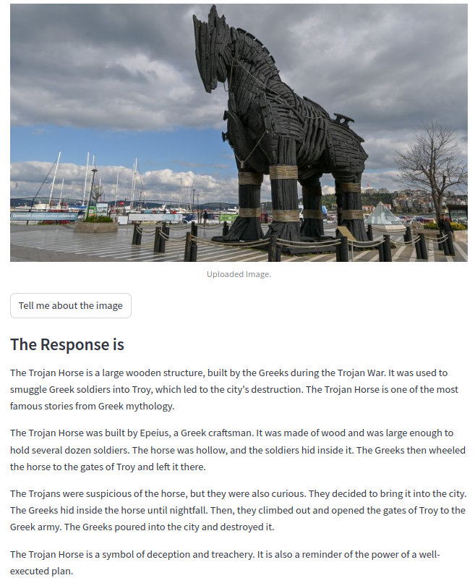
7.02.15 Test Gemini Image App
https://www.youtube.com/watch?v=1ICRLYtkmNU&list=PLZoTAELRMXVNbDmGZlcgCA3a8mRQp5axb&index=7
Test Gemini Image App (0:49:31-0:50:00/2:16:34)
Response: Trojan horse is a large wooden structure.

Slide 15
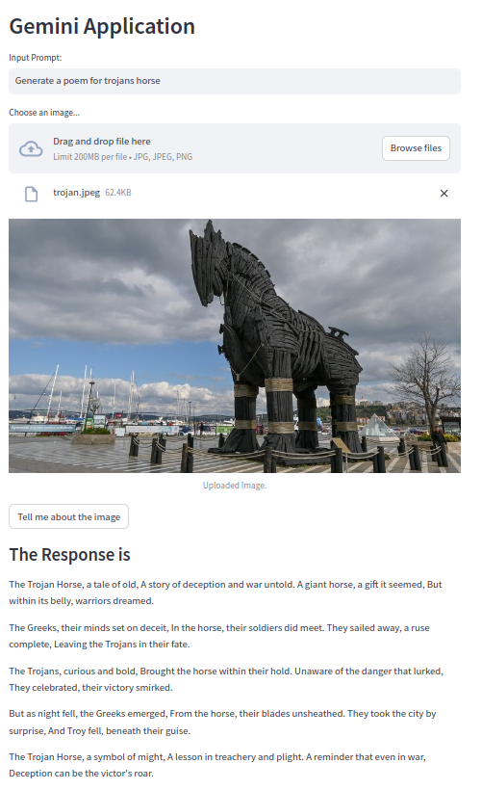
7.02.15 Test Gemini Image App
https://www.youtube.com/watch?v=1ICRLYtkmNU&list=PLZoTAELRMXVNbDmGZlcgCA3a8mRQp5axb&index=7
Test Gemini Image App (0:50:11-0:50:20/2:16:34)
Generate a Poem for Trojans horse

Slide 16
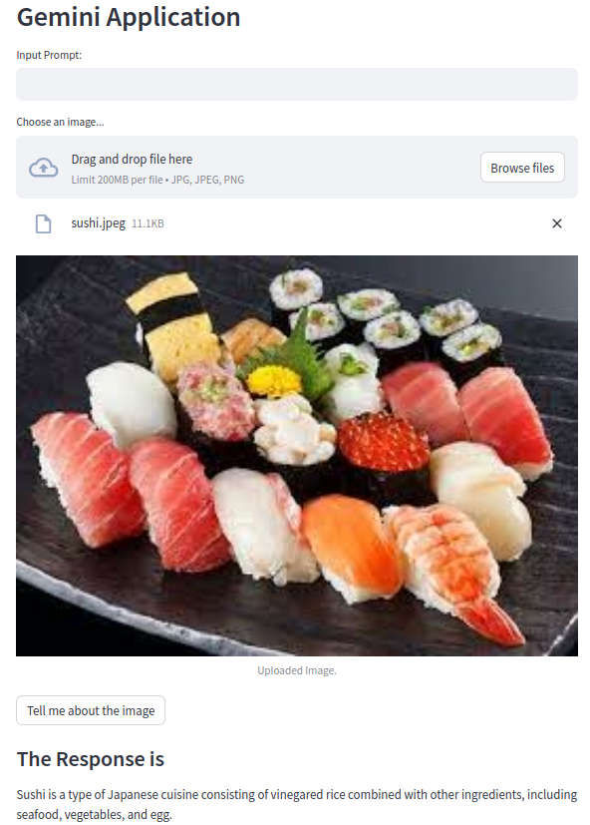
7.02.15 Test Gemini Image App
https://www.youtube.com/watch?v=1ICRLYtkmNU&list=PLZoTAELRMXVNbDmGZlcgCA3a8mRQp5axb&index=7
Test Gemini Image App (0:50:31-0:51:30/2:16:34)
Load the Sushi Image.
Click “Tell me about the image”

Slide 17
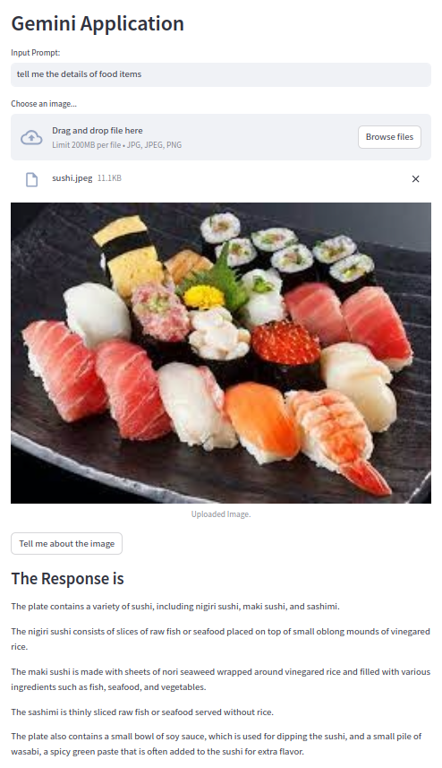
7.02.15 Test Gemini Image App
https://www.youtube.com/watch?v=1ICRLYtkmNU&list=PLZoTAELRMXVNbDmGZlcgCA3a8mRQp5axb&index=7
Test Gemini Image App (0:51:31-0:54:05/2:16:34)
“Provide me the details of food items”
Click “Tell me about the image”
Response:
The plate contains a variety of sushi, including nigiri sushi, maki sushi, and sashimi, ...

Slide 18
End

