Slide 1

1 LangChain Introduction
Peter H. Chen

Slide 2
1 LangChain Introduction
https://www.youtube.com/watch?v=4O1rs7mrNDo&list=PLZoTAELRMXVORE4VF7WQ_fAl0L1Gljtar&index=1
LangChain Introduction (00:00-09:00/12:28)
We use LangChain to integrate LLM Model.
LangChain is very practical implementation for the project.
The theory explanation and concept of LangChain are machine learning, deep learning, NLP (Natural Language Processing), and LLM (Large Language Model), et. They are important but not required. We can all API for us.
The only prerequisite is Python Programming: Object Oriented Programming, Class, inheritance, and etc.
We will use Gemini-pro, LangChain, and HuggingFace.

Slide 3
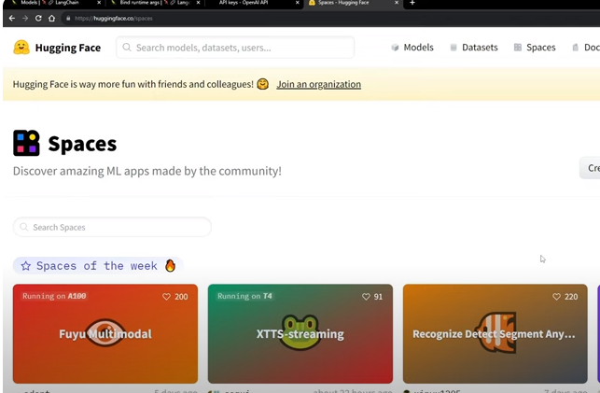
1 LangChain Introduction
https://www.youtube.com/watch?v=4O1rs7mrNDo&list=PLZoTAELRMXVORE4VF7WQ_fAl0L1Gljtar&index=1
LangChain Introduction (09:30-12:28/12:28)
We will host project on HuggingFace.

Slide 4
End

