Slide 1
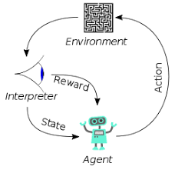
001 DL: Introduction
Peter H. Chen

Slide 2
001 DL: Introduction
https://www.youtube.com/watch?v=Mubj_fqiAv8&list=PLeo1K3hjS3uu7CxAacxVndI4bE_o3BDtO&index=1
DL: Introduction (0:00-3:38/3:38)
We do the Python Deep Learning. We do not need any prior background.
We need desire to learn, GPU computer, some basic knowledge of Python, Pandas, and Machine Learning.
We will use Python, Keras, Tensorflow, and PyTorch.
Deep Learning has a lot of concepts in mathematics and statistics. We will use simple dataset to describe the concepts.
NVIDIA Titan RTX GPU is used for deep learning job. You can add the graphic card on your computer.

Slide 3
End

