Slide 1

1 LC Introduction
Peter H. Chen

Slide 2
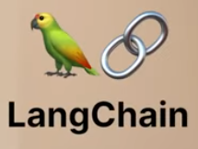
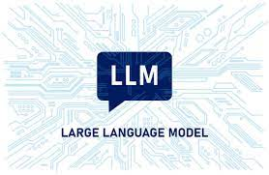
1 LC Introduction
https://www.youtube.com/watch?v=nAmC7SoVLd8&list=PLeo1K3hjS3uu0N_0W6giDXzZIcB07Ng_F&index=1
LC Introduction (00:00-00:05/46:07)
LangChain is a a framework that allow you to build application on top of LLM (Large Language Model).
We will use Open-Source Google Gemini instead of OpenAI GPT.

Slide 3
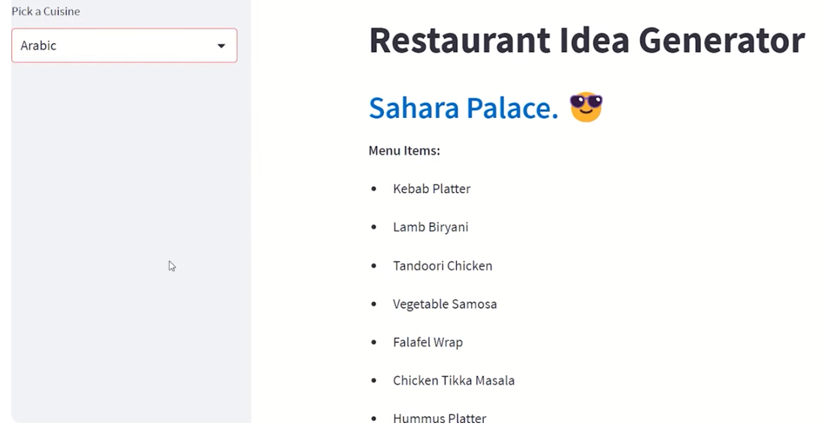
1 LC Introduction
https://www.youtube.com/watch?v=nAmC7SoVLd8&list=PLeo1K3hjS3uu0N_0W6giDXzZIcB07Ng_F&index=1
LC Introduction (00:06-00:10/46:07)
We will go over all the basic topics of LangChain
We will use LangChain to build a Restaurant application.

Slide 4
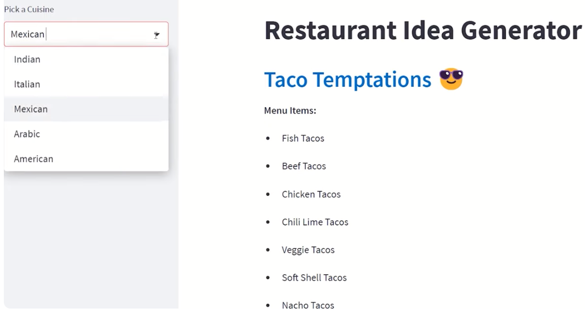
1 LC Introduction
https://www.youtube.com/watch?v=nAmC7SoVLd8&list=PLeo1K3hjS3uu0N_0W6giDXzZIcB07Ng_F&index=1
LC Introduction (00:11-00:15/46:07)
We are going to
1. Use LangChain and
2. Use streamlit (or ReactJS) for GUI where you can input any cuisine (recipe), such as, Indian, Italian, Mexican, Arabic, American, etc.

Slide 5
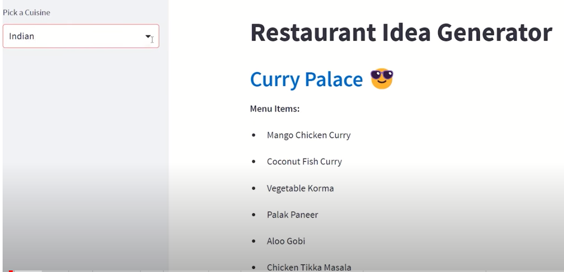
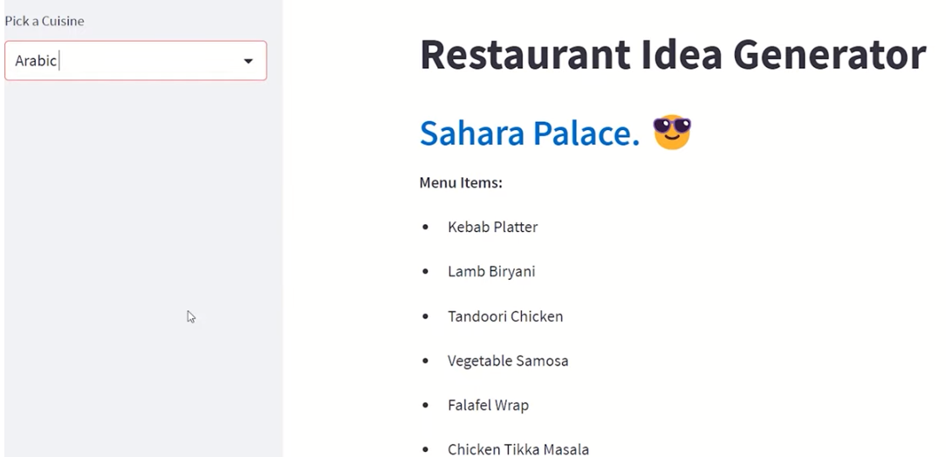
1 LC Introduction
https://www.youtube.com/watch?v=nAmC7SoVLd8&list=PLeo1K3hjS3uu0N_0W6giDXzZIcB07Ng_F&index=1
LC Introduction (00:11-00:20/46:07)
We display the menu items: Indian, Italian, Mexican, Arabic, American, etc., based on the input selection.

Slide 6
1.01 What is LangChain

Slide 7
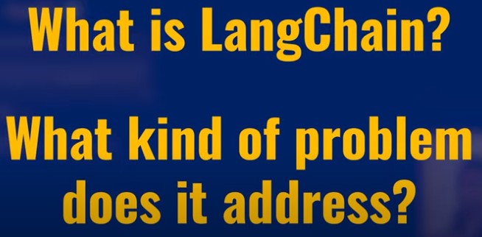
1.01 What is LangChain
https://www.youtube.com/watch?v=nAmC7SoVLd8&list=PLeo1K3hjS3uu0N_0W6giDXzZIcB07Ng_F&index=1
What is LangChain (00:26-00:27/46:07)
We want to know:
1. What is LangChain and
2. What kind of problem that LangChain solve??

Slide 8
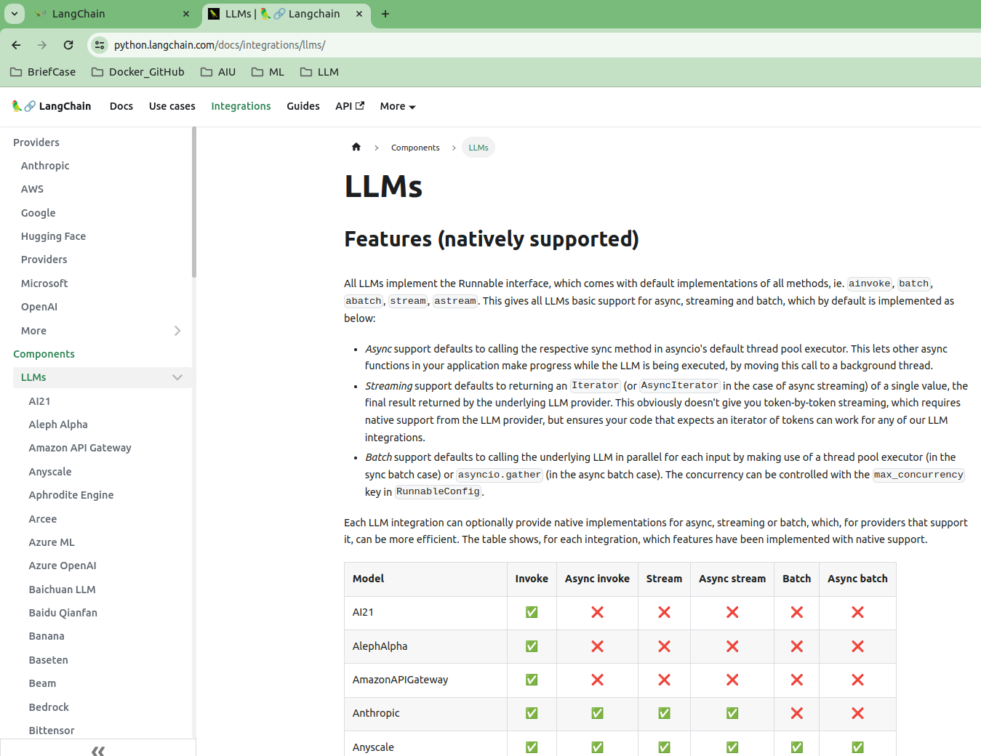
1.01 What is LangChain
https://www.youtube.com/watch?v=nAmC7SoVLd8&list=PLeo1K3hjS3uu0N_0W6giDXzZIcB07Ng_F&index=1
What is LangChain (00:28-00:30/46:07)
LangChain integrate more than 77+ Language Models, such as, Google Gemini, PaLM 2 (Pathway Language Model version 2), Meta LlaMa 2 (Large Language Model for Meta AI), HuggingFace Masked/Causal Language Model, Microsoft chatGPT (Chat Generative Pre-trained Transformer), etc.

Slide 9
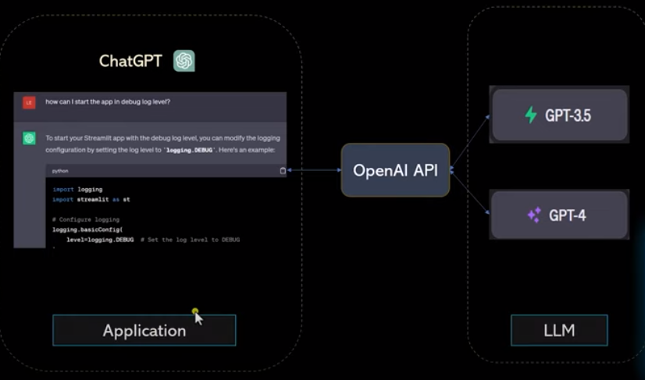
1.01 What is LangChain
https://www.youtube.com/watch?v=nAmC7SoVLd8&list=PLeo1K3hjS3uu0N_0W6giDXzZIcB07Ng_F&index=1
What is LangChain (00:30-01:00/46:07)
LC (LangChain) is a framework for chatGPT (can be Google chatbot or Meta chatbot):
1. We have application: Google chatbot, Meta chatbot, or OpenAI chatGPT, etc.
2. LC internally call LLM: GPT-3.5/4 (can be Google Gemini (or PaLM), Meta Llama, etc)
Note:
1. Google Gemini is free open-source and free.
2. OpenAI GPT is not open source and charged to use.

Slide 10
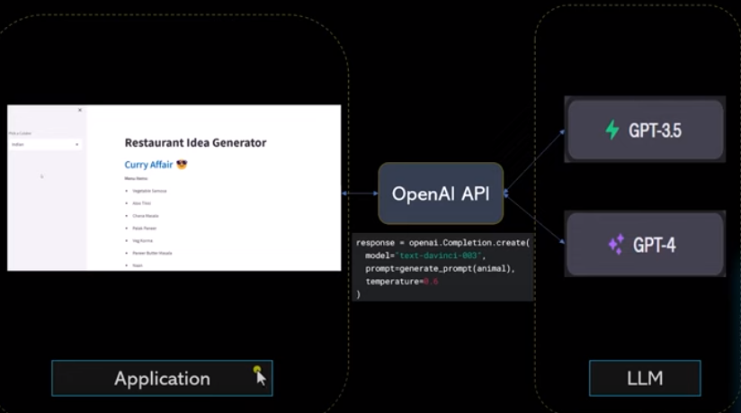
1.01 What is LangChain
https://www.youtube.com/watch?v=nAmC7SoVLd8&list=PLeo1K3hjS3uu0N_0W6giDXzZIcB07Ng_F&index=1
What is LangChain (01:19-02:00/46:07)
LangChain is a tool to integrate LLM for application. With the same LangChain Architecture, we can directly call Google Gemini API, OpenAI GPT API, or Meta Llama API. Internally, Gemini API will call Gemini-1.0/2.0, OpenAI API will call GPT-3.5/GPT4, or Llama 1.0/2.0/3.0.

Slide 11
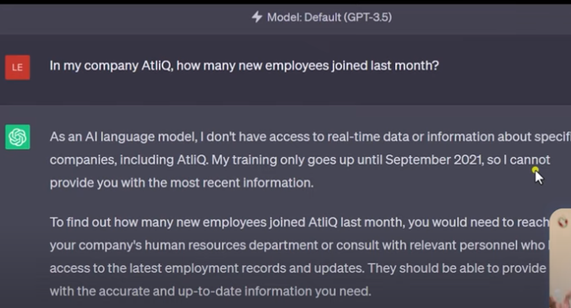
1.01 What is LangChain
https://www.youtube.com/watch?v=nAmC7SoVLd8&list=PLeo1K3hjS3uu0N_0W6giDXzZIcB07Ng_F&index=1
What is LangChain (02:50-03:10/46:07)
How many AtliQ employees last month?
ChatGPT do not have real-time information after September, 2021.
ChatGPT cannot answer.

Slide 12
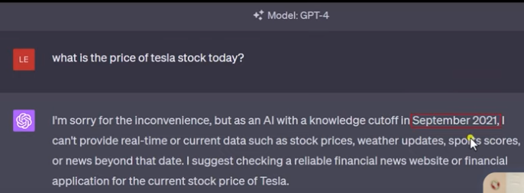
1.01 What is LangChain
https://www.youtube.com/watch?v=nAmC7SoVLd8&list=PLeo1K3hjS3uu0N_0W6giDXzZIcB07Ng_F&index=1
What is LangChain (02:21-02:50/46:07)
Why we use LangChain instead of Google chatbot, ChatGPT, or Meta chatbot.
1. Google Gemini is free, ChatGPT charge service, Llama is free.
2. Gemini/GPT/Llama does not have real-time data. The are trained by the dataset in specific date, e.g., Gemini knowledge is before March 2023, GPT knowledge limit to September 2021.
If you want to have today data of Google and wiki. We cannot get their data from Gemini, GPT, or Llama.
LangChain connect many LLM, real-time tools, many data sources, private database, Gemini, GPT, Llama are just some of them.
LangChain offers API to call Gemini, GPT, Llama Model, real-time search, etc.

Slide 13
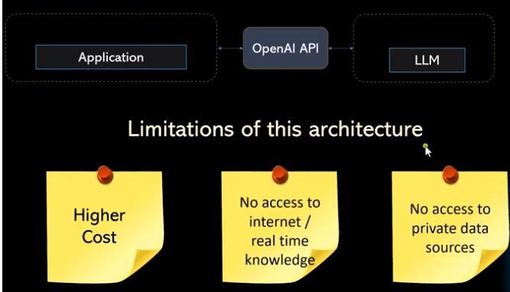
1.01 What is LangChain
https://www.youtube.com/watch?v=nAmC7SoVLd8&list=PLeo1K3hjS3uu0N_0W6giDXzZIcB07Ng_F&index=1
What is LangChain (03:15-03:30/46:07)
Below is the limitation of OpenAI.
1. High Cost
2. No real-time knowledge
3. No access to private data.

Slide 14
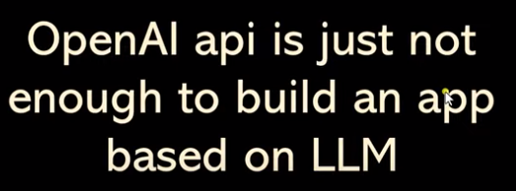
1.01 What is LangChain
https://www.youtube.com/watch?v=nAmC7SoVLd8&list=PLeo1K3hjS3uu0N_0W6giDXzZIcB07Ng_F&index=1
What is LangChain (03:31-03:37/46:07)
OpenAI API is based on chatGPT.
OpenAI is not enough to build an LLM app.
We need more data source.

Slide 15
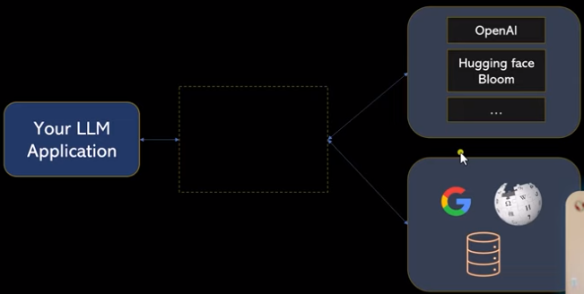
1.01 What is LangChain
https://www.youtube.com/watch?v=nAmC7SoVLd8&list=PLeo1K3hjS3uu0N_0W6giDXzZIcB07Ng_F&index=1
What is LangChain (03:42-03:50/46:07)
You do not have access to dataset of OpenAI which cost money.
We can only call OpenAI GPT3 and GPT4.
You can call Hugging face, Bloomberg, nasdaq, etc.
There are many open source models.
If you want to access GPT3 and GPT4, LangChain provides API for GPT3 and GPT4 model from chatGPT.

Slide 16
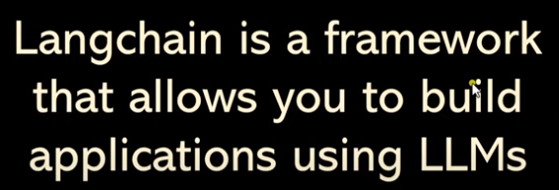
1.01 What is LangChain
https://www.youtube.com/watch?v=nAmC7SoVLd8&list=PLeo1K3hjS3uu0N_0W6giDXzZIcB07Ng_F&index=1
What is LangChain (04:00-04:33/46:07)
LangChain is a framework that allows you to build applications using LLMs.

Slide 17
End

