Slide 1

2 Gemini API
Peter H. Chen

Slide 2
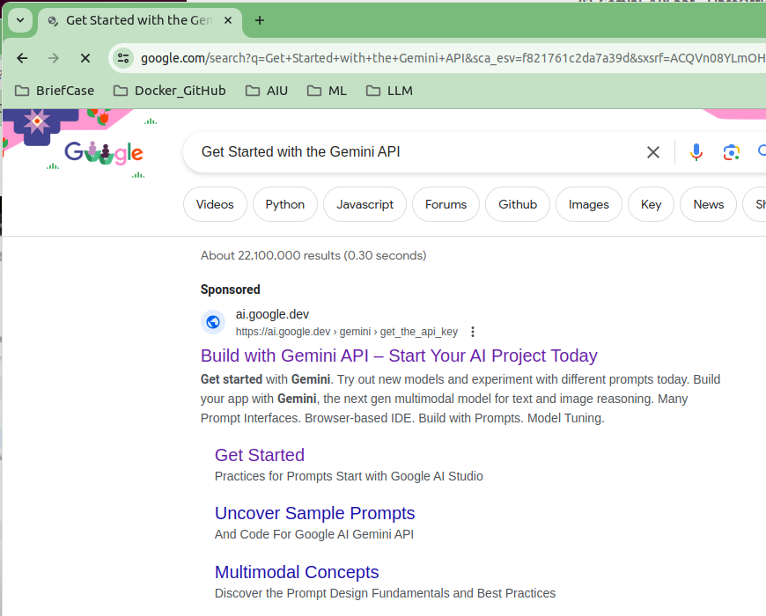
2 Gemini API
https://www.youtube.com/watch?v=W0rNUAfqGFc&list=PLZoTAELRMXVNbDmGZlcgCA3a8mRQp5axb&index=2
Gemini API (00:00-00:10/28:32)
Google search “Get Started with the Gemini API”
Click “Build with Gemini API – Start Your AI Project Today”

Slide 3
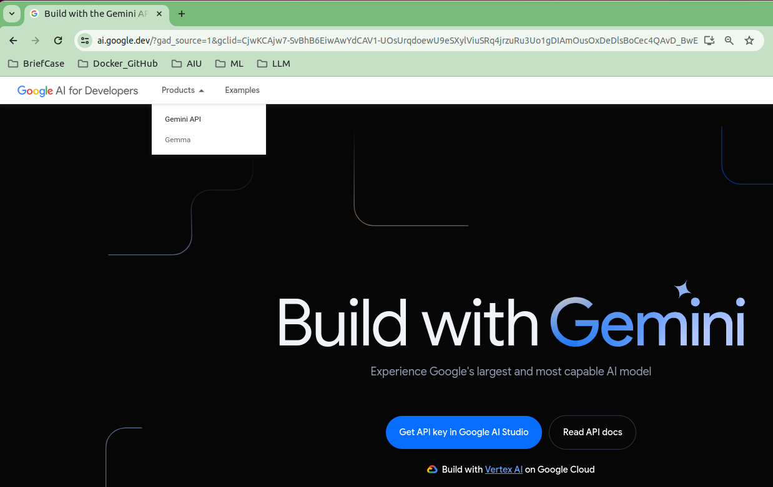
2 Gemini API
https://www.youtube.com/watch?v=W0rNUAfqGFc&list=PLZoTAELRMXVNbDmGZlcgCA3a8mRQp5axb&index=2
Gemini API (00:11-00:20/28:32)
Products > Gemini API

Slide 4
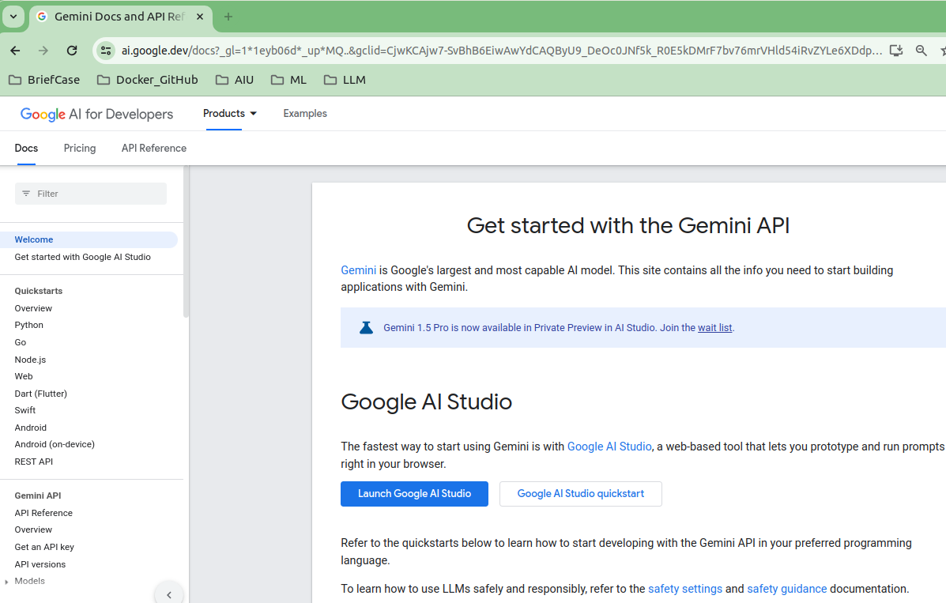
2 Gemini API
https://www.youtube.com/watch?v=W0rNUAfqGFc&list=PLZoTAELRMXVNbDmGZlcgCA3a8mRQp5axb&index=2
Gemini API (00:21-03:30/28:32)
Gemini is Google’s largest and mist capable AI Model.
Click “Welcome” on the left had side, we have “Get started with the Gemini API”.

Slide 5
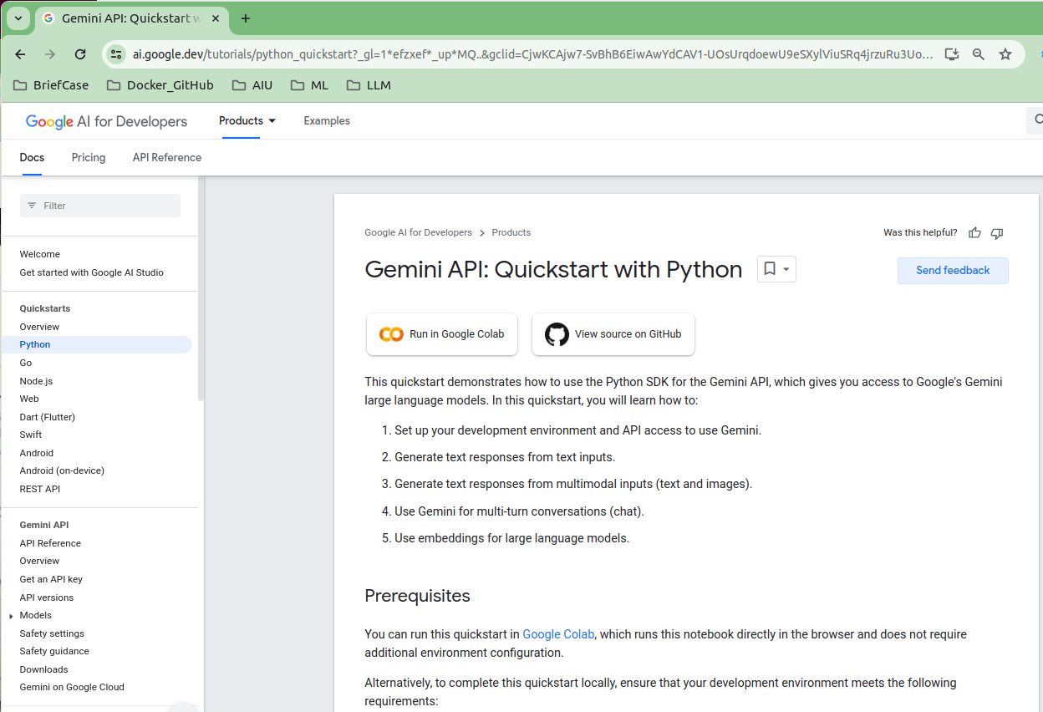
2 Gemini API
https://www.youtube.com/watch?v=W0rNUAfqGFc&list=PLZoTAELRMXVNbDmGZlcgCA3a8mRQp5axb&index=2
Gemini API (03:31-03:32/28:32)
We start with Python. Click “Python” on the left hand side.

Slide 6
2 Gemini API
https://www.youtube.com/watch?v=W0rNUAfqGFc&list=PLZoTAELRMXVNbDmGZlcgCA3a8mRQp5axb&index=2
Gemini API (03:32-03:33/28:32)
1. We start with Python. Click “Python” on the left hand side.
2. We click “Run in Google Colab”.
1
2

Slide 7
2.1 Gemini API Overview

Slide 8
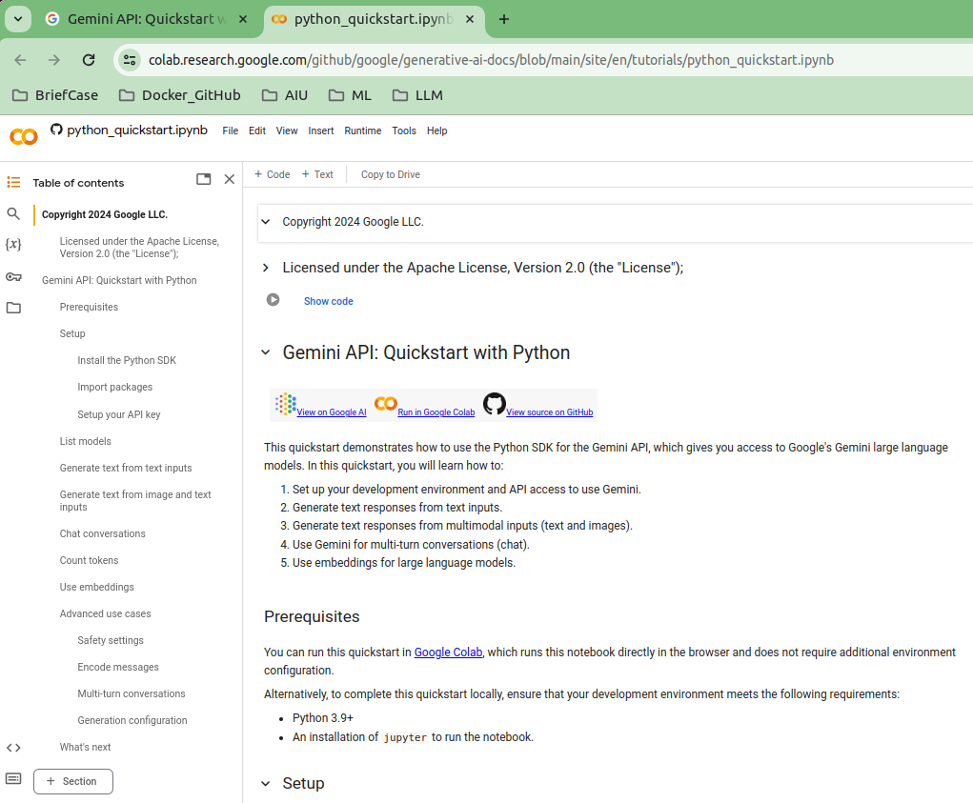
2.1 Gemini API Overview
https://www.youtube.com/watch?v=W0rNUAfqGFc&list=PLZoTAELRMXVNbDmGZlcgCA3a8mRQp5axb&index=2
Gemini API Overview (03:33-03:34/28:32)
We are in the “Gemini API: Quickstart with Python” with jupyter notebook now.

Slide 9
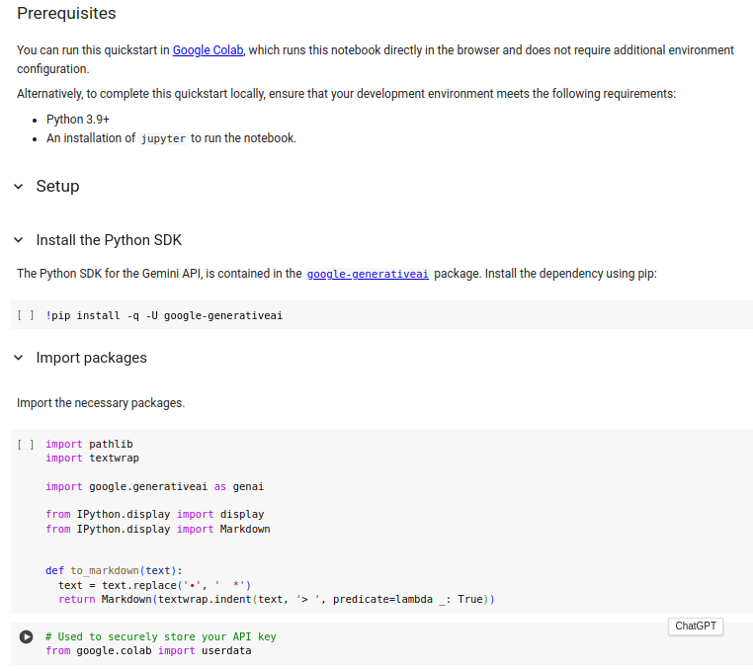
2.1 Gemini API Overview
https://www.youtube.com/watch?v=W0rNUAfqGFc&list=PLZoTAELRMXVNbDmGZlcgCA3a8mRQp5axb&index=2
Gemini API Overview (03:35-03:36/28:32)
Scroll down, we can see setup and import package.

Slide 10
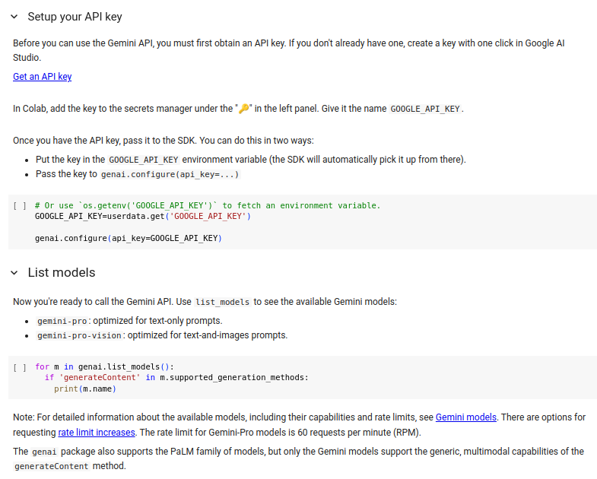
2.1 Gemini API Overview
https://www.youtube.com/watch?v=W0rNUAfqGFc&list=PLZoTAELRMXVNbDmGZlcgCA3a8mRQp5axb&index=2
Gemini API Overview (03:37-03:38/28:32)
Scroll down again, we can see Setup API Key and list Models

Slide 11
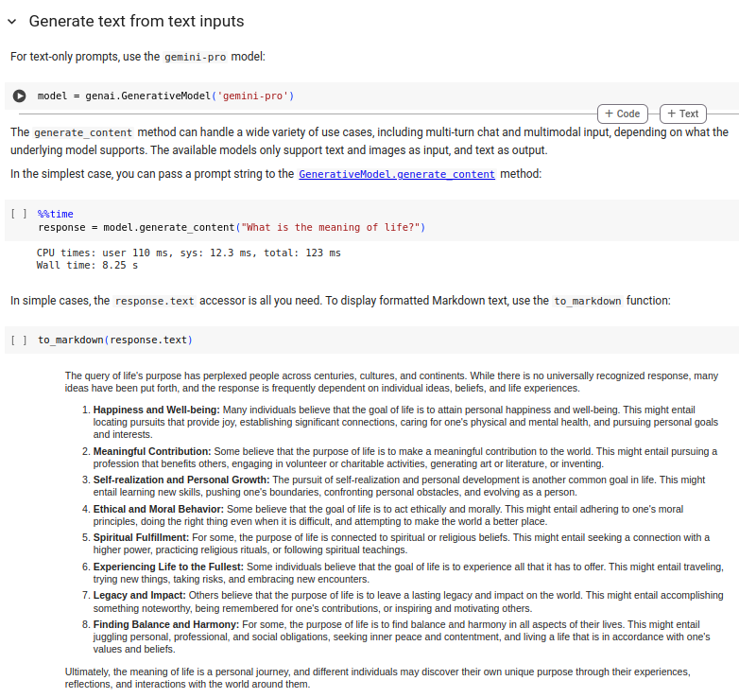
2.1 Gemini API Overview
https://www.youtube.com/watch?v=W0rNUAfqGFc&list=PLZoTAELRMXVNbDmGZlcgCA3a8mRQp5axb&index=2
Gemini API Overview (03:39-03:40/28:32)
Generate response.

Slide 12
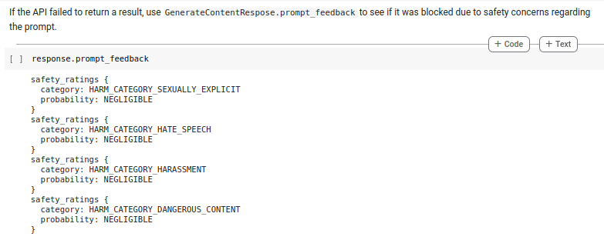
2.1 Gemini API Overview
https://www.youtube.com/watch?v=W0rNUAfqGFc&list=PLZoTAELRMXVNbDmGZlcgCA3a8mRQp5axb&index=2
Gemini API Overview (03:41-03:42/28:32)
Failed to response categories.

Slide 13
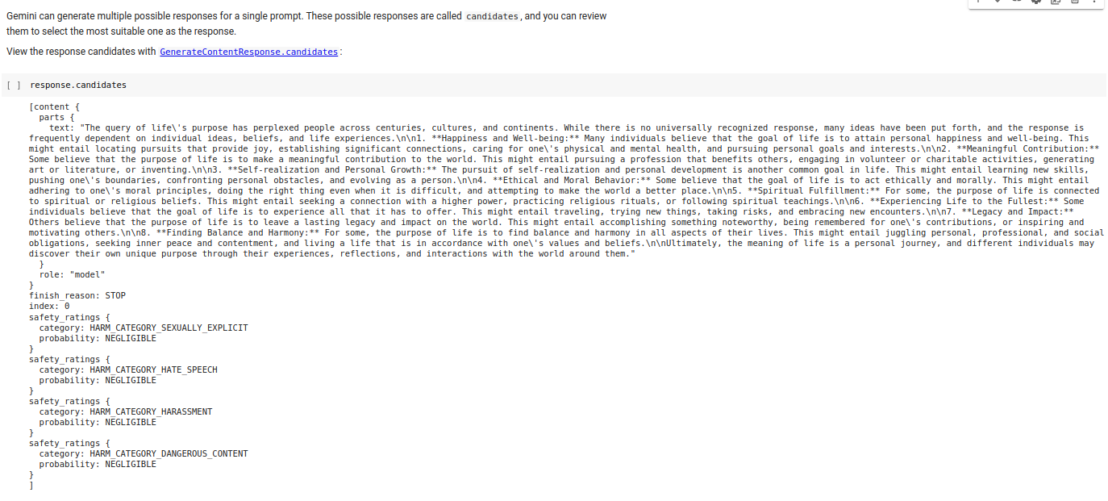
2.1 Gemini API Overview
https://www.youtube.com/watch?v=W0rNUAfqGFc&list=PLZoTAELRMXVNbDmGZlcgCA3a8mRQp5axb&index=2
Gemini API Overview (03:43-03:44/28:32)
Multiple responses.

Slide 14
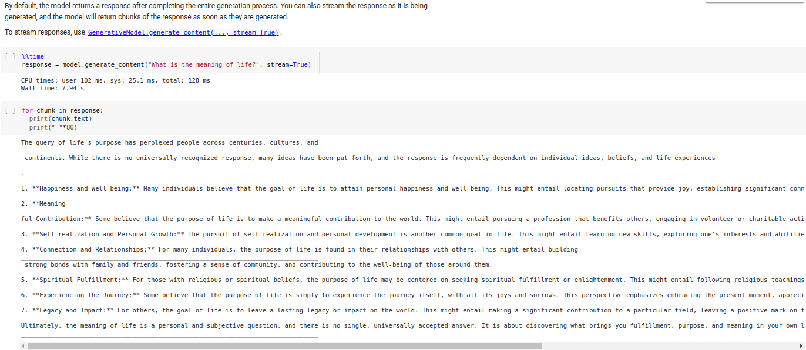
2.1 Gemini API Overview
https://www.youtube.com/watch?v=W0rNUAfqGFc&list=PLZoTAELRMXVNbDmGZlcgCA3a8mRQp5axb&index=2
Gemini API Overview (03:45-03:46/28:32)
Streaming response.

Slide 15
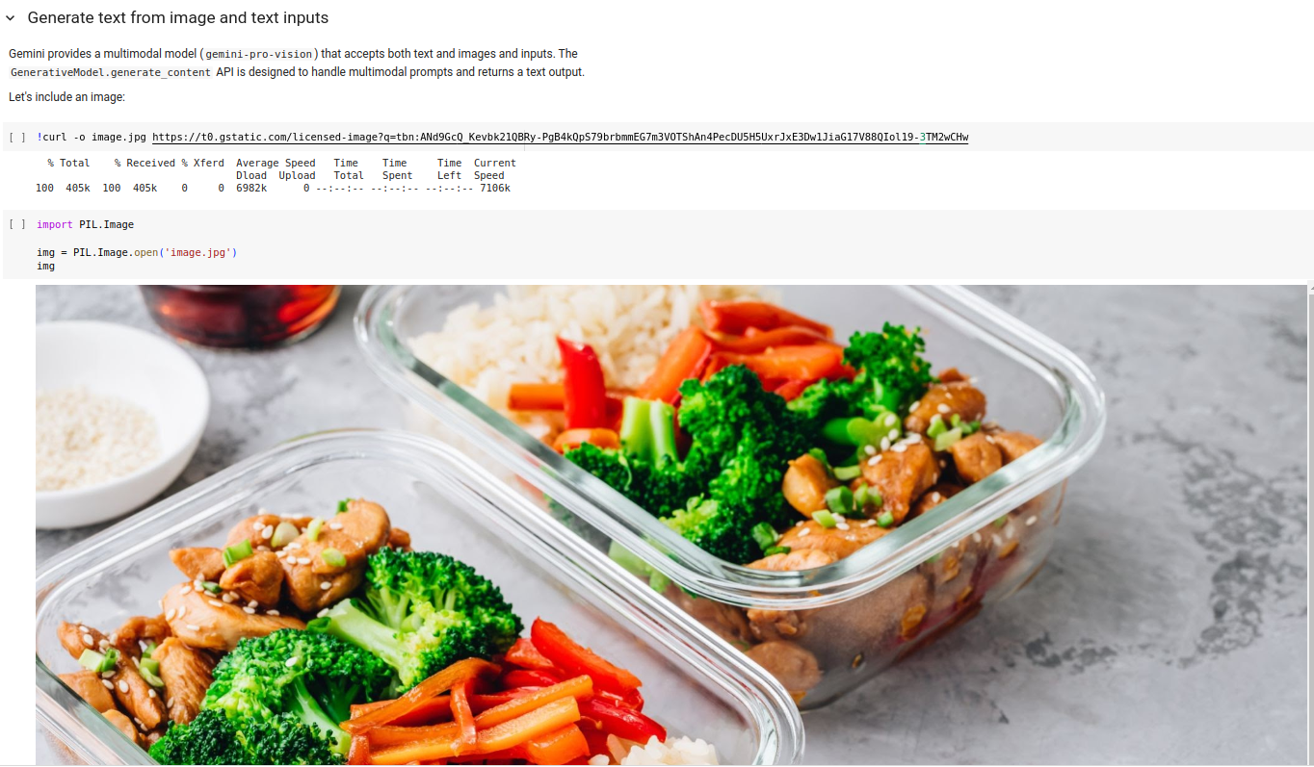
2.1 Gemini API Overview
https://www.youtube.com/watch?v=W0rNUAfqGFc&list=PLZoTAELRMXVNbDmGZlcgCA3a8mRQp5axb&index=2
Gemini API Overview (03:47-03:48/28:32)
Generate Text from images.

Slide 16
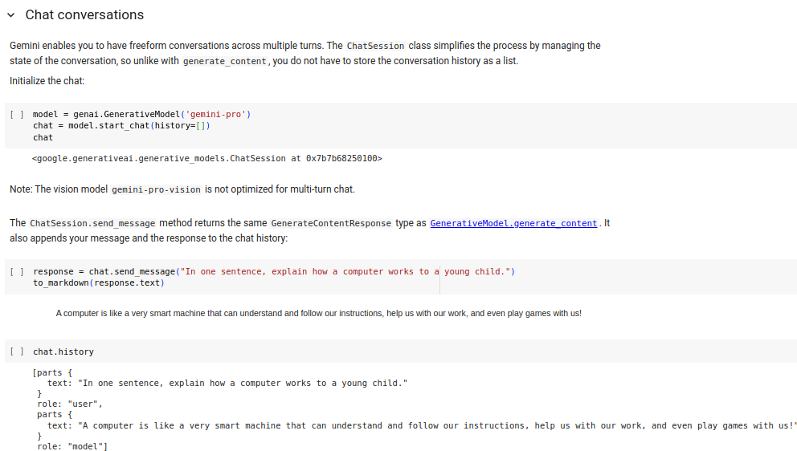
2.1 Gemini API Overview
https://www.youtube.com/watch?v=W0rNUAfqGFc&list=PLZoTAELRMXVNbDmGZlcgCA3a8mRQp5axb&index=2
Gemini API Overview (03:49-03:50/28:32)
Chat Conversation

Slide 17
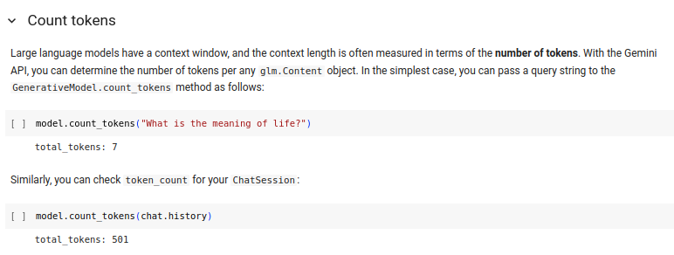
2.1 Gemini API Overview
https://www.youtube.com/watch?v=W0rNUAfqGFc&list=PLZoTAELRMXVNbDmGZlcgCA3a8mRQp5axb&index=2
Gemini API Overview (03:51-03:52/28:32)
Count Token

Slide 18
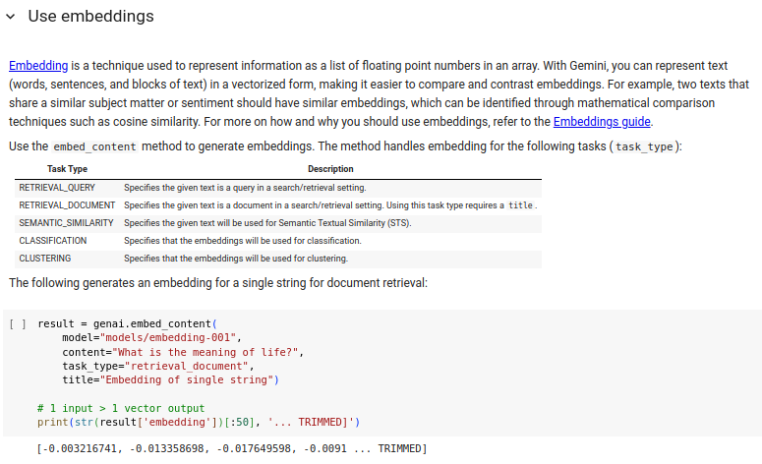
2.1 Gemini API Overview
https://www.youtube.com/watch?v=W0rNUAfqGFc&list=PLZoTAELRMXVNbDmGZlcgCA3a8mRQp5axb&index=2
Gemini API Overview (03:53-03:54/28:32)
Use Embedding

Slide 19
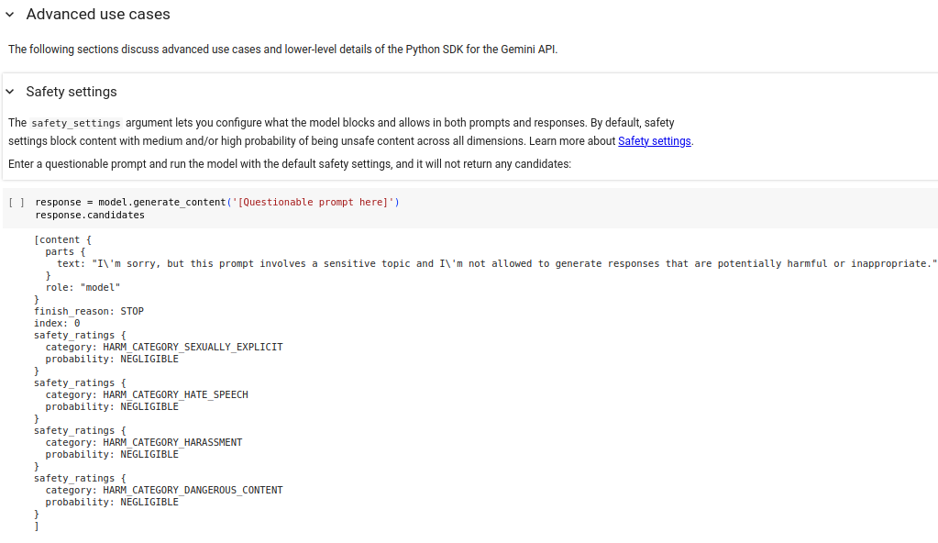
2.1 Gemini API Overview
https://www.youtube.com/watch?v=W0rNUAfqGFc&list=PLZoTAELRMXVNbDmGZlcgCA3a8mRQp5axb&index=2
Gemini API Overview (03:55-03:56/28:32)
Advanced use cases.

Slide 20
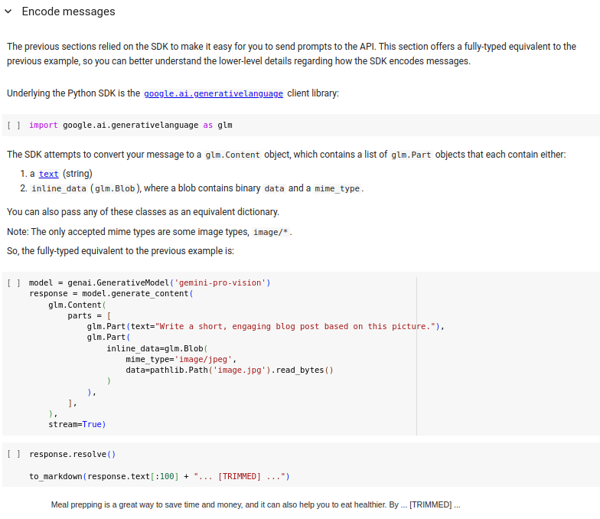
2.1 Gemini API Overview
https://www.youtube.com/watch?v=W0rNUAfqGFc&list=PLZoTAELRMXVNbDmGZlcgCA3a8mRQp5axb&index=2
Gemini API Overview (03:57-03:58/28:32)
Encode messages.

Slide 21
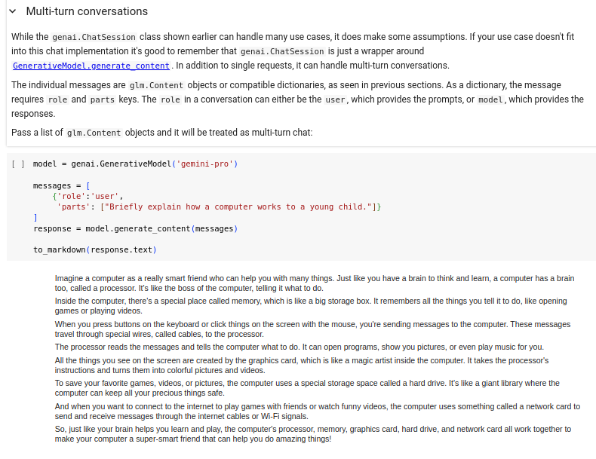
2.1 Gemini API Overview
https://www.youtube.com/watch?v=W0rNUAfqGFc&list=PLZoTAELRMXVNbDmGZlcgCA3a8mRQp5axb&index=2
Gemini API Overview (03:59-04:00/28:32)
Multi-Turn Conversation

Slide 22
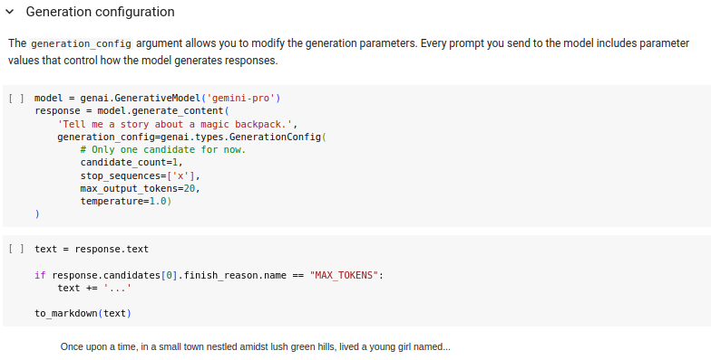
2.1 Gemini API Overview
https://www.youtube.com/watch?v=W0rNUAfqGFc&list=PLZoTAELRMXVNbDmGZlcgCA3a8mRQp5axb&index=2
Gemini API Overview (04:01-04:02/28:32)
Generation Configuration

Slide 23
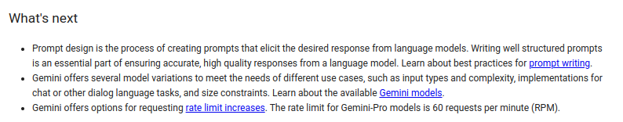
2.1 Gemini API Overview
https://www.youtube.com/watch?v=W0rNUAfqGFc&list=PLZoTAELRMXVNbDmGZlcgCA3a8mRQp5axb&index=2
Gemini API Overview (04:03-04:40/28:32)
What is next.

Slide 24
End

