Slide 1

2.13 Complete Generate Process
Peter H. Chen

Slide 2
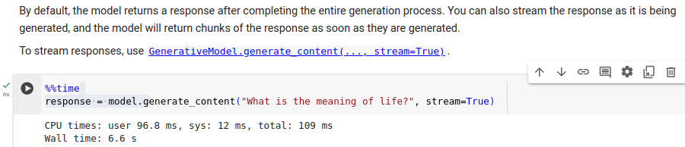
2.13 Complete Generate Process
https://www.youtube.com/watch?v=W0rNUAfqGFc&list=PLZoTAELRMXVNbDmGZlcgCA3a8mRQp5axb&index=2
Complete Generate Process (16:01-18:00/28:32)
By default, the model returns a response after completing the entire generation process.
You can also stream the response and the model will return chinks of response.

Slide 3
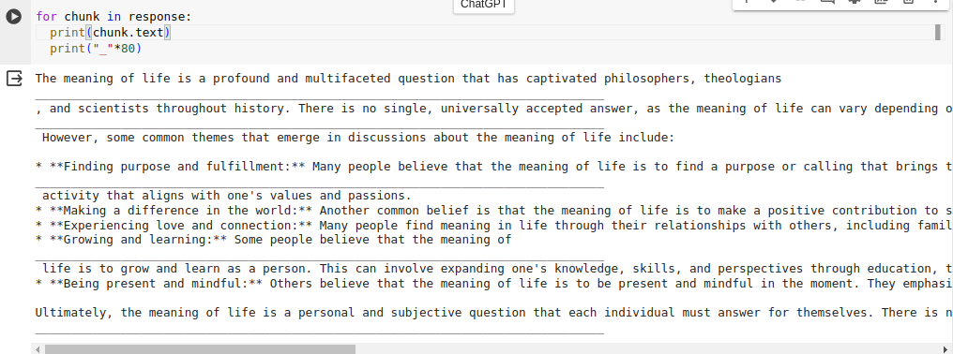
2.13 Complete Generate Process
https://www.youtube.com/watch?v=W0rNUAfqGFc&list=PLZoTAELRMXVNbDmGZlcgCA3a8mRQp5axb&index=2
Complete Generate Process (16:14-16:20/28:32)
We can stream the response.
We need to wait the entire response before we stream the response.

Slide 4
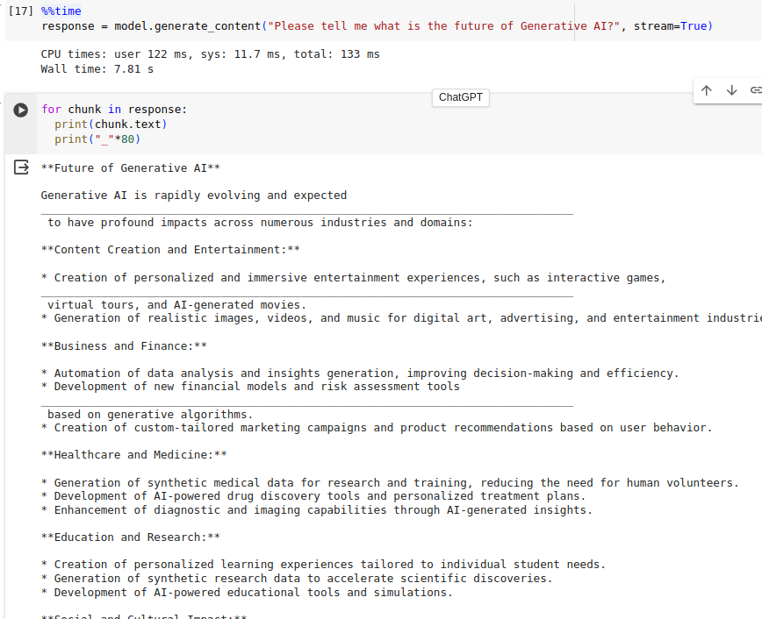
2.13 Complete Generate Process
https://www.youtube.com/watch?v=W0rNUAfqGFc&list=PLZoTAELRMXVNbDmGZlcgCA3a8mRQp5axb&index=2
Complete Generate Process (16:21-17:00/28:32)
Now, we try “Please tell me what is the future of Generative AI?”.
Then, we display the chunk of response.

Slide 5
2.14 Try … Except Error Handling

Slide 6
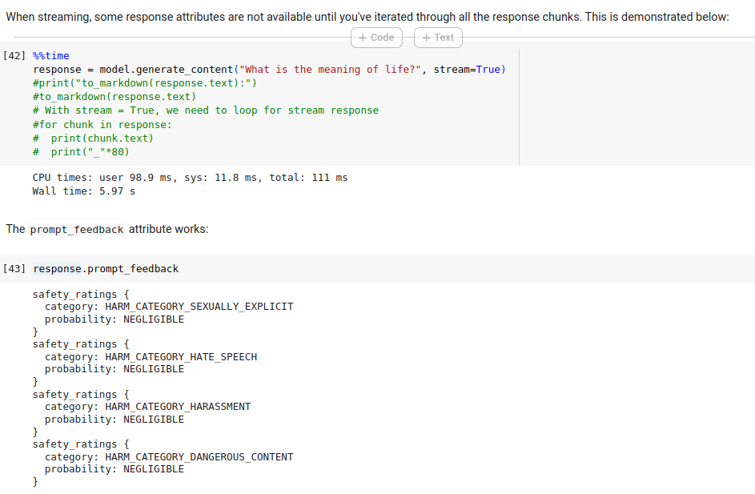
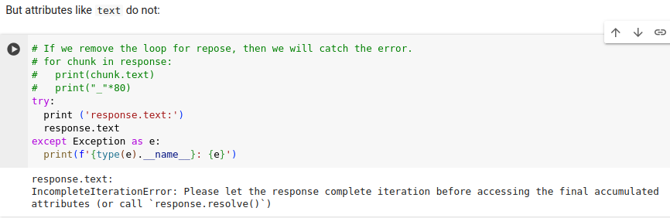
2.14 Try … Except Error Handling
https://www.youtube.com/watch?v=W0rNUAfqGFc&list=PLZoTAELRMXVNbDmGZlcgCA3a8mRQp5axb&index=2
Try … Except Error Handling (17:01-18:20/28:32)
When we do the streaming (we set “stream = True”), we need to iterate the stream result with “for chunk in response”.
Otherwise, it will have errors as below.

Slide 7
End

