Slide 1

2.15 Image Prompting
Peter H. Chen

Slide 2
2.15 Image Prompting
https://www.youtube.com/watch?v=W0rNUAfqGFc&list=PLZoTAELRMXVNbDmGZlcgCA3a8mRQp5axb&index=2
Image Prompting (18:21-16:30/28:32)
Gemini provides a multimodal model (gemini-pro-vision) that accept inputs from both texts and images.
The generate_content API handle multimodal prompt (both input with texts and images) and return texts.
In this section, we do “Image Prompting” (Image input only, i.e., without text).
First, we copy url:
> !curl -o image.jpg https://t0.gstatic.com/licensed-image?q=tbn:ANd9GcQ_Kevbk21QBRy-PgB4kQpS79brbmmEG7m3VOTShAn4PecDU5H5UxrJxE3Dw1JiaG17V88QIol19-3TM2wCHw

Slide 3
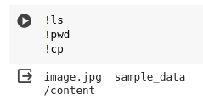
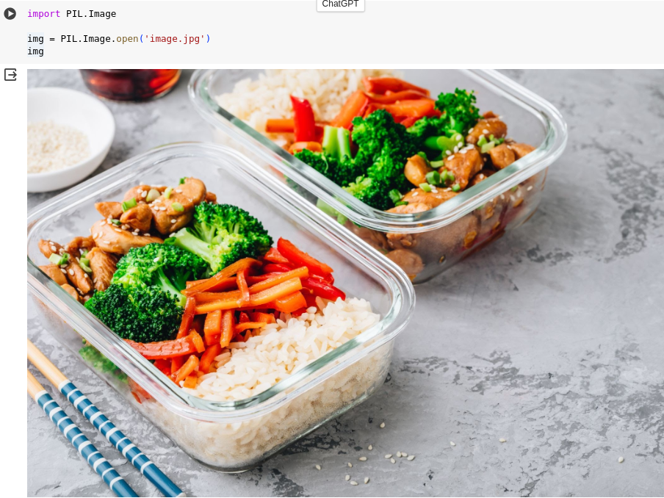
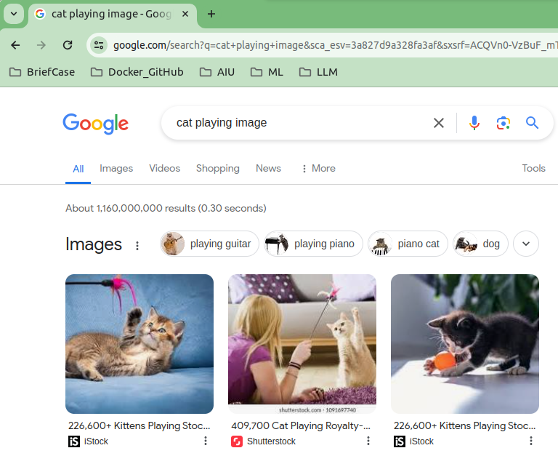
2.15 Image Prompting
https://www.youtube.com/watch?v=W0rNUAfqGFc&list=PLZoTAELRMXVNbDmGZlcgCA3a8mRQp5axb&index=2
Image Prompting (18:21-18:30/28:32)
In Colab
> !ls
>!pwd
There is image.jpg in the “/content” path

Slide 4
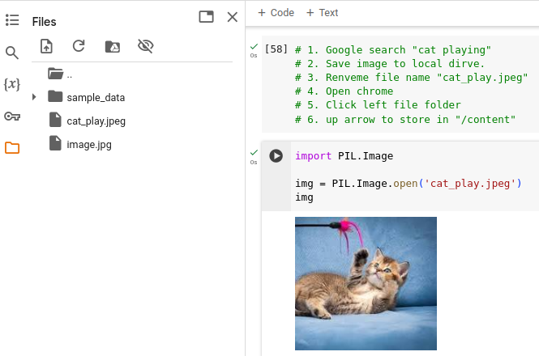
2.15 Image Prompting
https://www.youtube.com/watch?v=W0rNUAfqGFc&list=PLZoTAELRMXVNbDmGZlcgCA3a8mRQp5axb&index=2
Image Prompting (18:31-19:00/28:32)
1. Google search “cat playing” images.
2. Save image to local drive.
3. Rename file name "cat_play.jpeg"
4. Open chrome
5. Click left file folder
6. up arrow to store in "/content"

Slide 5
2.15 Image Prompting
https://www.youtube.com/watch?v=W0rNUAfqGFc&list=PLZoTAELRMXVNbDmGZlcgCA3a8mRQp5axb&index=2
Image Prompting (19:01-19:30/28:32)
Reload the image again.
We are going to give this image to gemini-pro-vision model and see what gemini can understand the image.

Slide 6
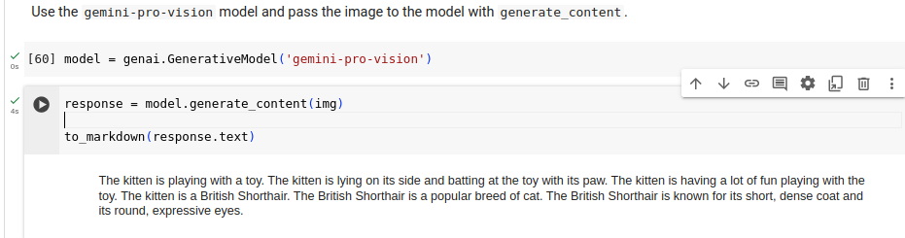
2.15 Image Prompting
https://www.youtube.com/watch?v=W0rNUAfqGFc&list=PLZoTAELRMXVNbDmGZlcgCA3a8mRQp5axb&index=2
Image Prompting (19:31-20:50/28:32)
We give the “cat_play.jpeg” to gemini-pro-vision. We got response ”The kitten is playing with a toy. …”
We use to_markdown(response.txt) to see the answer.
What is the requirement for text and image prompting?
1. Install generative AI framework: !pip install -q -U google-generativeai
2. Import Generative AI Framework: import google.generativeai as genai
3. generate mode: model = genai.GenerativeModel(‘gemini-pro-vision’)
4. download image ‘cat_play.jpeg’.
5. make sure image is there: !ls
6. read image img = PIL.image.open (‘cat_play.jpeg’)
7. Input image to model.generate_content(img)

Slide 7
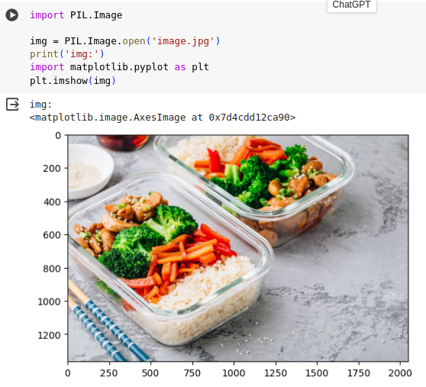
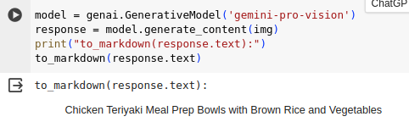
2.15 Image Prompting
https://www.youtube.com/watch?v=W0rNUAfqGFc&list=PLZoTAELRMXVNbDmGZlcgCA3a8mRQp5axb&index=2
Image Prompting (20:57-23:30/28:32)
Let check the previous image (‘image.jpg’)
1. Display the previous image: image.jpg
2. run image prompting.

Slide 8
2.16 Text/Image Prompting

Slide 9
2.16 Text/Image Prompting
https://www.youtube.com/watch?v=W0rNUAfqGFc&list=PLZoTAELRMXVNbDmGZlcgCA3a8mRQp5axb&index=2
Text/Image Prompting (23:38-25:50/28:32)
We just see the image prompting.
Now, we want to combine the “text and image” prompting together.
We use a [] to put the “description” and image into the [].
[“Write a short, engaging blog post based on this picture. It should include a description of the meal in the photo and talk about my journey meal prepping.", img]

Slide 10
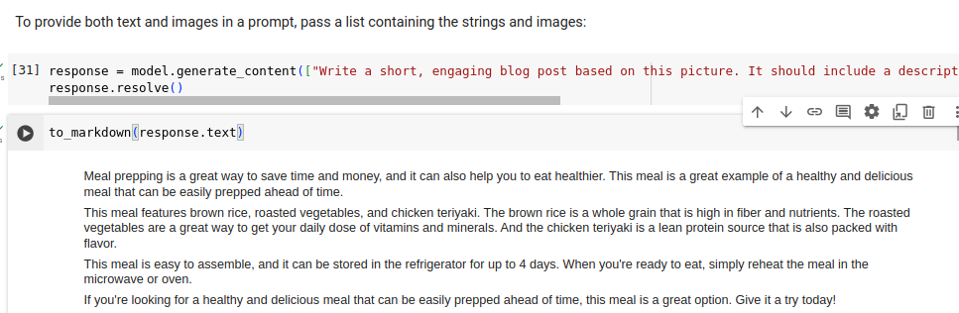
2.16 Text/Image Prompting
https://www.youtube.com/watch?v=W0rNUAfqGFc&list=PLZoTAELRMXVNbDmGZlcgCA3a8mRQp5axb&index=2
Text/Image Prompting (23:38-25:30/28:32)
1. Use a [] to put the “description” and image into the [].
2. Pass […] into the generate_content and get the response: response = model.generate_content ([…], stream =True)
2. Resolve the stream response: response.resolve()
3. to_markdown(response.txt)

Slide 11
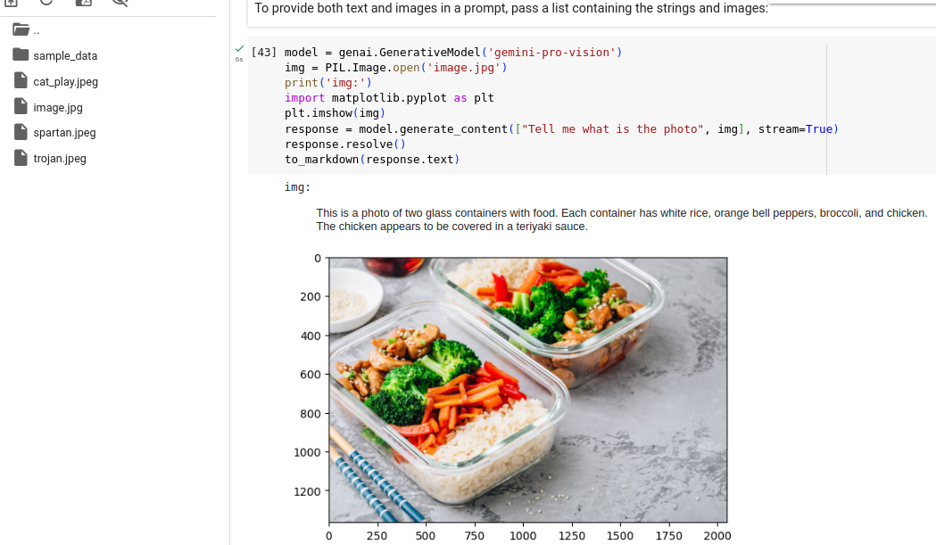
2.16 Text/Image Prompting
https://www.youtube.com/watch?v=W0rNUAfqGFc&list=PLZoTAELRMXVNbDmGZlcgCA3a8mRQp5axb&index=2
Text/Image Prompting (25:38-26:00/28:32)
Now, we test text/image prompting for “image.jpg”.

Slide 12
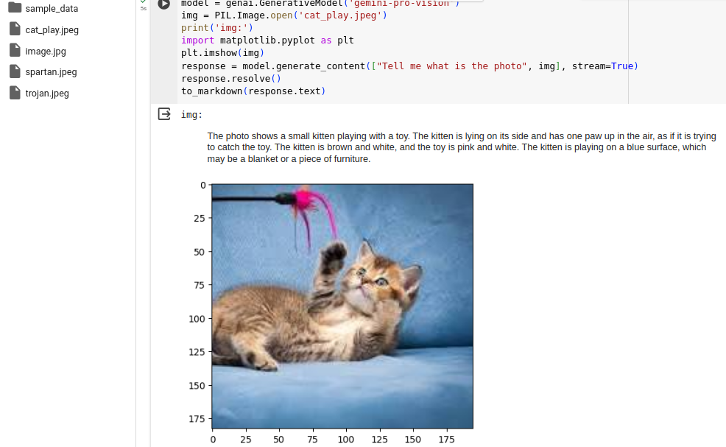
2.16 Text/Image Prompting
https://www.youtube.com/watch?v=W0rNUAfqGFc&list=PLZoTAELRMXVNbDmGZlcgCA3a8mRQp5axb&index=2
Text/Image Prompting (25:01-26:05/28:32)
Now, we test text/image prompting for “cat_play.jpeg”.

Slide 13
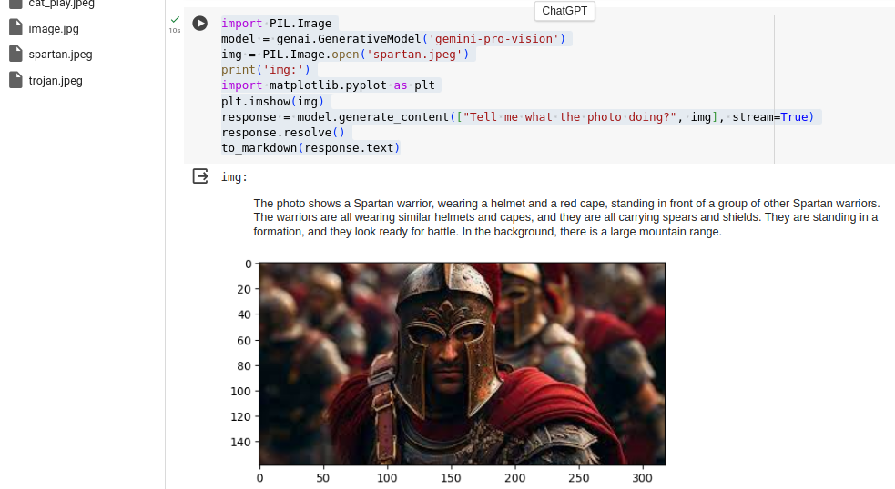
2.16 Text/Image Prompting
https://www.youtube.com/watch?v=W0rNUAfqGFc&list=PLZoTAELRMXVNbDmGZlcgCA3a8mRQp5axb&index=2
Text/Image Prompting (26:06-26:30/28:32)
Now, we test text/image prompting for “spartan.jpeg”.

Slide 14
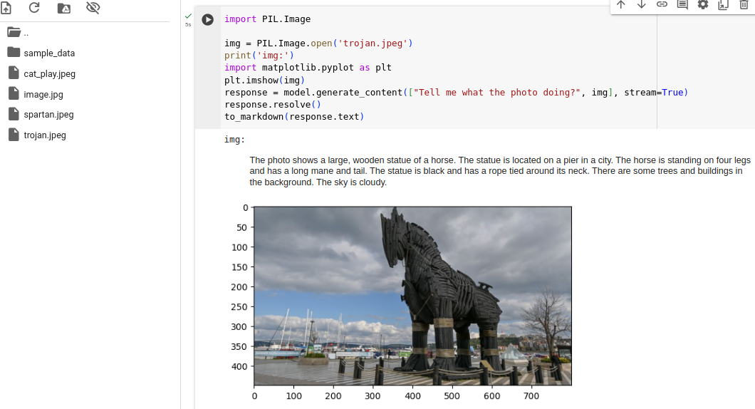
2.16 Text/Image Prompting
https://www.youtube.com/watch?v=W0rNUAfqGFc&list=PLZoTAELRMXVNbDmGZlcgCA3a8mRQp5axb&index=2
Text/Image Prompting (26:06-26:30/28:32)
Now, we test text/image prompting for “trojan.jpeg”.

Slide 15
2.17 Exercise

Slide 16
2.17 Exercise
https://www.youtube.com/watch?v=W0rNUAfqGFc&list=PLZoTAELRMXVNbDmGZlcgCA3a8mRQp5axb&index=2
Exercise (26:31-28:32/28:32)
1. Implement Chat Conversation and log history: Use model.start_chat() to create chat, chat.history.
2. Implement the Vector Database: Use embedding to convert the text information into the number.

Slide 17
End

