Slide 1

1 Google Gemini LLM
Peter H. Chen

Slide 2

1 Google Gemini LLM
https://www.youtube.com/watch?v=it0l6lx3qI0&list=PLZoTAELRMXVNbDmGZlcgCA3a8mRQp5axb&index=1
Google Gemini LLM (00:00-00:40/11:49)
Google Gemini is a Large Language Model and can be Large Image Model.
According to the report, Gemini has good accuracy compared to chatGPT.
We can use Gemini Model to go to the next level.

Slide 3
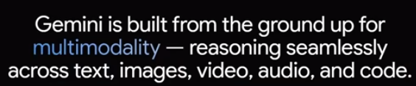
1 Google Gemini LLM
https://www.youtube.com/watch?v=it0l6lx3qI0&list=PLZoTAELRMXVNbDmGZlcgCA3a8mRQp5axb&index=1
Google Gemini LLM (00:51-01:30/11:49)
What exactly the Gemini Model is?
Gemini is built from ground up for multi-modality.
The word “multi-modality” means it can combine text image, video, audio, and code.
You can ask any type of questions.
We use Google Bot for Demo.
Google Bot integrates the Gemini Model.
When we see “multi-modality”, this means that it going to combine everything, text, image, video, audio, and code.
Since it is is an LLM model, we are able to ask any type of questions and it can suggest you many more things as you go ahead.
We will see the demo with respect to this.

Slide 4
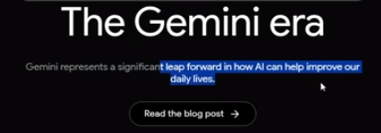
1 Google Gemini LLM
https://www.youtube.com/watch?v=it0l6lx3qI0&list=PLZoTAELRMXVNbDmGZlcgCA3a8mRQp5axb&index=1
Google Gemini LLM (01:33-01:40/11:49)
Gemini represents a significant leap forward in how AI can help improve our daily life.
https://deepmind.google/technologies/gemini/#introduction

Slide 5
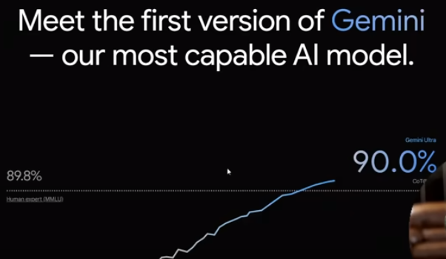
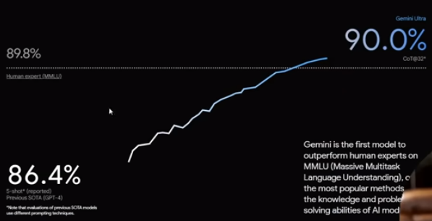
1 Google Gemini LLM
https://www.youtube.com/watch?v=it0l6lx3qI0&list=PLZoTAELRMXVNbDmGZlcgCA3a8mRQp5axb&index=1
Google Gemini LLM (01:44-01:50/11:49)
Now, this is the most important.

Slide 6
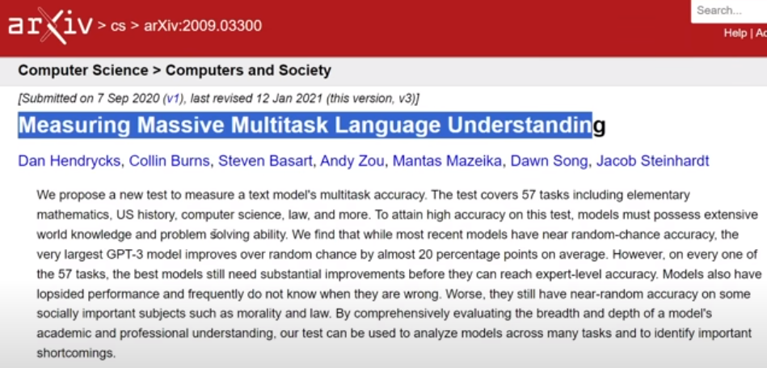
1 Google Gemini LLM
https://www.youtube.com/watch?v=it0l6lx3qI0&list=PLZoTAELRMXVNbDmGZlcgCA3a8mRQp5axb&index=1
Google Gemini LLM (01:55-02:00/11:49)
We measure the Multi-Task Language Understanding.
This is how application can understand the human language.

Slide 7
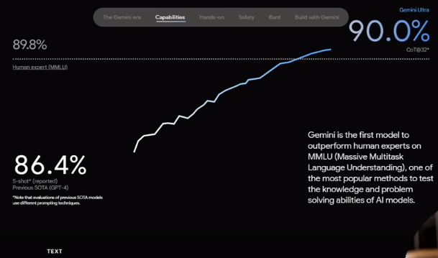
1 Google Gemini LLM
https://www.youtube.com/watch?v=it0l6lx3qI0&list=PLZoTAELRMXVNbDmGZlcgCA3a8mRQp5axb&index=1
Google Gemini LLM (02:05-03:00/11:49)
To measure how application can understand the human language, we j=have the performance metrics to measure.
Before, GPT4, we have 86.4% accuracy. Human expert is 89.8% accuracy. Gemini Ultra, which is one of the version of the Gemini Model, is able to achieve 90%.
It is very amazing and the reason that we choose Gemini for language understanding.
Gemini is the first LLM Model that outperform the human experts 89.8%.

Slide 8
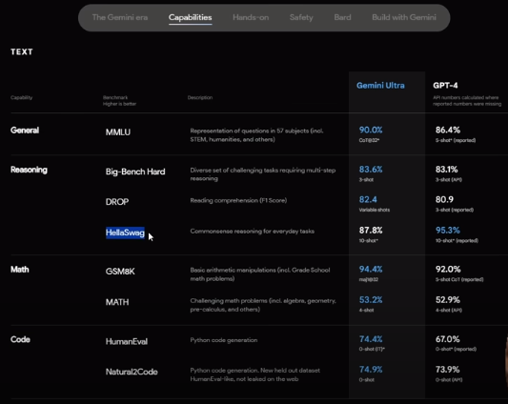
1 Google Gemini LLM
https://www.youtube.com/watch?v=it0l6lx3qI0&list=PLZoTAELRMXVNbDmGZlcgCA3a8mRQp5axb&index=1
Google Gemini LLM (03:10-03:30/11:49)
Along with that, we can see other categories: such as, general, reasoning, Math, and Code.
Gemini Ultra, you can see it has achieved the good accuracy.
In reasoning, you can see the Benchmark tool “HelloSwag”: Common Sense reasoning. GPT4 has a good accuracy 95/3% when compared to Gemini Ultra 87.8%.

Slide 9
1 Google Gemini LLM
https://www.youtube.com/watch?v=it0l6lx3qI0&list=PLZoTAELRMXVNbDmGZlcgCA3a8mRQp5axb&index=1
Google Gemini LLM (03:38-04:10/11:49)
Other than reasoning, we can see the remaining, the Gemini Ultra are better, such as, Math, Gemini Ultra achieve 94.4% and GPT is 92.0%.
We look at the code: HumanEval benchmark Gemini Ultra is 74.4% which is better than GPT 67.0%. Natrual2Code benchmark Gemini Ultra is 94.9% and GPT is 73.9%.

Slide 10
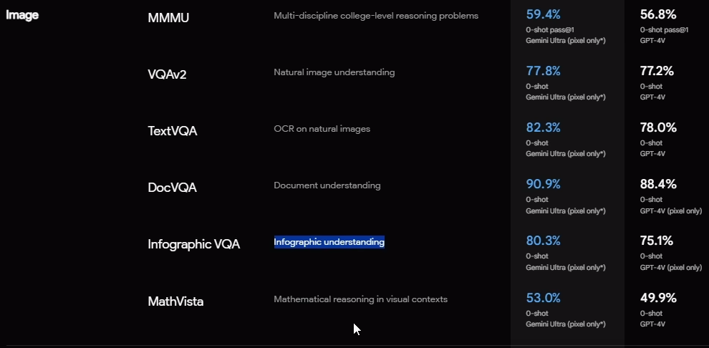
1 Google Gemini LLM
https://www.youtube.com/watch?v=it0l6lx3qI0&list=PLZoTAELRMXVNbDmGZlcgCA3a8mRQp5axb&index=1
Google Gemini LLM (04:14-04:20/11:49)
When we look at SOTA (State of The Art) performance for Multi-Model Tasks.
The benchmark of image part Gemini Ultra are all better than GPT-4.
Multi-disciple reasoning, Natural Image Understanding, OCR on Natural Images, document understanding, Iconographic understanding, Mathematical reasoning in visual contexts.

Slide 11
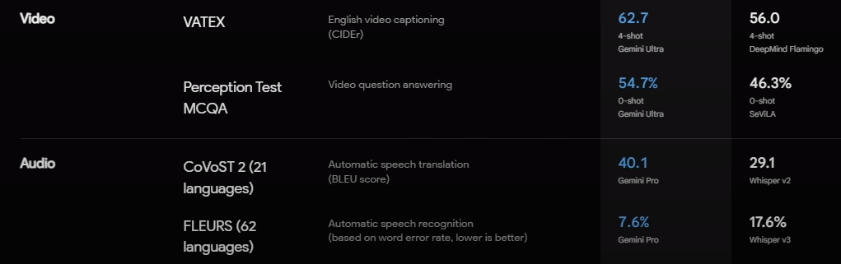
1 Google Gemini LLM
https://www.youtube.com/watch?v=it0l6lx3qI0&list=PLZoTAELRMXVNbDmGZlcgCA3a8mRQp5axb&index=1
Google Gemini LLM (04:21-04:25/11:49)
Video: English Video Caption, Video Question answering.
Audio:
Automatic Speech translation Gemini Ultra 40.1% is better than GPT 29.1%.
Automatic speech recognition Gemini Ultra 7.6% is worse than GPT 17.6%.

Slide 12
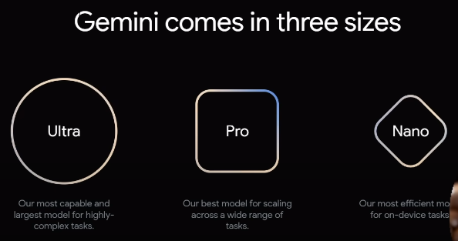
1 Google Gemini LLM
https://www.youtube.com/watch?v=it0l6lx3qI0&list=PLZoTAELRMXVNbDmGZlcgCA3a8mRQp5axb&index=1
Google Gemini LLM (04:31-05:00/11:49)
What is categories of Gemini?
1. Gemini Ultra: Most capable model fro highly-complex tasks.
2. Gemini Pro: Best model for scaling wide range of tasks.
3. Gemini Nano: This is for mobile app or iPad.

Slide 13
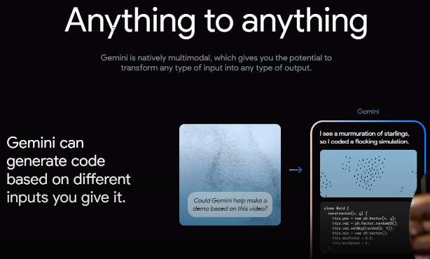
1 Google Gemini LLM
https://www.youtube.com/watch?v=it0l6lx3qI0&list=PLZoTAELRMXVNbDmGZlcgCA3a8mRQp5axb&index=1
Google Gemini LLM (05:05-05:10/11:49)
We can do Gemini from anything to anything.

Slide 14
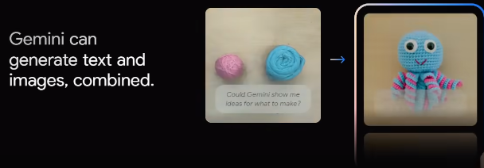
1 Google Gemini LLM
https://www.youtube.com/watch?v=it0l6lx3qI0&list=PLZoTAELRMXVNbDmGZlcgCA3a8mRQp5axb&index=1
Google Gemini LLM (05:15-05:15/11:49)
We can generate the text, images, and combined.

Slide 15
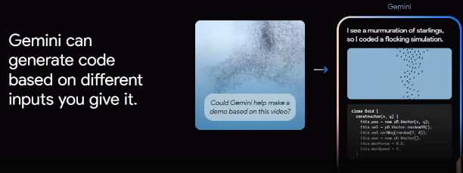
1 Google Gemini LLM
https://www.youtube.com/watch?v=it0l6lx3qI0&list=PLZoTAELRMXVNbDmGZlcgCA3a8mRQp5axb&index=1
Google Gemini LLM (05:17-05:30/11:49)
Gemini can generate from input texts.

Slide 16
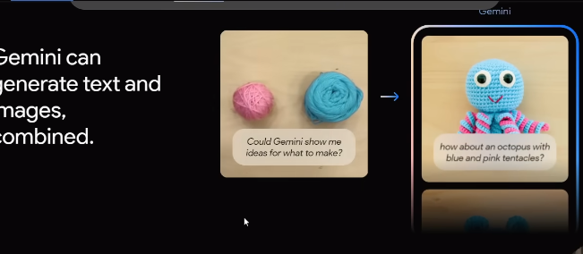
1 Google Gemini LLM
https://www.youtube.com/watch?v=it0l6lx3qI0&list=PLZoTAELRMXVNbDmGZlcgCA3a8mRQp5axb&index=1
Google Gemini LLM (05:31-05:35/11:49)
Gemini can understand human language and generate images

Slide 17
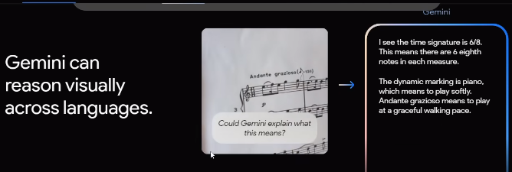
1 Google Gemini LLM
https://www.youtube.com/watch?v=it0l6lx3qI0&list=PLZoTAELRMXVNbDmGZlcgCA3a8mRQp5axb&index=1
Google Gemini LLM (05:31-06:00/11:49)
Gemini can combine all of them across different languages.

Slide 18
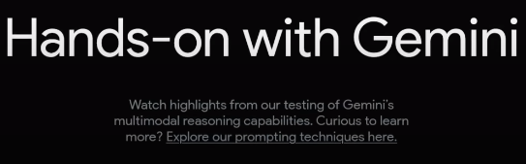
1 Google Gemini LLM
https://www.youtube.com/watch?v=it0l6lx3qI0&list=PLZoTAELRMXVNbDmGZlcgCA3a8mRQp5axb&index=1
Google Gemini LLM (06:03-06:04/11:49)

Slide 19
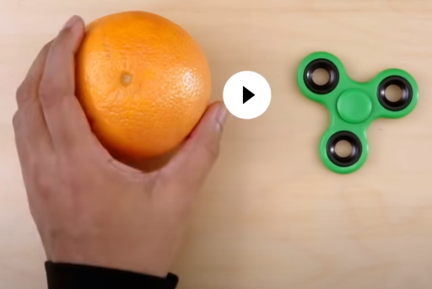
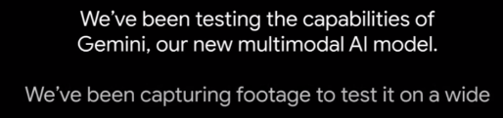
1 Google Gemini LLM
https://www.youtube.com/watch?v=it0l6lx3qI0&list=PLZoTAELRMXVNbDmGZlcgCA3a8mRQp5axb&index=1
Google Gemini LLM (06:05-06:16/11:49)
Test for Multi-Model.

Slide 20
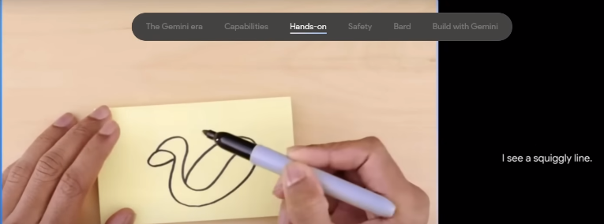
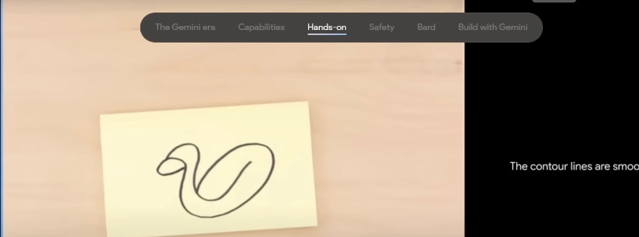
1 Google Gemini LLM
https://www.youtube.com/watch?v=it0l6lx3qI0&list=PLZoTAELRMXVNbDmGZlcgCA3a8mRQp5axb&index=1
Google Gemini LLM (06:05-06:16/11:49)
Test for Multi-Model.

Slide 21
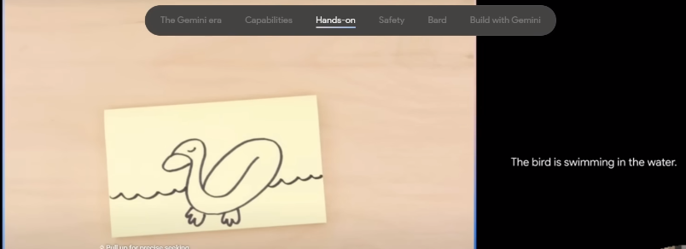
1 Google Gemini LLM
https://www.youtube.com/watch?v=it0l6lx3qI0&list=PLZoTAELRMXVNbDmGZlcgCA3a8mRQp5axb&index=1
Google Gemini LLM (06:20-06:44/11:49)

Slide 22
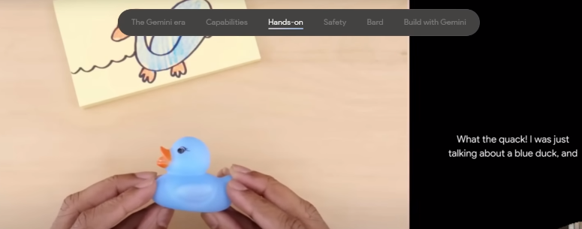
1 Google Gemini LLM
https://www.youtube.com/watch?v=it0l6lx3qI0&list=PLZoTAELRMXVNbDmGZlcgCA3a8mRQp5axb&index=1
Google Gemini LLM (07:20-08:20/11:49)

Slide 23
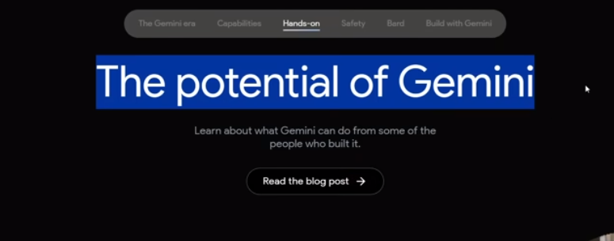
1 Google Gemini LLM
https://www.youtube.com/watch?v=it0l6lx3qI0&list=PLZoTAELRMXVNbDmGZlcgCA3a8mRQp5axb&index=1
Google Gemini LLM (08:20-08:25/11:49)

Slide 24
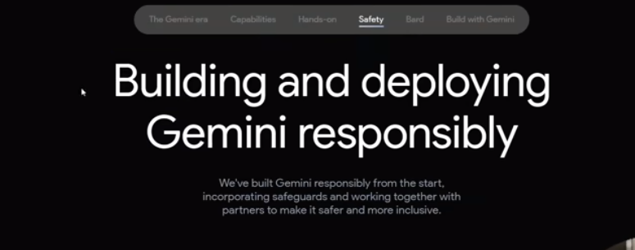
1 Google Gemini LLM
https://www.youtube.com/watch?v=it0l6lx3qI0&list=PLZoTAELRMXVNbDmGZlcgCA3a8mRQp5axb&index=1
Google Gemini LLM (08:30-08:44/11:49)

Slide 25
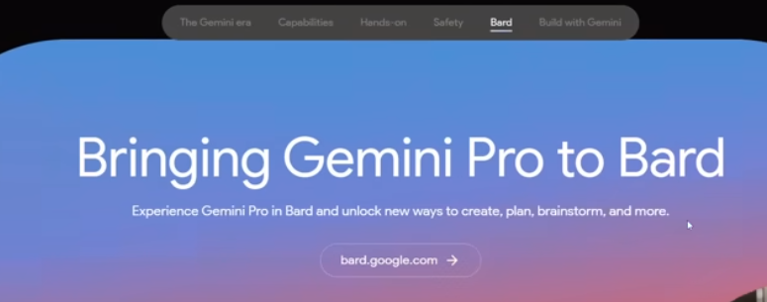
1 Google Gemini LLM
https://www.youtube.com/watch?v=it0l6lx3qI0&list=PLZoTAELRMXVNbDmGZlcgCA3a8mRQp5axb&index=1
Google Gemini LLM (08:45-09:00/11:49)

Slide 26
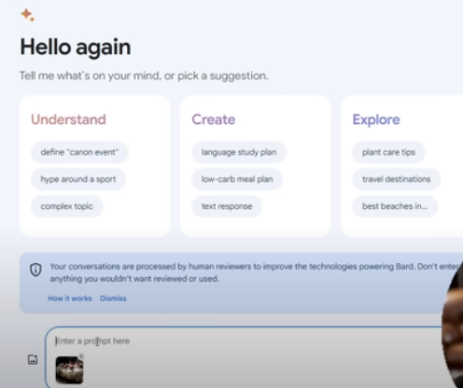
1 Google Gemini LLM
https://www.youtube.com/watch?v=it0l6lx3qI0&list=PLZoTAELRMXVNbDmGZlcgCA3a8mRQp5axb&index=1
Google Gemini LLM (09:01-10:00/11:49)

Slide 27
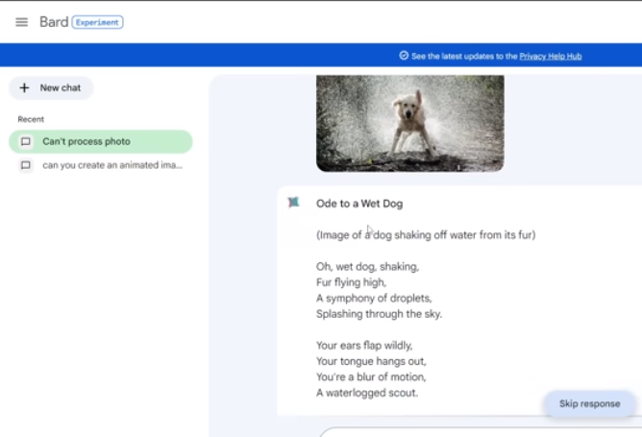
1 Google Gemini LLM
https://www.youtube.com/watch?v=it0l6lx3qI0&list=PLZoTAELRMXVNbDmGZlcgCA3a8mRQp5axb&index=1
Google Gemini LLM (10:01-10:50/11:49)

Slide 28
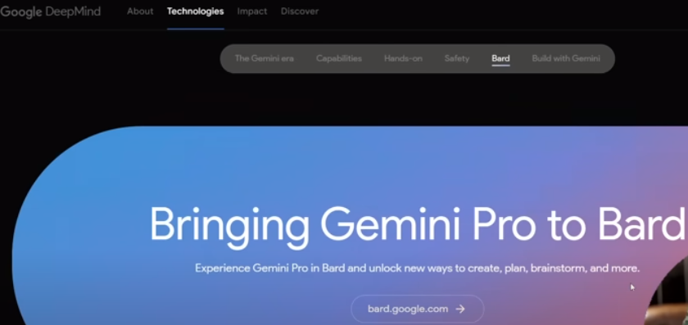
1 Google Gemini LLM
https://www.youtube.com/watch?v=it0l6lx3qI0&list=PLZoTAELRMXVNbDmGZlcgCA3a8mRQp5axb&index=1
Google Gemini LLM (10:51-11:15/11:49)
Bring Gemini Pro to Bard.

Slide 29
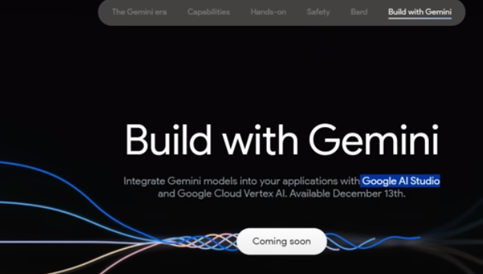
1 Google Gemini LLM
https://www.youtube.com/watch?v=it0l6lx3qI0&list=PLZoTAELRMXVNbDmGZlcgCA3a8mRQp5axb&index=1
Google Gemini LLM (10:16-11:49/11:49)
Build application with Gemini

Slide 30
End

