Slide 1

2.20 Simple Sequence Chain
Peter H. Chen

Slide 2
2.20 Simple Sequence Chain
https://www.youtube.com/watch?v=_FpT1cwcSLg&list=PLZoTAELRMXVORE4VF7WQ_fAl0L1Gljtar&index=2
Simple Sequence Chain (26:31-27:40/43:22)
We discuss the Simple sequential Chain.

Slide 3
2.21 Import Simple Sequential Chain

Slide 4
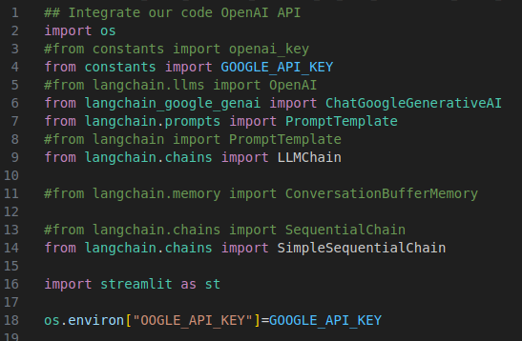
2.21 Import Simple Sequential Chain
https://www.youtube.com/watch?v=_FpT1cwcSLg&list=PLZoTAELRMXVORE4VF7WQ_fAl0L1Gljtar&index=2
Import Simple Sequence Chain (26:41-27:30/43:22)
1. SimpleSequentialChain: Simple Sequential Chain.

Slide 5
2.22 First Input Prompt: Name

Slide 6
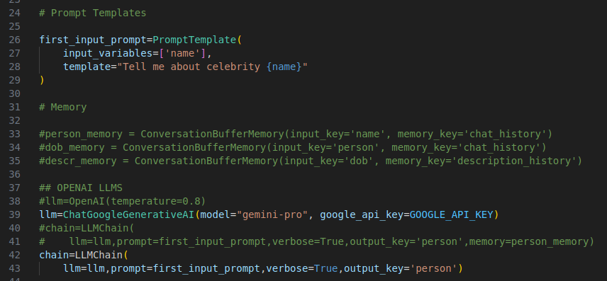
2.22 First Input Prompt: Name
https://www.youtube.com/watch?v=_FpT1cwcSLg&list=PLZoTAELRMXVORE4VF7WQ_fAl0L1Gljtar&index=2
LC: First Input Prompt: Name (27:31-28:30/43:22)
1. First input prompt: name
2. Load Gemini Model
3. LLMChain: first input prompt, output person.

Slide 7
2.23 Second Input Prompt: Person

Slide 8
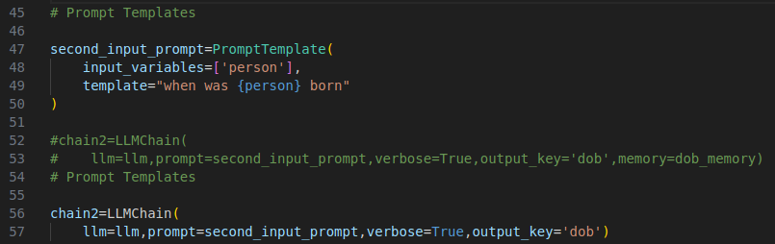
2.23 Second Input Prompt: Person
https://www.youtube.com/watch?v=_FpT1cwcSLg&list=PLZoTAELRMXVORE4VF7WQ_fAl0L1Gljtar&index=2
Second Input Prompt (28:31-29:30/43:22)
1. Second input prompt: Person (Person is Output from first link)
2. Load the Gemini Model
3. LLMChain: Second input prompt, output DOB (Date of Birth).

Slide 9
2.24 Simple Sequential Chain

Slide 10

2.24 Simple Sequential Chain
https://www.youtube.com/watch?v=_FpT1cwcSLg&list=PLZoTAELRMXVORE4VF7WQ_fAl0L1Gljtar&index=2
Simple Sequential Chain (29:31-30:00/43:22)
We use Sequential Chain to combine chain 1 and chain 2.

Slide 11
2.25 Display Output

Slide 12
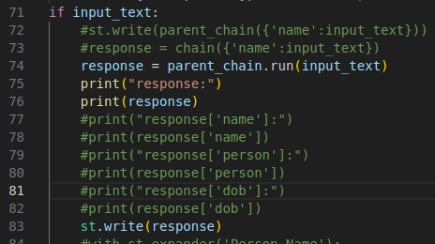
2.25 Display Output
https://www.youtube.com/watch?v=_FpT1cwcSLg&list=PLZoTAELRMXVORE4VF7WQ_fAl0L1Gljtar&index=2
Display Output (30:01-30:30/43:22)
Display Output

Slide 13
2.26 Test Simple Sequential Chain

Slide 14
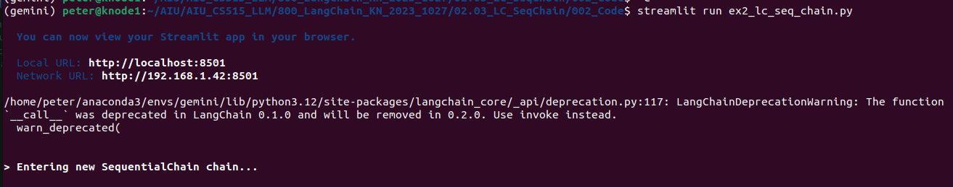
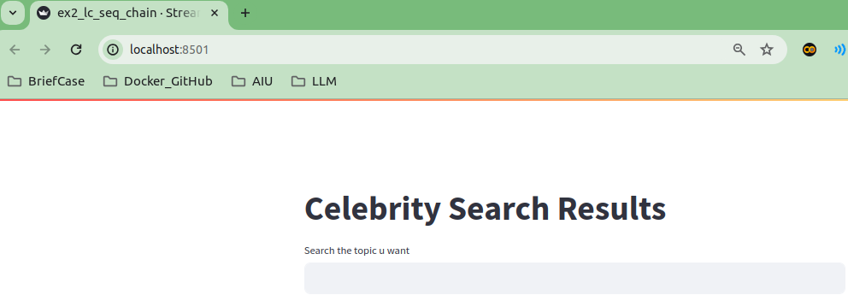
2.26 Test Sequential Chain
https://www.youtube.com/watch?v=_FpT1cwcSLg&list=PLZoTAELRMXVORE4VF7WQ_fAl0L1Gljtar&index=2
Test Sequential Chain (30:31-31:30/43:22)
> streamlit run ex3_simple_seq_chain.py

Slide 15
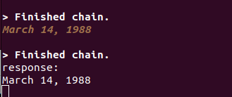
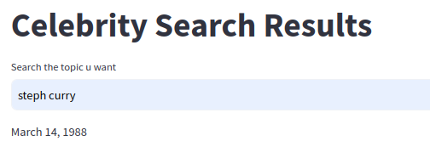
2.26 Test Sequential Chain
https://www.youtube.com/watch?v=_FpT1cwcSLg&list=PLZoTAELRMXVORE4VF7WQ_fAl0L1Gljtar&index=2
Test Sequential Chain (30:31-32:00/43:22)
Result

Slide 16
End

