Slide 1

2.27 Sequence Chain
Peter H. Chen

Slide 2
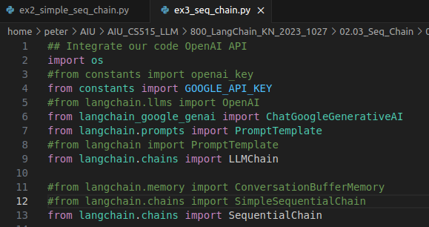
2.27 Sequential Chain
https://www.youtube.com/watch?v=_FpT1cwcSLg&list=PLZoTAELRMXVORE4VF7WQ_fAl0L1Gljtar&index=2
Sequential Chain (32:01-32:30/43:22)
Now, we change the simple sequential chain into sequential chain.
> code ex3_seq_chain.py
1. Replace SequentialChain for SimpleSequentialChain

Slide 3
2.28 Sequential Chain with Parameters

Slide 4
2.28 Sequential Chain with Parameters
https://www.youtube.com/watch?v=_FpT1cwcSLg&list=PLZoTAELRMXVORE4VF7WQ_fAl0L1Gljtar&index=2
Sequential Chain (32:31-33:00/43:22)
Use SequentialChain instead of SimpleSequentialChain
1. Specify input variable: name
2. output variables: person and DOB
SequentialChain has more variables than SimpleSequentialChain between the links.

Slide 5
2.29 Test Sequential Chain

Slide 6
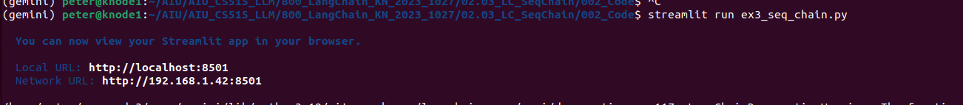
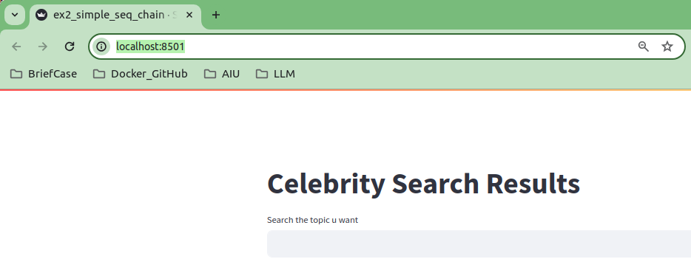
2.29 Test Sequential Chain
https://www.youtube.com/watch?v=_FpT1cwcSLg&list=PLZoTAELRMXVORE4VF7WQ_fAl0L1Gljtar&index=2
Test Sequential Chain (33:01-34:30/43:22)
> streamlit run ex4_seq_chain.py

Slide 7
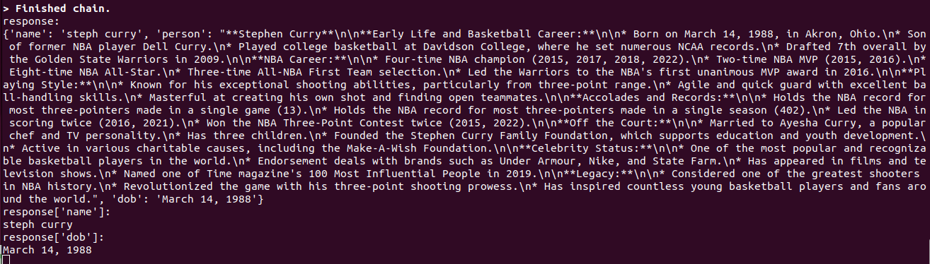
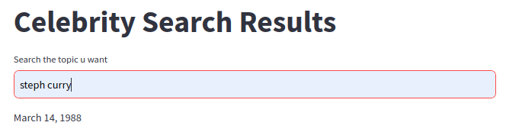
2.29 Test Sequential Chain
https://www.youtube.com/watch?v=_FpT1cwcSLg&list=PLZoTAELRMXVORE4VF7WQ_fAl0L1Gljtar&index=2
Test Sequential Chain (34:31-35:30/43:22)
> steph curry
Display Result

Slide 8
End

