Slide 1

2.30 Sequence Chain with Memory
Peter H. Chen

Slide 2
2.30 Sequential Chain with Memory
https://www.youtube.com/watch?v=_FpT1cwcSLg&list=PLZoTAELRMXVORE4VF7WQ_fAl0L1Gljtar&index=2
Sequential Chain with Memory (35:31-36:30/43:22)
Now, we discussed about the LangChain, Gemini, Sequential Chain, and Memory.

Slide 3
2.31 Conversation Buffer Memory

Slide 4
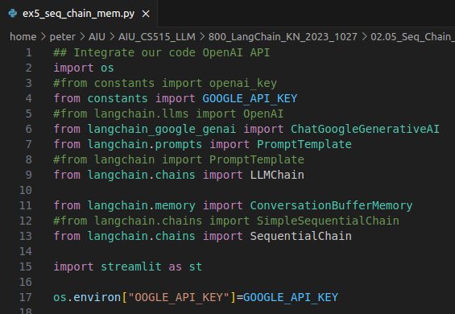
2.31 Conversation Buffer Memory
https://www.youtube.com/watch?v=_FpT1cwcSLg&list=PLZoTAELRMXVORE4VF7WQ_fAl0L1Gljtar&index=2
Conversation Buffer Memory (36:31-38:30/43:22)
Import Conversational Buffer Memory.

Slide 5
2.32 Add Third Chain

Slide 6
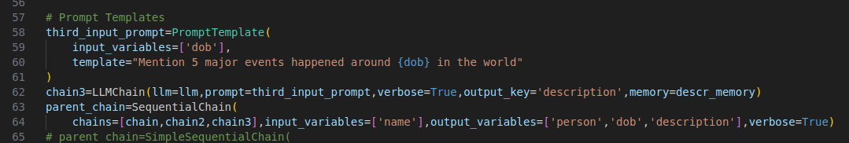
2.32 Add Third Chain
https://www.youtube.com/watch?v=_FpT1cwcSLg&list=PLZoTAELRMXVORE4VF7WQ_fAl0L1Gljtar&index=2
Add Third Chain (38:31-39:30/43:22)
Add some description in chain 3.

Slide 7
2.33 Sequential Chains: 1-3

Slide 8
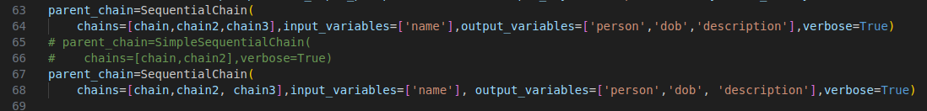
2.33 Sequential Chains: 1-3
https://www.youtube.com/watch?v=_FpT1cwcSLg&list=PLZoTAELRMXVORE4VF7WQ_fAl0L1Gljtar&index=2
Sequential Chains: 1-3 (39:31-40:30/43:22)
We sequentially chain 1 to 3.

Slide 9
2.34 Display Results of Chains 2 and 3

Slide 10
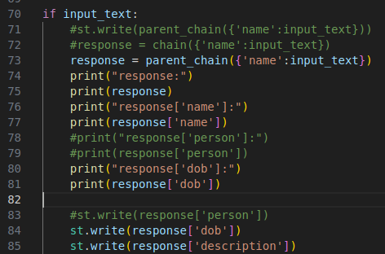
2.34 Display Result of Chains 2 and 3
https://www.youtube.com/watch?v=_FpT1cwcSLg&list=PLZoTAELRMXVORE4VF7WQ_fAl0L1Gljtar&index=2
Display Result of Chains 2 and 3 (40:31-41:30/43:22)
Chain 1: ‘person’ contains very detail information.
Chain 2: DOB
Chain 3: ‘Description’ contains short description.

Slide 11
2.30 Test Sequence Chain with Memory

Slide 12
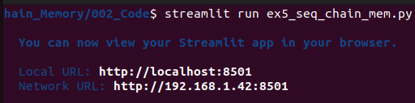
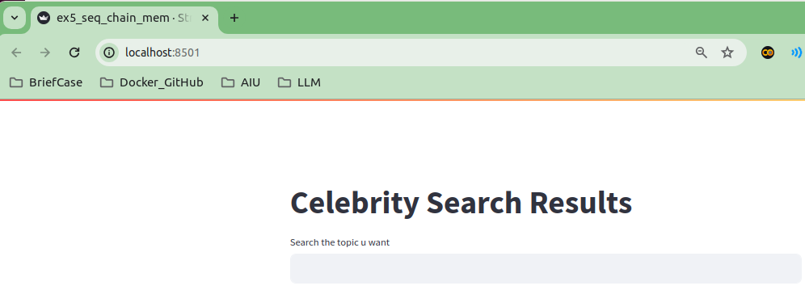
2.50 Test Sequential Chain with Memory
https://www.youtube.com/watch?v=_FpT1cwcSLg&list=PLZoTAELRMXVORE4VF7WQ_fAl0L1Gljtar&index=2
Test Sequential Chain with Memory (41:31-42:30/43:22)
> streamlit run ex5_seq_chain_mem.py

Slide 13
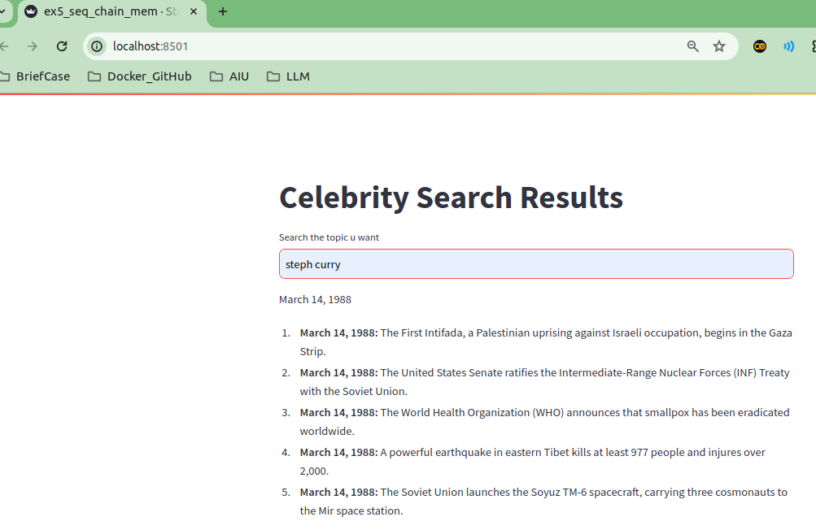
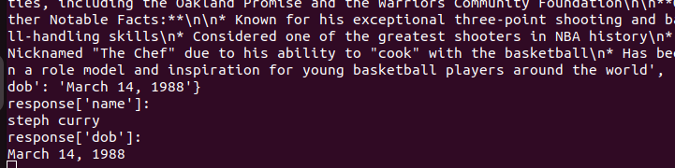
2.50 Test Sequential Chain with Memory
https://www.youtube.com/watch?v=_FpT1cwcSLg&list=PLZoTAELRMXVORE4VF7WQ_fAl0L1Gljtar&index=2
Test Sequential Chain with Memory (42:31-43:22/43:22)
> Steph Curry
Result

Slide 14
End

