Slide 1

15 Resume ATS
Peter H. Chen

Slide 2
15 Resume ATS
https://www.youtube.com/watch?v=EECUXqFrwbc&list=PLZoTAELRMXVNbDmGZlcgCA3a8mRQp5axb&index=9
Resume ATS (00:00-02:30/34:26)
We are going to create an “Resume ATS (Application Tracking System)” for resume using Gemini-pro.
Nowadays, companies use the ATS system to quality your resume.
It is important that your resumes are dynamic enough so that your resume can pass the ATS system.
We will provide a job description, then we will upload the resume.
Based on the job description, we will highlighted the key points and use key points to improve our resume.
We will build the resume in a very good way to match the job description.

Slide 3
15.01 Resume ATS Demo

Slide 4
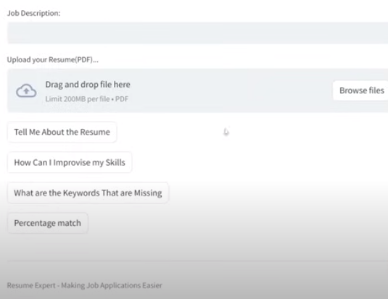
15.01 Resume ATS Demo
https://www.youtube.com/watch?v=EECUXqFrwbc&list=PLZoTAELRMXVNbDmGZlcgCA3a8mRQp5axb&index=9
Resume ATS Demo (02:31-02:40/34:26)
Here, is the resume application tracking system.
1. We input the job description.
2. Then, we upload the resume
3. Tell me about the resume
4. How to improve skill
5. What keywords are missing
6. Percentage match

Slide 5
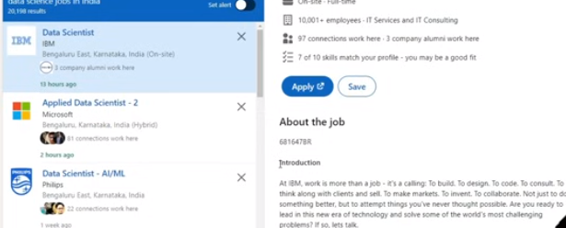
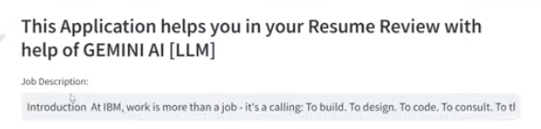
15.01 Resume ATS Demo
https://www.youtube.com/watch?v=EECUXqFrwbc&list=PLZoTAELRMXVNbDmGZlcgCA3a8mRQp5axb&index=9
Resume ATS Demo (02:41-02:50/34:26)
We copy ans paste the job description in the input.

Slide 6
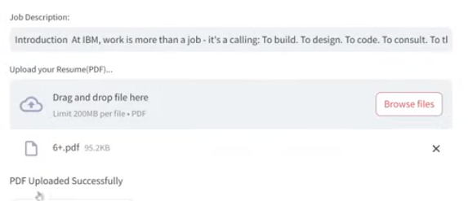
15.01 Resume ATS Demo
https://www.youtube.com/watch?v=EECUXqFrwbc&list=PLZoTAELRMXVNbDmGZlcgCA3a8mRQp5axb&index=9
Resume ATS Demo (02:51-03:30/34:26)
Upload the resume.

Slide 7
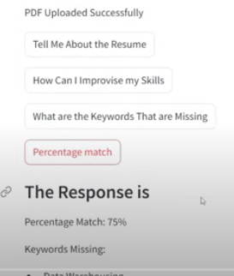
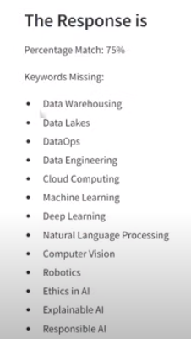

15.01 Resume ATS Demo
https://www.youtube.com/watch?v=EECUXqFrwbc&list=PLZoTAELRMXVNbDmGZlcgCA3a8mRQp5axb&index=9
Resume ATS Demo (03:31-04:10/34:26)
Percentage match 75%:
1. Data Warehousing,
2. Data Lakes,
3. DataOps,
4. Data Engineering,
5. Cloud Engineering,
6. Machine Learning,
7. Deep Learning,
8. Natural Language Processing,
9. Computer Vision,
10. Robotics,
11. Ethics in AI
12. Explainable AI
Final thoughts: Good match with job description...

Slide 8
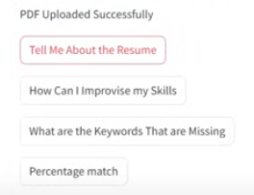
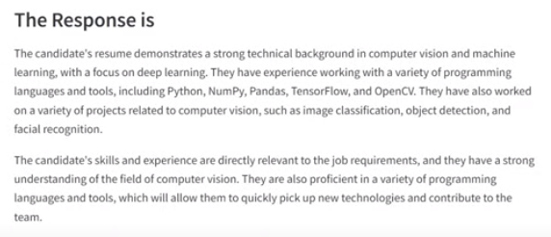
15.01 Resume ATS Demo
https://www.youtube.com/watch?v=EECUXqFrwbc&list=PLZoTAELRMXVNbDmGZlcgCA3a8mRQp5axb&index=9
Resume ATS Demo (04:11-04:20/34:26)
Tell me about the resume

Slide 9
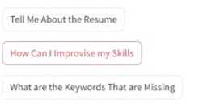
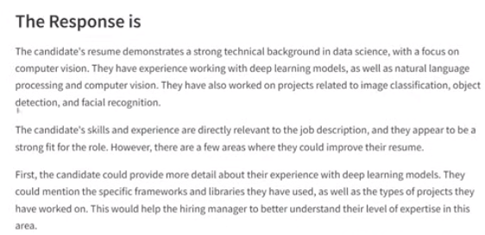
15.01 Resume ATS Demo
https://www.youtube.com/watch?v=EECUXqFrwbc&list=PLZoTAELRMXVNbDmGZlcgCA3a8mRQp5axb&index=9
Resume ATS Demo (04:31-04:50/34:26)
1. How to improve resume
2. What keywords are missing

Slide 10
End

