Slide 1

15.05 Load Environment Variable
Peter H. Chen

Slide 2
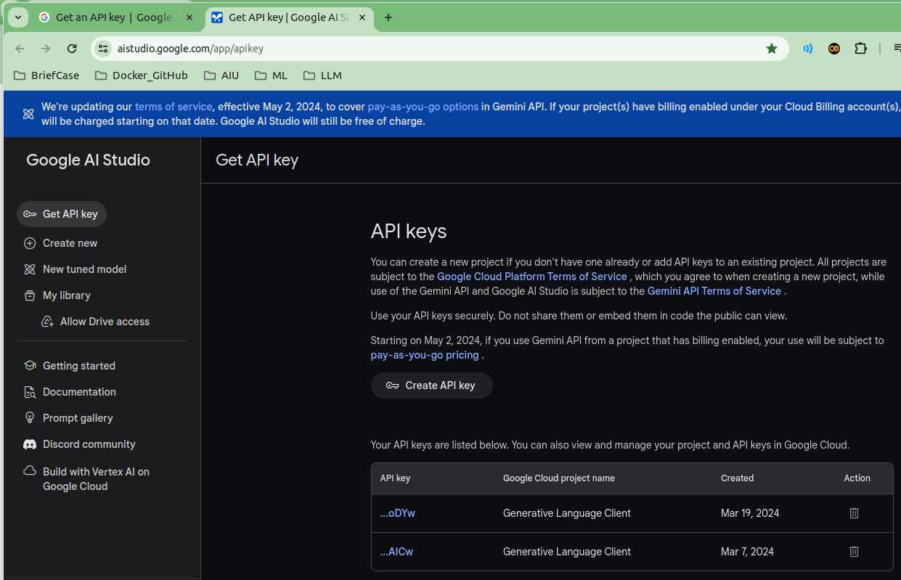
15.05 Load Environment Variable
https://www.youtube.com/watch?v=EECUXqFrwbc&list=PLZoTAELRMXVNbDmGZlcgCA3a8mRQp5axb&index=9
Load Environment (09:21-9:25/34:26)
Define GOOGLE_API_KEY in “.env” file

Slide 3
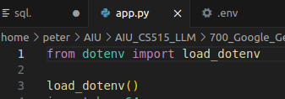
15.05 Load Environment Variable
https://www.youtube.com/watch?v=EECUXqFrwbc&list=PLZoTAELRMXVNbDmGZlcgCA3a8mRQp5axb&index=9
Load Environment (09:26-9:30/34:26)
Load Environment Variables: GOOGLE_API_KEY defined in “.env” file

Slide 4
15.06 Import Library

Slide 5
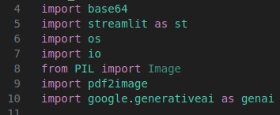
15.06 Import Library
https://www.youtube.com/watch?v=EECUXqFrwbc&list=PLZoTAELRMXVNbDmGZlcgCA3a8mRQp5axb&index=9
Import Library (09:31-10:00/34:26)
Import library:
1. base64: Data encoding from binary into ASCII Character for 64 bits
2. streamlit: GUI
3. os: get environment variable
5. io: Convert PDF into image (Byte format). The image is smaller byte format and fast for preview.
6. PIL: Python image library
7. pdf2image:
8. generative AI: Gemini Model

Slide 6
15.07 Configure Gemini

Slide 7
15.07 Configure Gemini
https://www.youtube.com/watch?v=EECUXqFrwbc&list=PLZoTAELRMXVNbDmGZlcgCA3a8mRQp5axb&index=9
Configure Gemini (10:01-12:10/34:26)
Configure Gemini with API Key.

Slide 8
15.08 Get Gemini Response

Slide 9
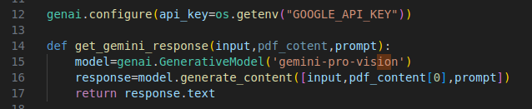
15.08 Get Gemini Response
https://www.youtube.com/watch?v=EECUXqFrwbc&list=PLZoTAELRMXVNbDmGZlcgCA3a8mRQp5axb&index=9
Get Gemini Response (12:11-14:10/34:26)
1. Define get_gemini_response function: Pass parameters (input, pdf_content, prompt).
2. Create model = GenerativeModel (‘gemini-pro-vision’): Convert the PDF into Image.
3. get response = model.generate_content ([input. pdf_content[0], prompt])
4. Prompt:
Prompt play very important role. Prompt define what is the model need to be doing.
5. Return response.txt

Slide 10
15.09 Load PDF into pdf_parts

Slide 11
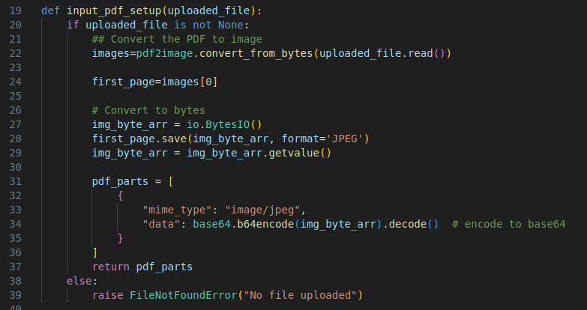
15.09 Load PDF into pdf_parts
https://www.youtube.com/watch?v=EECUXqFrwbc&list=PLZoTAELRMXVNbDmGZlcgCA3a8mRQp5axb&index=9
Load PDF into pdf_parts (14:11-18:00/34:26)
1. Define function:
2. Convert pdf into image
Why read PDF need to convert into image?
Converting a PDF to an image file gives you a smaller file size that's easier and faster to share previews or post online
3. Save image into byte format.
4. Read Image (in byte format)
5. Store pdf_parts data: Encode image byte data into MIME (Multi-purpose Internet Mail Extension) type.
6. Return pdf_parts.

Slide 12
15.10 Create GUI

Slide 13
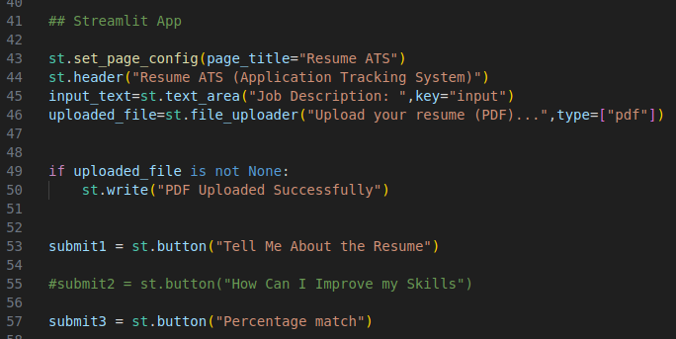
15.10 Create GUI
https://www.youtube.com/watch?v=EECUXqFrwbc&list=PLZoTAELRMXVNbDmGZlcgCA3a8mRQp5axb&index=9
Create GUI (18:01-21:10/34:26)
1. Page Title: ATS Resume Expert
2. Header: ATS Tracking System
3. Text input: “Job Description” input
4. PDF File overload: Here, we use PDF. We also can add “MS-Word”.
5. Display “Load Successfully” message
6. Create Buttons Submit1 (“Tell Me About the Resume”), Submit2 (“How Can Improve my Skills”), and Submit3 (Percentage match”).

Slide 14
15.11 Create Prompt

Slide 15
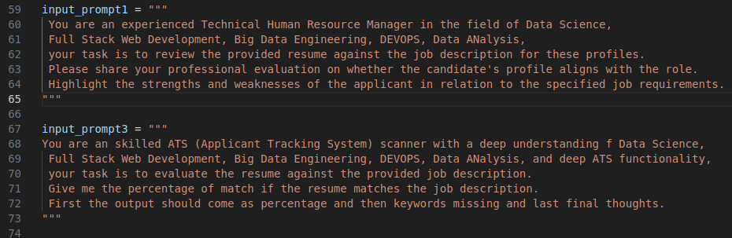
15.11 Create Prompt
https://www.youtube.com/watch?v=EECUXqFrwbc&list=PLZoTAELRMXVNbDmGZlcgCA3a8mRQp5axb&index=9
Create Prompt (21:11-24:50/34:26)
Create promtp1 and rompt3.
We remove prompt2 which is same as prompt1.

Slide 16
15.12 Process Submission

Slide 17
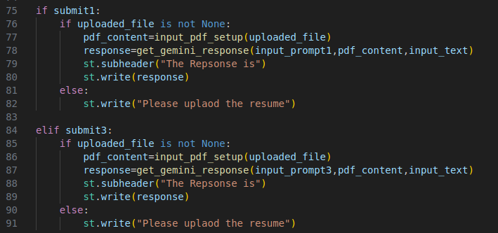
15.12 Process Submission
https://www.youtube.com/watch?v=EECUXqFrwbc&list=PLZoTAELRMXVNbDmGZlcgCA3a8mRQp5axb&index=9
Process Submission (24:51-27:50/34:26)
1. If submit1:
1.1 Upload file
1.2 Get gemini (input_promp1, pdf_content, input_text) response
1.3 Write response
2. If submit2:
2.1 Upload file
2.2 Get gemini (input_promp1, pdf_content, input_text) response
2.3 Write response

Slide 18
End

