Slide 1

5.04 Load Environment Variable
Peter H. Chen

Slide 2
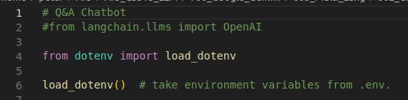
5.04 Load Environment Variable
https://www.youtube.com/watch?v=-ny5_RSMV6k&list=PLZoTAELRMXVNbDmGZlcgCA3a8mRQp5axb&index=5
Load Environment Variable (06:51-07:30/25:58)
Load Environment variables GOOGLE_API_KEY from hidden “.env” file.
1. load_dotenv: load all the environment variables in “.env” file.
load_dotenv()

Slide 3
5.05 Import Libraries

Slide 4
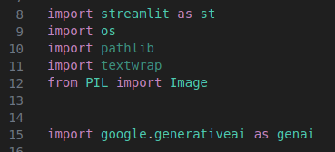
5.05 Import Libraries
https://www.youtube.com/watch?v=-ny5_RSMV6k&list=PLZoTAELRMXVNbDmGZlcgCA3a8mRQp5axb&index=5
Import Libraries (06:51-09:30/25:58)
Import Libraries:
1. streamlit: libraries for GUI creation
2. os: assign and process environment variable of operating system
3. pathlib: path processing
4. textwrap: text wrapper
5. from PIL import Image: Python image library.
6. Google generative AI: Google Gemini Model

Slide 5
5.06 Setup API Key for Gemini

Slide 6

5.06 Setup API Key for Gemini
https://www.youtube.com/watch?v=-ny5_RSMV6k&list=PLZoTAELRMXVNbDmGZlcgCA3a8mRQp5axb&index=5
Setup API Key for Gemini (09:31-09:50/25:58)
Setup Google API Key for Gemini AI Model.

Slide 7
End

