Slide 1

5.12 Test MLIE
Peter H. Chen

Slide 2
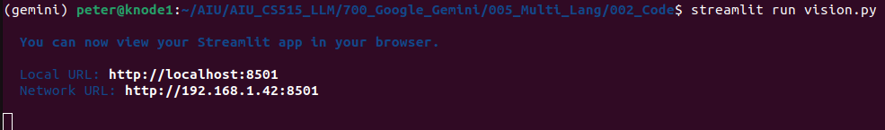
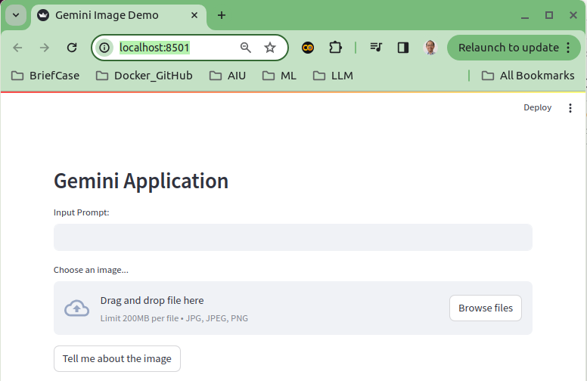
5.12 Test MLIE
https://www.youtube.com/watch?v=-ny5_RSMV6k&list=PLZoTAELRMXVNbDmGZlcgCA3a8mRQp5axb&index=5
Test MLIE (Multi-Language Invoice Extractor) (21:11-21:20/25:58)
Test MLIE (Multi-Language Invoice Extractor):
1. > streamlit run vision.py

Slide 3
5.13 Test Taiwan Invoice

Slide 4
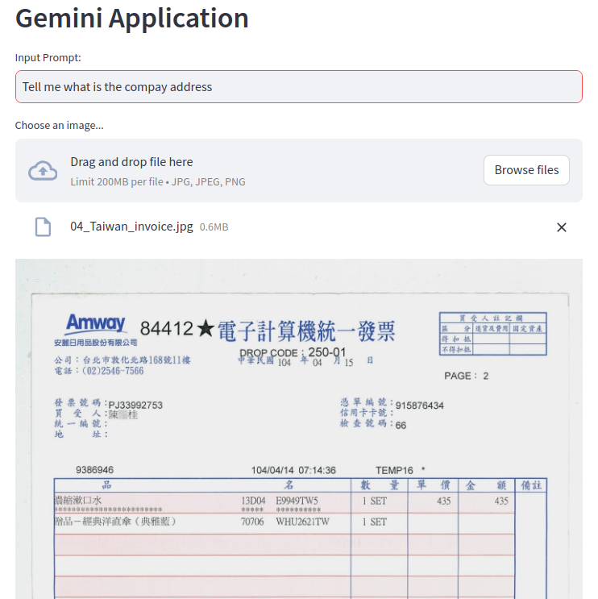
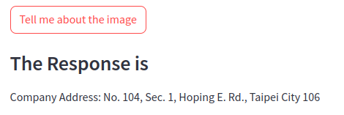
5.13 Test Taiwan Invoice
https://www.youtube.com/watch?v=-ny5_RSMV6k&list=PLZoTAELRMXVNbDmGZlcgCA3a8mRQp5axb&index=5
Test Taiwan Invoice (21:21-21:30/25:58)
Input: What is the company name?

Slide 5
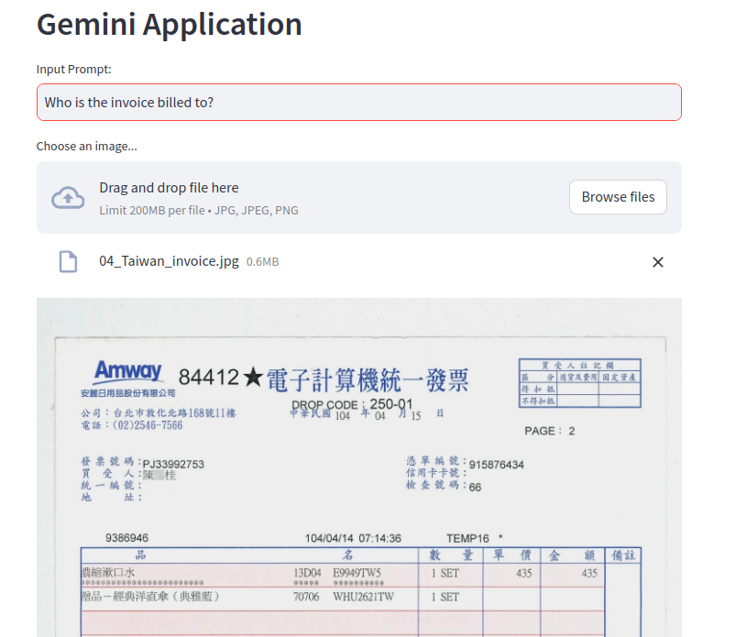
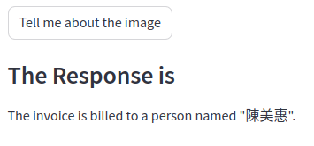
5.13 Test Taiwan Invoice
https://www.youtube.com/watch?v=-ny5_RSMV6k&list=PLZoTAELRMXVNbDmGZlcgCA3a8mRQp5axb&index=5
Test Taiwan Invoice (21:31-21:50/25:58)
Who is the invoice billed to?

Slide 6
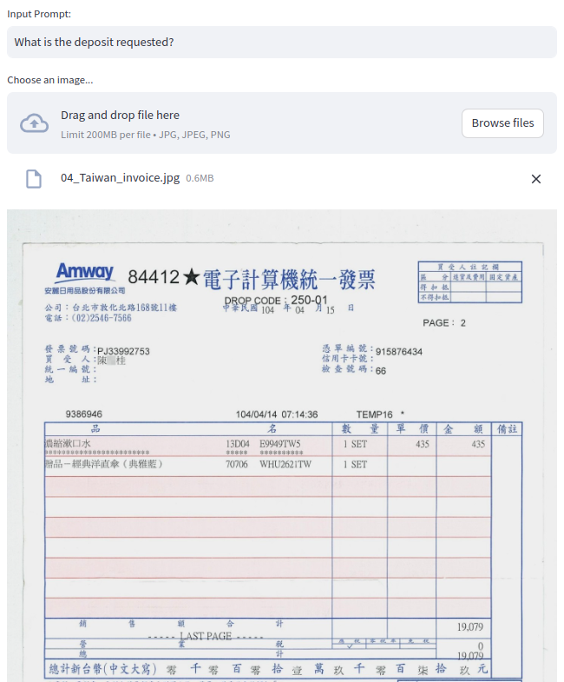
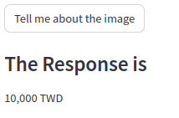
5.13 Test Taiwan Invoice
https://www.youtube.com/watch?v=-ny5_RSMV6k&list=PLZoTAELRMXVNbDmGZlcgCA3a8mRQp5axb&index=5
Test Taiwan Invoice (21:31-21:50/25:58)
What is the deposit requested?

Slide 7
5.14 Test Japan Invoice

Slide 8
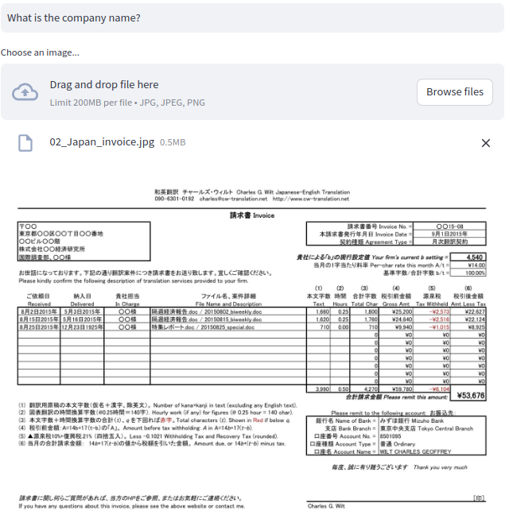
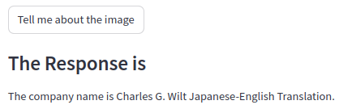
5.14 Test Japan Invoice
https://www.youtube.com/watch?v=-ny5_RSMV6k&list=PLZoTAELRMXVNbDmGZlcgCA3a8mRQp5axb&index=5
Test Japan Invoice (21:51-22:30/25:58)
What is company name?

Slide 9
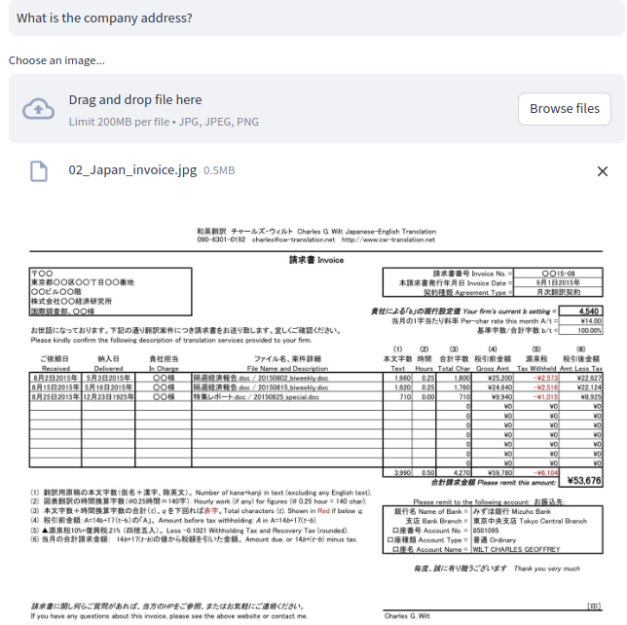

5.14 Test Japan Invoice
https://www.youtube.com/watch?v=-ny5_RSMV6k&list=PLZoTAELRMXVNbDmGZlcgCA3a8mRQp5axb&index=5
Test Japan Invoice (22:31-23:30/25:58)
What is company address?

Slide 10
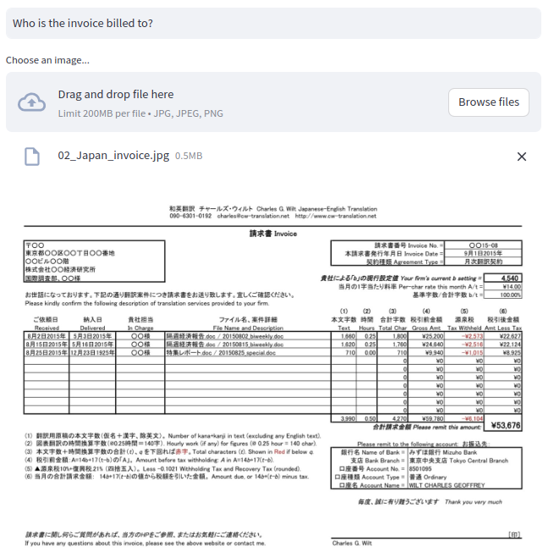

5.14 Test Japan Invoice
https://www.youtube.com/watch?v=-ny5_RSMV6k&list=PLZoTAELRMXVNbDmGZlcgCA3a8mRQp5axb&index=5
Test Japan Invoice (23:31-24:30/25:58)
Who is the invoice billed to?

Slide 11

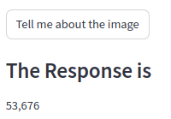
5.14 Test Japan Invoice
https://www.youtube.com/watch?v=-ny5_RSMV6k&list=PLZoTAELRMXVNbDmGZlcgCA3a8mRQp5axb&index=5
Test Japan Invoice (24:31-25:30/25:58)
How much of the deposit request?

Slide 12
5.15 Test India Invoice

Slide 13
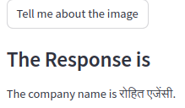
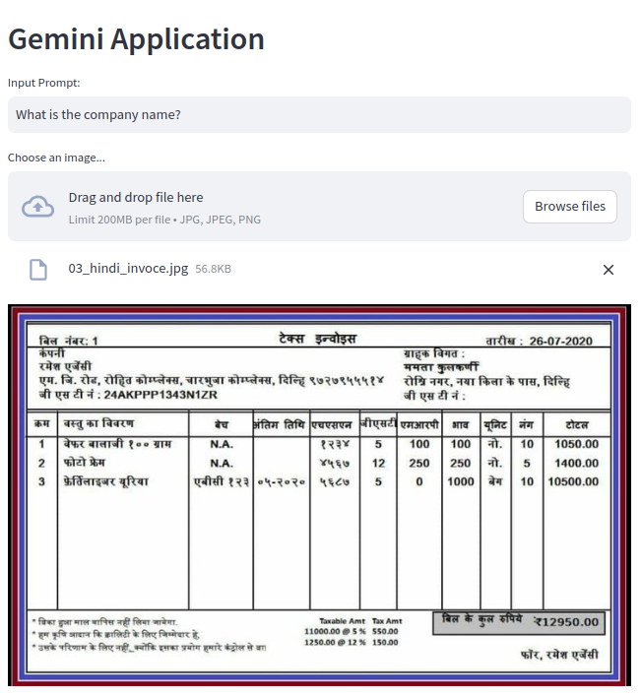
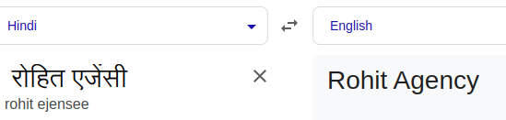
5.15 Test India Invoice
https://www.youtube.com/watch?v=-ny5_RSMV6k&list=PLZoTAELRMXVNbDmGZlcgCA3a8mRQp5axb&index=5
Test India Invoice (25:31-25:40/25:58)
What is company name? रोहित एजेंसी

Slide 14
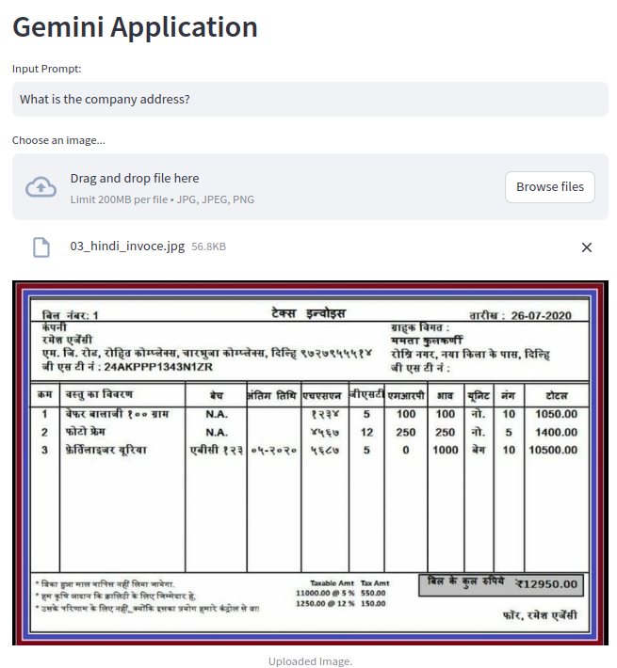

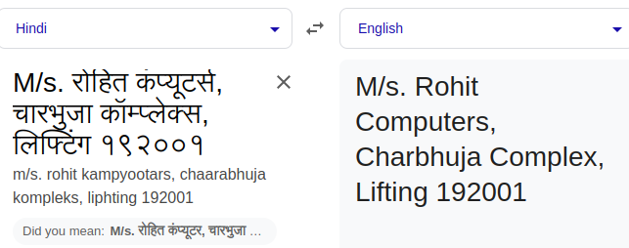
5.15 Test India Invoice
https://www.youtube.com/watch?v=-ny5_RSMV6k&list=PLZoTAELRMXVNbDmGZlcgCA3a8mRQp5axb&index=5
Test India Invoice (25:41-25:50/25:58)
What is company address?
M/s. रोहित कंप्यूटर्स, चारभुजा कॉम्प्लेक्स, लिफ्टिंग १९२००१

Slide 15
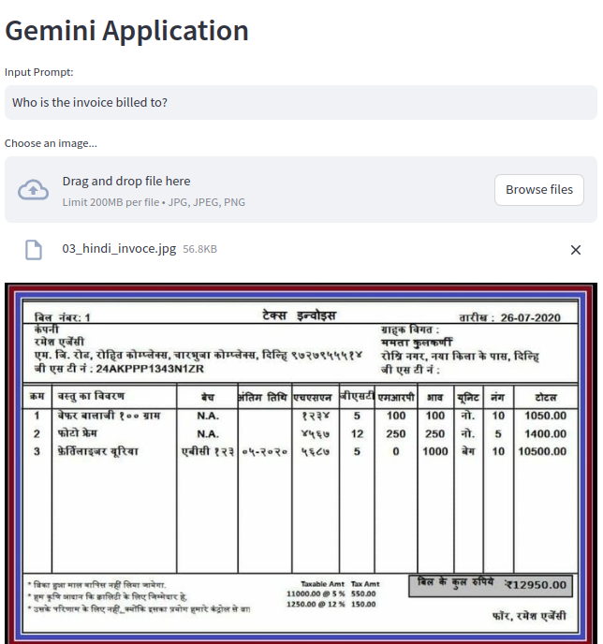
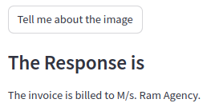
5.15 Test India Invoice
https://www.youtube.com/watch?v=-ny5_RSMV6k&list=PLZoTAELRMXVNbDmGZlcgCA3a8mRQp5axb&index=5
Test India Invoice (25:51-25:58/25:58)
Who is the invoice billed to?

Slide 16
5.15 Test India Invoice
https://www.youtube.com/watch?v=-ny5_RSMV6k&list=PLZoTAELRMXVNbDmGZlcgCA3a8mRQp5axb&index=5
Test India Invoice (24:31-25:30/25:58)
How much of the deposit request?

Slide 17
End

