Slide 1

10 LC Text Summarization
Peter H. Chen

Slide 2
10 LC Text Summarization
https://www.youtube.com/watch?v=o11J4oO-P28&list=PLZoTAELRMXVORE4VF7WQ_fAl0L1Gljtar&index=10
Text Summarization (00:00-02:00/33:29)
We discussed various ways of summarization.
We will use 5 different ways of text summarization and create different projects.
We use LangChain to solve various business use cases.
We will focus on LLM Gemini Model. We will get more accurate results.
Companies have huge PDFs documents and text summarization can play a very important role in solving various use cases.

Slide 3
10.00 Google API Key

Slide 4
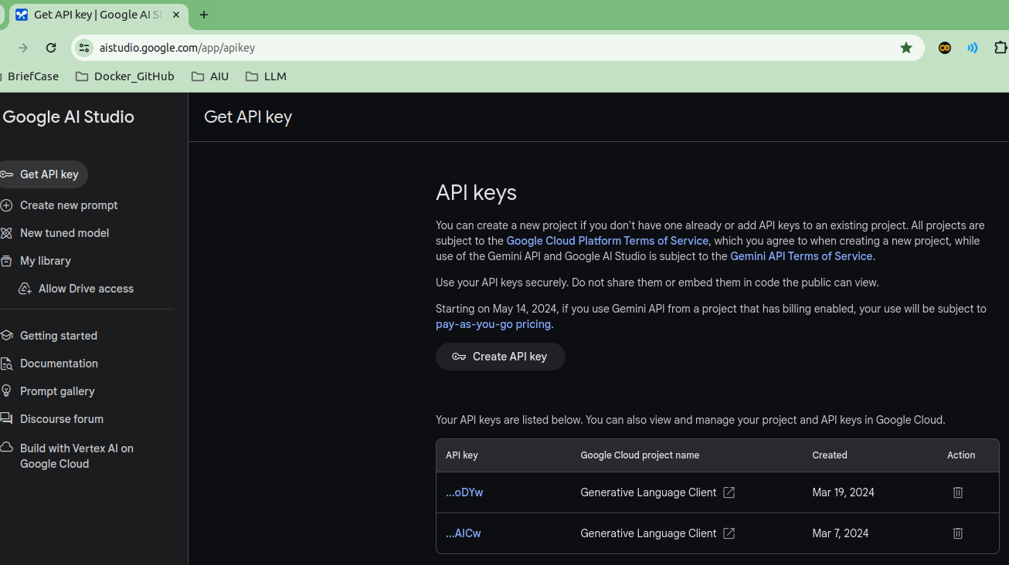
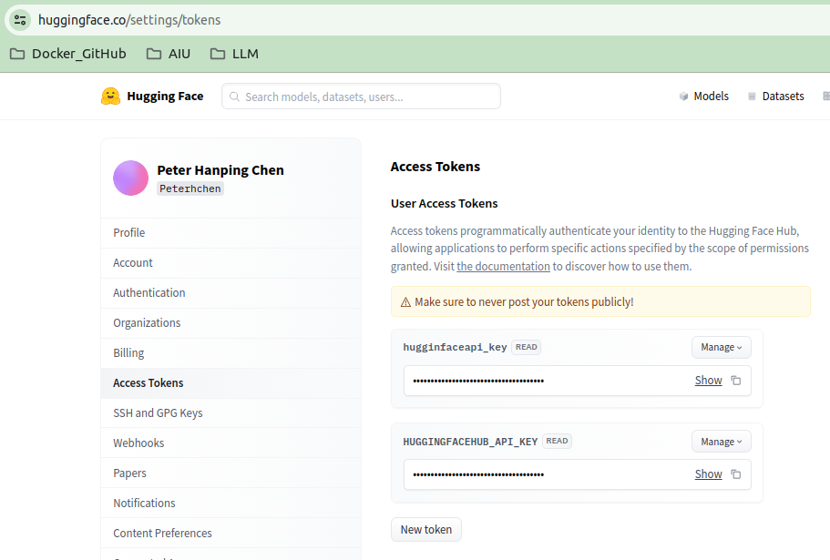
10.01 Google API Key
https://www.youtube.com/watch?v=o11J4oO-P28&list=PLZoTAELRMXVORE4VF7WQ_fAl0L1Gljtar&index=10
Google API Key (02:01-02:05/33:29)
First step is to get the API Key.
Below,
1. We can get Google API Key.
https://aistudio.google.com/app/apikey
2. We get HuggingFace API Key.
https://huggingface.co/settings/tokens

Slide 5
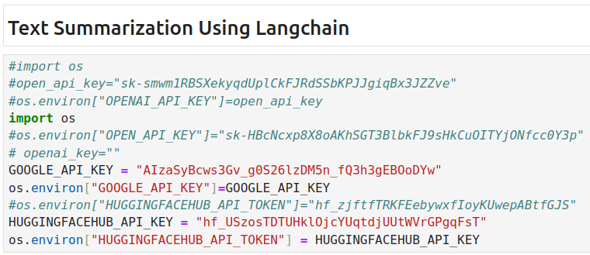
10.00 Google API Key
https://www.youtube.com/watch?v=o11J4oO-P28&list=PLZoTAELRMXVORE4VF7WQ_fAl0L1Gljtar&index=10
Google API Key (02:06-02:40/33:29)
Copy the Google API Key and HuggingFace API Key for your application.
When we create google API Key, the same key can be used in different techniques of text summarization.
LangChain have different functionalities to do the things with respect to text summarization.
These keys will be used in LLM Models and HuggingFace Host/LangChain Tools.

Slide 6
End

