Slide 1

10.01 Basic Prompt Summarization
Peter H. Chen

Slide 2
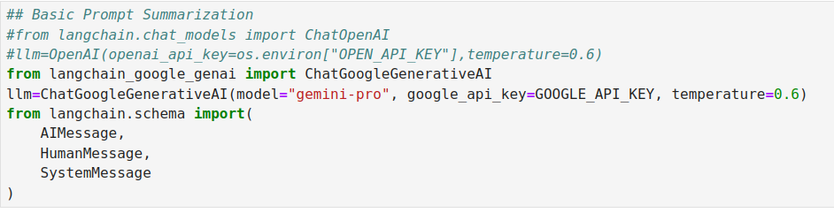
10.01 Basic Prompt Summarization
https://www.youtube.com/watch?v=o11J4oO-P28&list=PLZoTAELRMXVORE4VF7WQ_fAl0L1Gljtar&index=10
Basic Prompt Summarization (02:41-03:00/33:29)
To do the text summarization, we start with Basic Prompt Summarization.
LangChain Schema defines three basic prompt packages:
1. HumanMessage: User input message
2. SystemMessage: System Message for LangChain Tool
3. AIMessage: AI Message for Output from LLM (Google Gemini, Meta Llama, or OpenAI).
We give some prompt and then we do the entire text summarization of any kind of user input data.
Here, Human Message is any kind of message that a user input to LLM Model.
AI Message is the response of LLM Model.
The System Message is the initial message that specified in in the chatbot application, for example, we want to the chatBot like a Poet, lawyers, etc. The system message defines the main function of chatbot. So, if we define the chatbot like a poet, then chatbot will always return the Poem based on the user request.

Slide 3
End

