Slide 1

10.02 Speech Summarization
Peter H. Chen

Slide 2
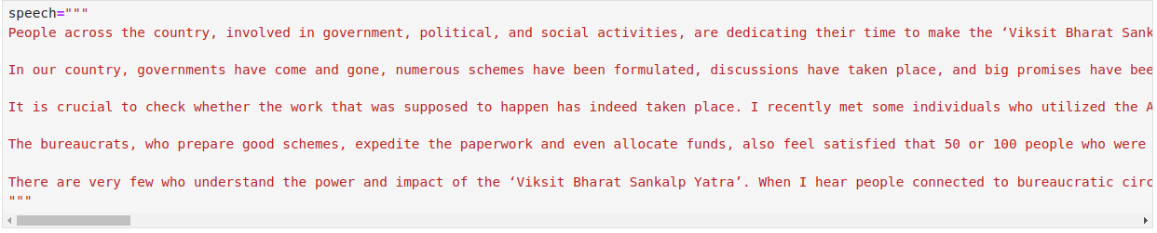
10.02 Speech Summarization
https://www.youtube.com/watch?v=o11J4oO-P28&list=PLZoTAELRMXVORE4VF7WQ_fAl0L1Gljtar&index=10
Speech Summarization (03:01-04:30/33:29)
Below is a speech. We want the chatBot to summarized for us.
How to tell chatBot with SystemMessage and HumanMessage?

Slide 3
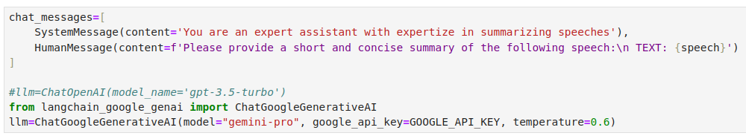
10.02 Speech Summarization
https://www.youtube.com/watch?v=o11J4oO-P28&list=PLZoTAELRMXVORE4VF7WQ_fAl0L1Gljtar&index=10
Speech Summarization (04:31-05:30/33:29)
First, we define the chat_message and put the {speech} into the HumanMessage.
We define a
chat_message = {
SystemMessage: “You are an export assistant for summarization …”
HumanMessage: “Please summarize for the {speech}”
}
We load llm with LangChain function ChatGoogleGenerativeAI (model =”gemini-pro”, GOOGLE_API_KEY, temperature default = 0.6). The 0.6 is default parameter for how creative/random of chatBot.

Slide 4

10.02 Speech Summarization
https://www.youtube.com/watch?v=o11J4oO-P28&list=PLZoTAELRMXVORE4VF7WQ_fAl0L1Gljtar&index=10
Speech Summarization (05:31-06:30/33:29)
We have very long speech with 853 tokens (words) (speech = “”” …very long speech… ”””).
Our president is very busy.
We need a standard to do the summarization of the parliament speech.

Slide 5
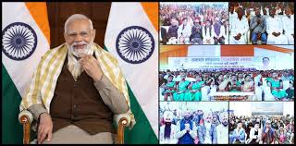
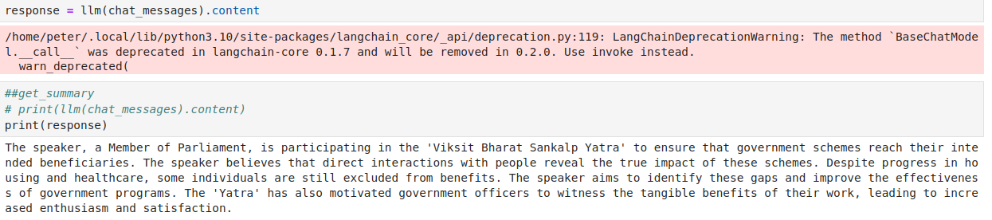
10.02 Speech Summarization
https://www.youtube.com/watch?v=o11J4oO-P28&list=PLZoTAELRMXVORE4VF7WQ_fAl0L1Gljtar&index=10
Speech Summarization (06:31-08:30/33:29)
We have
response = llm (chat_messages).content.
1. The speaker, a Member of Parliament, is participating in the 'Viksit Bharat Sankalp Yatra' to ensure that government schemes reach their intended beneficiaries.
2. The speaker believes that direct interactions with people reveal the true impact of these schemes.
3. Despite progress in housing and healthcare, some individuals are still excluded from benefits.
4. The speaker aims to identify these gaps and improve the effectiveness of government programs.
5. The 'Yatra' has also motivated government officers to witness the tangible benefits of their work, leading to increased enthusiasm and satisfaction.

Slide 6

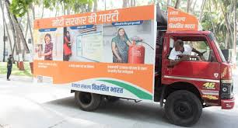

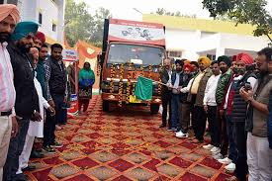
10.02 Speech Summarization
https://www.youtube.com/watch?v=o11J4oO-P28&list=PLZoTAELRMXVORE4VF7WQ_fAl0L1Gljtar&index=10
Speech Summarization (06:31-09:40/33:29)
Note:
1. This is a Speech in Parliament (議会).
2. What is “Viksit Bharat Sankalp Yatra”?
Answer: Viksit (Advanced) Bharat (India) Sankalp (resolution) Yatra (Trip): Advanced India Resolution Trip for benefit and insurance.
“Viksit Bharat Sankalp Yatra” focuses on government benefits and make sure “reach citizens across India”. India people have faith that president Modi guarantee of fulfillment.

Slide 7
End

