Slide 1

10.06 Map Reduce W/ Custom Prompt Text Summarization
Peter H. Chen

Slide 2
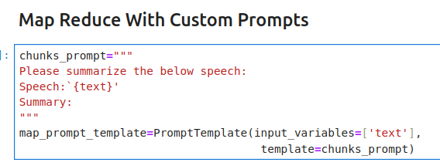
10.06 Map Reduce W/ Custom Prompt Text Summarization
https://www.youtube.com/watch?v=o11J4oO-P28&list=PLZoTAELRMXVORE4VF7WQ_fAl0L1Gljtar&index=10
Map Reduce with Custom Prompt Text Summarization (29:21-30:10/33:29)
We define a map reduce chunks prompt

Slide 3
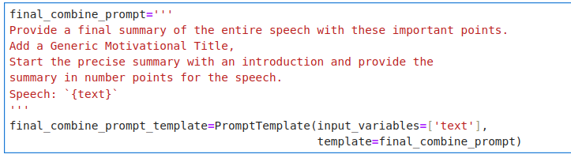
10.06 Map Reduce W/ Custom Prompt Text Summarization
https://www.youtube.com/watch?v=o11J4oO-P28&list=PLZoTAELRMXVORE4VF7WQ_fAl0L1Gljtar&index=10
Map Reduce with Custom Prompt Text Summarization (29:21-30:10/33:29)
We define the final summary combine prompt

Slide 4
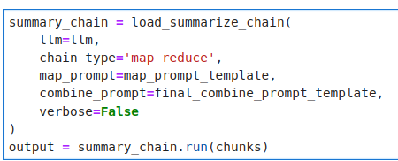
10.06 Map Reduce W/ Custom Prompt Text Summarization
https://www.youtube.com/watch?v=o11J4oO-P28&list=PLZoTAELRMXVORE4VF7WQ_fAl0L1Gljtar&index=10
Map Reduce with Custom Prompt Text Summarization (29:21-30:10/33:29)
We use 2 prompt together:
1. map reduce prompt
2. final summary with combined chunk.

Slide 5
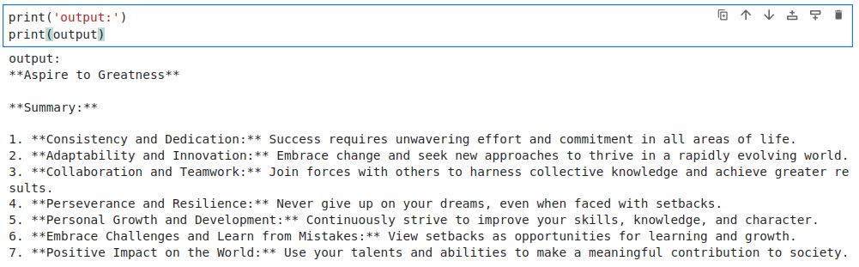
10.06 Map Reduce W/ Custom Prompt Text Summarization
https://www.youtube.com/watch?v=o11J4oO-P28&list=PLZoTAELRMXVORE4VF7WQ_fAl0L1Gljtar&index=10
Map Reduce with Custom Prompt Text Summarization (29:21-31:30/33:29)
We use 2 prompt together:
1. Map reduce prompt
2. Final summary with combined chunk.

Slide 6
End

