Slide 1

3 Combinational Logic
Peter H. Chen

Slide 2
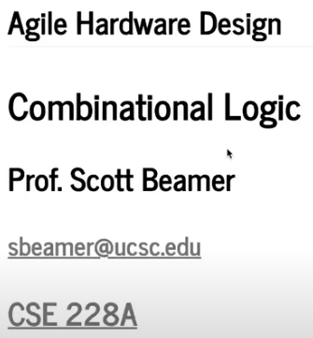
3 Combinational Logic
https://www.youtube.com/watch?v=BpJ21q-reFU&list=PLfrN7RIcMe6g2LBRJLTHTdhyj5s8ag0Rg&index=3
Combinational Logic (0:00-0:34/1:03:50)
We discuss Chisel Combinational Logic.
Topics:
1. Setup: jupyter notebook, select scala, and run cells
2. Import Chisel Library
3. Mux: select two-inputs for output
4. Scala Class: class, inheritance, parameters, instance, object, keyword val, function overloaded.
5. Mux with parameter width
6. Scala logic control: if/else.
7. Chisel frontend: Scala programming and Scala Compilation
8. Chisel backend: Run Chisel, Chisel Library, Generator, ASIC Verilog/FPGA Verilog, Simulation/Verification.
9. Scala/Software Reference and Chisel/Hardware Object
10. Chisel Wire: Connect the Chisel/Hardware Object together.
11. Chisel logic control: when/.otherwise/.elsewhen.
12. Chisel Last Connect/Example
13. Chisel Bitwidth Truncation
14. 2’complement: Implement with Scala and verified Hardware.
15. Sign Bit Extension: Implement with Scala Fill and Concatenation and verified Hardware.

Slide 3
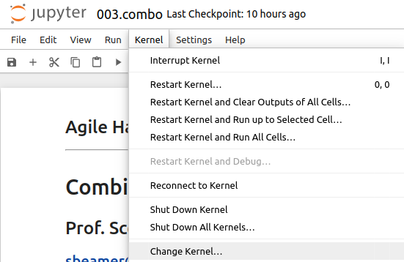
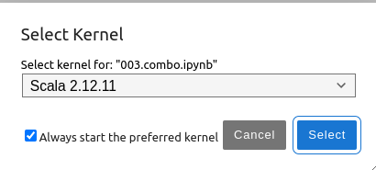
3 Combinational Logic
https://www.youtube.com/watch?v=BpJ21q-reFU&list=PLfrN7RIcMe6g2LBRJLTHTdhyj5s8ag0Rg&index=3
Combinational Logic (0:00-0:34/1:03:50)
We discuss Chisel Combinational Logic.
> jupyter notebook 003.combo.ipynb > Kernel > Change Kernel … > Select Scala2.21.22
> Run All Cells

Slide 4
3.1 Plan

Slide 5
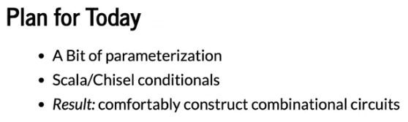
3.1 Plan
https://www.youtube.com/watch?v=BpJ21q-reFU&list=PLfrN7RIcMe6g2LBRJLTHTdhyj5s8ag0Rg&index=3
Plan (0:36-1:25/1:03:50)

Slide 6
3.2 Import Chisel Library

Slide 7
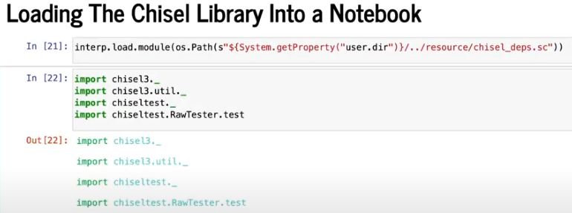
3.2 Import Chisel Library
https://www.youtube.com/watch?v=BpJ21q-reFU&list=PLfrN7RIcMe6g2LBRJLTHTdhyj5s8ag0Rg&index=3
Import Chisel Library (1:26-1:29/1:03:50)

Slide 8
3.3 Chisel Mux

Slide 9
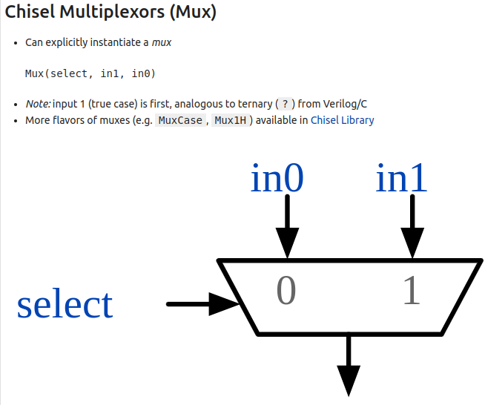
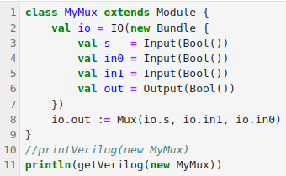
3.3 Chisel Mux
https://www.youtube.com/watch?v=BpJ21q-reFU&list=PLfrN7RIcMe6g2LBRJLTHTdhyj5s8ag0Rg&index=3
Chisel Mux (1:30-4:45/1:03:50)
We write Scala code:
1. We inherit Module Library to create Mux function.
2. Then, we use Scala code to generate the Verilog.

Slide 10
3.4 Scala Class

Slide 11
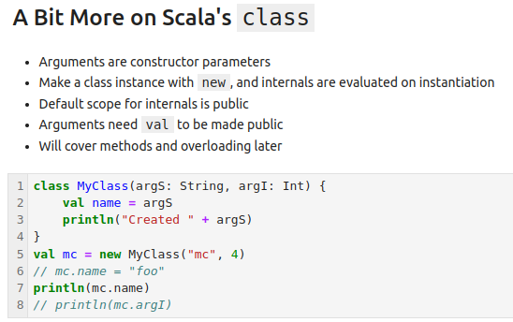
3.4 Scala Class
https://www.youtube.com/watch?v=BpJ21q-reFU&list=PLfrN7RIcMe6g2LBRJLTHTdhyj5s8ag0Rg&index=3
Scala Class (4:46-9:28/1:03:50)
1. class MyMux are inhibited from class Module. Arguments are constructor Parameters.
2. Create instance with new operator.
3. Default object is public
4. Arguments are made public with keyword val.
5. Functions (Modules/Methods) are dynamic overloaded.
6. We can change something and play around.

Slide 12
3.5 Width Parameter

Slide 13
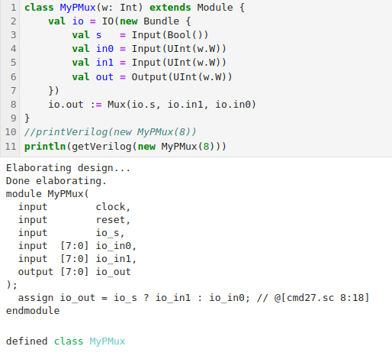
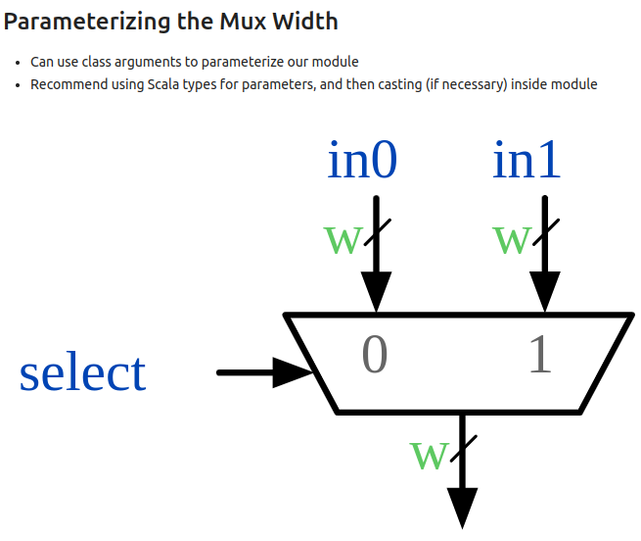
3.5 Width Parameter
https://www.youtube.com/watch?v=BpJ21q-reFU&list=PLfrN7RIcMe6g2LBRJLTHTdhyj5s8ag0Rg&index=3
Width Parameter (9:29-12:35/1:03:50)
1. We pass width parameter.
2. We use class arguments for parameters of function (module).
3. We use Scala type for parameters and then casting with Chisel type.
4. Below, we add the requirement for width if we need.
> require (w >= 0)
5. We pass in width = 8 and use Generator to print the Verilog code:
> println(getVerilog (new MyPMux (8))

Slide 14
3.6 Scala if/else

Slide 15
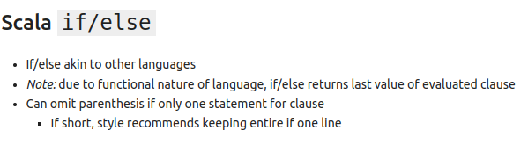
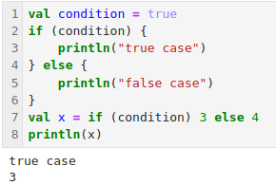
3.6 Scala if/else
https://www.youtube.com/watch?v=BpJ21q-reFU&list=PLfrN7RIcMe6g2LBRJLTHTdhyj5s8ag0Rg&index=3
Scala if/else (12:36-14:44/1:03:50)
1. We have if/else conditional for Scala.
2. The last line is the return value.

Slide 16
3.7 Scala if/else

Slide 17
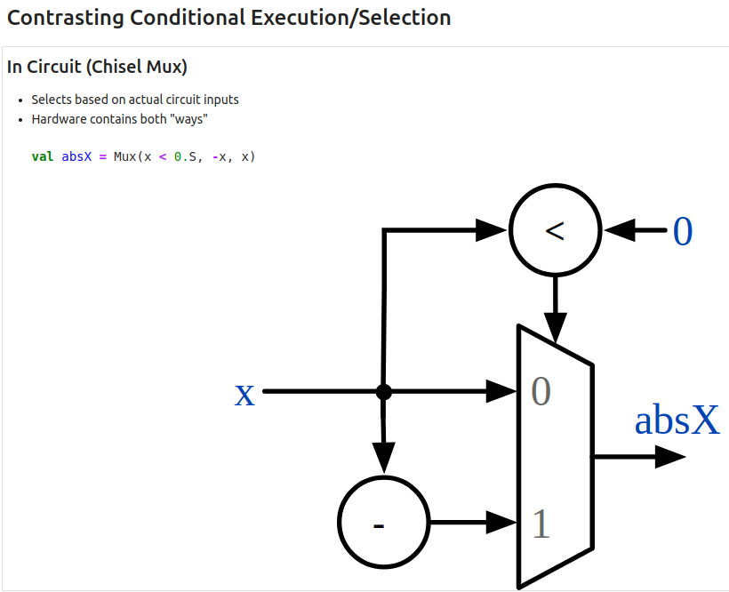
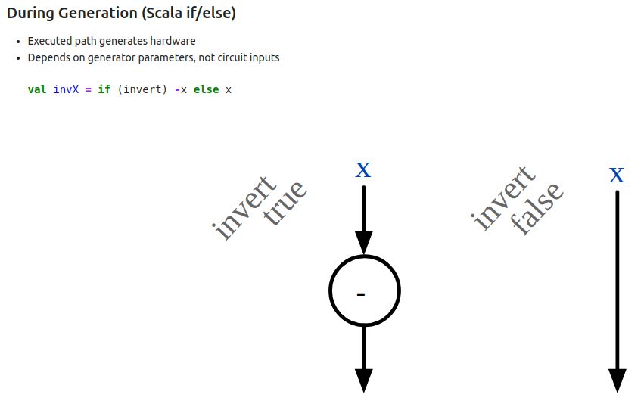
3.6 Scala if/else
https://www.youtube.com/watch?v=BpJ21q-reFU&list=PLfrN7RIcMe6g2LBRJLTHTdhyj5s8ag0Rg&index=3
Scala if/else (14:45-20:13/1:03:50)
In software, it is simple to do the value conversion, such as, absolute value. We write logic in Scala.
How to do the value conversion in hardware?
The Chisel generator converts the Scala software if/else logic into hardware.

Slide 18
3.8 Chisel Frontend

Slide 19
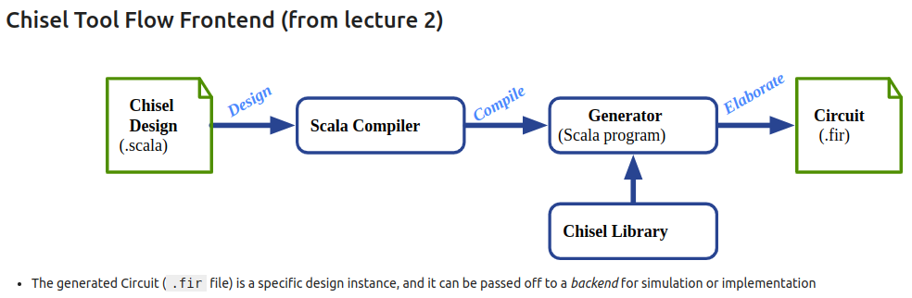
3.8 Chisel Frontend
https://www.youtube.com/watch?v=BpJ21q-reFU&list=PLfrN7RIcMe6g2LBRJLTHTdhyj5s8ag0Rg&index=3
Chisel Frontend (20:14-21:55/1:03:50)
1. We write design in Scala.
2. We compile the Scala in Jupyter Notebook.
3. Below, we generate the Verilog Code with the Chisel Library. The generator is in JVM (Java Virtual Machine) environment.
4. The result of execution, the FIRRTL file (.fir) is generated. The FIRRTL file is a hardware circuit.
5. The hardware circuit is a concrete instance. There is no more parameters, no more ambiguity, no more execution. Every line in the FIRRTL file is describing an exact piece of hardware. Then, we pass this file for ASIC manufacture or FPGA Verilog.
6. For example, SiFive is the largest users of Chisel. Even though Chisel change a lot in the release. The FIRRTL to generate the hardware is never change.

Slide 20
3.9 Run Chisel

Slide 21
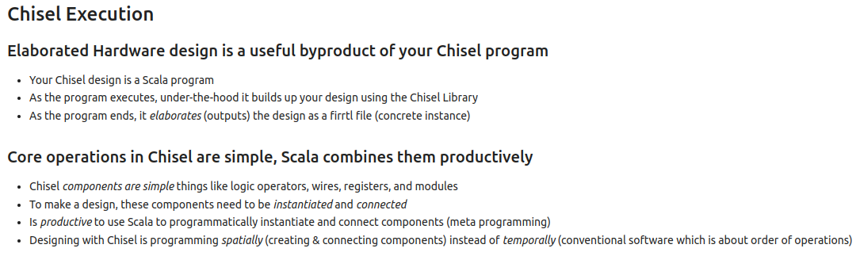
3.9 Run Chisel
https://www.youtube.com/watch?v=BpJ21q-reFU&list=PLfrN7RIcMe6g2LBRJLTHTdhyj5s8ag0Rg&index=3
Run Chisel (21:56-26:29/1:03:50)
1. Elaborate Hardware:
  a. Write code in Scala,
  b. build design by Chisel Library,
  c. the elaborated output the FIRRTL file.
2. Chisel is simple
  a. Logic in Scala are simple and convert into the Chisel Components
  b. Connect all components together.
  c. Increase Productivity.
  d. We just need to connect the hardware components with software functions.

Slide 22
3.10 Scala Reference vs. Chisel Object

Slide 23
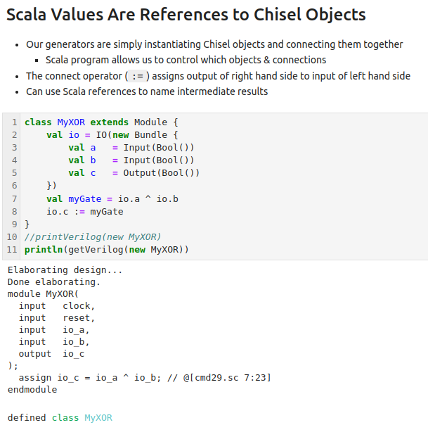
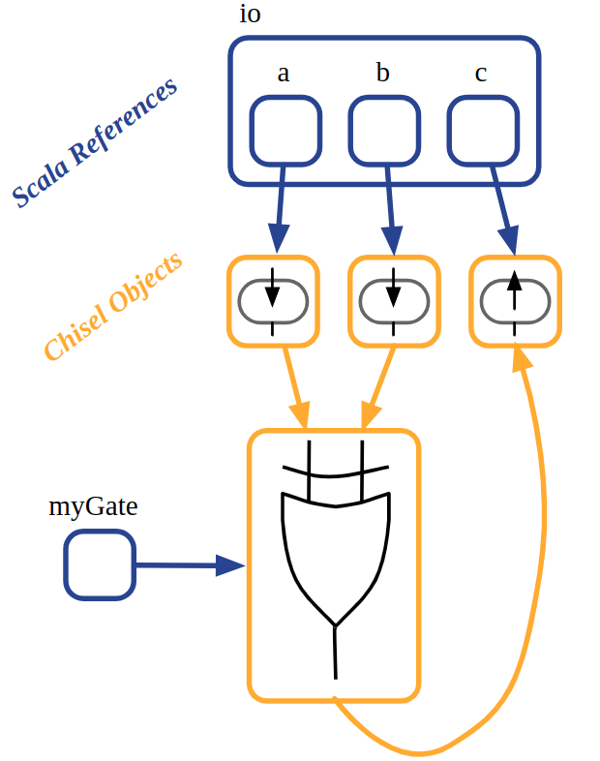
3.10 Scala Reference vs. Chisel Objects
https://www.youtube.com/watch?v=BpJ21q-reFU&list=PLfrN7RIcMe6g2LBRJLTHTdhyj5s8ag0Rg&index=3
Scala Reference vs. Chisel Object (26:30-30:26/1:03:50)
1. Generators create Chisel Objects.
2. We connect the object together by Scala code.
3. We use connect operator (:=) to assign the output.
4. Here, we have chisel code with modules and operational gates.
5. On the right hand schematic diagram, we have:
  a. Scala Reference
  b. Chisel Object
  c. Connect Objects together into the gates.
5
a
4
b
c

Slide 24
3.11 Chisel Wire

Slide 25
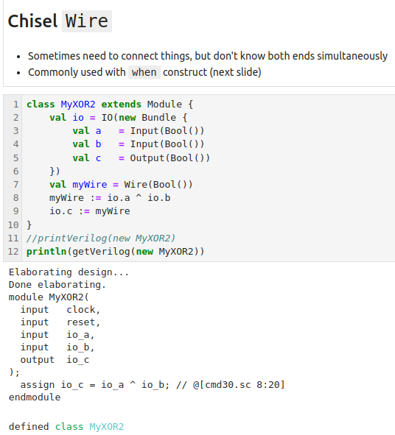
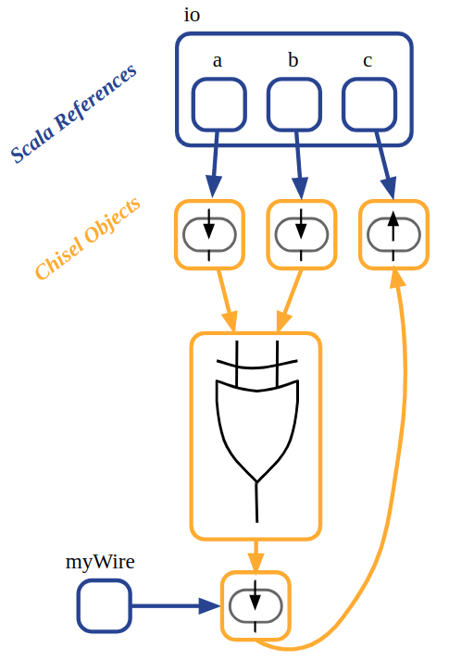
3.11 Chisel Wire
https://www.youtube.com/watch?v=BpJ21q-reFU&list=PLfrN7RIcMe6g2LBRJLTHTdhyj5s8ag0Rg&index=3
Chisel Wire (30:27-38:22/1:03:50)
1. Why do we need wire?
2. We have components but we do not know how to to connect the components.
3. In the right hand side schematic, we create Wire myWire. The Wire myWire need to connect to output components and operations.
5. Now, the old myWire is immutable.
6. After we point the myWire to the output of logic operation. The content of myWire is point the Gate operation (a ^ b).

Slide 26
3.12 Chisel when

Slide 27
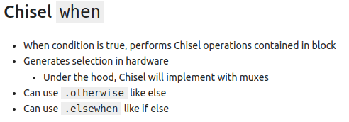
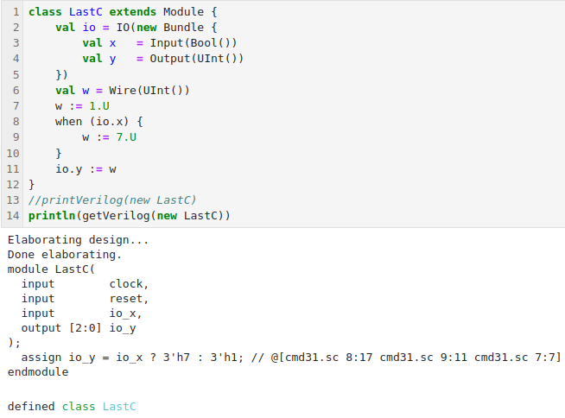
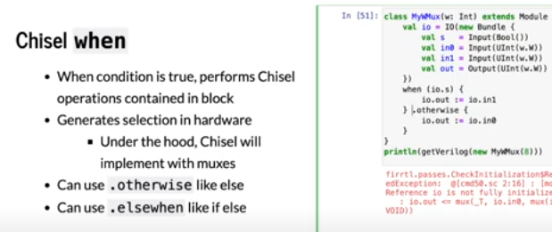
3.12 Chisel when
https://www.youtube.com/watch?v=BpJ21q-reFU&list=PLfrN7RIcMe6g2LBRJLTHTdhyj5s8ag0Rg&index=3
Chisel when (38:23-42:22/1:03:50)
1. Scala use “if” for condition and use “=” for value assignment.
2. Chisel use “when” for condition and “:=” for hardware wire assignment.
3. In the when block, we can perform the operation. When the condition is True.
4. when () { … }
5. .otherwise { … }
6. .elsewhen { … }
7. We can play around the conditions.

Slide 28
3.12 Chisel Last Connect

Slide 29
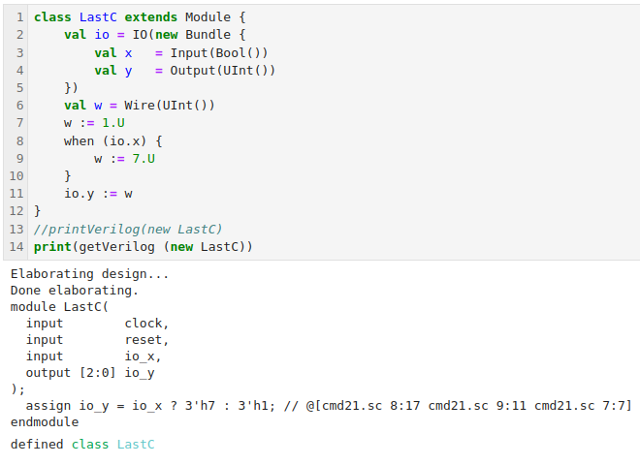
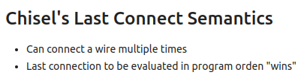
3.12 Chisel Last Connect
https://www.youtube.com/watch?v=BpJ21q-reFU&list=PLfrN7RIcMe6g2LBRJLTHTdhyj5s8ag0Rg&index=3
Chisel Last Connect (42:23-48:54/1:03:50)
1. Chisel has “Last Connect” Semantics.
2. We can connect wire multiple times.
3. In another words, we can connect the same wire multiple times, but only the last connect wire will connected.
4. If we have multiple drivers, only the last driver wins.
5. In common case, we are not going to do the multiple drivers connections in the same wire.
6. The easiest way is:
  a. we have the default value, and
  b. then optional override it,
a
b

Slide 30
3.13 Last Connect Example

Slide 31
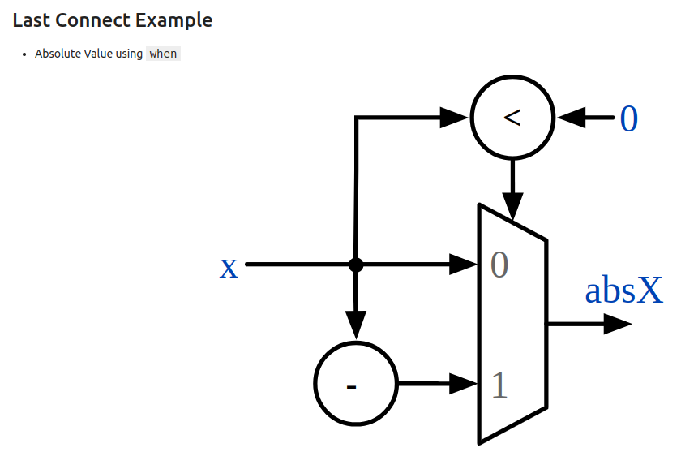
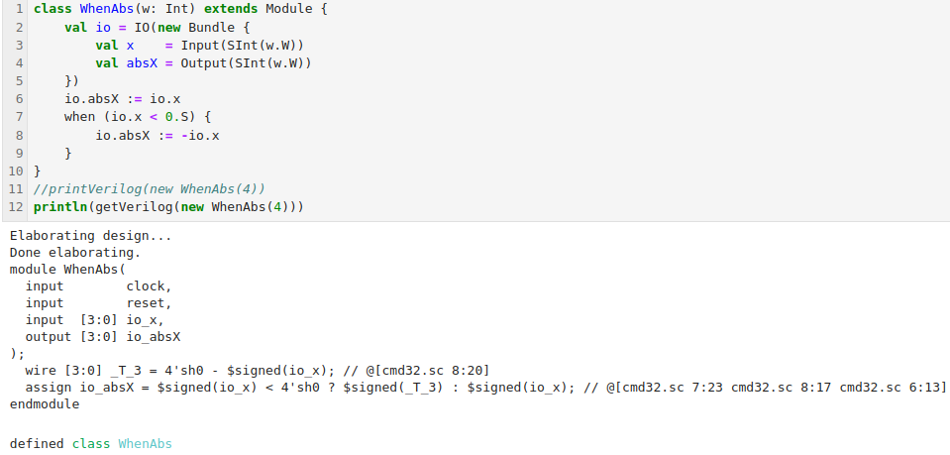
3.13 Last Connect Example
https://www.youtube.com/watch?v=BpJ21q-reFU&list=PLfrN7RIcMe6g2LBRJLTHTdhyj5s8ag0Rg&index=3
Last Connect Example (48:55-49:51/1:03:50)
1. Below is the Last Connect Example.
2. We have default connection.
3. If the input value is negative, then we invert the value it.
4. We have the same hardware we had earlier.
5. Below, we have Verilog for sign comparison
5

Slide 32
3.14 Bitwidth Truncation

Slide 33
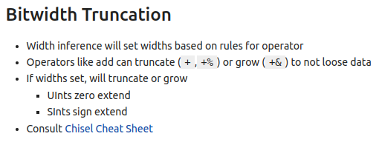
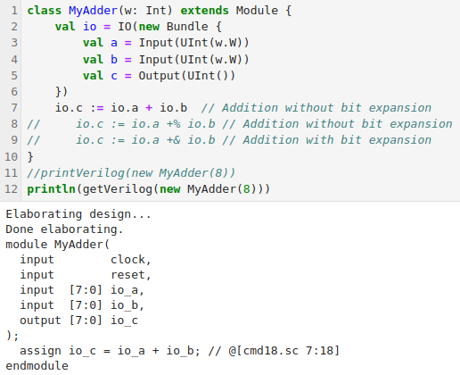
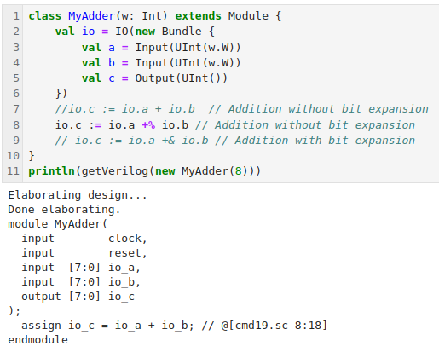
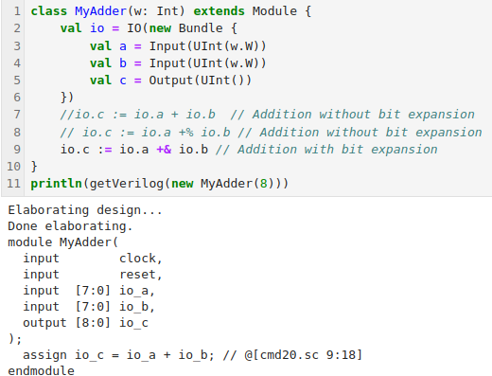
3.14 Bitwidth Truncation
https://www.youtube.com/watch?v=BpJ21q-reFU&list=PLfrN7RIcMe6g2LBRJLTHTdhyj5s8ag0Rg&index=3
Bitwidth Truncation (49:52-53:32/1:03:50)
1. We pass in the width.
2. We can do bit with inference and determine what width should be.
3. We have different width with different operators
  a. io.c := io.a + io.b // Addition without expansion
  b. io.c := io.a +% io.b // Addition without expansion
  c. io.c := io.a +& io.b // addition with expansion
a
b
c

Slide 34
3.15 2’s Complement Example

Slide 35
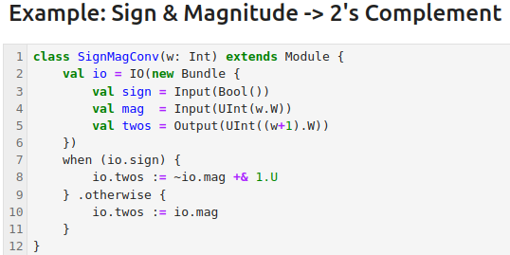
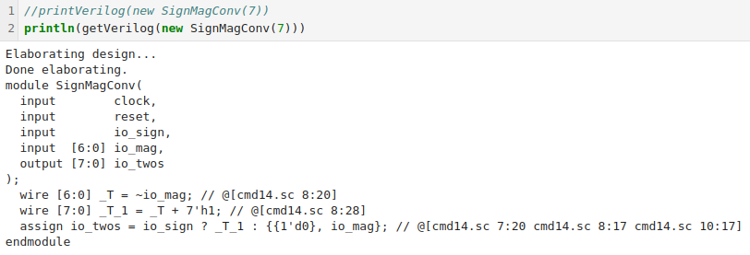
3.15 2’s Complement Example
https://www.youtube.com/watch?v=BpJ21q-reFU&list=PLfrN7RIcMe6g2LBRJLTHTdhyj5s8ag0Rg&index=3
2’s Complement Example (53:33-57:21/1:03:50)
1. We have multiple ways to do the negative number
2. Here, we have single bit for the sign, some width of magnitude, and we output the 2’s complement.
3. When the io.sign is 1 (True), it is the negative number: we take 2’s complement: We negative the magnitude and add 1.
4. Otherwise sign bit is 0 (False), it is the positive number. the output just the input.
5. We print the Hardware Verilog code. Check the Verilog see how Verilog do it.
6. Google search “2’s complement” for more information.

Slide 36
3.16 Sign Bit Extension Example

Slide 37
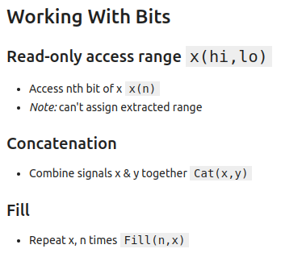
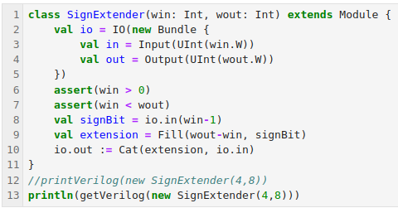
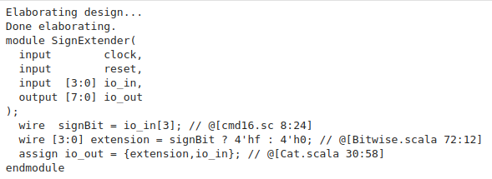
3.16 Sign Bit Extension Example
https://www.youtube.com/watch?v=BpJ21q-reFU&list=PLfrN7RIcMe6g2LBRJLTHTdhyj5s8ag0Rg&index=3
Sign Bit Extension Example (57:22-1:03:50/1:03:50)
1. SignExtender (4, 8)
  a. win (word-input): 4 (highest bit location of input)
  b. wout (word-output): 8 output 8-bits to hold the result.
2. assertion: Scala handles error condition
3. signBit = io.in (win – 1) = io.in(3): signBit = 0/1
4. extension = Fill (wout – win, signBit) = Fill (8 – 4, 0/1) = Fill (4, 0/1): extension = “0000” or “1111”
5. io.out = Cat (extension, io.in) = {extension, “0/1”} = {“00000”, “0”} or {“1111”, “1”} = {“00000”} or {“11111”}

Slide 38
End

