Slide 1

12 Functional Programming: Pattern Match
Peter H. Chen

Slide 2
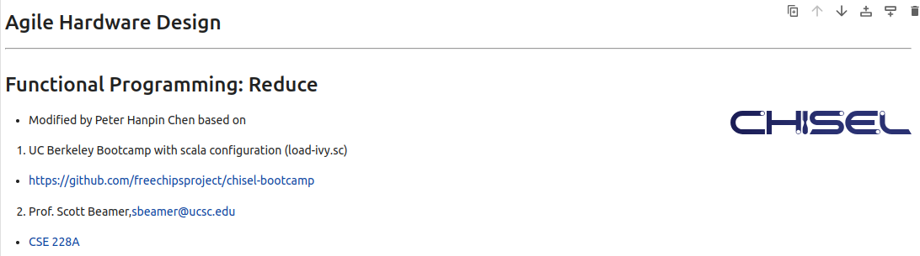
12 Functional Programming: Pattern Match
https://www.youtube.com/watch?v=zlYkaS63UY8&list=PLfrN7RIcMe6g2LBRJLTHTdhyj5s8ag0Rg&index=12
Functional Programming: Pattern Match (0:00-0:01/1:01:02)
We used UCB bootcamp configuration file (load_ivy.sc)
source/load-ivy.sc (https://github.com/freechipsproject/chisel-bootcamp)

Slide 3
12 Functional Programming: Pattern Match
https://www.youtube.com/watch?v=zlYkaS63UY8&list=PLfrN7RIcMe6g2LBRJLTHTdhyj5s8ag0Rg&index=12
Functional Programming: Pattern Match (0:02-0:03/1:01:02)
We discus the Functional Programming in flatMap, filter, sum, pattern Match, and options.
Topics:
1. Setup: jupyter notebook, select scala, and run cells.
2. map vs. flatMap: Map return list, flatMap return the flatten list and logic operation.
3. Sieve function with filter and sum.
4. Functional Programming for Matrix Multiplication: map, foreach, two loop map, zip Index, tabulate, etc.
5. Pattern match in Scala: Class name, string, logic conditions, objects, etc.
Note: Scala use match … case, Chisel uses switch … case (Similar to C/C++).
6. Scala Options.

Slide 4
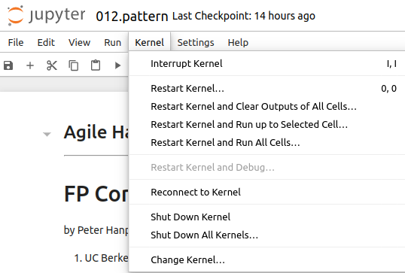
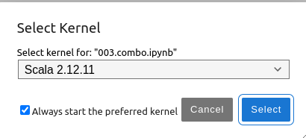
12 Functional Programming: Pattern Match
https://www.youtube.com/watch?v=zlYkaS63UY8&list=PLfrN7RIcMe6g2LBRJLTHTdhyj5s8ag0Rg&index=12
Functional Programming: Pattern Match (0:03-0:28/1:01:02)
We discuss Chisel Collection.
> jupyter notebook 012.pattern.ipynb > Kernel > Change Kernel … > Select Scala2.21.22
> Run All Cells

Slide 5
12.1 Plan

Slide 6
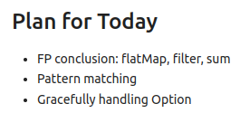
12.1 Plan
https://www.youtube.com/watch?v=zlYkaS63UY8&list=PLfrN7RIcMe6g2LBRJLTHTdhyj5s8ag0Rg&index=12
Plan (0:29-0:40/1:01:02)
Today, we talk about FP conclusion (flatMap, filter, sum) and pattern matching.

Slide 7
12.2 Import Chisel Library

Slide 8
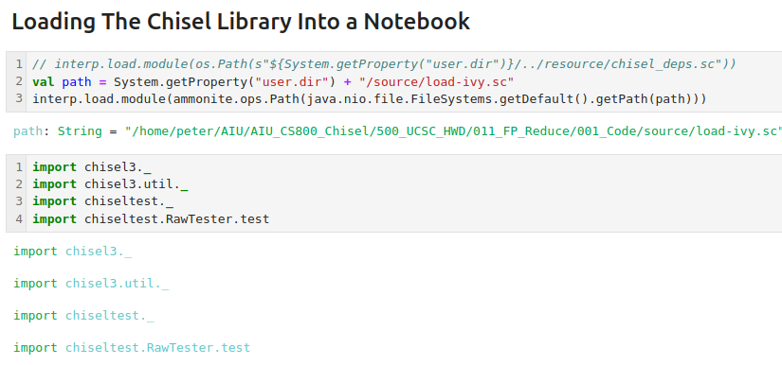
12.2 Import Chisel Library
https://www.youtube.com/watch?v=zlYkaS63UY8&list=PLfrN7RIcMe6g2LBRJLTHTdhyj5s8ag0Rg&index=12
Import Chisel Library (0:41-0:43/1:01:02)

Slide 9
12.3 Scala: flatMap

Slide 10
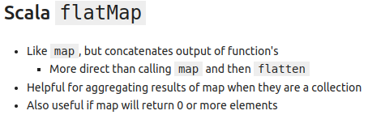
12.3 Scala: flatMap
https://www.youtube.com/watch?v=zlYkaS63UY8&list=PLfrN7RIcMe6g2LBRJLTHTdhyj5s8ag0Rg&index=12
Scala: flatMap (0:44-1:43/1:01:02)
Q. What is difference between the map and flatMap?
Ans:
map: list to list, flatMap: list to multi-list.
1. map turns a list into another, where for every element in the original list, the supplied function is apply.
2. flatMap runs a function on every element on the list, resulting in many mini-lists; these lists are then concatenated into the final result.

Slide 11
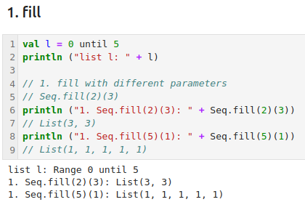
12.3 Scala: flatMap
https://www.youtube.com/watch?v=zlYkaS63UY8&list=PLfrN7RIcMe6g2LBRJLTHTdhyj5s8ag0Rg&index=12
Scala: flatMap (1:44-2:43/1:01:02)
We use the map in the previous discussion, it a collection of elements.
However, if we have collections of collection, map works fine.
1. We input a collection of list
> l = (0. 1, 2, 3, 4)
And test fill function with different parameters
Fill(1)(1), fill(2)(2), etc.

Slide 12
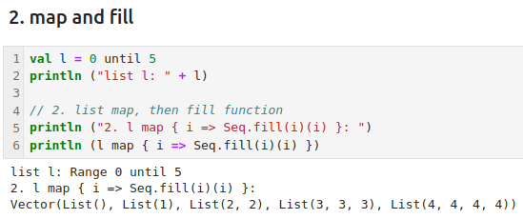
12.3 Scala: flatMap
https://www.youtube.com/watch?v=zlYkaS63UY8&list=PLfrN7RIcMe6g2LBRJLTHTdhyj5s8ag0Rg&index=12
Scala: flatMap (2:44-3:43/1:01:02)
2. We map a collection of collection.
> l map { i => Seq.fill(i)(i) }
>> List(0) = ()
>> fill(1, 1) = (1)
>> fill(2, 2) = (2, 2)
>> fill(3, 3) = (3, 3, 3)
>> fill (4, 4) = (4, 4, 4, 4)

Slide 13
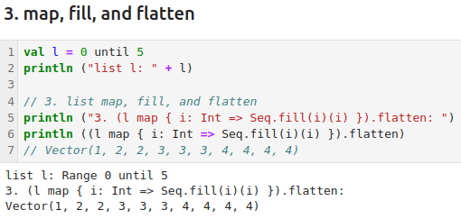
12.3 Scala: flatMap
https://www.youtube.com/watch?v=zlYkaS63UY8&list=PLfrN7RIcMe6g2LBRJLTHTdhyj5s8ag0Rg&index=12
Scala: flatMap (3:44-4:00/1:01:02)
3. map with fill and flatten

Slide 14
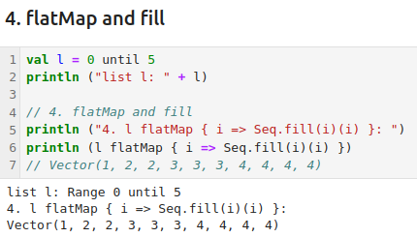
12.3 Scala: flatMap
https://www.youtube.com/watch?v=zlYkaS63UY8&list=PLfrN7RIcMe6g2LBRJLTHTdhyj5s8ag0Rg&index=12
Scala: flatMap (4:01-4:35/1:01:02)
4. flatMap and fill.

Slide 15
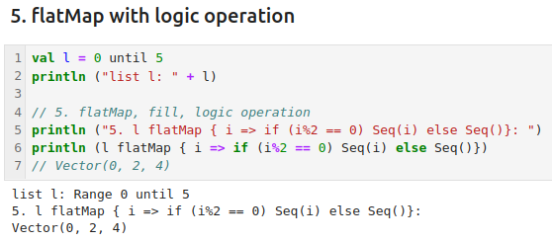
12.3 Scala: flatMap
https://www.youtube.com/watch?v=zlYkaS63UY8&list=PLfrN7RIcMe6g2LBRJLTHTdhyj5s8ag0Rg&index=12
Scala: flatMap (4:36-6:57/1:01:02)
5. flatMap with logic operation. There can have a lot of syntax for logic operation, such as, case, if, etc. in the flatMap. We can have flatten at the end of flatMap.

Slide 16
12.4 Visualize Map on Collection

Slide 17
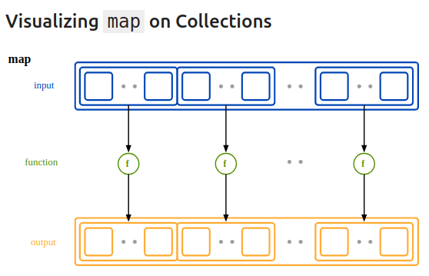
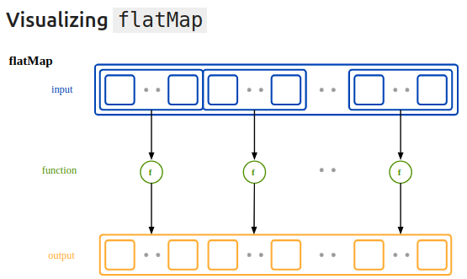
12.4 Visualize Map/flatMap
https://www.youtube.com/watch?v=zlYkaS63UY8&list=PLfrN7RIcMe6g2LBRJLTHTdhyj5s8ag0Rg&index=12
Visualize Map/flatMap on Collection (6:58-8:23/1:01:02)

Slide 18
12.5 Apply Predicate in Scala

Slide 19
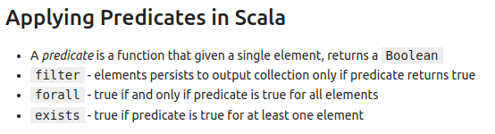
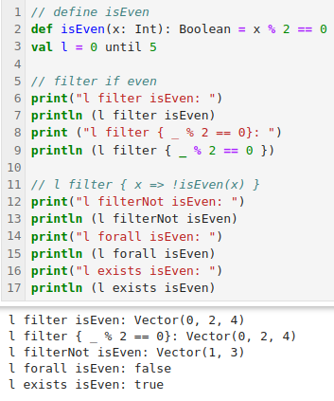
12.5 Apply Predicate in Scala
https://www.youtube.com/watch?v=zlYkaS63UY8&list=PLfrN7RIcMe6g2LBRJLTHTdhyj5s8ag0Rg&index=12
Apply Predicate in Scala (8:24-11:31/1:01:02)
We define a function “isEven”.
We apply the filter, forall, exists for the function “isEven”.

Slide 20
12.6 Visualize filter

Slide 21
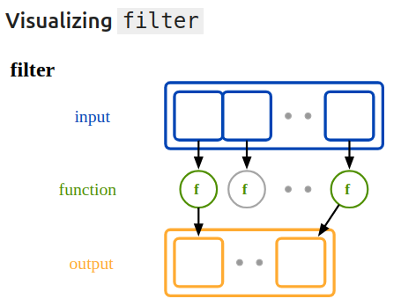
12.6 Visualize filter
https://www.youtube.com/watch?v=zlYkaS63UY8&list=PLfrN7RIcMe6g2LBRJLTHTdhyj5s8ag0Rg&index=12
Visualize filter (11:32-11:45/1:01:02)
Filter call the filter function

Slide 22
12.8 Scala Sieve

Slide 23
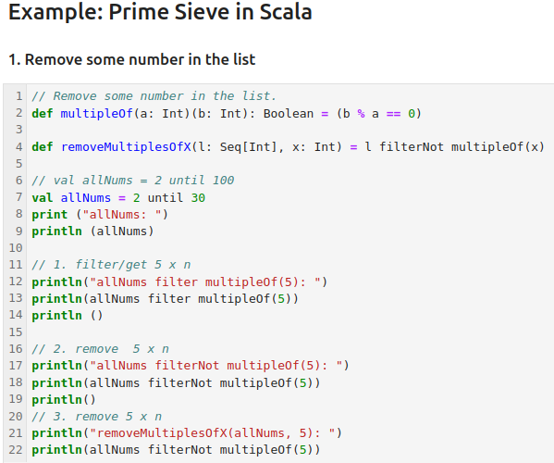
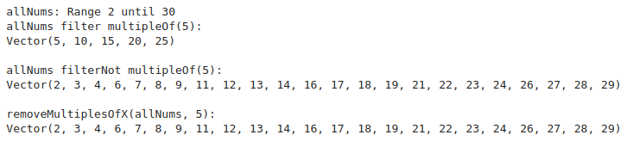
12.8 Scala Sieve
https://www.youtube.com/watch?v=zlYkaS63UY8&list=PLfrN7RIcMe6g2LBRJLTHTdhyj5s8ag0Rg&index=12
Scala Sieve (11:46-13:00/1:01:02)
Remove some number in the list.

Slide 24
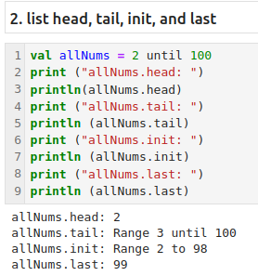
12.8 Scala Sieve
https://www.youtube.com/watch?v=zlYkaS63UY8&list=PLfrN7RIcMe6g2LBRJLTHTdhyj5s8ag0Rg&index=12
List head, tail, init, and last (13:01-14:00/1:01:02)

Slide 25
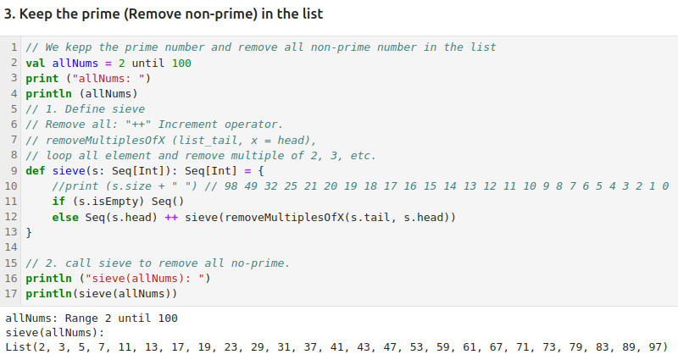
12.8 Scala Sieve
https://www.youtube.com/watch?v=zlYkaS63UY8&list=PLfrN7RIcMe6g2LBRJLTHTdhyj5s8ag0Rg&index=12
Remove non-prime in the list (14:01-20:29/1:01:02)
1. Use “++”” to add all loop through all elements.
2. We can see the size of s keeping decrease all the time.

Slide 26
12.9 Scala Built-in Reduction

Slide 27
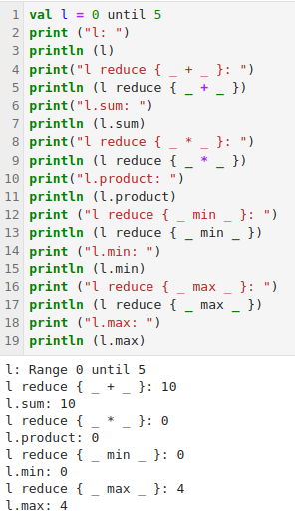

12.9 Scala Built-in Reduction
https://www.youtube.com/watch?v=zlYkaS63UY8&list=PLfrN7RIcMe6g2LBRJLTHTdhyj5s8ag0Rg&index=12
Scala Built-in Reduction (20:30-21:05/1:01:02)
Scala built-in Reduction: Sum, product, min, max

Slide 28
12.10 Scala Method for flatMap, filter, and fold

Slide 29
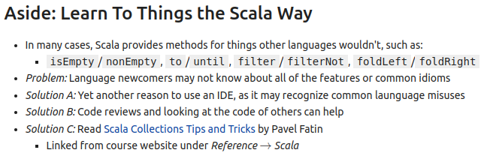
12.10 Scala Method for flatMap, filter, and fold
https://www.youtube.com/watch?v=zlYkaS63UY8&list=PLfrN7RIcMe6g2LBRJLTHTdhyj5s8ag0Rg&index=12
Scala Method for flatMap, filter, and fold (20:30-22:30/1:01:02)
Scala provides convenient methods (isEmpty/nonEmpty, to/until, filter/filterNot, foldLeft/foldRight).

Slide 30
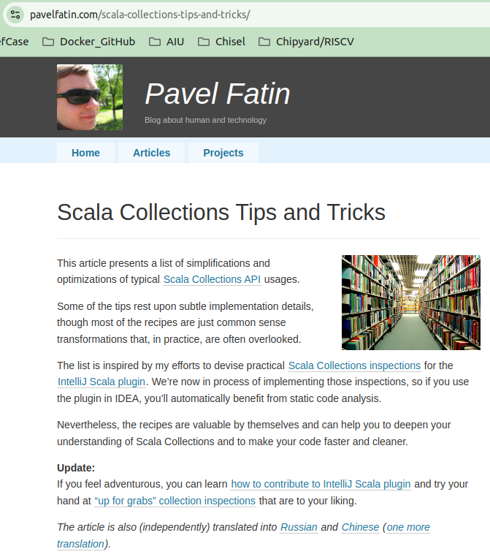
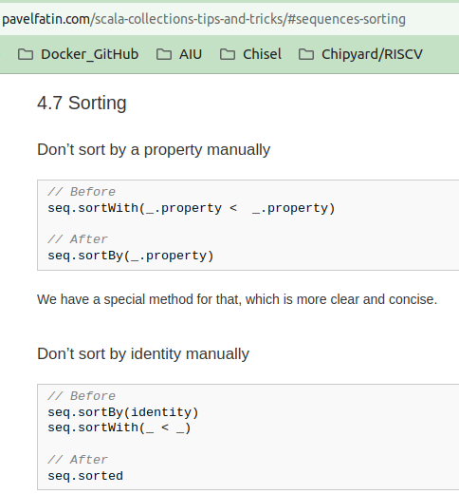
12.10 Scala Method for flatMap, filter, and fold
https://www.youtube.com/watch?v=zlYkaS63UY8&list=PLfrN7RIcMe6g2LBRJLTHTdhyj5s8ag0Rg&index=12
Scala Method for flatMap, filter, and fold (22:31-24:43/1:01:02)
Some Scala tip and trick.
Scroll down to see more.

Slide 31
12.11 Example: FP for Matrix Multiplication

Slide 32
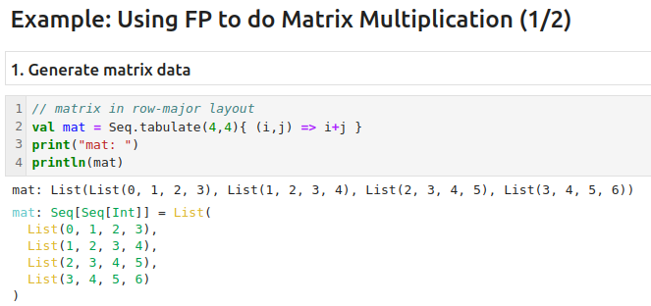
12.11 Example: FP for Matrix Multiplication
https://www.youtube.com/watch?v=zlYkaS63UY8&list=PLfrN7RIcMe6g2LBRJLTHTdhyj5s8ag0Rg&index=12
Example: FP for Matrix Multiplication (24:44-25:13/1:01:02)
1. Generate matrix data with Seq.tabulate()

Slide 33
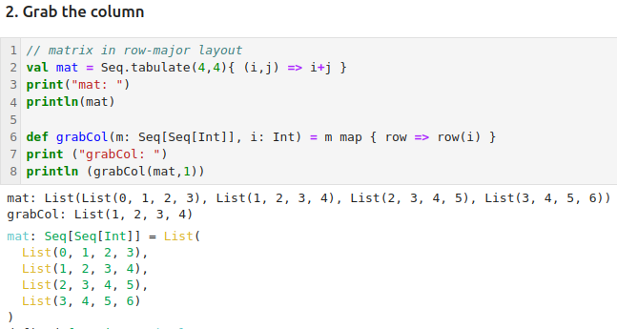
12.11 Example: FP for Matrix Multiplication
https://www.youtube.com/watch?v=zlYkaS63UY8&list=PLfrN7RIcMe6g2LBRJLTHTdhyj5s8ag0Rg&index=12
Example: FP for Matrix Multiplication (25:14-26:40/1:01:02)
1. Generate the matrix.
2. Grab the column 1.

Slide 34
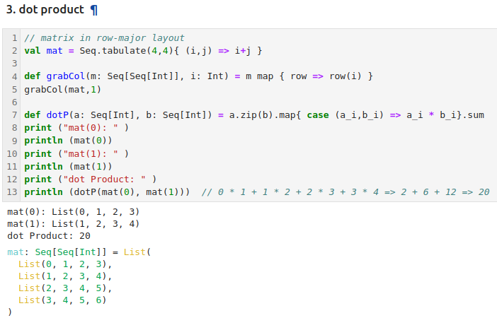
12.11 Example: FP for Matrix Multiplication
https://www.youtube.com/watch?v=zlYkaS63UY8&list=PLfrN7RIcMe6g2LBRJLTHTdhyj5s8ag0Rg&index=12
Example: FP for Matrix Multiplication (26:41-27:13/1:01:02)
1. Generate the matrix.
2. Grab the column 1.
3. Dot product of a selected row (0) to selected column (1).

Slide 35
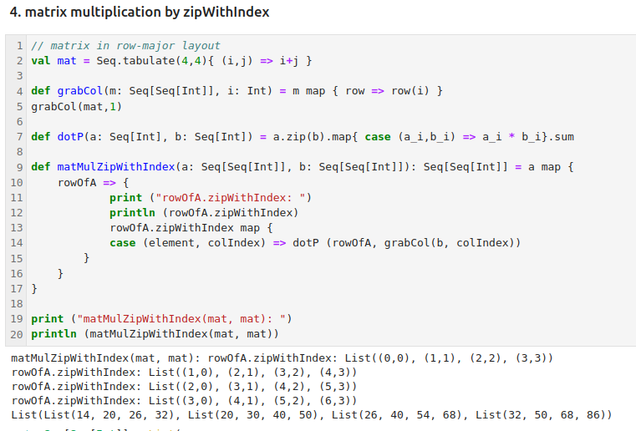
12.11 Example: FP for Matrix Multiplication
https://www.youtube.com/watch?v=zlYkaS63UY8&list=PLfrN7RIcMe6g2LBRJLTHTdhyj5s8ag0Rg&index=12
Example: FP for Matrix Multiplication (27:14-28:13/1:01:02)
Matrix multiplication by zipWithIndex.

Slide 36
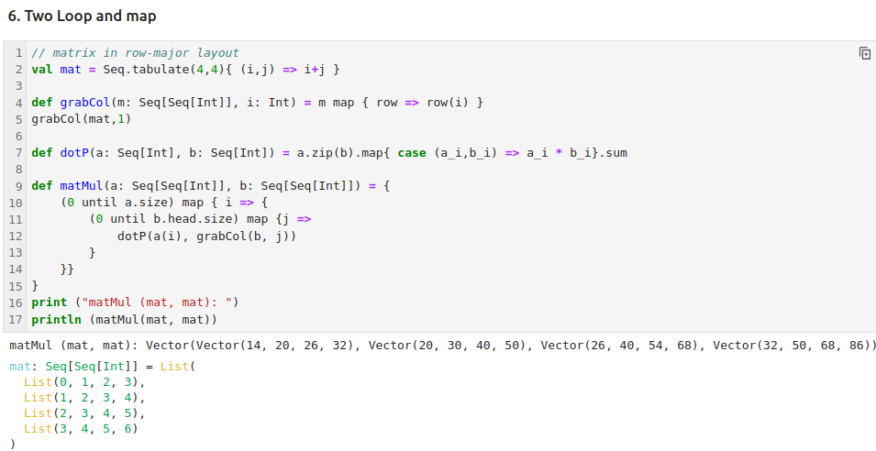
12.11 Example: FP for Matrix Multiplication
https://www.youtube.com/watch?v=zlYkaS63UY8&list=PLfrN7RIcMe6g2LBRJLTHTdhyj5s8ag0Rg&index=12
Example: FP for Matrix Multiplication (27:14-31:00/1:01:02)
Matrix multiplication by Loop and Map.

Slide 37
12.12 Example: FP with Two Loop of Matrix Multiplication

Slide 38
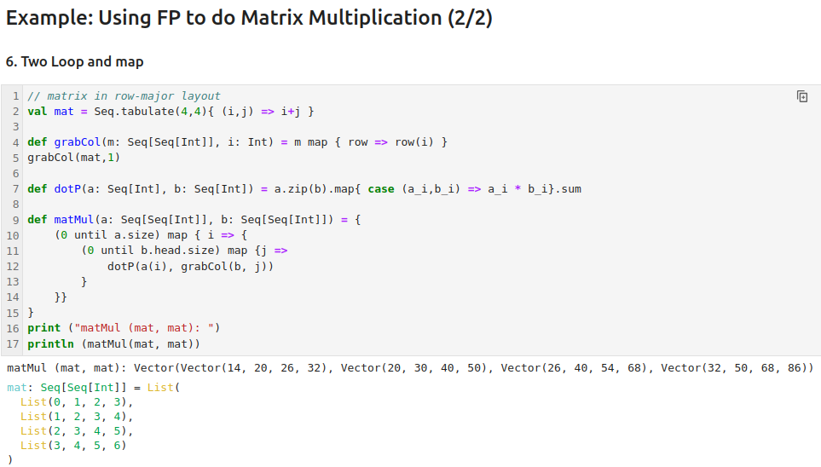
12.12 Example: FP with Two Loop of Matrix Multiplication
https://www.youtube.com/watch?v=zlYkaS63UY8&list=PLfrN7RIcMe6g2LBRJLTHTdhyj5s8ag0Rg&index=12
Example: FP with Two Loops of Matrix Multiplication (31:01-32:13/1:01:02)
Two Loops of Matrix Multiplication

Slide 39
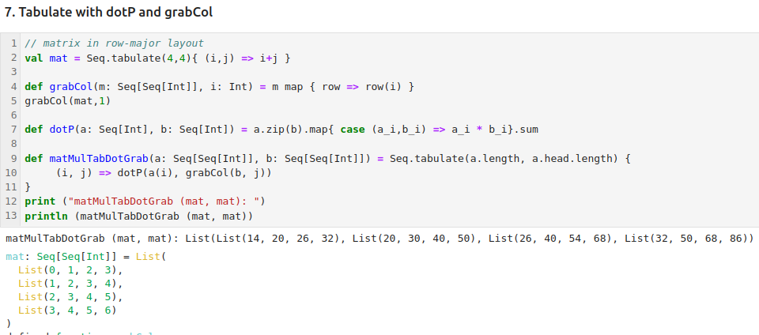
12.12 Example: FP with Two Loop of Matrix Multiplication
https://www.youtube.com/watch?v=zlYkaS63UY8&list=PLfrN7RIcMe6g2LBRJLTHTdhyj5s8ag0Rg&index=12
Example: FP with Two Loops of Matrix Multiplication (31:01-40:12/1:01:02)
1. Use Tabulate to generate the matrix table.
2. Use dotP and grabCol to get the element data and put into matrix table.

Slide 40
12.13 Pattern Match in Scala

Slide 41
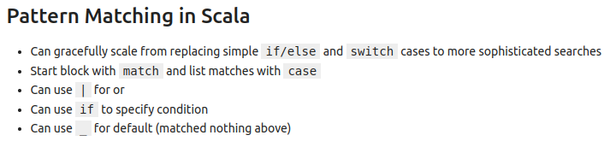
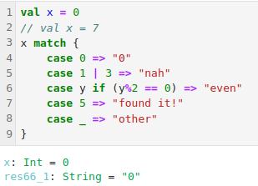
12.13 Pattern Match in Scala
https://www.youtube.com/watch?v=zlYkaS63UY8&list=PLfrN7RIcMe6g2LBRJLTHTdhyj5s8ag0Rg&index=12
Pattern Match in Scala (40:12-44:34/1:01:02)
Below, we have the match keyword with case. The match .. case is similar to switch in C/C++ Language.
We can try different x value.
Note:
1. Scala use match ..case,
2. Chisel use switch .. case

Slide 42
12.14 Pattern Match in Case Class

Slide 43
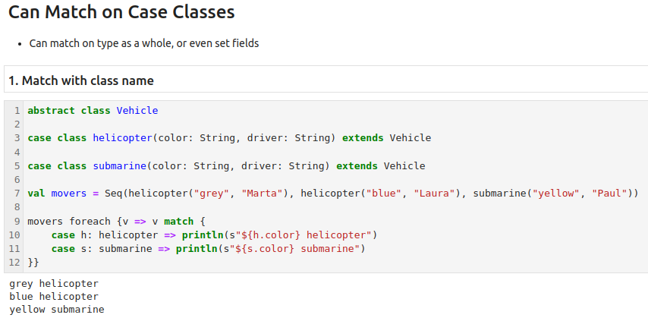
12.14 Pattern Match in Case Class
https://www.youtube.com/watch?v=zlYkaS63UY8&list=PLfrN7RIcMe6g2LBRJLTHTdhyj5s8ag0Rg&index=12
Pattern Match in Case Class (44:35-46:12/1:01:02)
1. Match with class name

Slide 44
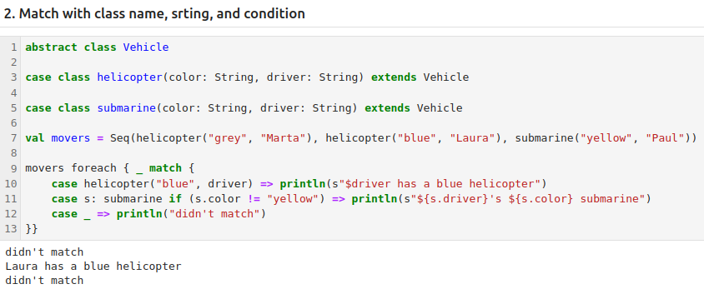
12.14 Pattern Match in Case Class
https://www.youtube.com/watch?v=zlYkaS63UY8&list=PLfrN7RIcMe6g2LBRJLTHTdhyj5s8ag0Rg&index=12
Pattern Match in Case Class (46:13-49:00/1:01:02)
2. Match with class name, string, conditions, objects, etc.

Slide 45
12.15 Pattern Option

Slide 46
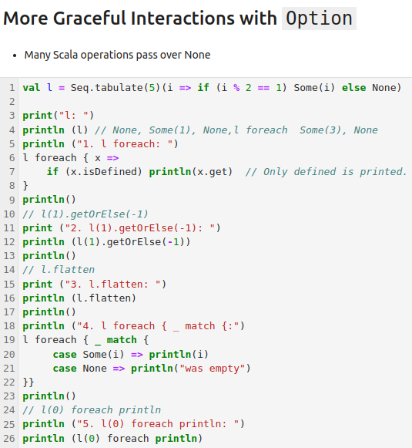
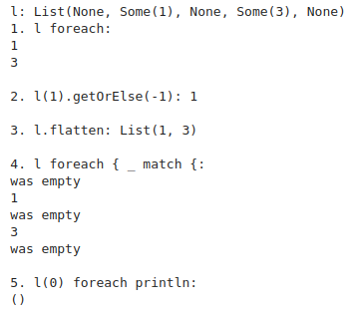
12.15 Pattern Option
https://www.youtube.com/watch?v=zlYkaS63UY8&list=PLfrN7RIcMe6g2LBRJLTHTdhyj5s8ag0Rg&index=12
Pattern Option (49:01-53:00/1:01:02)
More pattern option
1. foreach
2. getOrElse
3. flatten
4. match
5. empty case.

Slide 47
12.16 Project Overview

Slide 48
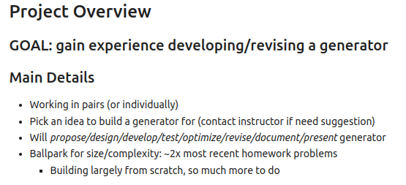
12.16 Project Overview
https://www.youtube.com/watch?v=zlYkaS63UY8&list=PLfrN7RIcMe6g2LBRJLTHTdhyj5s8ag0Rg&index=12
Project Overview (53:01-58:00/1:01:02)

Slide 49
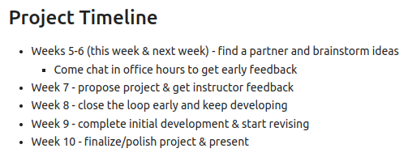
12.16 Project Overview
https://www.youtube.com/watch?v=zlYkaS63UY8&list=PLfrN7RIcMe6g2LBRJLTHTdhyj5s8ag0Rg&index=12
Project Overview (58:01-1:00:00/1:01:02)

Slide 50
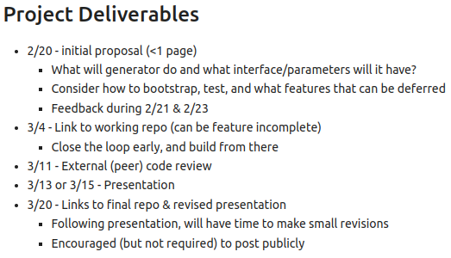
12.16 Project Overview
https://www.youtube.com/watch?v=zlYkaS63UY8&list=PLfrN7RIcMe6g2LBRJLTHTdhyj5s8ag0Rg&index=12
Project Overview (1:00:01-1:01:02/1:01:02)

Slide 51
End

