Slide 1

2.1 Chisel Module
Peter H. Chen

Slide 2
2.1 Chisel Module
https://github.com/freechipsproject/chisel-bootcamp
Chisel Module
We knew how to run scala. Now, we start to run the Chisel Module.
Topics:
1. Setup: Scala is a Domain-Specific Language. We import Scala libraries and specify Chisel Language Configuration as our Domain-Language.
2. Define Scala Module: Define class Passthrough as our first module.
3. Generate Verilog Module
4. Test Hardware Code: Test Verilog Code. Scala give us interface function test(). Inside test(), we need to fill in the test code and run the test. The Scale generate “???” and ask developer to fill in.
5. In the Exercise: We write 2 tests. In test 1: we test 10 bits (0 and 1023), In test 2: We test 20 bits (0 and 1,048,575).
6. Generate Verilog/FIRRTL Code: Use getVerilog(new Passthrough)/getFirrtl (new Passthrough)

Slide 3
2.1.1 Setup

Slide 4
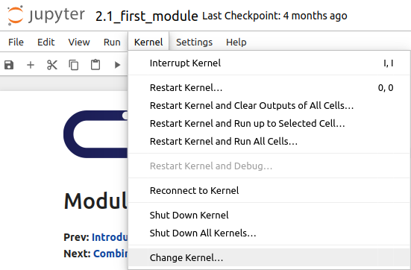
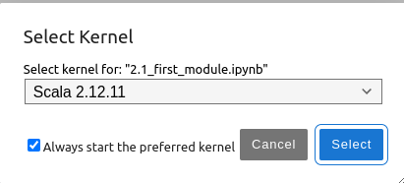
2.1.1 Setup
https://github.com/freechipsproject/chisel-bootcamp
Setup
1. Change folder to chisel-bootcamp. If you want to work on your working space, copy image folder and source folder to your working directory.
> cd chisel-bootcamp
2. Start Jupyter notebook
> jupyter notebook 2.1_first_module.ipynb
3. Select the scala interpreter: > Kernel > Change Kernel… >Scala 2.12.11
3

Slide 5

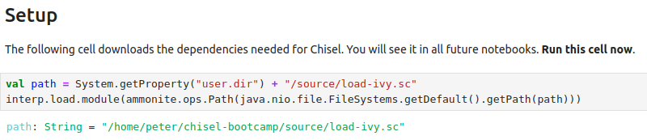
2.1.1 Setup
https://github.com/freechipsproject/chisel-bootcamp
Setup
1. Load images/chisel_1024.png image.
2. Load the files in the source folder.
1
2

Slide 6
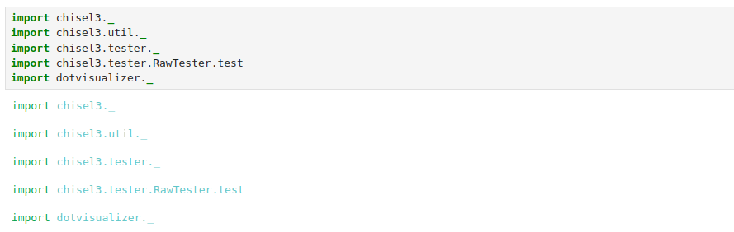
2.1.1 Setup
https://github.com/freechipsproject/chisel-bootcamp
Setup
Setup: Scala is a Domain-Specific Language. We import Scala libraries and specify Chisel Language Configuration as our Domain-Language.
Import Modules.
1. import chisel3.* // Define chisel language definition/configuration for options and value.
2. import chisel3.util.* // chisel utility functions
3. import chisel3.tester.* // tester interface
4. import chisel3.tester.RawTester.test // most flexible tester.
5. import dotvisualizer.* // data virtualization

Slide 7
2.1.2 Define Scala Module

Slide 8
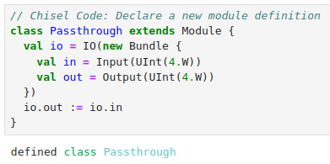
2.1.2 Define Scala Module
https://github.com/freechipsproject/chisel-bootcamp
Define Scala Module
Here, the first hardware module. Similar to Verilog, we declare module definitions in Chisel.
The following example
1. Define Chisel Module named Passthrough.
2. The Passthrough inherit/extends the class Module
3. Create an instance io.
4. The Passthrough module has one 4-bit input, in, and one 4-bit output, out.
5. The module combinationally connects in and out. Therefore, in drives out.
1
2
3
4
5

Slide 9
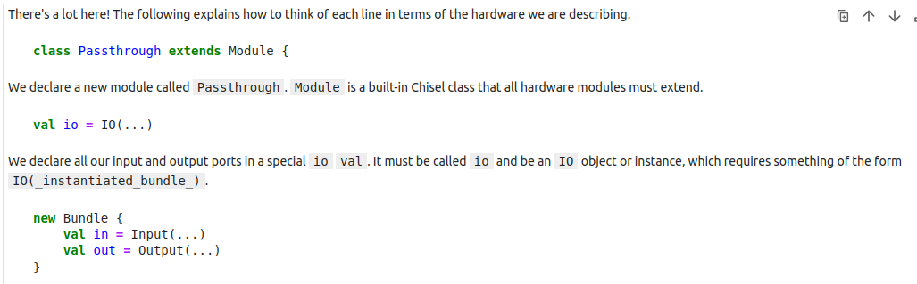
2.1.2 Define Scala Module
https://github.com/freechipsproject/chisel-bootcamp
Define Scala Module
1. Define class Passthrough.
2. Define instance io.
3. Create Input and output ports by Bundle.

Slide 10
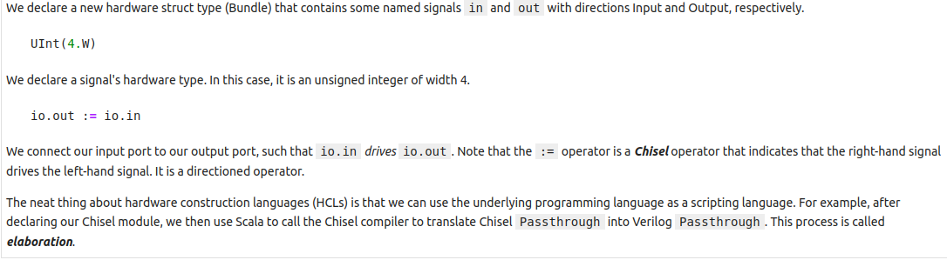
2.1.2 Define Scala Module
https://github.com/freechipsproject/chisel-bootcamp
Define Scala Module
1. Bundle contains the in and out structure.
2. Chisel translate the Chisel Passthrough into Verilog Passthrough.

Slide 11
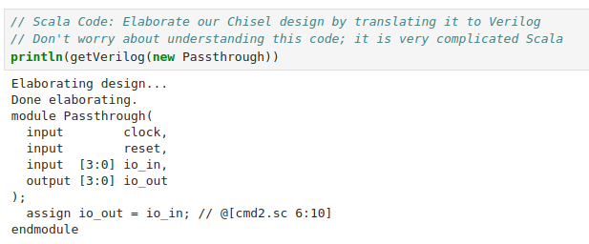
2.1.2 Define Scala Module
https://github.com/freechipsproject/chisel-bootcamp
Define Scala Module
Here, we use getVerilog to get the Passthrough in Verilog format.
> println (getVerilog (new Passthrough)

Slide 12
2.1.3 Generate Verilog Module

Slide 13
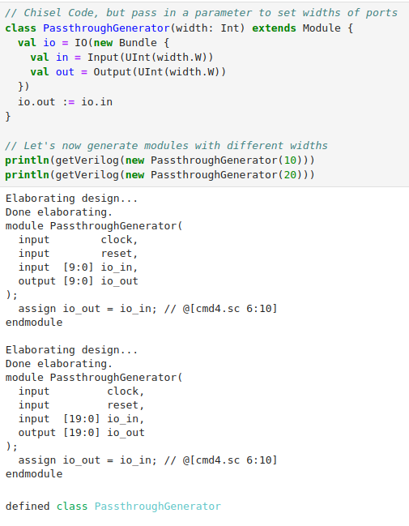
2.1.3 Generate Verilog Module
https://github.com/freechipsproject/chisel-bootcamp
1
Generate Verilog Module
1. Here, we define a Module PassThroughGenerator (parameter)
2. We pass in different parameters for PassThroughGenerator (10) and PassThroughGenerator (20). We use getVerilog to get the Verilog modules and then print out different Verilog code.
3. Result
2
3

Slide 14
2.1.3 Generate Verilog Module
https://github.com/freechipsproject/chisel-bootcamp
Generate Verilog Module
Note:
1. The generated Verilog uses different bitwidths for the input/output depending on the value assigned to the width parameter. Because Chisel Modules are normal Scala classes, we pass in different parameters to generate different Verilog design.
We call Passthrough is a generator since it generate different Verilog Passthrough codes.
1

Slide 15
2.1.4 Test Hardware Code

Slide 16
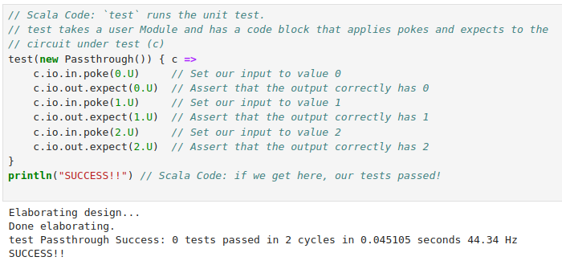
2.1.4 Test Hardware Code
https://github.com/freechipsproject/chisel-bootcamp
Test Hardware Code
1. We need a tester to Hardware Module/Generator.
2. Chisel has built-in test which we will use it in the bootcamp.
3. Below is a test example (Chisel test harness).
4. We pass values at the input port (in) to a Passthrough instance and check the output port (out).
5. Here, we only need to know the poke and expect commands.
6. In the rest of the code, we can use the same example to write simple tests.

Slide 17
2.1.4 Test Hardware Code
https://github.com/freechipsproject/chisel-bootcamp
Test Hardware Code
1. What's going on?
2. The test accepts a Passthrough module, assigns values to the module's inputs, and checks its outputs.
3. To set an input, we call poke.
4. To check an output, we call expect.
5. If we don't want to compare the output to an expected value (no assertion), we can peek the output instead.
6. If all expect statements are true, then our boilerplate code will return pass.

Slide 18
2.1.4 Test Hardware Code
https://github.com/freechipsproject/chisel-bootcamp
Test Hardware Code
Note:
1. The poke and expect are chisel hardware literal notation. Both operations expect literals of the correct type.
2. For pokeing a UInt(), we must supply a UInt literal, for example, c.io.in.poke(10.U),
3. If the input is a Bool() the poke would expect either true.B or false.B.

Slide 19
2.1.5 Exercise: Write Your Tester

Slide 20
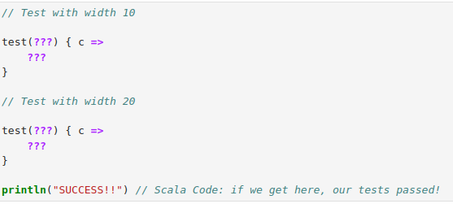
2.1.5 Exercise: Write Your Tester
https://github.com/freechipsproject/chisel-bootcamp
Exercise: Write Your Tester
Below, we write/run two tests:
1. test 1: tests PassthroughGenerator for a width of 10 and
2. test 2: tests PassthroughGenerator for a width of 20.
3. Here, we check two values for each: zero and maximum value supported by the specified width.

Slide 21
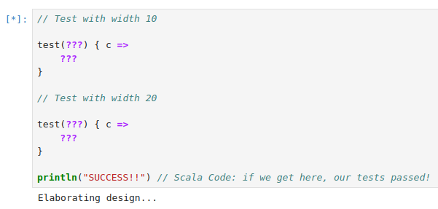
2.1.5 Exercise: Write Your Tester
https://github.com/freechipsproject/chisel-bootcamp
Exercise: Write Your Tester
Note:
1. The triple question mark has a special meaning in Scala.
2. You may see it frequently in these bootcamp exercises.
3. Running code with the ??? will produce the NotImplementedError.
4. Replace ??? with your own code.
5. When we run, we will get the [*] forever run … with “Elaborating design. . .”

Slide 22
2.1.6 Exercise Solution

Slide 23
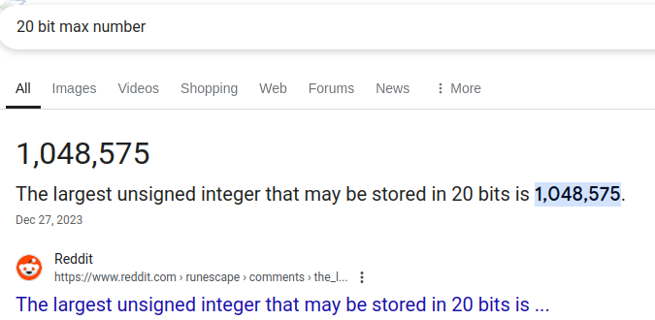
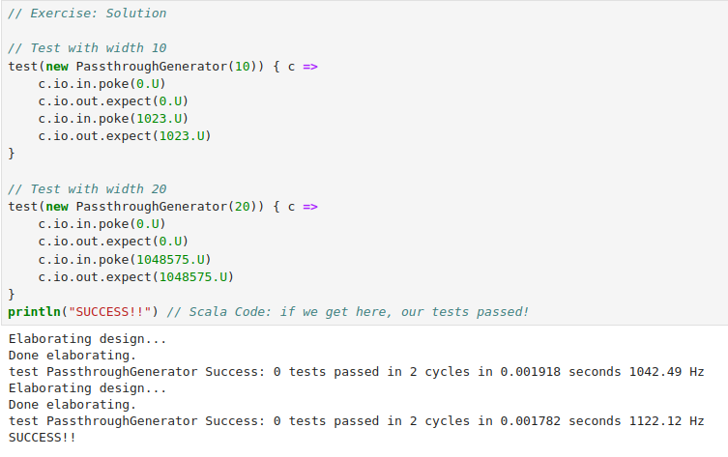
2.1.6 Exercise: Solution
https://github.com/freechipsproject/chisel-bootcamp
Exercise: Solution
Below, we Replace ??? with our tester code.
1. Test 1: We check at 0U and 1023U. (10 bit = 0 to1,023)
2. Test 2: We check at 0U and 1048575U (20 bit = 0 to 1,048,575).
3. We run again.

Slide 24
2.1.7 Generate Verilog/FIRRTL Code

Slide 25
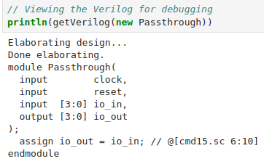
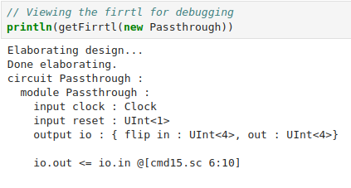
2.1.7 Generate Verilog/FIRRTL Code
https://github.com/freechipsproject/chisel-bootcamp
Generate Verilog/FIRRTL Code
1. Now, we look at Verilog and FIRRTL (Chisel’s Flexible Internal Representation of RTL). FIRRTL is compatible to Synopsys synthesis Verilog.
2. Below left, we generate the Verilog with getVerilog(new Passthrough)
3. Below right, we generate the FIRRTL with getFirrtl (new Passthrough)
2
3

Slide 26
End

