Slide 1

3 Basics
Peter H. Chen

Slide 2
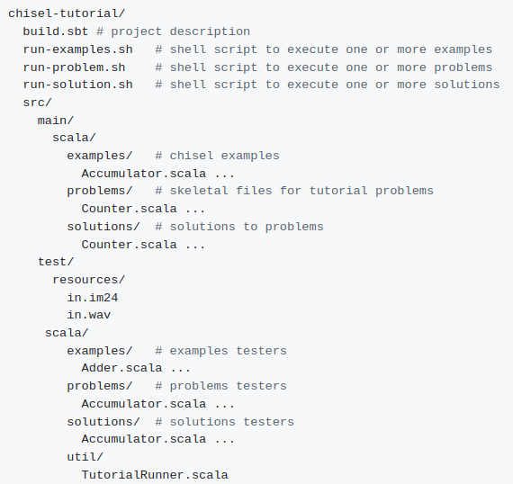
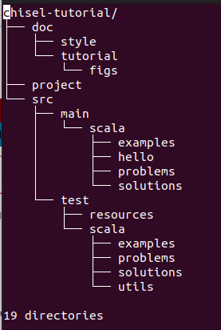
3 Basics
https://github.com/ucb-bar/chisel-tutorial/wiki/The-Basics
Basics
Below is the files/directory structure of Chisel (Constructing Hardware in Scala Language).
> sudo apt-get install tree
> tree -d chisel-tutorial > chisel_dir.log
> vim chisel_dir.log

Slide 3
3 Basics
https://github.com/ucb-bar/chisel-tutorial/wiki/The-Basics
Basics
There are:
1. Three scripts: run-problem.sh, run-solution.sh, and run-examples.sh
2. Two directories main and directory test.
3. Chisel source files are problems, and solutions directories.
4. The problems contains the UC Berkeley class assignment to be implemented.
5. The solutions contains the solution of the problems.
6. The examples are more complicate examples.
7. build.sbt file contains the build configuration information used to specify what version of Chisel to make your project.

Slide 4
3.1 GCD Example

Slide 5
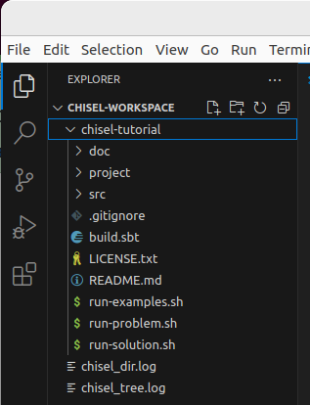
3.1 GCD Example
https://github.com/ucb-bar/chisel-tutorial/wiki/The-Basics
GCD Example
We will go through the GCD Example in Chisel.
1. chisel-tutorial > code
2. We are at chisel-tutorial directory.
1
2

Slide 6
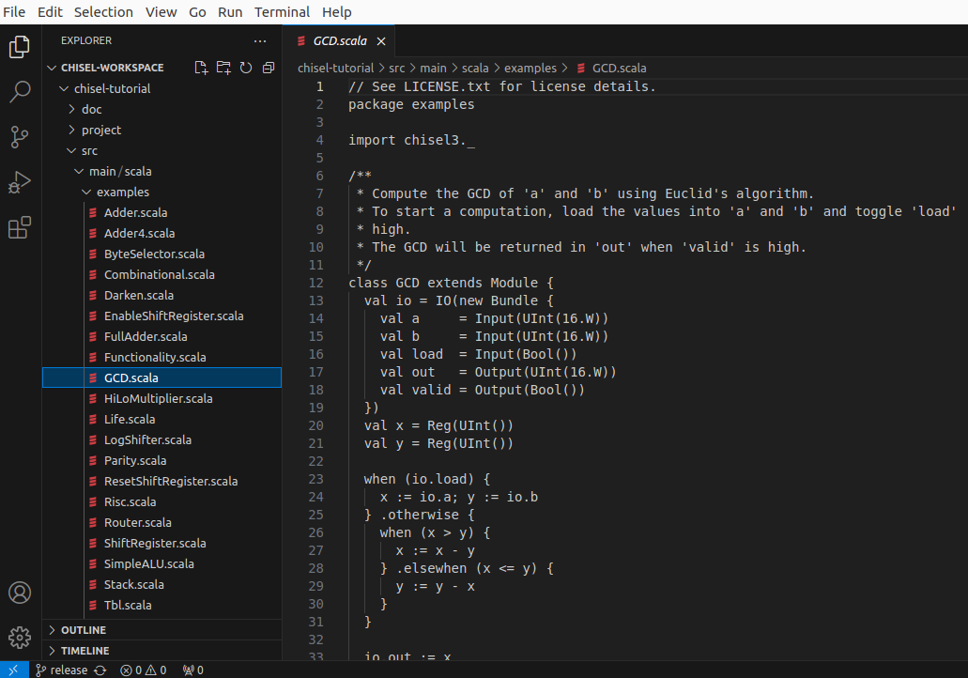
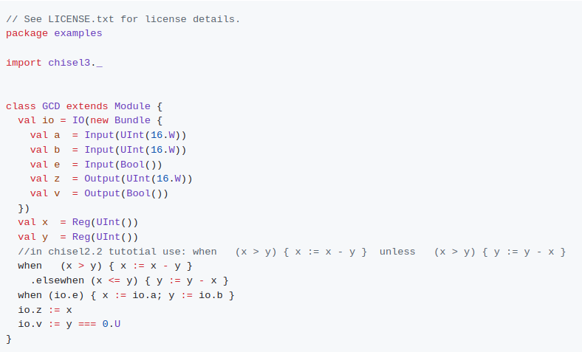
3.1 GCD Example
https://github.com/ucb-bar/chisel-tutorial/wiki/The-Basics
GCD Example
Below, we open GCD.scala in src/main/scala/examples.
Here is the code of GCD (Greatest Common Divisor) which return the greatest common divisor of input a and b.

Slide 7
3.2 Import Chisel Library

Slide 8
3.2 Import Chisel Library
https://github.com/ucb-bar/chisel-tutorial/wiki/The-Basics
Import Chisel Library
1. First we need to import the chisel library
> import chisel3._:
2. After we import Chisel library, we can define the Scala class and inherit the Module.
3. We can write the code similar to Verilog Module.
1
2
3

Slide 9
3.3 io Object and IO Class

Slide 10
3.3 io Object and IO Class
https://github.com/ucb-bar/chisel-tutorial/wiki/The-Basics
Io Object and IO Class
1. In the Scala Class, we creates the io object with IO Class:
> val io = IO(new Bundle{…})
1

Slide 11
3.4 Bundle () Macro

Slide 12
3.4 Bundle () Macro
https://github.com/ucb-bar/chisel-tutorial/wiki/The-Basics
Bundle () Macro
1. The Bundle() is a Macro/Function,
2. Below, we new Bundle (…). The Bundle (...) takes several arguments as part of its construction.
3. We define each parameter with a specified type (UInt, Bool, etc.), a bit width, and wrapped into a direction (either Input or Output). If a bit width is not specified, Chisel will infer the appropriate bit width for you (in this case default to 1). The io Bundle is essentially a constructor for the component interface.
1
2
3

Slide 13
3.5 Compute GCD

Slide 14

3.5 Compute GCD
https://github.com/ucb-bar/chisel-tutorial/wiki/The-Basics
Compute GCD
1. Computer the actual GCD computation for the module. The register declarations for x and y tell Chisel to treat x and y as registers of type UInt().
1

Slide 15
3.6 when/.elsewhen Statement

Slide 16
3.6 when/.elsewhen Statement
https://github.com/ucb-bar/chisel-tutorial/wiki/The-Basics
When /.elsewhen Statement
1. The when is a Spark statement. The when is a infinity loop when the condition is true. In hardware this is basically a multiplexer selecting the values in the when block when the condition is true.
2. .elsewhen: is the exit condition for when.
1
2

Slide 17
3.7 when vs. Verilog posedge

Slide 18
3.7 when vs. Verilog posedge
https://github.com/ucb-bar/chisel-tutorial/wiki/The-Basics
when vs. Verilog Posedge
1.when (io.0): The register on the left hand side of the expression, the assignment is executed on a positive clock edge if the condition is true. This is similar to how Verilog uses always @ (posedge clk) to specify synchronous logic.
1

Slide 19
3.8 Output Assignment

Slide 20
3.8 Output Assignment
https://github.com/ucb-bar/chisel-tutorial/wiki/The-Basics
when vs. Verilog Posedge
1. The output assignments for the computation for io.z and io.v.
One particular thing to notice is that, we do not have to specify the width of x and y in this example. This is because Chisel does the bit width inference for you and sets these values to their appropriate widths based on the computations they are executing.
1

Slide 21
3.9 Run GCD

Slide 22
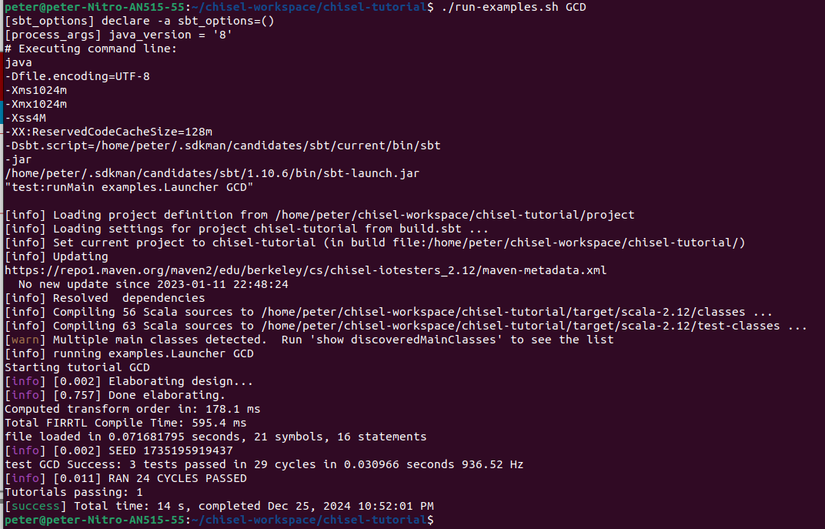
3.9 Run GCD
https://github.com/ucb-bar/chisel-tutorial/wiki/The-Basics
Run GCD
1. > run-examples GCD
This will generate the firrtl description of the circuit for the component defined in src/main/scala/examples/GCD.scala and use the firrtl interpreter to simulate it using the test harness defined in src/test/scala/examples/GCDTests.scala.
If the simulation succeeds, you should see some debug output followed by:

Slide 23
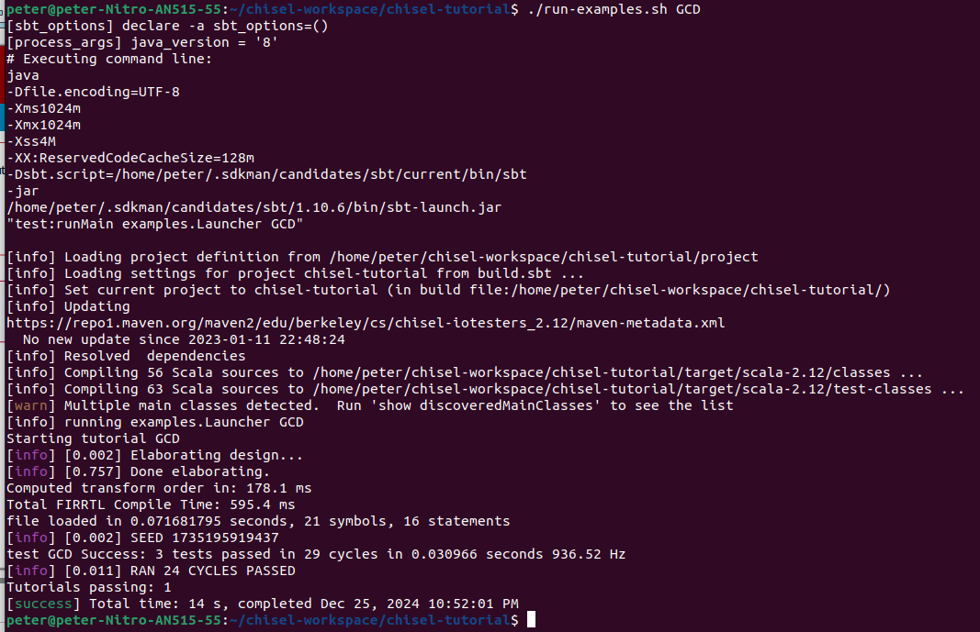

3.9 Run GCD
https://github.com/ucb-bar/chisel-tutorial/wiki/The-Basics
Run GCD
If the simulation succeeds, you should see some debug output followed by:

Slide 24
3.10 GCD fir File

Slide 25
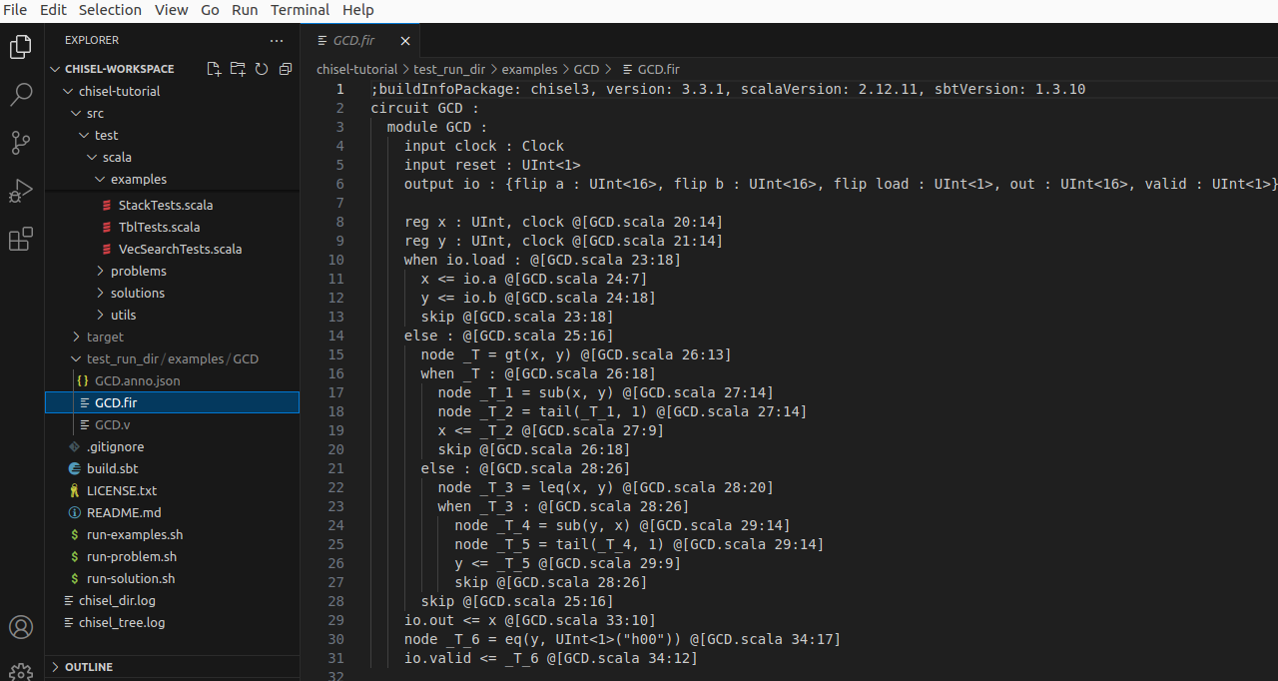
3.10 GCD fir File
https://github.com/ucb-bar/chisel-tutorial/wiki/The-Basics
GCD fir File
1. In addition to the debug output, the build also creates a
> test_run_dir/examples/GCD/GCD.fir file.
2. This fir file contains the firrtl definition of the GCD circuit and its tester. We will talk about this more later.
2
1

Slide 26
3.11 Generate Verilog

Slide 27
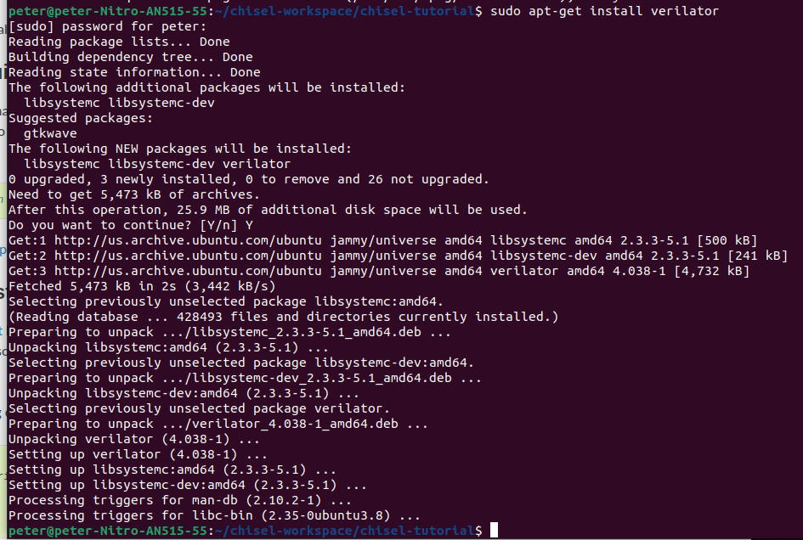
3.11 Generate Verilog
https://github.com/ucb-bar/chisel-tutorial/wiki/The-Basics
Generate Verilog
We need to install the Verilator to generate the Verilog.
> sudo apt-get install verilator
https://verilator.org/guide/latest/install.html

Slide 28
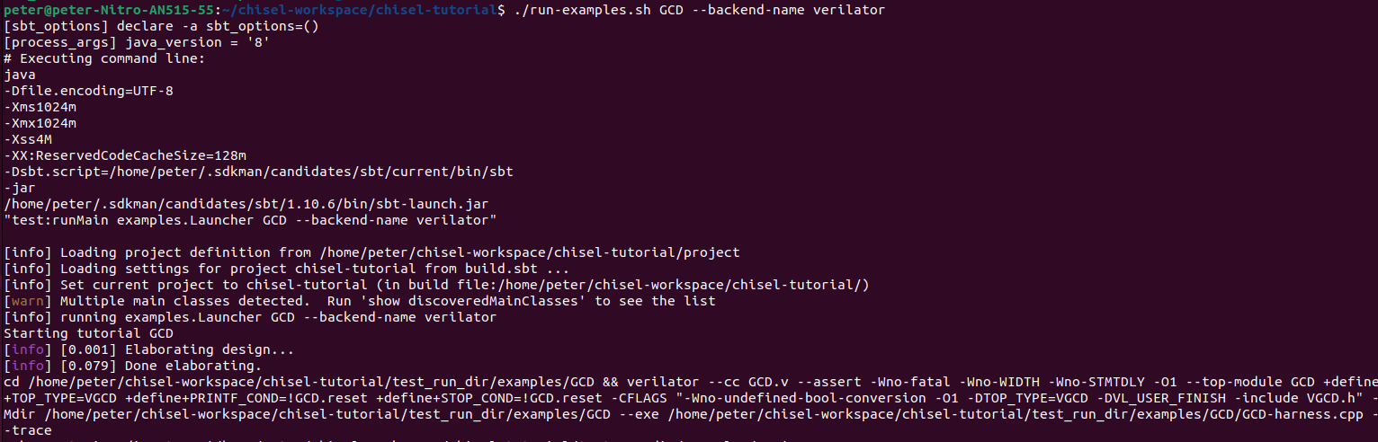
3.11 Generate Verilog
https://github.com/ucb-bar/chisel-tutorial/wiki/The-Basics
Generate Verilog
After we finished the simulation, we can generate FPGA and ASIC Verilog from the Scala sources.
1. The Verilog are used to construct a circuit. To do this, we use an environment variable to specify a different tester backend:
> ./run-examples.sh GCD --backend-name verilator
2. This will instruct the tester driver to generate Verilog output and use Verilator to generate a C++ simulation from the generated Verilog for the specified Chisel component. When the Verilog generation finishes, you should see a [success] message similar to the one you saw after running the firrtl-interpreter backend.
1
2

Slide 29
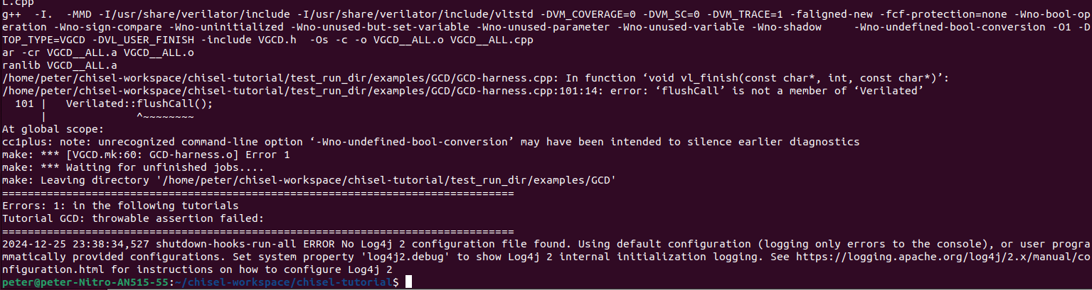
3.11 Generate Verilog
https://github.com/ucb-bar/chisel-tutorial/wiki/The-Basics
Generate Verilog
Note:
1. There is error message when generating the VCD (Value Change Dump).
1

Slide 30
3.12 Verify Verilog

Slide 31
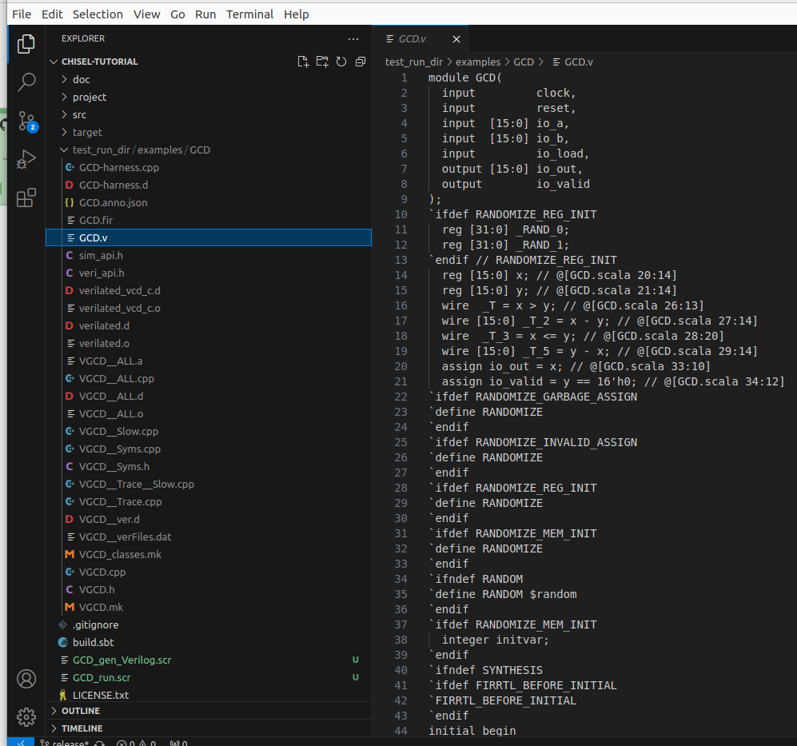
3.12 Verify Verilog
https://github.com/ucb-bar/chisel-tutorial/wiki/The-Basics
Verify Verilog
If you look in the test_run_dir/examples/GCD/ directory, you will see quite a few additional files, notably:
1. GCD.v - Verilog representation of the Chisel circuit,
2. GCD.vcd - waveform dump of the circuit signals during the simulation.
The Verilog source is roughly divided into three parts:
Module declaration with input and outputs
Temporary wire and register declaration used for holding intermediate values
Register assignments in always @ (posedge clk)
You can use gtkwave to view the vcd dump.
1
2

Slide 32
3.13 gtkwave

Slide 33
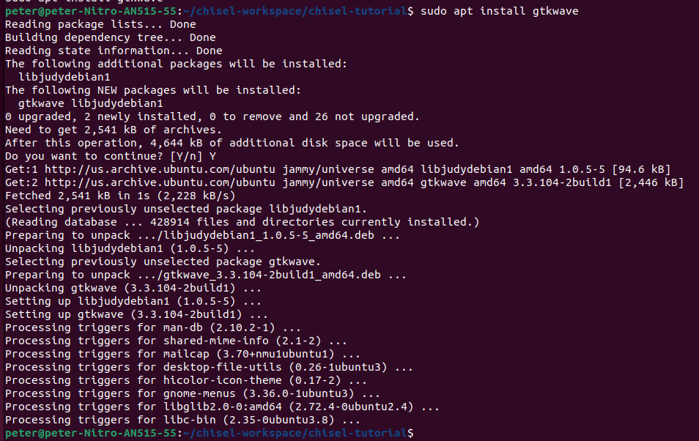
3.13 gtkwave
https://github.com/ucb-bar/chisel-tutorial/wiki/The-Basics
gtkwave
> sudo apt install gtkwave

Slide 34
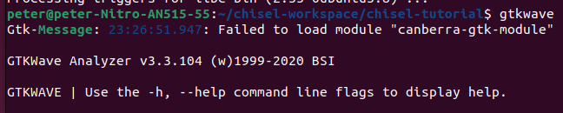
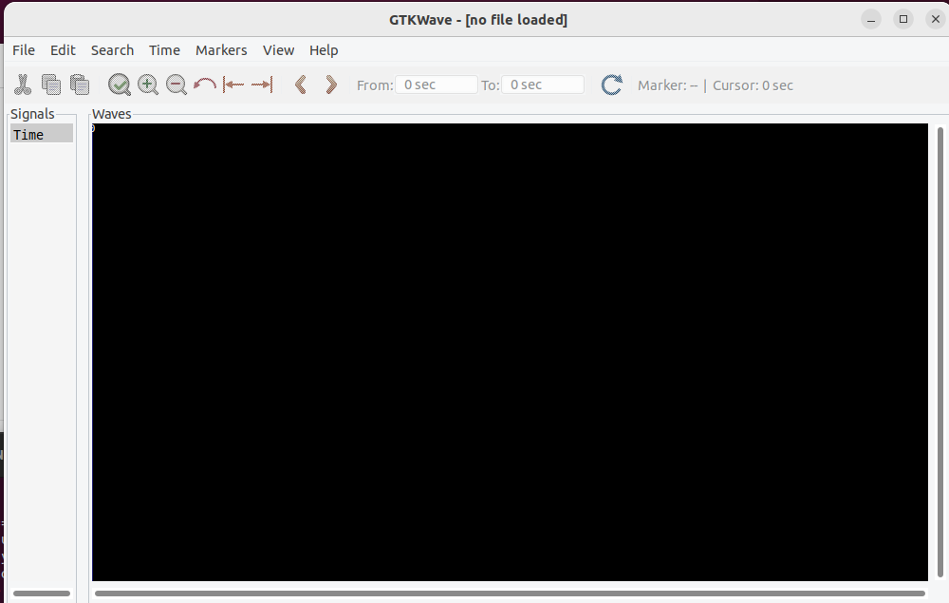
3.13 gtkwave
https://github.com/ucb-bar/chisel-tutorial/wiki/The-Basics
gtkwave
> gtkwave
You can use gtkwave to view the vcd dump.

Slide 35
3.13 gtkwave
https://github.com/ucb-bar/chisel-tutorial/wiki/The-Basics
Gtkwave
> gtkwave
Below is gtkwave GUI.

Slide 36
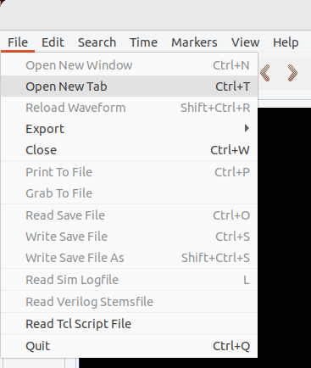
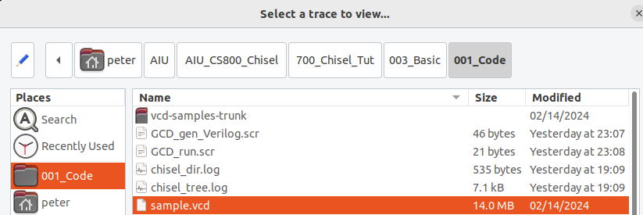
3.13 gtkwave
1
https://github.com/ucb-bar/chisel-tutorial/wiki/The-Basics
Gtkwave
Because the verilator has error in VCD dump, instead, we download the sample.vcd dumped from google search.
1. File > Open New Tab
2. Browse the 001_Code directory
3. Select sample.vcd to display.
2
3

Slide 37
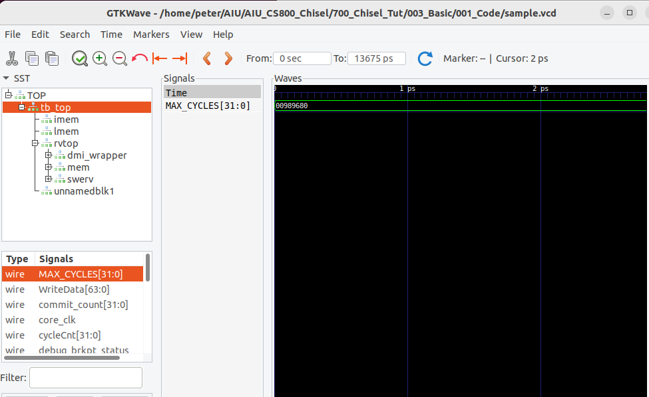
3.13 gtkwave
https://github.com/ucb-bar/chisel-tutorial/wiki/The-Basics
Gtkwave
1. Select wire MAX_CYCLES[31:0]
2. Drag and drop wire MAX_CYCLES[31:0] into the canvas to see the waveform.
2
1

Slide 38
End

