Slide 1

13.31 Bundle
Peter H. Chen

Slide 2

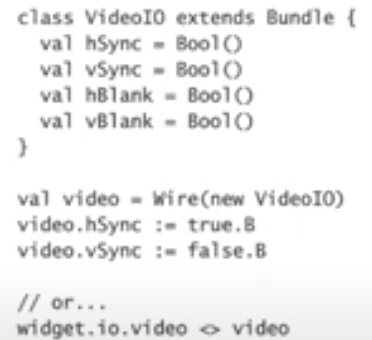
13.31 Bundle
https://www.youtube.com/watch?v=Wst8IoYRWKo&list=PLlu0CT-JnSasfpk8tq1ZDiE2G0AK1BhOg&index=13
Bundle (27:18-28:06/40:19)
Bundles are passing around a group of signals together.
Here, we have the class VideoIO extends the Bundle class.
We got analog signals: hSync, vSync, hBlank, vBlank.
We always want to passing around those signals as a group together. We never want to pass them individually.
So, a bundle is a way we group those signals together.
If we need a wire, we use
> val video = Wire (new videoIO)
To create an instance of that bundle and then assign those signals
Or we can do them together in one statement
> widget.io.video <> video
Note: <> is used to bulk connect all of the identically named ports between two modules.
https://stackoverflow.com/questions/52123791/what-is-the-operator-in-chisel

Slide 3
13.32 Vector

Slide 4

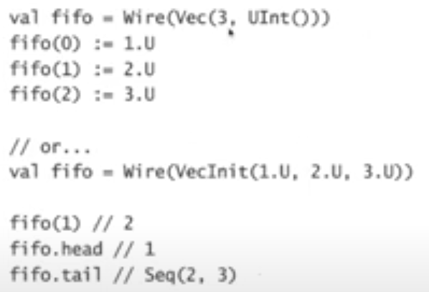
13.32 Vector
https://www.youtube.com/watch?v=Wst8IoYRWKo&list=PLlu0CT-JnSasfpk8tq1ZDiE2G0AK1BhOg&index=13
Vector (27:18-28:38/40:19)
Vectors is used in Math.
A Vector in Math is like an array in programming.
Vector contains a fixed of number particular tope of value.
> val fifo = Wire (Vec(3, UInt()))
We store the values in a FIFO queue vector.
> fifo(0) := 1.U
> fifo(1) := 2.U
> fifo(2) := 3.U
We assign the value 1 to the index 0 of FIFO queue.
Or we can use one statement below.
> val fifo = Wire (VecInt (1.U, 2.U, 3.U))
We can access the index of value
> fifo(1) // value = 2
> fifo.head // value = 1
> fifo.tail // tail of the list (2, 3) = Seq (2, 3)

Slide 5
13.33 Module

Slide 6

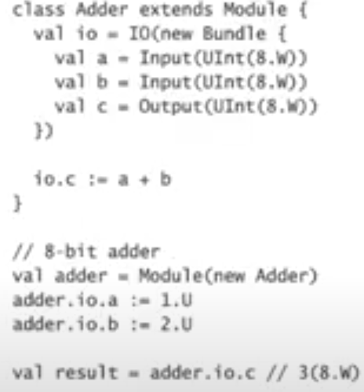
13.33 Module
https://www.youtube.com/watch?v=Wst8IoYRWKo&list=PLlu0CT-JnSasfpk8tq1ZDiE2G0AK1BhOg&index=13
Module (28:39-29:07/40:19)
Modules are used to tie all the hierarchical structure in the generated circuits together.
In the circuits, we have input and output signal and behavior inside the module. We wan to wrap them into one piece of functionality.
We instantiate a module by calling the module function. We got the module instance of that class.
Here, we instantiate an adder and input signal a =1.U and b = 2.U.
We got the output signal c is 3 with default 8 bit input/output.

Slide 7
13.34 Parameter

Slide 8

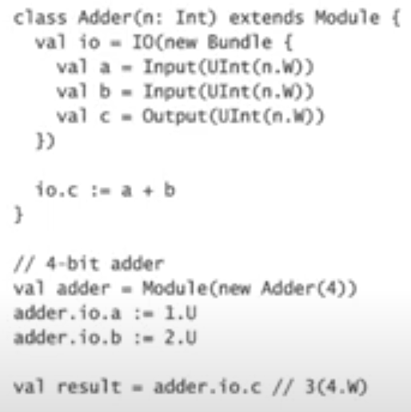
13.34 Parameter
https://www.youtube.com/watch?v=Wst8IoYRWKo&list=PLlu0CT-JnSasfpk8tq1ZDiE2G0AK1BhOg&index=13
Parameter (29:08-29:32/40:19)
Parameters are way to generalize the idea of behavior.
Here, we rather than hard coding the module with 8 bits, we can pass in parameter when we instantiate that module.
Here, the we passed in parameter n = 4 bit wide.
> value adder = Module (new Adder (4))
Now, the output still 3 but width is 4. 3 (4.W).

Slide 9
13.35 Black Box

Slide 10

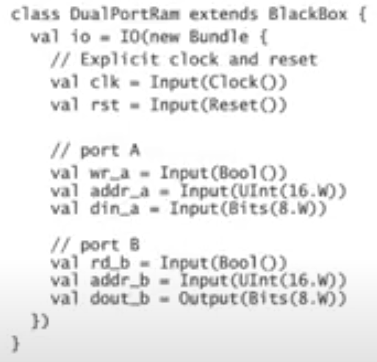
13.35 Black Box
https://www.youtube.com/watch?v=Wst8IoYRWKo&list=PLlu0CT-JnSasfpk8tq1ZDiE2G0AK1BhOg&index=13
Black Box (29:33-30:10/40:19)
Black Boxes are way of wrapping up the functionality in some external module that maybe written in Verilog, VHDL, or some chisel modules.
We use a black box to bring them (Verilog, VHDL, Chisel) together into chisel language.
The black box need to explicitly define a clock and reset because Chisel doesn’t know how to pass implicit signals to the external module.
Otherwise, the black box and module are similar.

Slide 11
13.36 MISTER

Slide 12

13.36 MISTER
https://www.youtube.com/watch?v=Wst8IoYRWKo&list=PLlu0CT-JnSasfpk8tq1ZDiE2G0AK1BhOg&index=13
MISTER (30:11-31:06/40:19)
MiSTer (Amiga and Atari ST on Terasic) is the project for FPGA cores development.

Slide 13
13.37 MiSTer FPGA

Slide 14
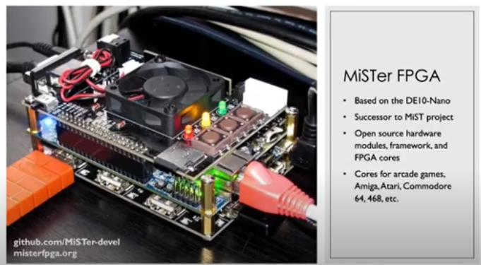
13.37 MiSTer FPGA
https://www.youtube.com/watch?v=Wst8IoYRWKo&list=PLlu0CT-JnSasfpk8tq1ZDiE2G0AK1BhOg&index=13
MiSTer FPGA (31:07-32:14/40:19)
MiSTer uses Terasic DE10-Nano development board to build the MiSTer system, which utilizes an FPGA (Field Programmable Gate Array) chip for hardware emulation.
MiSTer FPGA success the previous MiST Project.
MiSTer is a board in between two other boards.
There are analog IO here.
Cores are for Arcade game, Amiga, Atari, Commodore 64, 468, etc. platforms.

Slide 15
13.38 DEMO

Slide 16

13.38 DEMO
https://www.youtube.com/watch?v=Wst8IoYRWKo&list=PLlu0CT-JnSasfpk8tq1ZDiE2G0AK1BhOg&index=13
DEMO (32:15-32:25/40:19)

Slide 17
13.39 Run MiSTer Board on Chisel

Slide 18
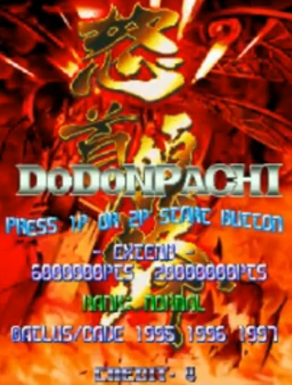
13.39 Run MiSTer Board on Chisel
https://www.youtube.com/watch?v=Wst8IoYRWKo&list=PLlu0CT-JnSasfpk8tq1ZDiE2G0AK1BhOg&index=13
Run MiSTer Board on Chisel (32:26-33:10/40:19)
We run this game with MiSTer Board on Chisel.

Slide 19
13.40 Running Game

Slide 20
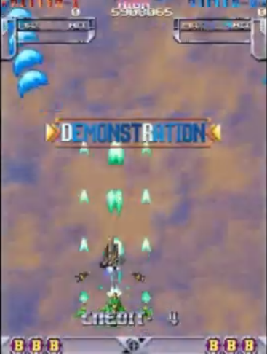
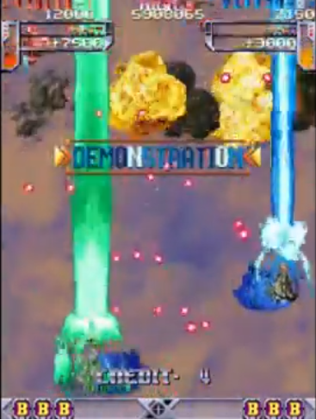
13.40 Running Game
https://www.youtube.com/watch?v=Wst8IoYRWKo&list=PLlu0CT-JnSasfpk8tq1ZDiE2G0AK1BhOg&index=13
Running Game (33:11-35:03/40:19)

Slide 21
End

