Slide 1

13.41 Chisel Code
Peter H. Chen

Slide 2
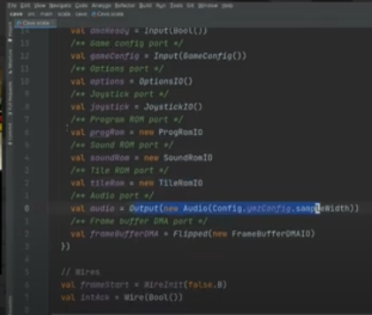
13.41 Chisel Code
https://www.youtube.com/watch?v=Wst8IoYRWKo&list=PLlu0CT-JnSasfpk8tq1ZDiE2G0AK1BhOg&index=13
Chisel Code (35:04-37:00/40:19)
These are all Chisel codes in Scala syntax.

Slide 3
13.42 Unit Test

Slide 4
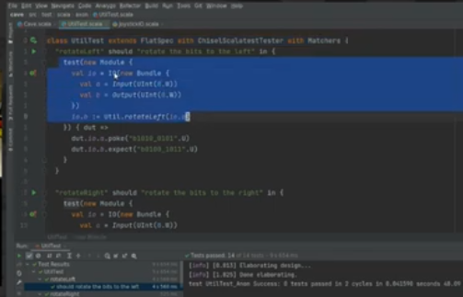
13.42 Unit Test
https://www.youtube.com/watch?v=Wst8IoYRWKo&list=PLlu0CT-JnSasfpk8tq1ZDiE2G0AK1BhOg&index=13
Unit Test (37:01-37:32/40:19)

Slide 5
13.43 Learn More

Slide 6

13.43 Learn Mode
https://www.youtube.com/watch?v=Wst8IoYRWKo&list=PLlu0CT-JnSasfpk8tq1ZDiE2G0AK1BhOg&index=13
Learn More (37:33-37:57/40:19)

Slide 7
13.44 Digital Design With Chisel

Slide 8
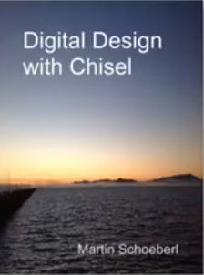
13.44 Digital Design With Chisel
https://www.youtube.com/watch?v=Wst8IoYRWKo&list=PLlu0CT-JnSasfpk8tq1ZDiE2G0AK1BhOg&index=13
Digital Design With Chisel (37:33-40:19/40:19)
Book by Martin Schoeberl. He is from Denmark University.

Slide 9
13.45 Chisel Bootcamp and Lab

Slide 10
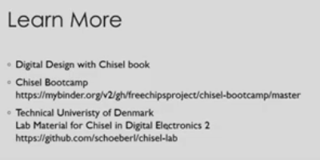
13.45 Chisel Bootcamp and Lab
https://www.youtube.com/watch?v=Wst8IoYRWKo&list=PLlu0CT-JnSasfpk8tq1ZDiE2G0AK1BhOg&index=13
Chisel Bootcamp and Lab (37:58-38:53/40:19)
Bootcamp and Lab

Slide 11
13.46 Q & A

Slide 12
13.46 Q & A
https://www.youtube.com/watch?v=Wst8IoYRWKo&list=PLlu0CT-JnSasfpk8tq1ZDiE2G0AK1BhOg&index=13
Q & A (38:54-40:19/40:19)
Q: Are there open tools to output chisel designs to other languages? For example, if you wan to pass over to other team.
Ans: Chisel output to Verilog by default. The other is to output to VHDL. Verilog is the main output.
The Verilog output is not totally human readable in signals. You need to name the signal name appropriately. You can run them without confusion.
You can integrate the Verilog into other projects written in VHDL.

Slide 13
End

