Slide 1

1.11 HW Generator
Peter H. Chen

Slide 2

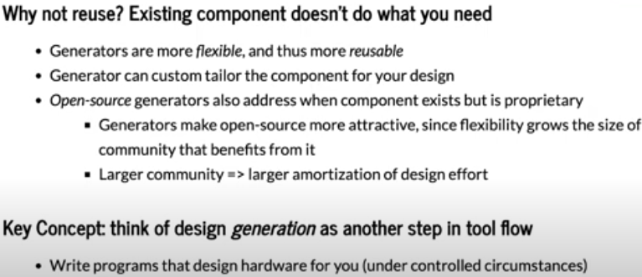
1.11 HW Generator
https://www.youtube.com/watch?v=L2e-55iSA_8&list=PLfrN7RIcMe6g2LBRJLTHTdhyj5s8ag0Rg&index=1
HW Generator (18:08-25:13/56:21)
HW Generator generates Verilog component. Generators increase usability. Why not reuse? Existing component doesn’t do what you want
1. Software is flexible than hardware Component Verilog. Generators are meta programs and are more flexible and more reusable. Generators are template program with passing parameters to produce the hardware component.
2. Generator can custom tailor and fit for your design need.
3. Open Source Generator is more attractive than proprietary component. Open source is bigger community than proprietary resource.

Slide 3
1.12 Chisel Tool

Slide 4
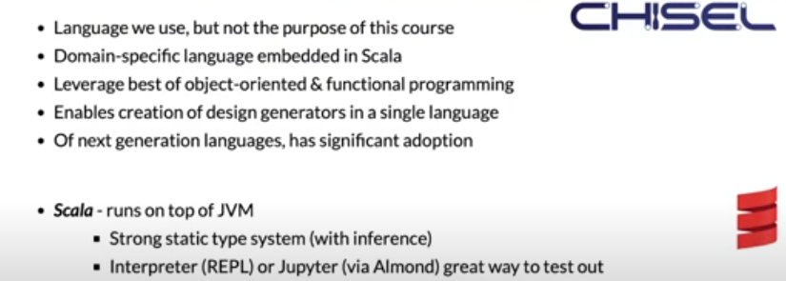
1.12 Chisel Tool
https://www.youtube.com/watch?v=L2e-55iSA_8&list=PLfrN7RIcMe6g2LBRJLTHTdhyj5s8ag0Rg&index=1
Chisel Tool (25:14-31:04/56:21)
Chisel (Constructing Hardware In a Scala Embedded Language).
1. Chisel is software tool. In Chisel, we write software to develop the hardware Verilog design.
2. Chisel is domain-specific language embedded in Scala.
3. Chisel inherited Scala (similar to Java/C++) Object-Oriented Programming and Functional Programming.
4. Chisel create and generate Verilog hardware generator in one single language.
5. Chisel embedded in Scala and adopt next generation language.
Scala (Scalable Language) run on JVM (Java Virtual Machine):
1. Scala is a strong static type. It is easy to inference/understand)
2. Scala is an interpreter is easier to try/run. We will also use Jupyter to try.

Slide 5
1.13 Common Themes

Slide 6
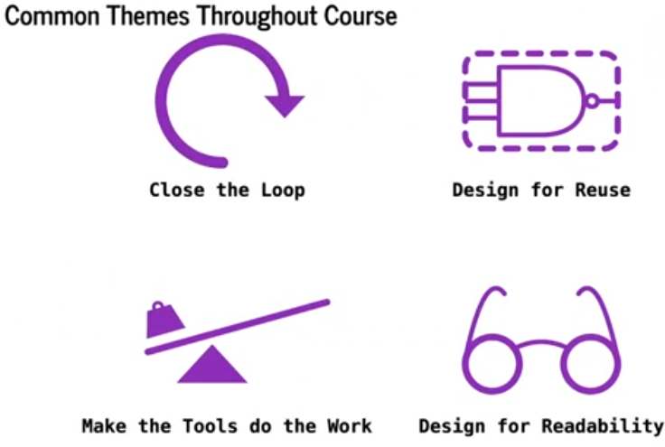
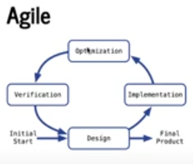
1.13 Common Themes
https://www.youtube.com/watch?v=L2e-55iSA_8&list=PLfrN7RIcMe6g2LBRJLTHTdhyj5s8ag0Rg&index=1
Common Themes (31:05-35:13/56:21)
Below are the themes (topics) we commonly used.
1. Close the loop, 2. Design for Reuse, 3. Make the tools do the works, 4. Design for Readability (Make code more clear).

Slide 7
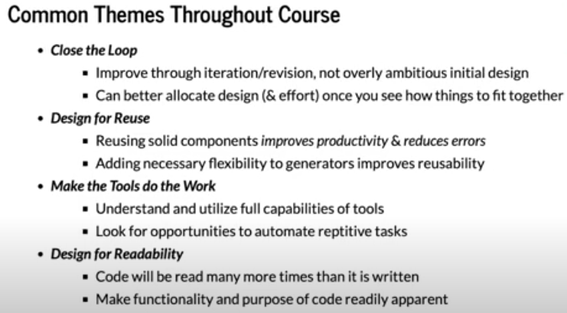
1.14 Common Themes
https://www.youtube.com/watch?v=L2e-55iSA_8&list=PLfrN7RIcMe6g2LBRJLTHTdhyj5s8ag0Rg&index=1
Common Themes (35:14-35:39/56:21)
Below are the main key topics.

Slide 8
1.14 Who Need Chisel?

Slide 9
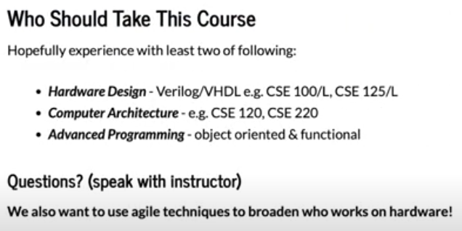
1.14 Who Need Chisel?
https://www.youtube.com/watch?v=L2e-55iSA_8&list=PLfrN7RIcMe6g2LBRJLTHTdhyj5s8ag0Rg&index=1
Who Need Chisel? (35:40-37:41/56:21)
1. Hardware: Hardware Design/Computer Architecture
2. Advanced Programming: Object-Oriented Programming and Functional Programming

Slide 10
1.15 Staff

Slide 11

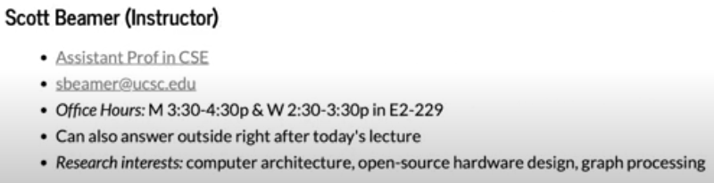
1.15 Staff
https://www.youtube.com/watch?v=L2e-55iSA_8&list=PLfrN7RIcMe6g2LBRJLTHTdhyj5s8ag0Rg&index=1
Staff (37:42-38:45/56:21)
Scott Beamer: Computer Architecture, Open Source Hardware Design using Chisel, Graph Processing

Slide 12
1.16 Course Structure

Slide 13

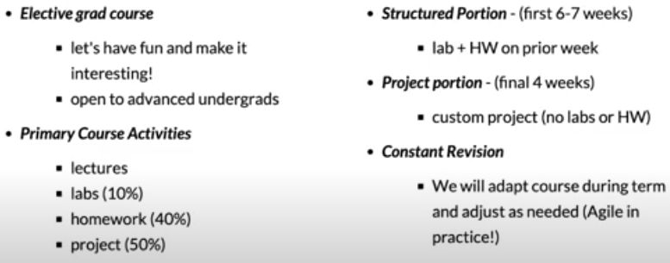
1.16 Course Structure
https://www.youtube.com/watch?v=L2e-55iSA_8&list=PLfrN7RIcMe6g2LBRJLTHTdhyj5s8ag0Rg&index=1
Course Structure (38:46-41:47/56:21)
1. Lab, HW: 6-7 weeks
2. Project (4 weeks)

Slide 14
1.17 Lecture

Slide 15
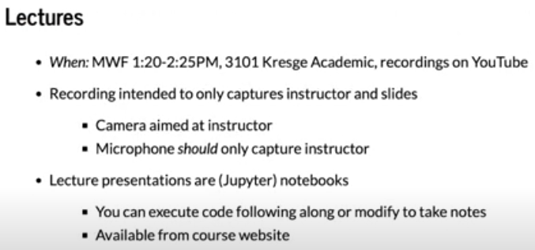
1.17 Lecture
https://www.youtube.com/watch?v=L2e-55iSA_8&list=PLfrN7RIcMe6g2LBRJLTHTdhyj5s8ag0Rg&index=1
Lecture (41:48-43:13/56:21)
Scala run in Jupyter Notebook

Slide 16
1.18 Lab

Slide 17
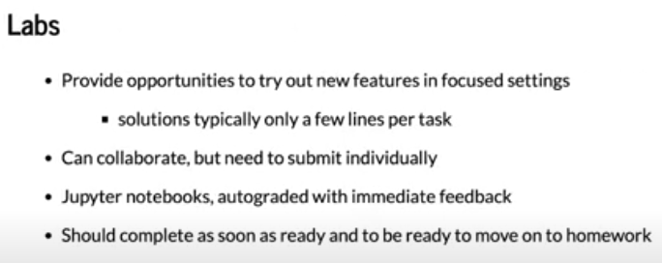
1.18 Lab
https://www.youtube.com/watch?v=L2e-55iSA_8&list=PLfrN7RIcMe6g2LBRJLTHTdhyj5s8ag0Rg&index=1
Lab (43:14-44:39/56:21)
Short problem to try out, for example, in one line of code in Jupyter Notebook.
Should be done in few minutes.

Slide 18
1.19 Homework

Slide 19
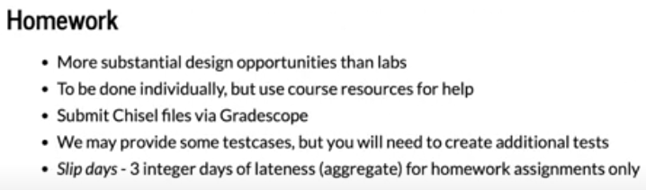
1.19 Homework
https://www.youtube.com/watch?v=L2e-55iSA_8&list=PLfrN7RIcMe6g2LBRJLTHTdhyj5s8ag0Rg&index=1
Homework (44:40-49:01/56:21)
Homework is more complicate Design and more grade points than Lab.

Slide 20
1.20 Project

Slide 21
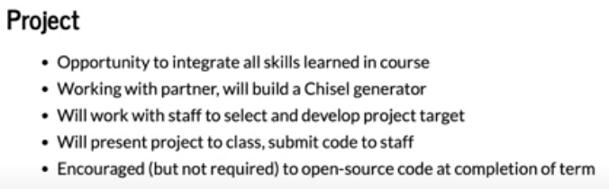
1.20 Project
https://www.youtube.com/watch?v=L2e-55iSA_8&list=PLfrN7RIcMe6g2LBRJLTHTdhyj5s8ag0Rg&index=1
Project (49:02-51:43/56:21)
1. Integrate all we learned
2. Work with partner
3. Build a Chisel Generator
4. Work with staff and select project
5. Present in class
6. Use open source code to complete the project.

Slide 22
End

