Slide 1

0.1 Install SDK
Peter H. Chen

Slide 2
0.1 Install SDK
https://github.com/ucb-bar/chisel-tutorial?tab=readme-ov-file
Install SDK
Q1: Why do we need JDK (Java Development Kit) and SBT (Simple Build Kit)
Ans: Because Chisel is based on Scala, Scala is based on Java, Java is based on C/C++, we need to install JDK (Java Development Kit) and SBT (Simple Build Kit) to build C application, such as , C++, Java, Scala, or Chisel.
Q2: How to install the SDK and SBT?
Ans: Get SDKMAN to get SDK, then use SDK to install JDK and SBT.
1. SDKMAN: We use SDKMAN (Simple Build Tool Manager) SDK (Software Development Kit)
2. We use SDK (Java Development Kit) to the JDK (Java Development Kit)
3. We use SDK to install the SBT (Simple Build Kit)

Slide 3
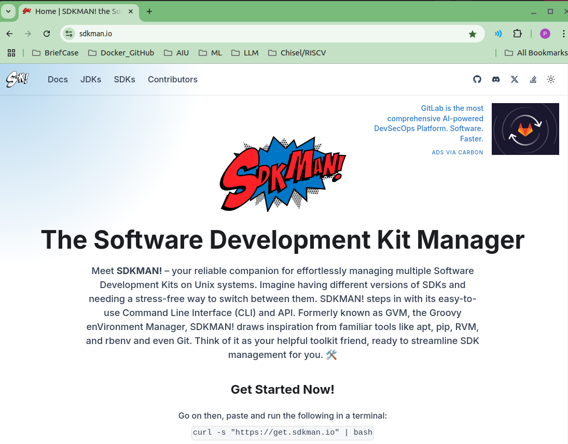

0.1 Install SDK
https://github.com/ucb-bar/chisel-tutorial?tab=readme-ov-file
Install SDK
Use CURL to copy SDK from URL (get.sdkman.io)
1. > curl -s "https://get.sdkman.io" | bash
Next slide shows get copy SDK and setup SDK.
https://sdkman.io/
1

Slide 4
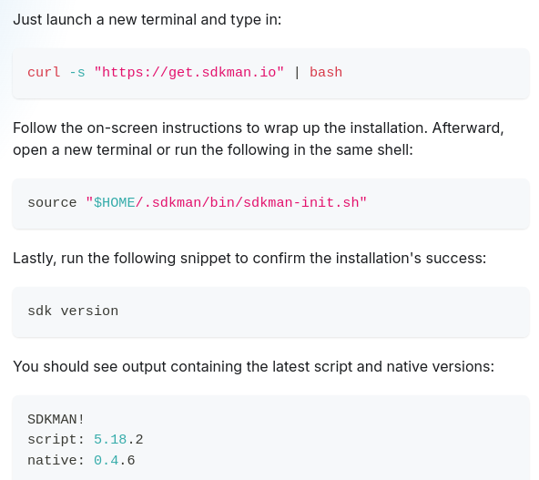

0.1 Install SDK
https://github.com/ucb-bar/chisel-tutorial?tab=readme-ov-file
Install SDK
Get SDK from URL and then setup.
1. > curl -s "https://get.sdkman.io" | bash # CURL (Copy URL): Clone sdkman from URL
2. > source "$HOME/.sdkman/bin/sdkman-init.sh"
https://sdkman.io/install
1
2

Slide 5
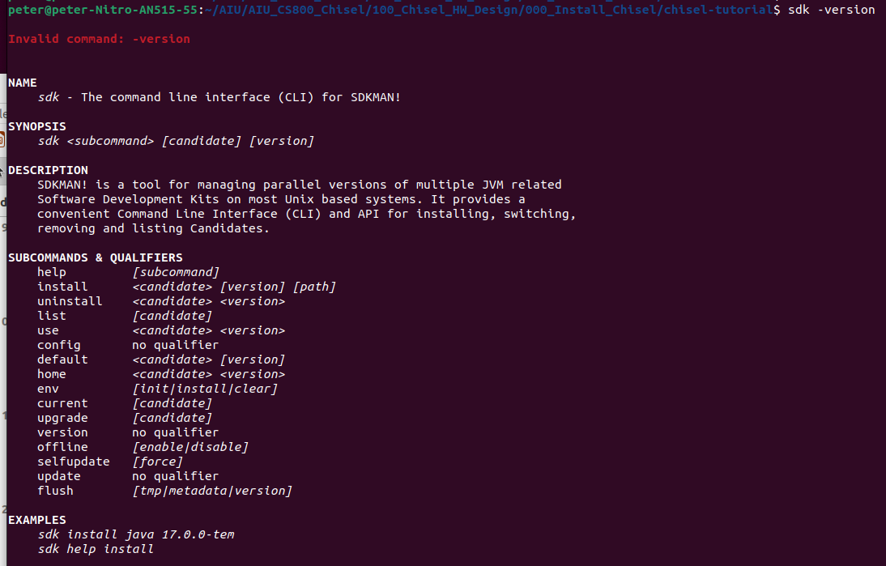
0.1 Install SDK
https://github.com/ucb-bar/chisel-tutorial?tab=readme-ov-file
Install SDK
3. > sdk version
4. > sdk -version
man.io/install
3
4

Slide 6
End

