Slide 1

0.2 Install JDK
Peter H. Chen

Slide 2
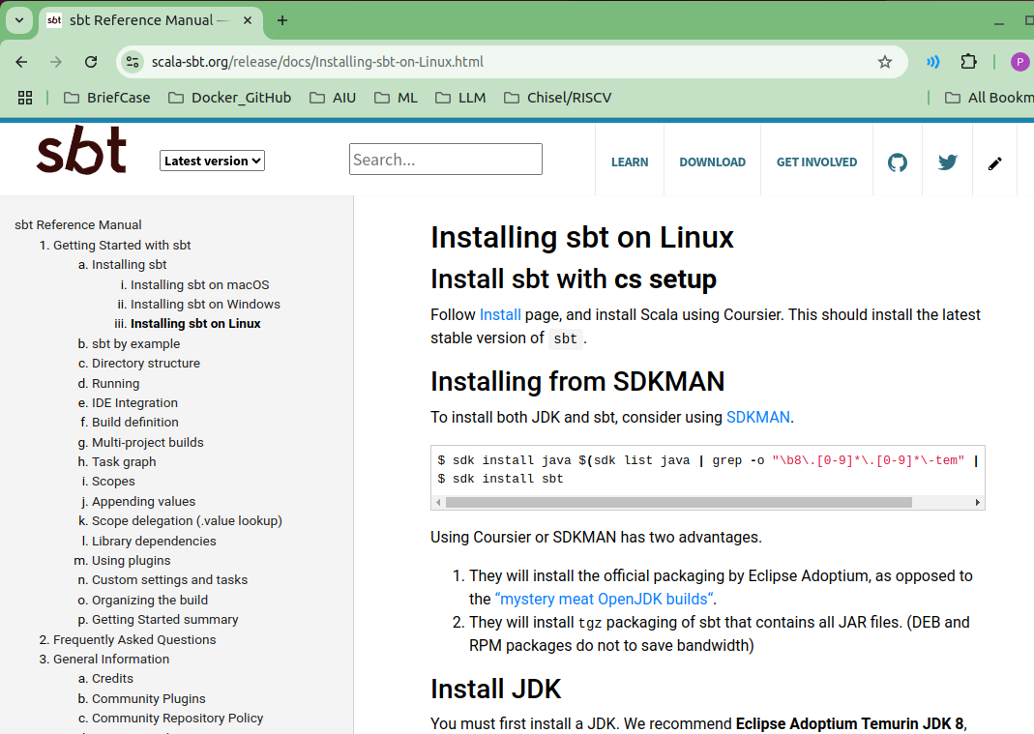
0.2 Install JDK
https://github.com/ucb-bar/chisel-tutorial?tab=readme-ov-file
Install JDK
Below, we have installed the SDK, now, we can use SDK to install JDK and SBT.
https://www.scala-sbt.org/release/docs/Installing-sbt-on-Linux.html

Slide 3
0.2.1 Install JDK

Slide 4


0.2.1 Install JDK
https://github.com/ucb-bar/chisel-tutorial?tab=readme-ov-file
Install JDK
After we install JDK, we can check
1. Java Compiler version:
> javac -version
>> javac 1.8.0_432 # Java 1.8 or Java 8
2. JVM (JVM is part of JRE) version
> java -version
>> openjdk version “1.8._432”
>> OpenJDK Runtime Environment (JRE): 1.8
>> OpenJDK 64-bit Server VM (JVM)
https://www.scala-sbt.org/release/docs/Installing-sbt-on-Linux.html
1
2

Slide 5
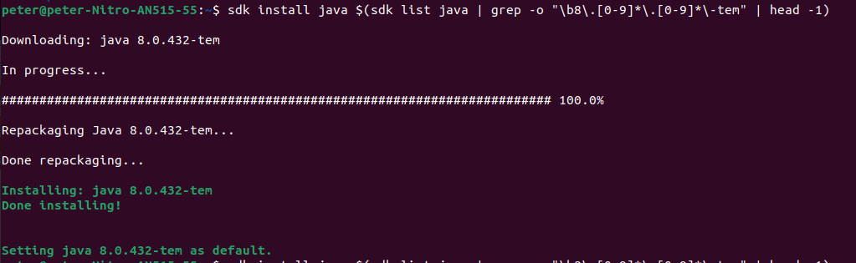
0.2.1 Install JDK
https://github.com/ucb-bar/chisel-tutorial?tab=readme-ov-file
Install JDK
Below, we use SDK to install JDK
> sdk install java $(sdk list java | grep -o "\b8\.[0-9]*\.[0-9]*\-tem" | head -1)
https://www.scala-sbt.org/release/docs/Installing-sbt-on-Linux.html

Slide 6
End

