Slide 1

0.3 Install SBT
Peter H. Chen

Slide 2
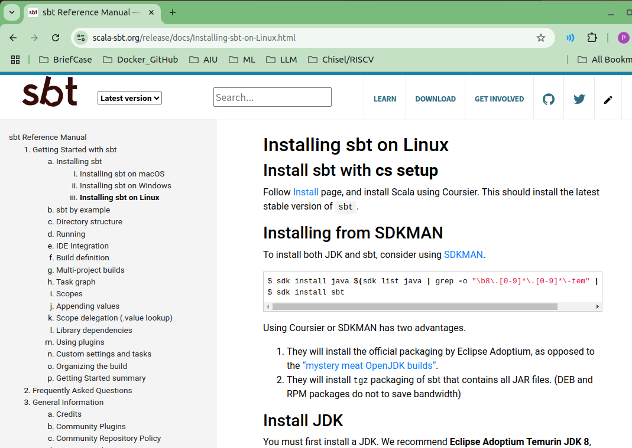
0.3 Install SBT
https://github.com/ucb-bar/chisel-tutorial?tab=readme-ov-file
Install SBT
Below, we have installed the SDK, now, we can use SDK to install JDK and SBT.
https://www.scala-sbt.org/release/docs/Installing-sbt-on-Linux.html

Slide 3
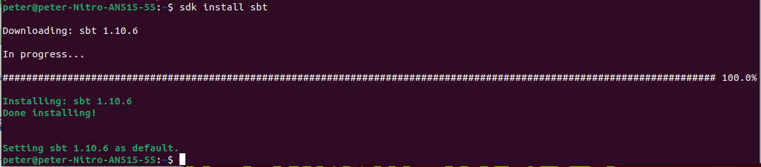
0.3 Install SBT
https://github.com/ucb-bar/chisel-tutorial?tab=readme-ov-file
Install SBT
Install SBT:
> sdk install sbt
https://www.scala-sbt.org/release/docs/Installing-sbt-on-Linux.html

Slide 4

0.3 Install SBT
https://github.com/ucb-bar/chisel-tutorial?tab=readme-ov-file
Check SBT Version
After we install SBT, we can check sbt version
> sbt -version
https://www.scala-sbt.org/release/docs/Installing-sbt-on-Linux.html

Slide 5
End

