Slide 1

0.8 Run Scala in Jupyter Notebook
Peter H. Chen

Slide 2
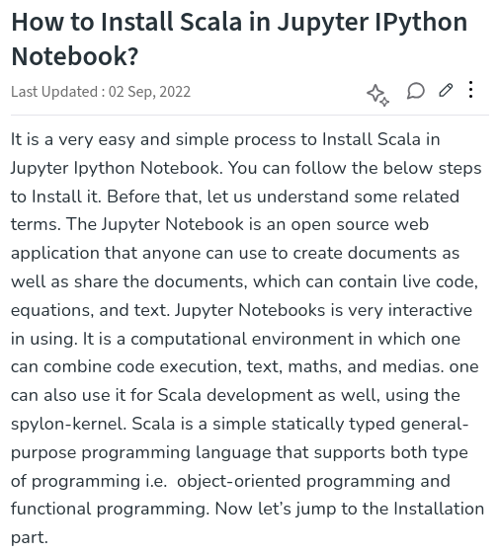
0.8 Install Scala in Jupyter Notebook
https://www.geeksforgeeks.org/how-to-install-scala-in-jupyter-ipython-notebook/
Why Jupyter Notebook and Scala?
Jupyter Notebook + Scala:
1. Jupyter Notebook is very interactive for code and document: We use spylon-kernel for installation.
2. Scala: Object-Oriented Programming and Functional Programming.

Slide 3
0.8.1 Install spylon-kernel

Slide 4
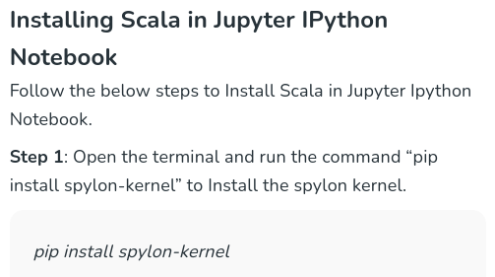

0.8.1 Install spylon-kernel
https://www.geeksforgeeks.org/how-to-install-scala-in-jupyter-ipython-notebook/
Install spylon-kernel
1. Open terminal
2. > pip install spylon-kernel
2

Slide 5
0.8.2 Create Kernel Spec

Slide 6
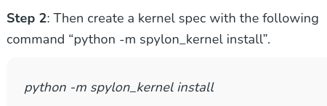
0.8.2 Create Kernel Spec
https://www.geeksforgeeks.org/how-to-install-scala-in-jupyter-ipython-notebook/
Create Kernel Spec
1. > python3 -m spylon_kernel install --user
-m: Library module
1

Slide 7
0.8.3 Start Jupyter Notebook

Slide 8
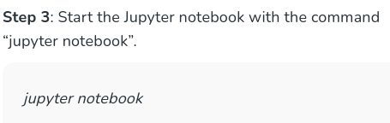
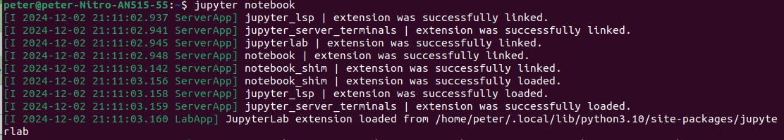
0.8.3 Start Jupyter Notebook
https://www.geeksforgeeks.org/how-to-install-scala-in-jupyter-ipython-notebook/
Start Jupyter Notebook
1. > jupyter notebook
1

Slide 9
0.8.4 Select spylon-kernel

Slide 10
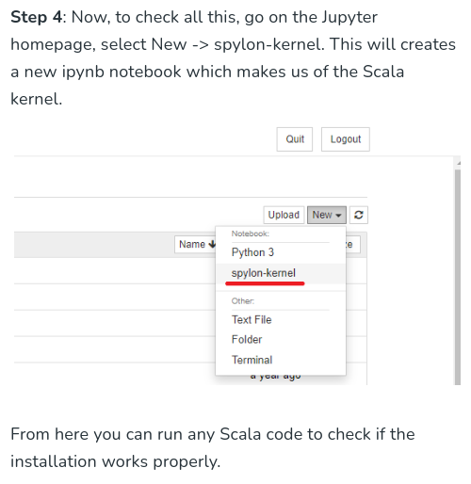
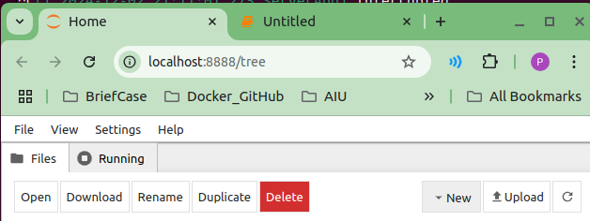
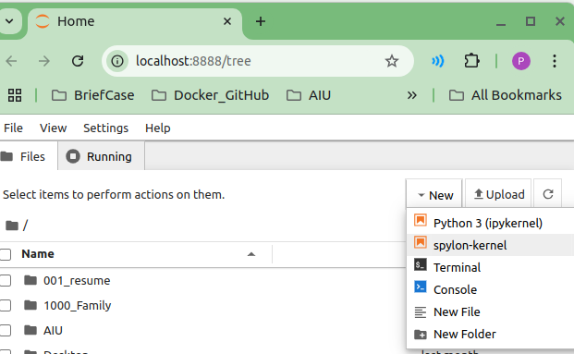
0.8.4 Select spylon-kernel
https://www.geeksforgeeks.org/how-to-install-scala-in-jupyter-ipython-notebook/
Select spylon-kernel
We select the spylon-kernel for Jupyter notebook
1. In the Chrome,
2. New -> Spylon-kernel
1
2

Slide 11
0.8.5 Scala in Jupyter Notebook

Slide 12
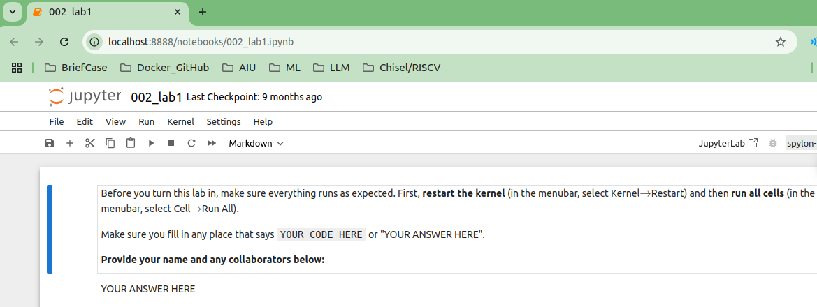
0.8.5 Scala in Jupyter Notebook
https://www.geeksforgeeks.org/how-to-install-scala-in-jupyter-ipython-notebook/
Scala in spylon-kernel
1. > cd 001_code # go to the jupyter code location
2. > jupyter notebook 002_lab1.ipynb
3. Jupyter notebook in chrome.
2
3

Slide 13
0.8.6 Check spylon-kernel Setting

Slide 14
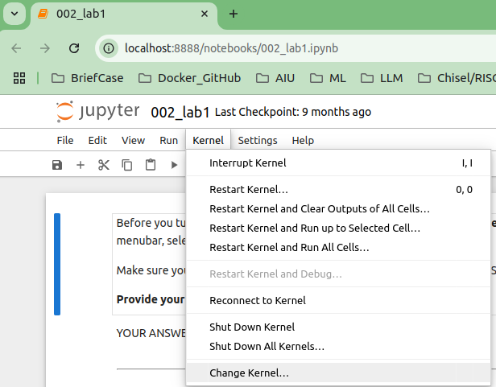
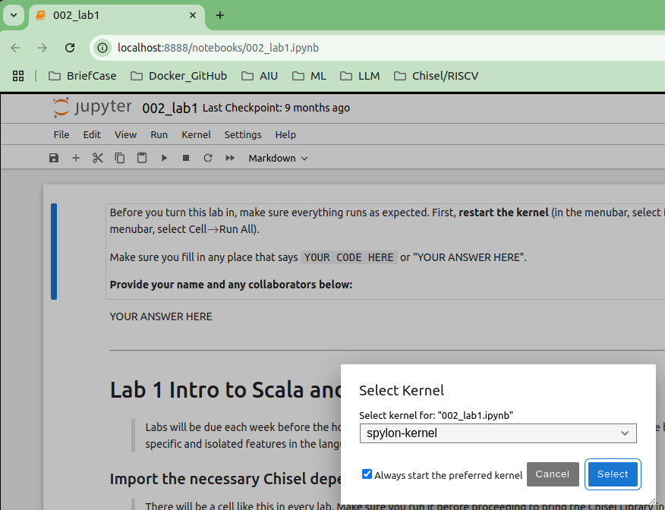
0.8.6 Check spylon-kernel Setting
https://www.geeksforgeeks.org/how-to-install-scala-in-jupyter-ipython-notebook/
Check spylon-kernel Setting
1. > Kernel > Change Kernel...
2. We can see the kernel is “spylon-kernel”
> select kernel for: “002_lab1.ipynb”
1
2

Slide 15
0.8.8 Run Scala in Jupyter Notebook

Slide 16
0.8.8 Run Scala in Jupyter Notebook
https://www.geeksforgeeks.org/how-to-install-scala-in-jupyter-ipython-notebook/
Run Scala in Jupyter Notebook
When we run the scala code, we have error message:
> could not find Spark.
We need to install the Spark.

Slide 17
0.8.9 Install Spark for Scala

Slide 18
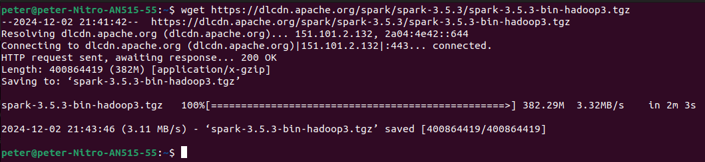
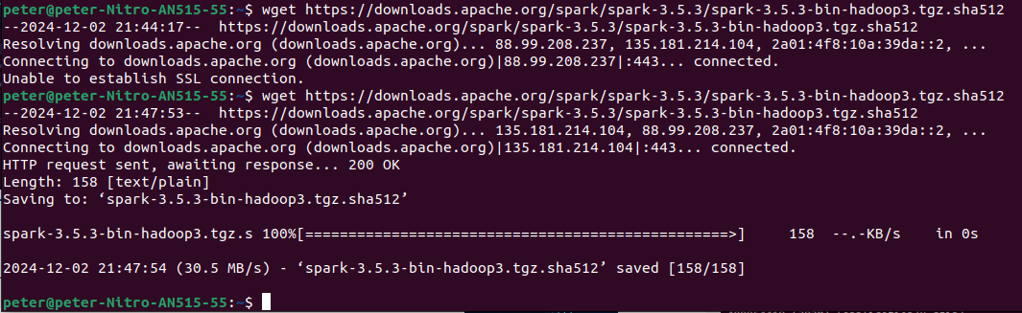
0.8.9 Install Spark for Scala
https://phoenixnap.com/kb/install-spark-on-ubuntu
Install Spark for Scala
1. Download Spark
2. Unzip/Verify the integrity of download with SHA-512
1
2

Slide 19
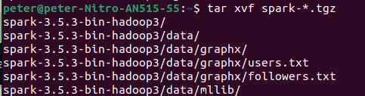
0.8.9 Install Spark for Scala
https://phoenixnap.com/kb/install-spark-on-ubuntu
Checksum and Unzip
1. Check Checksum (SHA-512) for zip file.
2. Extract Apache Spark Package: tar xvf spark-*.tgz
3. Move extracted spark to /opt/spark: sudo mv spark
1
2
3

Slide 20
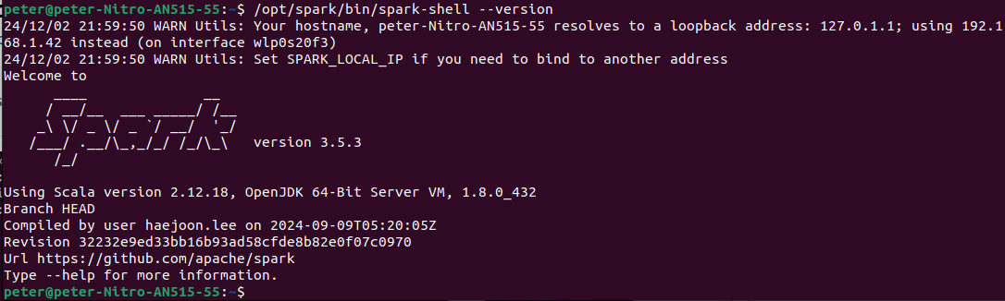
0.8.9 Install Spark for Scala
https://phoenixnap.com/kb/install-spark-on-ubuntu
Verify Spark Installation
1. > ls /opt/spark
2. /opt/spark/bin/spark-shell --version
1
2

Slide 21
0.8.9 Install Spark for Scala
https://phoenixnap.com/kb/install-spark-on-ubuntu
Setup Spark Environment
1. Setup Spark Environment
> echo "export SPARK_HOME=/opt/spark" >> ~/.bashrc
> echo "export PATH=$PATH:$SPARK_HOME/bin:$SPARK_HOME/sbin" >> ~/.bashrc
> echo "export PYSPARK_PYTHON=/usr/bin/python3" >> ~/.bashrc
1

Slide 22
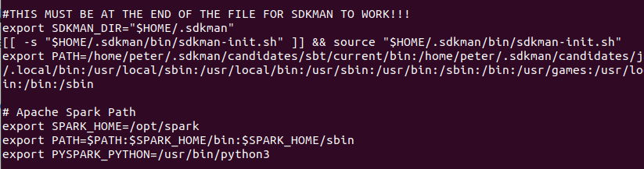
0.8.9 Install Spark for Scala
https://phoenixnap.com/kb/install-spark-on-ubuntu
Verify spark Setup Environment
1. > vi ~/.bashrc
2. Verify Spark Setup
> export SPARK_HOME = … # for Scala
> export PATH = … # for start the binary command
> export PYSPARK_PYTHON =… # for Python API
1
2

Slide 23
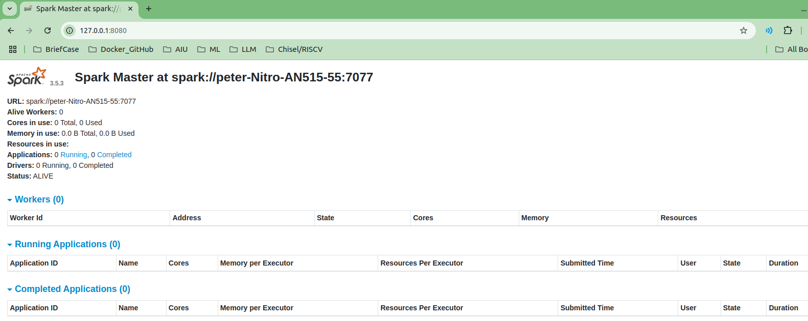
0.8.10 Source Enviornemnt
https://phoenixnap.com/kb/install-spark-on-ubuntu
Check Spark in Chrome
1. > source ~/.bashrc
2. > start-master.sh
3. Open chrome: type “http://127.0.0.1:8080/
1
2
3

Slide 24
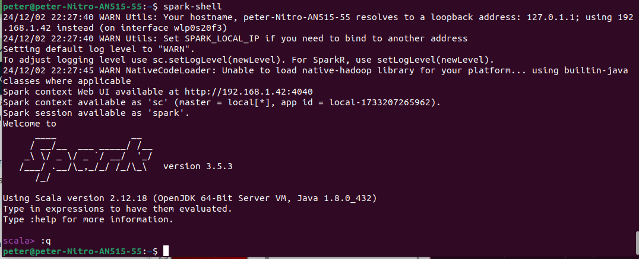
0.8.11 Check Spark Shell
https://phoenixnap.com/kb/install-spark-on-ubuntu
Check Spark Shell for Scala
1. > spark-shell
>> scala >
Type “:q” or “Control-D” to quit

Slide 25
End

