Slide 1

24 XLS: GPU Synthesis
Peter H. Chen

Slide 2
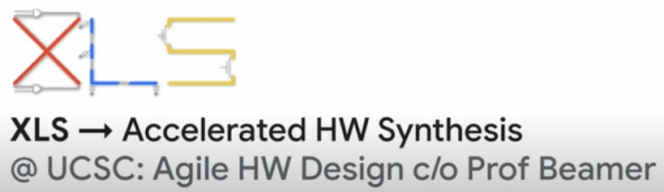
24 XLS: GPU Synthesis
https://www.youtube.com/watch?v=TOJ8QWuEec8&list=PLfrN7RIcMe6g2LBRJLTHTdhyj5s8ag0Rg&index=24
XLS: GPU Synthesis (0:00-0:47/1:02:43)
Agile Hardware Design C/O (Care of) Prof. Beamer.
Q: What is XLS?
Ans: XLS (Accelerated Low-Level Hardware Synthesis) implements a Hardware (Low-Level) Synthesis toolchain that produces synthesizable designs (Verilog and SystemVerilog) from flexible, high-level descriptions of functionality. It is Apache 2 licensed.
https://google.github.io/xls/

Slide 3
24.1 Code and Docs

Slide 4

24.1 Code and Docs
https://www.youtube.com/watch?v=TOJ8QWuEec8&list=PLfrN7RIcMe6g2LBRJLTHTdhyj5s8ag0Rg&index=24
Code and Docs (0:48-2:29/1:02:43)
Code: github.com/google/xls
Docs: google.github.io/xls
License: Apache 2.0

Slide 5
24.2 Why XLS?

Slide 6
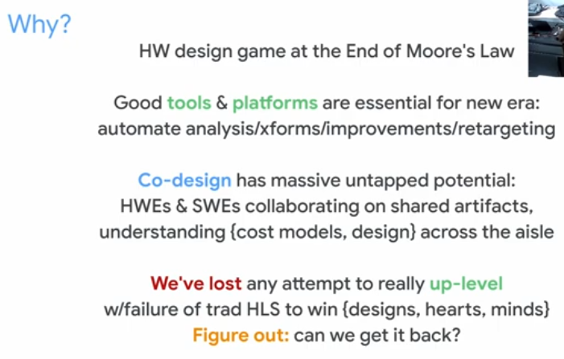
24.2 Why XLS?
https://www.youtube.com/watch?v=TOJ8QWuEec8&list=PLfrN7RIcMe6g2LBRJLTHTdhyj5s8ag0Rg&index=24
Why XLS? (0:48-6:34/1:02:43)
Computer, OS, Hardware Design.
1. Hardware Design in Game: End of Moore Law.
2. Tool accelerate design
3. HSL (High Level Synthesis)

Slide 7
24.3 Goal

Slide 8
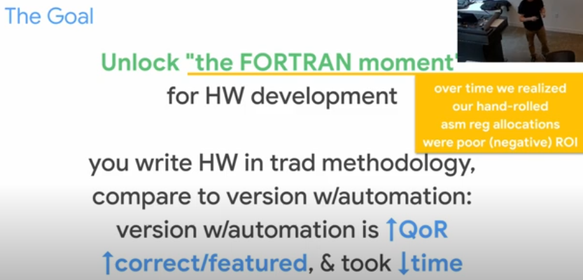
24.3 Goal
https://www.youtube.com/watch?v=TOJ8QWuEec8&list=PLfrN7RIcMe6g2LBRJLTHTdhyj5s8ag0Rg&index=24
Goal (6:35-7:23/1:02:43)
The first high level language for Hardware Design is FORTRAN.
Then, we move to other languages for automation.

Slide 9
24.4 Methodology and Quality of Result

Slide 10
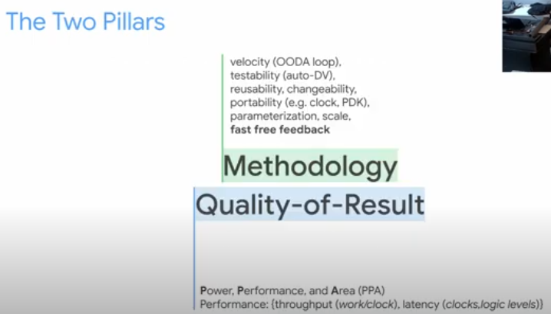
24.4 Methodology and Quality of Result
https://www.youtube.com/watch?v=TOJ8QWuEec8&list=PLfrN7RIcMe6g2LBRJLTHTdhyj5s8ag0Rg&index=24
Methodology and Quality of Result (7:24-8:42/1:02:43)
1. Methodology: We want Fast/Free Feedback in design. We concern the Velocity (OODA (Observe, Orient, Decide, and Act), reusability, portability, parameterization, and scale.
2. QoS (Quality of Result): PAT (Power, Area, Timing/Performance). In Performance, we consider the overall throughput of work and clock speed, shorten latency time of clock rate for the logic levels sensing.

Slide 11
24.5 Methodology and Quality of Result

Slide 12
24.4 Methodology and Quality of Result
https://www.youtube.com/watch?v=TOJ8QWuEec8&list=PLfrN7RIcMe6g2LBRJLTHTdhyj5s8ag0Rg&index=24
Methodology and Quality of Result (7:24-8:42/1:02:43)
1. Methodology: We want Fast/Free Feedback in design. We concern the Velocity (OODA (Observe, Orient, Decide, and Act), reusability, portability, parameterization, and scale.
2. QoS (Quality of Result): PAT (Power, Area, Timing/Performance). In Performance, we consider the overall throughput of work and clock speed, shorten latency time of clock rate for the logic levels sensing.

Slide 13
End

