Slide 1

4.1 RISCV Rocket Chip
Peter H. Chen

Slide 2
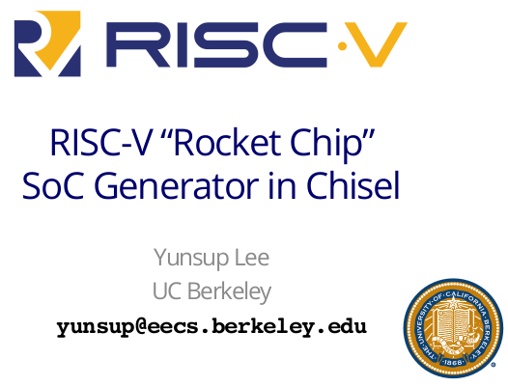
4.1 RISCV Rocket Chip
https://www.youtube.com/watch?v=Ir3h3qWcNlg&list=PLlu0CT-JnSasfpk8tq1ZDiE2G0AK1BhOg&index=4
RISCV Rocket Chip (0:00-1:30/41:08)
We discuss the “RISCV Rocket Chip: SoC Generator in Chisel”

Slide 3
4.2 What is Rocket Chip?

Slide 4
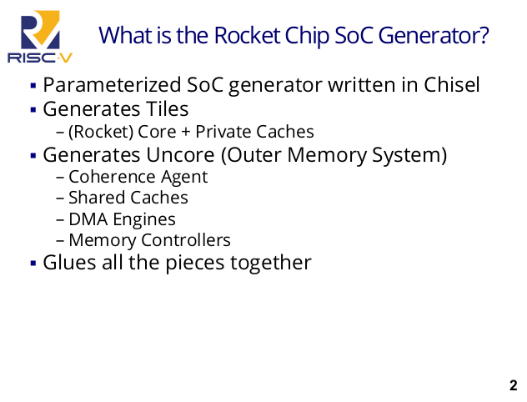
4.2 What is Rocket Chip?
https://www.youtube.com/watch?v=Ir3h3qWcNlg&list=PLlu0CT-JnSasfpk8tq1ZDiE2G0AK1BhOg&index=4
What is Rocket Chip? (1:31-1:40/41:08)
What is Rocket Chip SoC generator?
The SoC Generator is a parameterized SoC Generator written in Chisel.
It generates some tiles which currently put in the Rocket Core and some private caches.
It also generates the UnCore including the outer memory system.

Slide 5
4.3 Block Diagram

Slide 6
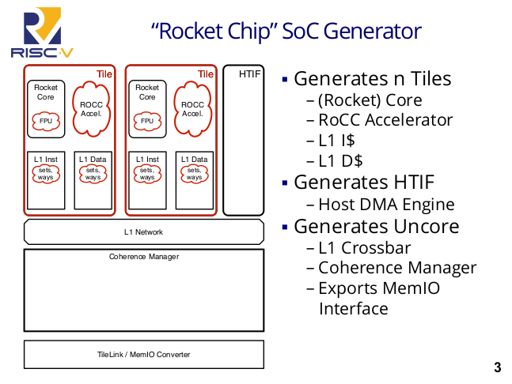
4.3 Block Diagram
https://www.youtube.com/watch?v=Ir3h3qWcNlg&list=PLlu0CT-JnSasfpk8tq1ZDiE2G0AK1BhOg&index=4
Block Diagram (1:41-2:54/41:08)
Rocket Chip SoC Generator generates several block diagrams as below.
Rocket Chip SoC generates
4. the arbitrary number of tiles which consists of
  a. Rocket Core: with or without a floating-point unit.
  b. ROCC Accel (Rocket Custom Accelerator): Rocket Custom Co-processor
  c. L1 Instruction Cache
  d. non-blocking L1 Data Cache.
2. HTIF Block: Host DMA engine can read/write target memory without any CPU intervention.
3. UnCore:
  a. L1 Crossbar,
  b. Coherence Manager,
  c. some converter to convert the complicated memory I/O.
1
2
3

Slide 7
4.4 Why SoC Generator?

Slide 8
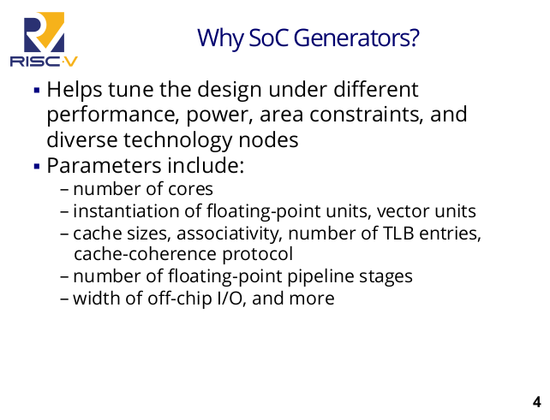
4.4 Why SoC Generator?
https://www.youtube.com/watch?v=Ir3h3qWcNlg&list=PLlu0CT-JnSasfpk8tq1ZDiE2G0AK1BhOg&index=4
Why SoC Generator? (2:55-3:38/41:08)
Why do we need SoC Generator?

Slide 9
4.5 Why Chisel?

Slide 10
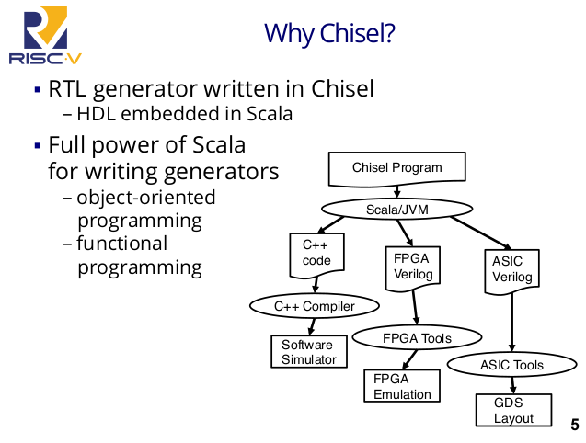
4.5 Why Chisel?
https://www.youtube.com/watch?v=Ir3h3qWcNlg&list=PLlu0CT-JnSasfpk8tq1ZDiE2G0AK1BhOg&index=4
Why Chisel? (3:39-720/41:08)
Why do we use Scala?
Scala is OOD Programming and Functional Programming
Why do we need Chisel?
1. C++ Code: Generates C++ Code for VCS simulation without license.
2. FPGA Verilog: Generates FPGA Verilog for FPGA Emulation with license.
3. ASIC Verilog: Generates ASIC RTL (Register/Transfer Level) Verilog for ASIC placement/Route and GDS Layout.

Slide 11
End

