Slide 1

2.11 Chisel Tool Flow
Peter H. Chen

Slide 2
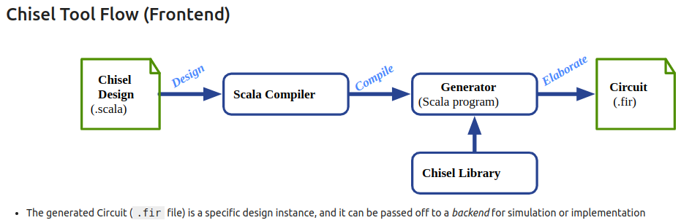
2.11 Chisel Tool Flow
https://www.youtube.com/watch?v=9GD6PROUlWw&list=PLfrN7RIcMe6g2LBRJLTHTdhyj5s8ag0Rg&index=2
Chisel Tool Flow (19:57-21:27/53:20)
1. We have one or many chisel design files, for example, main.scala.
2. We use Scala compiler to compile design file, main.scala
4. We input the Chisel component Library
4. Chisel generate the circuit (*.Fir)
5. Circuit (*.fir) is the FIRRTL program.
6. Circuit (*.fir) I the implement circuit and can be used for simulation.

Slide 3
2.12 Load Chisel Library

Slide 4
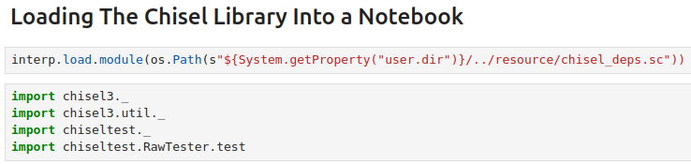
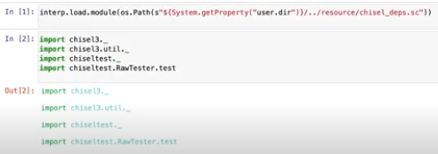
2.12 Load Chisel Library
https://www.youtube.com/watch?v=9GD6PROUlWw&list=PLfrN7RIcMe6g2LBRJLTHTdhyj5s8ag0Rg&index=2
Load Chisel Library (21:28-21:59/53:20)
Load Chisel Library into the Jupyter Notebook.
We will work on this behind in another class.

Slide 5
2.13 Chisel Type

Slide 6
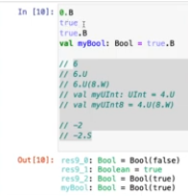
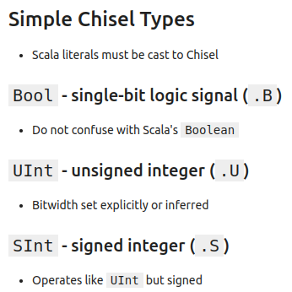
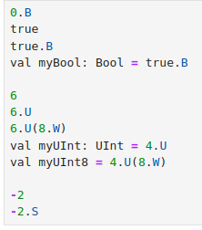
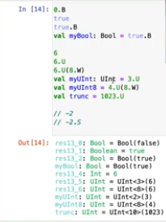
2.13 Chisel Type
https://www.youtube.com/watch?v=9GD6PROUlWw&list=PLfrN7RIcMe6g2LBRJLTHTdhyj5s8ag0Rg&index=2
Chisel Type (22:00-22:27/53:20)
We only look at very simple type.
1. Boolean
2. Integer
3. Integer/Signed Integer
1
2

Slide 7
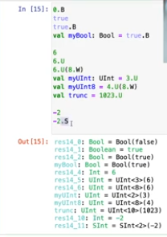
2.13 Chisel Type
https://www.youtube.com/watch?v=9GD6PROUlWw&list=PLfrN7RIcMe6g2LBRJLTHTdhyj5s8ag0Rg&index=2
Chisel Type (22:00-28:25/53:20)
We only look at very simple type.
1. Boolean
2. Integer
3. Integer/Signed Integer
3

Slide 8
2.14 Chisel Operator

Slide 9
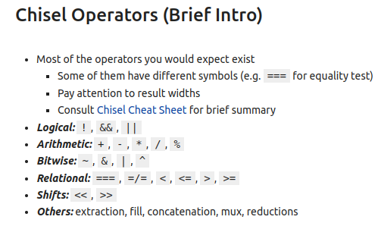

2.14 Chisel Operator
https://www.youtube.com/watch?v=9GD6PROUlWw&list=PLfrN7RIcMe6g2LBRJLTHTdhyj5s8ag0Rg&index=2
Chisel Operator (28:26-29:11/53:20)
Operators:
1. Logical
2. Arithmetic
3. Bitwise
4. Relational
5. Shift
6. Others: extraction, fill, concatenation, Mux, reduction

Slide 10
2.15 First Chisel Module

Slide 11
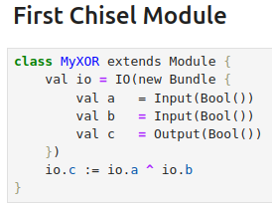
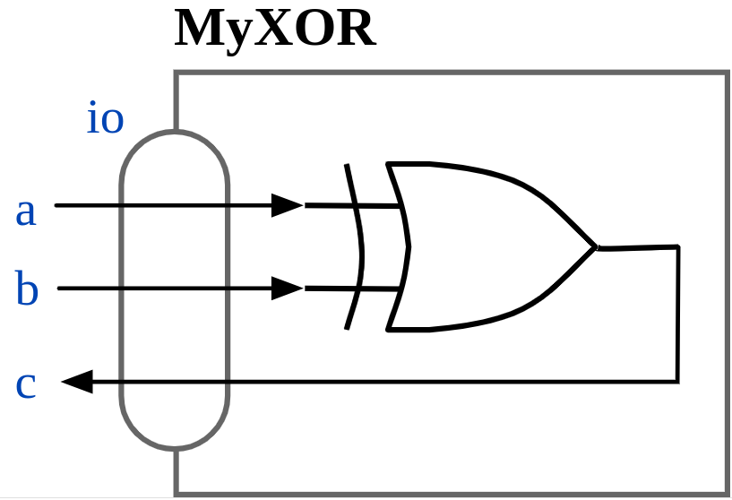
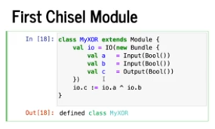
2.15 First Chisel Module
https://www.youtube.com/watch?v=9GD6PROUlWw&list=PLfrN7RIcMe6g2LBRJLTHTdhyj5s8ag0Rg&index=2
First Chisel Module (29:12-33:11/53:20)
We have
1. IO for the Module.
2. operator

Slide 12
2.16 Generate Design

Slide 13
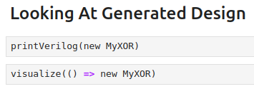
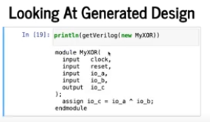
2.16 Generate Design
https://www.youtube.com/watch?v=9GD6PROUlWw&list=PLfrN7RIcMe6g2LBRJLTHTdhyj5s8ag0Rg&index=2
Generate Design (33:12-42:15/53:20)
After we finish the design and simulation, we can generate the Design in Verilog.
1. getVerilog()
2. println (getVerilog())
Below, we have one “clock”. We can have multiple clocks.
Questions:
1. How Chisel report “Single/port are not match”?
2. How Chisel handle “Non-Blocking in Verilog”?
3. How Chisel shift the clock domain?
Ans:
Internal Chisel is very complicated, we only talk simple usage in Chisel.
Chisel can handle mixed signals (Analog/Digital).
Register by default is positive register.

Slide 14
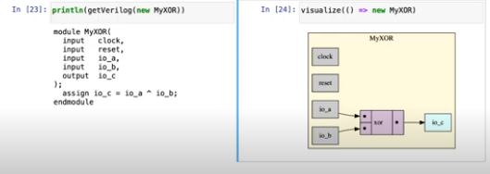
2.16 Generate Design
https://www.youtube.com/watch?v=9GD6PROUlWw&list=PLfrN7RIcMe6g2LBRJLTHTdhyj5s8ag0Rg&index=2
Generate Design (42:16-42:47/53:20)
If we want to visualize () the Design, use visualize() command:
> visualize(() => new MyXOR)
Chisel uses the diagrammer to produce the picture.

Slide 15
2.17 Chisel Backend Flow

Slide 16
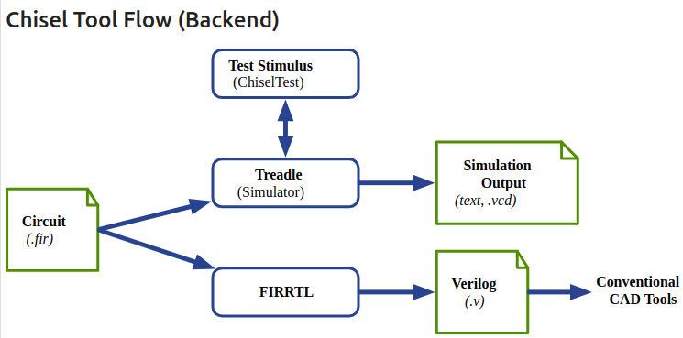
2.17 Chisel Backend Flow
https://www.youtube.com/watch?v=9GD6PROUlWw&list=PLfrN7RIcMe6g2LBRJLTHTdhyj5s8ag0Rg&index=2
Chisel Backend Flow (42:48-45:00/53:20)
In the frontend, Chisel produce the circuit (*.fir).
In the backend,
1. Chisel does the simulation
2. FIRRTL produce the synthesized RTL (Register Transfer Level) Verilog for CAD Tool production.

Slide 17
2.18 Chisel Backend Flow

Slide 18
2.18 Chisel Backend Flow
https://www.youtube.com/watch?v=9GD6PROUlWw&list=PLfrN7RIcMe6g2LBRJLTHTdhyj5s8ag0Rg&index=2
Chisel Backend Flow (42:48-45:00/53:20)
In the frontend, Chisel produce the circuit (*.fir).
In the backend,
1. Chisel does the simulation
2. FIRRTL produce the synthesized RTL (Register Transfer Level) Verilog for CAD Tool production.

Slide 19
2.19 ChiselTest

Slide 20
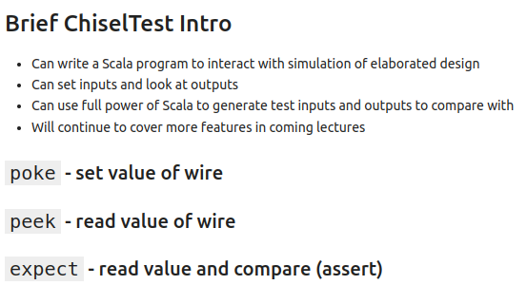
2.19 ChiselTest
https://www.youtube.com/watch?v=9GD6PROUlWw&list=PLfrN7RIcMe6g2LBRJLTHTdhyj5s8ag0Rg&index=2
ChiselTest (45:01-46:25/53:20)
ChiselTest:
1. Interactive simulation
2. Set inputs and look Outputs
3. Generate Test inputs and outputs

Slide 21
2.20 Run ChiselTest

Slide 22
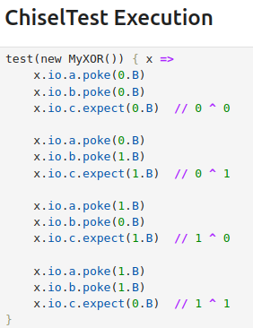
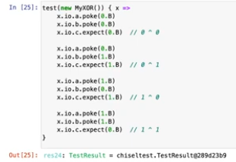
2.20 Run ChiselTest
https://www.youtube.com/watch?v=9GD6PROUlWw&list=PLfrN7RIcMe6g2LBRJLTHTdhyj5s8ag0Rg&index=2
Run ChiselTest (46:26-48:00/53:20)
Run ChiselTest:
Show pass Result

Slide 23
2.21 Chisel Version

Slide 24
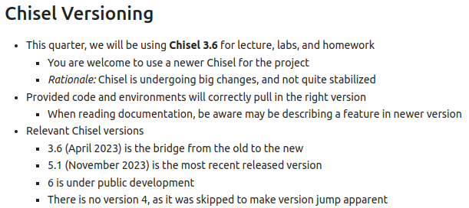


2.21 Chisel Version
https://www.youtube.com/watch?v=9GD6PROUlWw&list=PLfrN7RIcMe6g2LBRJLTHTdhyj5s8ag0Rg&index=2
Chisel Version (48:01-53:20/53:20)
Chisel is changing version in development.
Chisel 3 is around 2023.
Chisel stable version is 3.6.

Slide 25
End

