Slide 1

10.1 Lipsi Processor Design in Chisel
Peter H. Chen

Slide 2
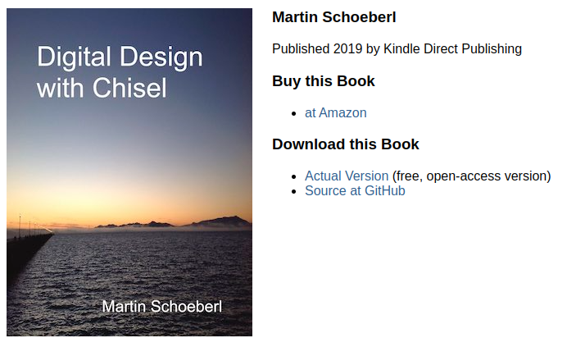
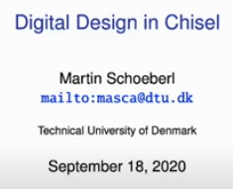
10.1 Lipsi Processor Design in Chisel
https://www.youtube.com/watch?v=u-d1LZMhNFU&list=PLlu0CT-JnSasfpk8tq1ZDiE2G0AK1BhOg&index=10
Lipsi Processor Design in Chisel (0:00-0:10/31:56)
“dtu” Denmark Technical University. “dk” is internet domain for Denmark.
Professor Martin Schoeberl from Denmark Technical University at Denmark. He published book “Digital Design in Chisel in 2019”
Lipsi island is located at Greece. Lipsi mean “beautiful”.
Professor Marin created Lipsi processor at Lipsi Island less than 14 hour. Lipsi is the smallest processor for FPGA Research and Design Purpose.
Lipsi processor contains:
1. the hardware description
2. an assembler,
3. a software simulator,
4. testers for individual testing and for co-simulation,
5. Lipsi processor is design in Chisel/Scala and combined in a single program.
6. a serial port
7. more than 100 Lipsi cores in a low-cost FPGA (with simple point-to-point connections between cores).
8. Chisel made Lipsi processor design with above features in less than 14 hours.
https://github.com/schoeberl/lipsi

Slide 3
10.2 Lipsi: Smallest Processor

Slide 4
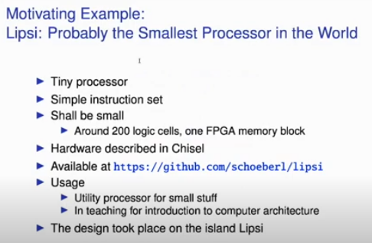
10.2 Lipsi: Smallest Processor
https://www.youtube.com/watch?v=u-d1LZMhNFU&list=PLlu0CT-JnSasfpk8tq1ZDiE2G0AK1BhOg&index=10
Lipsi: Smallest Processor (0:11-0:36/31:56)
Lipsi: Girl name means Beautiful.
1. Tiny Processor
2. Simple Instruction Set
3. 200 logic cell, one FPGA memory block
4. Design in Chisel
5. The design took place on the island Lipsi. Lipsi is a Greek island.
https://github.com/schoeberl/lipsi

Slide 5
10.3 Design Processor on Lipsi Island

Slide 6
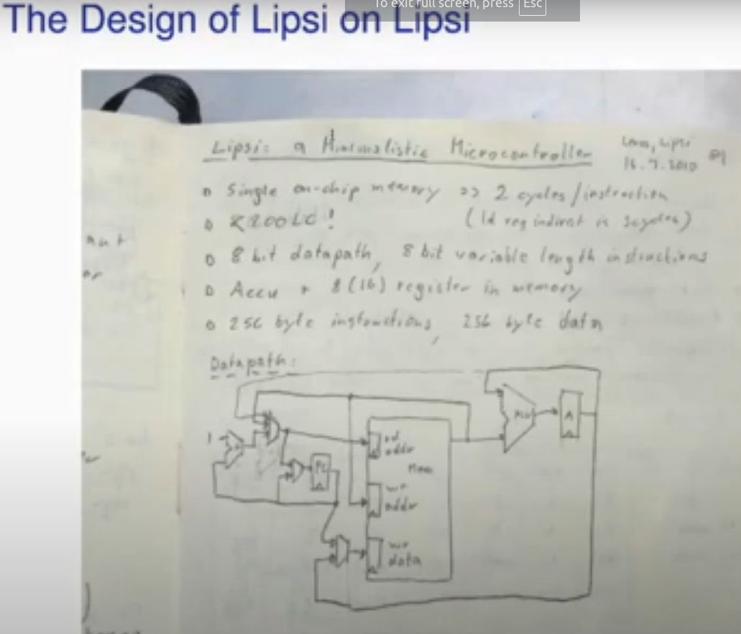
10.3 Design Processor on Lipsi Island
https://www.youtube.com/watch?v=u-d1LZMhNFU&list=PLlu0CT-JnSasfpk8tq1ZDiE2G0AK1BhOg&index=10
Design Processor On Lipsi Island (0:37-0:49/31:56)
Here is the paper for Lipsi Processor Design started on Lipsi Island.
It is a single on-chip memory. It is less than 200 logic cell and simple data path,

Slide 7
10.4 Lipsi Implementation

Slide 8
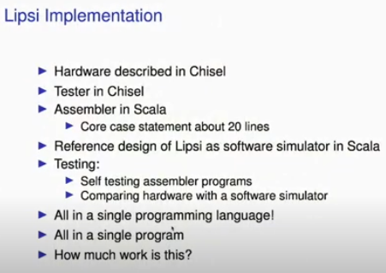
10.4 Lipsi Implementation
https://www.youtube.com/watch?v=u-d1LZMhNFU&list=PLlu0CT-JnSasfpk8tq1ZDiE2G0AK1BhOg&index=10
Lipsi Implementation (0:50-2:11/31:56)
Simplest Processor:
1. Hardware description in Chisel
2. Tester in Chisel
3. Assembler in Scala: 20n lines of assembly code
4. Reference design in Scala simulator
5. Testing: assembly program testing
6. Single program language
7. Single program
8. How much work?

Slide 9
10.5 Lipsi: How Much Work?

Slide 10
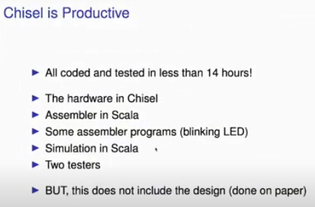
10.5 Lipsi: How Much Work?
https://www.youtube.com/watch?v=u-d1LZMhNFU&list=PLlu0CT-JnSasfpk8tq1ZDiE2G0AK1BhOg&index=10
Lipsi: How Much Work? (2:12-2:31/31:56)
1. Chisel is productive: Implement Lipsi processor takes 14 hours to implement and test.
2. The hardware is compiled by assembler in Scala
3. Some assembly program program (Blinking LED) in Scala.
4. Simulate the Assembly program in Scala
5. There are two testers in Scala
6. The design is started on paper and then start implement from scratch in Scala.

Slide 11
10.6 Chisel Ecosystem

Slide 12
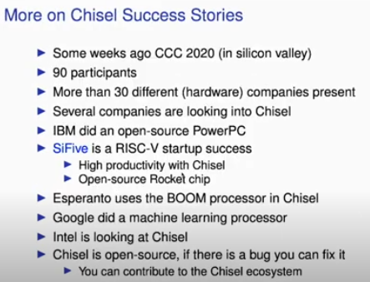
10.6 Chisel Ecosystem
https://www.youtube.com/watch?v=u-d1LZMhNFU&list=PLlu0CT-JnSasfpk8tq1ZDiE2G0AK1BhOg&index=10
Chisel Ecosystem (2:32-3:13/31:56)
1. CCC (Chisel Community Conference) 2020 in Silicon Valley.
2. 90 engineers
3. 30 different companies
4. Several companies look into Chisel
5. IBM open source PowerPC
6. SiFive Startup by Chisel
7. Esperanto uses Chisel
8. Google Machine Learning processor
9. Intel start loop at Chisel
10. Open source

Slide 13
10.7 Chisel

Slide 14
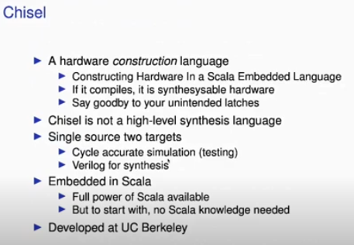
10.7 Chisel
https://www.youtube.com/watch?v=u-d1LZMhNFU&list=PLlu0CT-JnSasfpk8tq1ZDiE2G0AK1BhOg&index=10
Chisel (3:14-4:10/31:56)
1. HCL (Hardware Construction Language):
  Construct hardware in Scala Embedded Language
  Synthesize hardware
  Do not need the Verilog/VHDL programming
2. Chisel is not a synthesis language: we cannot translate Behavioral model into Transistor level RTL.
3. Chisel has two targets:
  Cycle accuracy in testing
  Real Circuit/RTL Verilog
4. Embedded in Scala:
  Inherited full power from Scala (OOD and Functional Programming)
  Do not need Scala knowledge to start with. Just need Chisel Knowledge
5. Developed at UC Berkeley

Slide 15
10.8 C Language Family

Slide 16
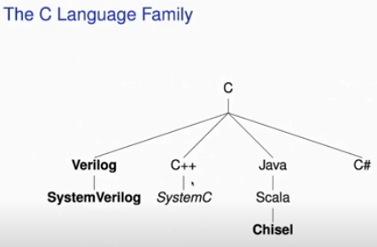
10.8 C Language Family
https://www.youtube.com/watch?v=u-d1LZMhNFU&list=PLlu0CT-JnSasfpk8tq1ZDiE2G0AK1BhOg&index=10
C Language Family (4:11-4:35/31:56)
There are a lot of languages based on C:
1. Verilog/SystemVerilog
2. C++/SystemC
3. Java/Scala/Chisel
4. C#
Verilog/SystemVerilog and Chisel are hardware Description/Construction related.

Slide 17
10.9 Other Language Family

Slide 18
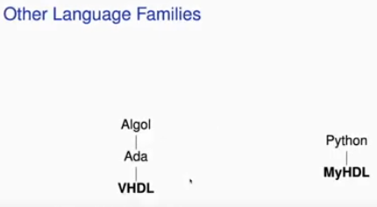
10.9 Other Language Family
https://www.youtube.com/watch?v=u-d1LZMhNFU&list=PLlu0CT-JnSasfpk8tq1ZDiE2G0AK1BhOg&index=10
Other Language Family (4:36-5:35/31:56)
1. Algol/Ada/VHDL
2. Python/MyHDL
VHDL and MyHDL are hardware description/construction related languages.

Slide 19
10.10 Scala Notes

Slide 20
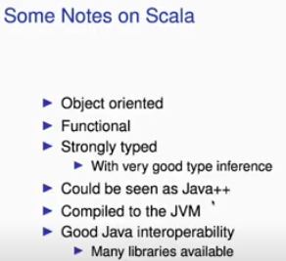
10.10 Scala Notes
https://www.youtube.com/watch?v=u-d1LZMhNFU&list=PLlu0CT-JnSasfpk8tq1ZDiE2G0AK1BhOg&index=10
Scala Notes (4:36-5:49/31:56)
1. OOP (Object Oriented Programming).
2. Functional Programming
3. Strong type: Hardware design need strong/static type. Python is weakly type.
4. Similar to new Java++ with Java library.
5. Use JVM (Java Virtual Machine): java
6. Easily Integrated into Java.

Slide 21
End

