Slide 1

10.11 Chisel vs Scala
Peter H. Chen

Slide 2
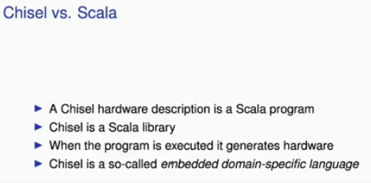
10.11 Chisel vs. Scala
https://www.youtube.com/watch?v=u-d1LZMhNFU&list=PLlu0CT-JnSasfpk8tq1ZDiE2G0AK1BhOg&index=10
Chisel vs. Scala (5:50-6:41/31:56)
What is difference between Chisel and Scala?
1. Chisel basically is a Scala program.
2. Chisel is a Scalar Library.
3. When you execute the Chisel program, chisel generates hardware. Chisel generates netlist of individual components, then it generates an intermediate representation from a FIRRTL. You can test it or you can split out Verilog.
4. Chisel is called an Embedded Domain Specific Language. Chisel is embedded in Scala and the domain is Hardware Description.
5. Chisel is a small language. It is small on purpose so there are not many constructs to remember.

Slide 3
10.13 Chisel Tool Flow

Slide 4
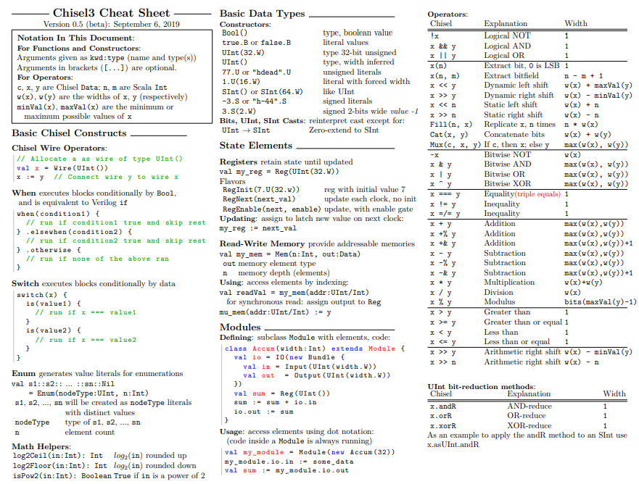
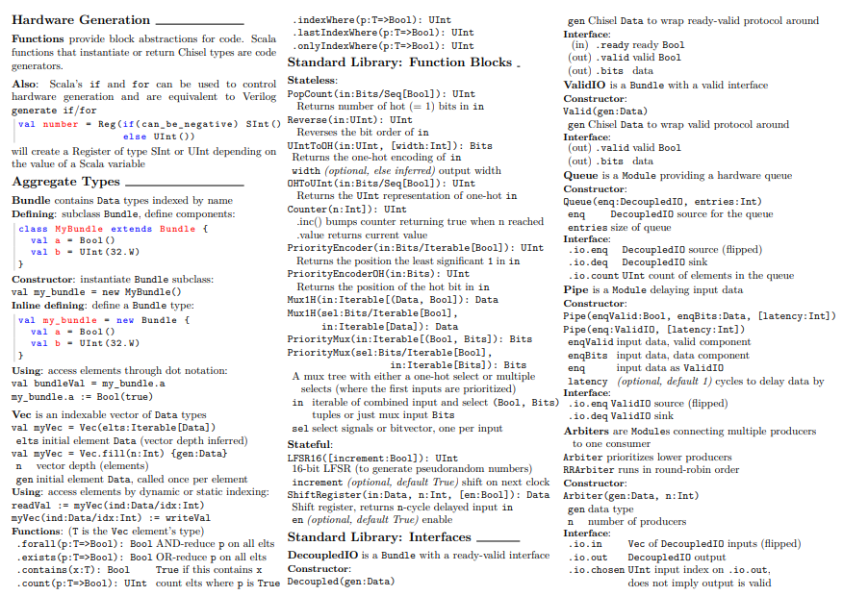
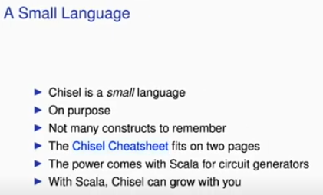
10.12 Chisel is Small Language
https://www.youtube.com/watch?v=u-d1LZMhNFU&list=PLlu0CT-JnSasfpk8tq1ZDiE2G0AK1BhOg&index=10
Chisel is Small Language (6:42-8:12/31:56)
1. Chisel is a small language
2. Chisel is on purpose to be small.
3. Chisel does not have a lot of construction to remember
4. Chisel Cheat sheet is 2 pages:
4.1 The first page for main construct command.
4.2 The second page for library. https://users.cs.duke.edu/~lkw34/Chisel-Cheatsheet.pdf
5. Chisel Power come with circuit generator
6. Chisel grow with Scala.

Slide 5
10.12 Chisel is Small Language

Slide 6
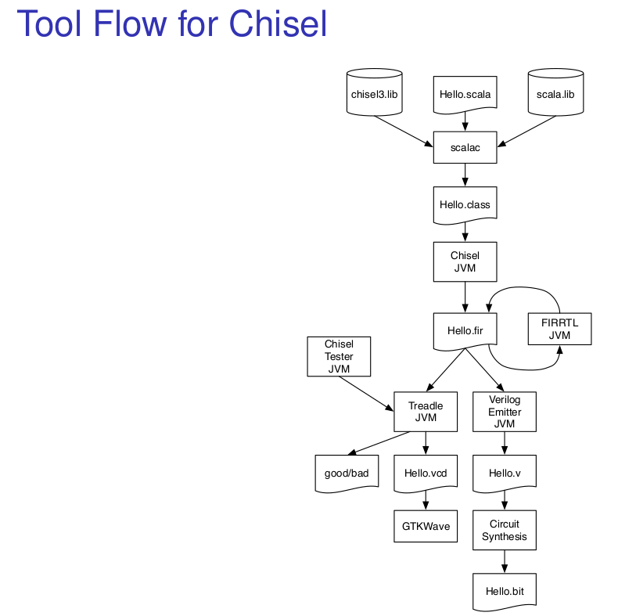
10.13 Chisel Tool Flow
https://www.youtube.com/watch?v=u-d1LZMhNFU&list=PLlu0CT-JnSasfpk8tq1ZDiE2G0AK1BhOg&index=10
Chisel Tool Flow (8:13-9:14/31:56)
Here is the Tool Flow of Chisel:
1. We start with a program Hello.scala.
2. We can import some Scala and chisel3 library.
3. Chisel produces Scala class. Chisel produces files from Scala compiler, scalac.
4. We run Java Virtual Machine to generate FIRRTL JVM. FIRRTL will have optimization and then we have two paths.
5. The first path is testing with Treadle JVM. Treadle is tester for FIRRTL. Testing our circuit us good or bad.
  5.1 The testing will can produce the VCD.
  5.2 We can see the waveform for the test result.
The second path is Verilog Emitter.
  5.1 We can look at the circuit synthesis RTL Verilog
  5.2 We can look at circuit synthesis for FPGA
  5.3 We can have the bit code (binary symbols, such as, hex, binary, signed/unsigned).
1
2
3
4
5
6
5.1
6.1
5.2
6.2
6.3

Slide 7
10.13 Expressions: Combinational Circuit

Slide 8
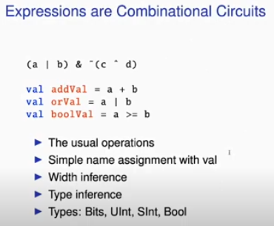
10.13 Expressions: Combinational Circuit
https://www.youtube.com/watch?v=u-d1LZMhNFU&list=PLlu0CT-JnSasfpk8tq1ZDiE2G0AK1BhOg&index=10
Expression: Combinational Circuit (9:15-9:56/31:56)
1. The expressions are Combinational Circuits.
2. The first line is syntax for C/Java/C# language which can be applied to chisel circuits.
3. The name is strong type.
4. We can specify the width
5. We can specify the type
6. The types can be bits, Uint (Unsigned Integer), Sint (Signed Integer), Bool (Boolean)

Slide 9
10.14 Conditional: Combinational Circuit

Slide 10
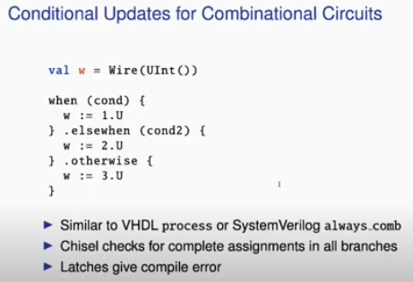
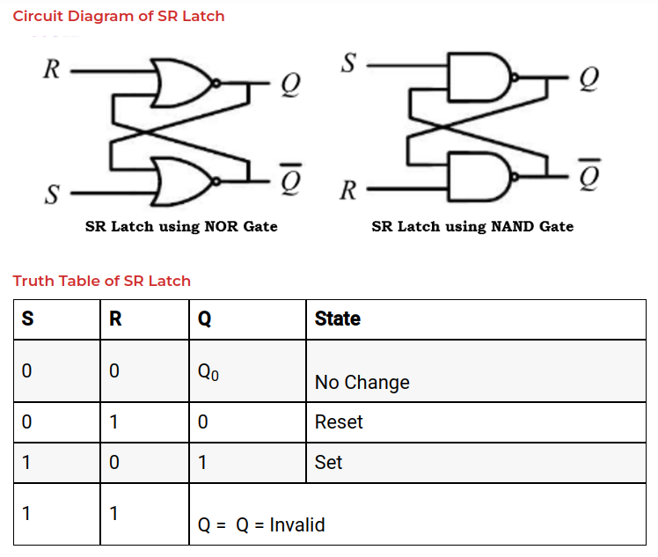
10.14 Conditional: Combinational Circuit
https://www.youtube.com/watch?v=u-d1LZMhNFU&list=PLlu0CT-JnSasfpk8tq1ZDiE2G0AK1BhOg&index=10
Conditional: Combinational Circuit (9:57-10:57/31:56)
1. We define a wire for later on assignment and check.
2. We have if, else, when, otherwise, etc for conditional logic and conditional assignment.
3. These conditional logic are similar to VHDL/SystemVerilog command always.comb (for Combinational Circuit) block.
> when (cond) { … }: is three (when, elsewhen, otherwise) to one (w) multiplexer depend on one default and two conditions.
4. Chisel checks for complete assignment in all branches.
5. If you missing assignment which usually used in latch (such as, SR Latch, Set/Reset Latch below) will give you the compilation error. It is very common that designer make mistakes in assignments.

Slide 11
10.15 Register

Slide 12
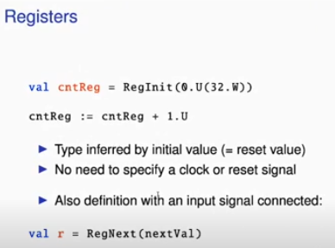
10.15 Register
https://www.youtube.com/watch?v=u-d1LZMhNFU&list=PLlu0CT-JnSasfpk8tq1ZDiE2G0AK1BhOg&index=10
Register (10:58-12:07/31:56)
1. Register is defined as a component. We defines as a component of a register.
2. The initial value means this register is reset to zero. We use RegInit() specify a constant 0.U means it is a zero as an unsigned int and then in parenthesis, we define 32.W, W is the width. It is a 32 bits width.
3. There is no inferring on Rising Edge of clock or whatever.
4. Then, we are sending a register value with count register + 1.U. This is a simple register counter here.
5. We do not have clock, set, reset, signal here. Chisel is intended for synchronous design mainly. In synchronous design, we always have the same clock in our synchronous blocks. So, there is no point in messing around the clock and reset. If we want to get hold of clock and reset, we can have access to it.
6. We also can define with signal connected with
> val r= RegNext (nextVal)

Slide 13
10.16 Functional Abstraction

Slide 14
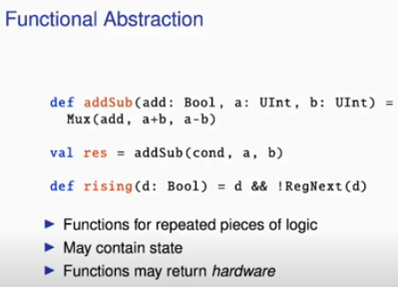
10.16 Functional Abstraction
https://www.youtube.com/watch?v=u-d1LZMhNFU&list=PLlu0CT-JnSasfpk8tq1ZDiE2G0AK1BhOg&index=10
Functional Abstraction (12:08-13:10/31:56)
1. it is easy to write the small function and then this function just returns hardware, such as, Mux.
2. The functions may represent repeated pieces of logic.
3. For example, in the addSub circuit, we have three parameters, add (boolean), a (unsigned integer), b (unsigned Integer).
4. We have two input ports and then return a multiplexer switching between an adder (a + b) and a subtract circuit (a -b).
5. Line:
> res = addSub (cond, s, b)
Generates a hardware with one multiplexer with input one adders (a + b) and one subtractor (a – b).
So, function may return hardware.
6. Line:
> rising(d: Bool) = d && !RegNext(d)
This circuit contains a rising edge of a Register RegNext()

Slide 15
10.17 Bundle

Slide 16
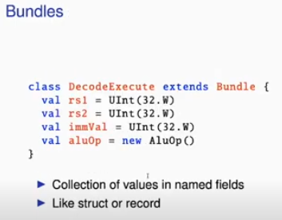
10.17 Bundle
https://www.youtube.com/watch?v=u-d1LZMhNFU&list=PLlu0CT-JnSasfpk8tq1ZDiE2G0AK1BhOg&index=10
Bundle (13:11-13:31/31:56)
1. Bundle is a structure way to write wires.
2. It is a collection of values with named fields.
3. It is like a structure or record.

Slide 17
10.18 Vector

Slide 18
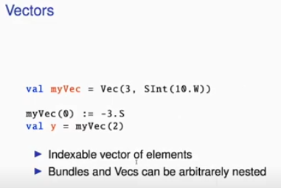
10.18 Vector
https://www.youtube.com/watch?v=u-d1LZMhNFU&list=PLlu0CT-JnSasfpk8tq1ZDiE2G0AK1BhOg&index=10
Vector (13:32-13:56/31:56)
1. Vector is like an array. Vector is an indexable elements.
2. Below example,
> val myVec = Vec (3, SInt (10.W))
Vector myVec is 3 elements, with Signed Integer of width 10 bits.
3. Bundle and Vector can be arbitrarily nested.
So, you can build your data structure with bundle and vector.
1
3

Slide 19
10.19 IO Port

Slide 20
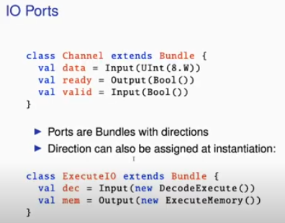
10.19 IO Port
https://www.youtube.com/watch?v=u-d1LZMhNFU&list=PLlu0CT-JnSasfpk8tq1ZDiE2G0AK1BhOg&index=10
IO Port (13:57-14:28/31:56)
1. IO Port is actually bundles with a direction.
2. The below example,
> class Channel extends Bundle
We define a class Channel which inherit class Bundle.
We have input data and Valid, output ready
> val data = Input (Uint (8.W))
> val ready = Output (Bool())
> val valid = Input (Bool())
3. The direction can be assigned later on or at the instantiation.
> dec = Input ( …)
> mem = Output (...)

Slide 21
10.20 Hello World in Chisel

Slide 22
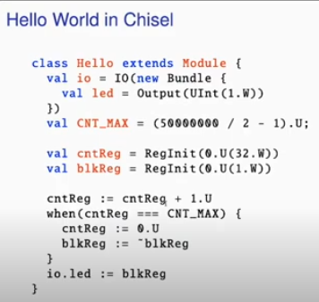
10.20 Hello World in Chisel
https://www.youtube.com/watch?v=u-d1LZMhNFU&list=PLlu0CT-JnSasfpk8tq1ZDiE2G0AK1BhOg&index=10
Hello World in Chisel (14:29-15:52/31:56)
1. We are ready to write the Hello World program in Chisel in 30 minutes,
2. Below is a complete program. Chisel is a little component.
It has a name class Hello which extends/inherits a Module. Module is is a digital component.
3. Then, we have IO field with a LED output.
> val io = IO (…)
> val led = Output (Uint (1.W))
Our Hello World is a hardware with blinking LED. We define a unsigned integer with width 1 bit.
4. Then, we define a constant CNT_MAX with 50 MHz (50,000,000) clock on out FPGA board and we want to blink it in one Hz. Here, we define a maximum value for counter CNT_MAX.
5. Here, we have two registers: counter register (cntReg) and blinking register (blkReg). We initialize both registers into 0. We have counter 32 bits Width and blinking register 1 bit width.
1
6. We set cntReg = 1.
> cntReg := cntReg + 1.U
7. We cntReg === CNT_MAX, then we
Reset cntReg = 0 and flip blkReg
8. We assign the output port to the value of blink register.
2
3
4
5
6
7
8

Slide 23
End

