Slide 1

10.21 Connection
Peter H. Chen

Slide 2
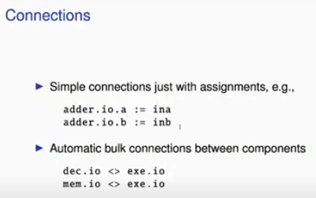
10.21 Connection
https://www.youtube.com/watch?v=u-d1LZMhNFU&list=PLlu0CT-JnSasfpk8tq1ZDiE2G0AK1BhOg&index=10
Connection (15:52-16:51/31:56)
1. When we have a component adder.io.a, we have to this dot notation like in Java/Scala to access the sub element. The assignment is “:=”. This “:=” is for individual name connection/assignment.
> adder.io.a := ina
> adder.io.b := inb
2. If component has several fields with the same type and name for different directions, we can do a bulk connection/assignment with this diamond symbol.
> dec.io <> exe.io
> mem.io <> exe.io
Here, the type io contains many names (a, b, etc). We can do the bulk connection/assignment without invidivual connection/assignment “:=”, such as,“ina, inb, etc.

Slide 3
10.22 Chisel Multiplexer

Slide 4
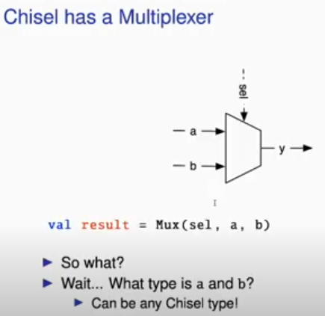
10.22 Chisel Multiplexer
https://www.youtube.com/watch?v=u-d1LZMhNFU&list=PLlu0CT-JnSasfpk8tq1ZDiE2G0AK1BhOg&index=10
Chisel Multiplexer (16:52-17:24/31:56)
Chisel has a multiplexer.
Below
> val result = Mux (sel, a, b)
What type of a and b? They can be any type.

Slide 5
10.23 Chisel Generic Multiplexer

Slide 6
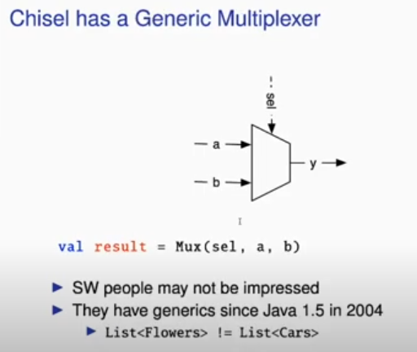
10.23 Chisel Generic Multiplexer
https://www.youtube.com/watch?v=u-d1LZMhNFU&list=PLlu0CT-JnSasfpk8tq1ZDiE2G0AK1BhOg&index=10
Chisel Generic Multiplexer (17:25-17:44/31:56)
Chisel has a generic multiplexer.
Below
> val result = Mux (sel, a, b)
What type of a and b? They can be any type.
Some people may not be impressed. But in hardware, this is definitely something very new.

Slide 7
10.24 Generic Hardware Construction

Slide 8
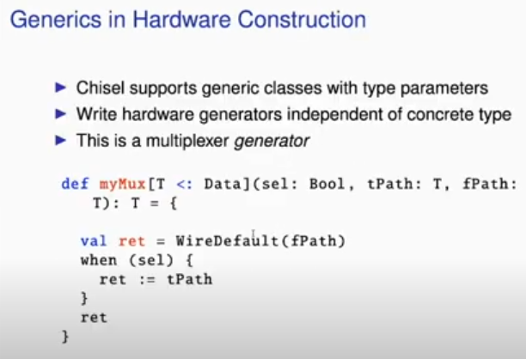
10.24 Generic Hardware Construction
https://www.youtube.com/watch?v=u-d1LZMhNFU&list=PLlu0CT-JnSasfpk8tq1ZDiE2G0AK1BhOg&index=10
Generic Hardware Construction (17:45-18:27/31:56)
1. Chisel support generic classes with type Parameters. This is a possible implementation of Generic Multiplexer.
2. There is a little bit in syntax to understand. The type parameter T here which is subtype data or subtype. In Scala, “<:” mean “must a subtype of”
https://stackoverflow.com/questions/6828875/what-does-mean-in-scala
3. Here, we have true path (tPath) is type T and false path (fPath) is type T.
4. We have return type is type T.
5. Then, we write the Multiplexer. We write the default path (WireDefault) for wire is false path (fPath). 6. When sel is true, then return ret value which is assign to true path (tPath) at the end of function. Here, The T is any data type.
2
4
3
5
6

Slide 9
10.25 Define DecoupledIO

Slide 10
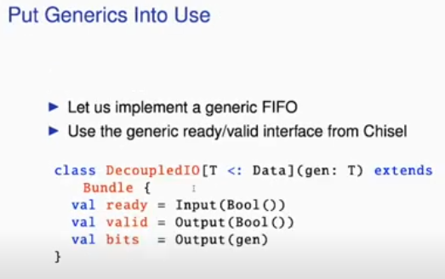
10.25 Define DecoupledIO
https://www.youtube.com/watch?v=u-d1LZMhNFU&list=PLlu0CT-JnSasfpk8tq1ZDiE2G0AK1BhOg&index=10
Define DecoupledIO (18:28-19:01/31:56)
1. We Implement Generic FIFO and use generic ready/valid interface from Chisel
2. Passing parameter is “gen” with type generic T.
3. Output (gen)
2
3

Slide 11
10.26 Define FIFO Interface

Slide 12
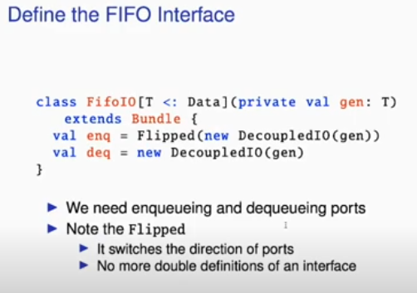
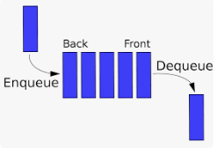
10.26 Define FIFO Interface
https://www.youtube.com/watch?v=u-d1LZMhNFU&list=PLlu0CT-JnSasfpk8tq1ZDiE2G0AK1BhOg&index=10
Define FIFO Interface (19:02-19:27/31:56)
1. We define the FIFO interface. We use the previous defined DecoupledIO.
2. We have the Flipped() Function enqueue to read data from the back to front.
3. We have DecoupledIO for dequeue to read data from the front to back.
Note:
1. We need the enqueue and dequeue ports for both direction.
2. We only define in FIFO Interface once with generic type T.

Slide 13
10.27 FIFO Implementation

Slide 14
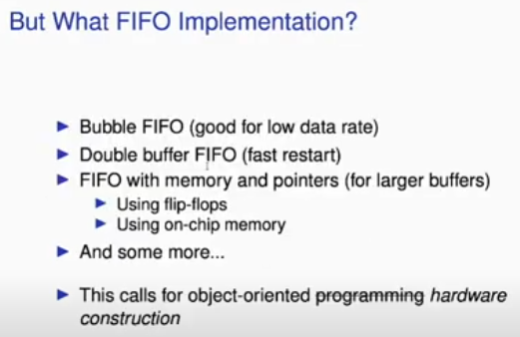
10.27 FIFO Implementation
https://www.youtube.com/watch?v=u-d1LZMhNFU&list=PLlu0CT-JnSasfpk8tq1ZDiE2G0AK1BhOg&index=10
FIFO Implementation (19:28-19:47/31:56)
1. What kind of FIFO we want to implement?
2. Single buffer FIFO for Low rate is cheap.
3. Double buffer for fast rate and expensive.
4. FIFO with memory and pointer for large buffer.
5. It is Object-Oriented Programming for hardware construction.

Slide 15
10.28 Abstract Base/Concrete Class

Slide 16
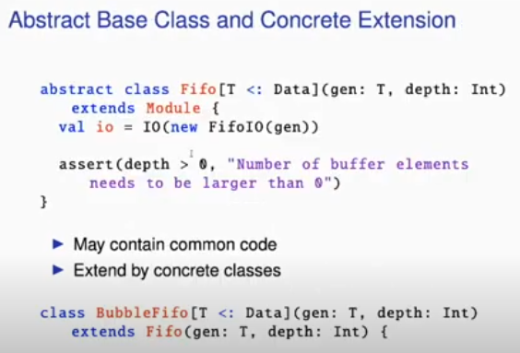
10.28 Abstract Base/Concrete Class
https://www.youtube.com/watch?v=u-d1LZMhNFU&list=PLlu0CT-JnSasfpk8tq1ZDiE2G0AK1BhOg&index=10
Abstract Base/Concrete Class (19:48-20:22/31:56)
1. We have Base class which define abstract type for handle (no real circuit defined) only.
2. We extend/inherit the abstract base class and implement the solid hardware construction in concrete class for the real circuit.
1
2

Slide 17
10.29 Implement Concrete FIFO

Slide 18
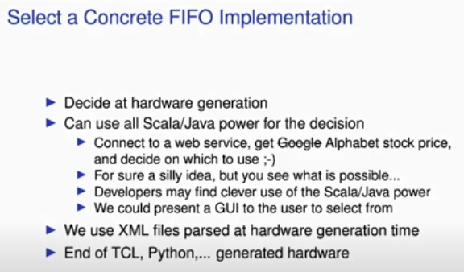
10.29 Implement Concrete FIFO
https://www.youtube.com/watch?v=u-d1LZMhNFU&list=PLlu0CT-JnSasfpk8tq1ZDiE2G0AK1BhOg&index=10
Implement Concrete FIFO (20:23-21:07/31:56)
Which implementation do we select for hardware generation at the generate time?
We connect to google search the stock p[rice for the selection.

Slide 19
10.30 VHDL for Binary to BCD

Slide 20
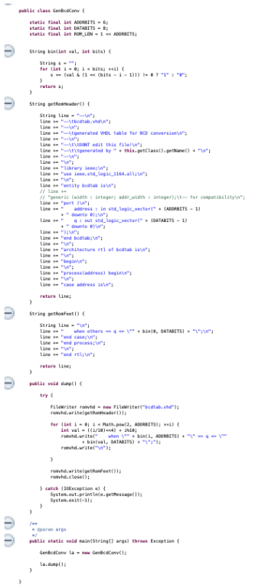
10.30 VHDL for Binary to BCD
https://www.youtube.com/watch?v=u-d1LZMhNFU&list=PLlu0CT-JnSasfpk8tq1ZDiE2G0AK1BhOg&index=10
VHDL for Binary to BCD Conversion (21:08-21:26/31:56)
Here is the VHDL code for Binary to BCD Conversion.
This code is too complicated to understand.
We will see how easy in Java/Scala next.

Slide 21
End

