Slide 1

10.31 Java: Binary to BCD Conversion
Peter H. Chen

Slide 2
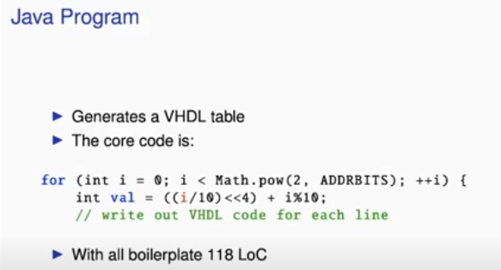
10.31 Java: Binary to BCD Conversion
https://www.youtube.com/watch?v=u-d1LZMhNFU&list=PLlu0CT-JnSasfpk8tq1ZDiE2G0AK1BhOg&index=10
Java: Binary to BCD Conversion (21:27-21:45/31:56)
1. Below is Java Code for Binary to BCD Conversion. This Java Code split out the VHDL code. It generates the VHDL table.
2. The Code is two lines of Java code.
3. All the boilerplate code is 118 LoC (Lines of Java Code) which running external of AMD/Xilinx Vivado, Intel/Altera Quartus, etc.
1
2

Slide 3
10.32 Chisel: Binary to BCD Conversion

Slide 4
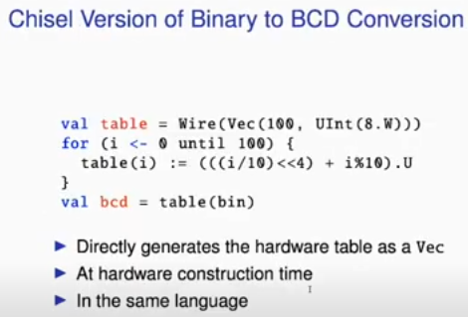
10.32 Chisel: Binary to BCD Conversion
https://www.youtube.com/watch?v=u-d1LZMhNFU&list=PLlu0CT-JnSasfpk8tq1ZDiE2G0AK1BhOg&index=10
Chisel: Binary to BCD Conversion (21:46-22:09/31:56)
Below is Chisel Code for Binary to BCD Conversion. This Chisel Code split out the VHDL code. It generates the VHDL table.
1. The Code is five lines of Chisel code: We put the data into Vec and generate into table. And use table() from Binary into BCD. Chisel directly generate the hardware table from Vec.
2. Generate the VHDL at construction time. Generate in the same Chisel language. We don’t need the different code and tool to generate the VHDL.
1

Slide 5
10.33 Free Tools for Chisel and FPGA

Slide 6
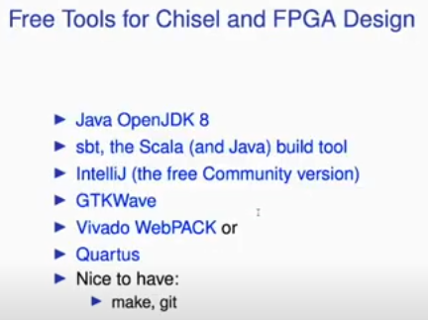
10.33 Free Tools for Chisel and FPGA
https://www.youtube.com/watch?v=u-d1LZMhNFU&list=PLlu0CT-JnSasfpk8tq1ZDiE2G0AK1BhOg&index=10
Free Tools for Chisel and FPGA (22:10-22:25/31:56)
We have free tools for FPGA:
1. Java Open JDK 8
2. SBT (Simple Build Tool)
3. GTKWave
4. AMD/Xilinx Vivado
5. Intel/Altera Quartus

Slide 7
10.34 T-CREST Project

Slide 8
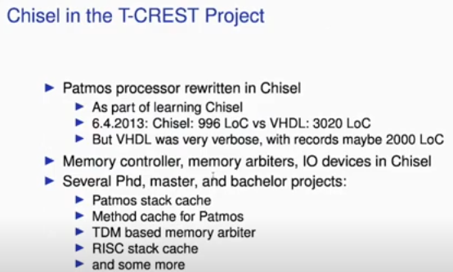
10.34 T-CREST Project
https://www.youtube.com/watch?v=u-d1LZMhNFU&list=PLlu0CT-JnSasfpk8tq1ZDiE2G0AK1BhOg&index=10
T-CREST Project (22:26-22:59/31:56)
1. Patmos processor: Created by Berkeley for learning Chisel
2. Memory, IO in Chisel
3. PhD, MS, BS projects.

Slide 9
10.35 Teaching

Slide 10
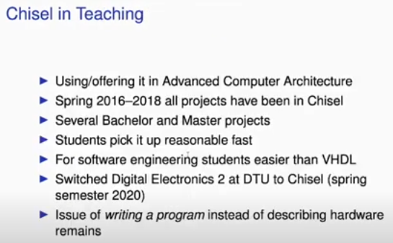
10.35 Teaching
https://www.youtube.com/watch?v=u-d1LZMhNFU&list=PLlu0CT-JnSasfpk8tq1ZDiE2G0AK1BhOg&index=10
Teaching (23:00-24:05/31:56)
1. Advanced Computer Architecture
2. 2016-2018 Chisel projects
3. MS/BS projects
4. Fast development.
5. Easier than VHDL for software engineer
6. Class Switched tool to Chisel (2020)
7. Issues

Slide 11
10.36 Chisel in Digital Electronic Class

Slide 12
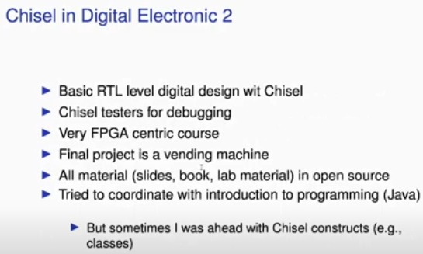
10.36 Chisel in Digital Electronic Class
https://www.youtube.com/watch?v=u-d1LZMhNFU&list=PLlu0CT-JnSasfpk8tq1ZDiE2G0AK1BhOg&index=10
Chisel in Digital Electronic Class (24:06-25:10/31:56)
1. Basic RTL (Register Transfer Level) Digital Design with Chisel
2. Chisel testing and debugging
3. Use Chisel for FPGA
4. Projects
5. Open sources
6. Coordinate with Java/Scala
7. Chisel Construction

Slide 13
10.37 Feedback

Slide 14
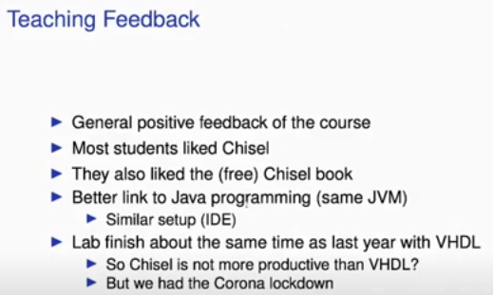
10.37 Feedback
https://www.youtube.com/watch?v=u-d1LZMhNFU&list=PLlu0CT-JnSasfpk8tq1ZDiE2G0AK1BhOg&index=10
Feedback (25:11-26:09/31:56)
1. Positive with Chisel
2. People like Chisel
3. People like free chisel book
4. Good Setup JVM web site
5. Chisel is easier than VHDL.

Slide 15
10.38 Chisel Book

Slide 16
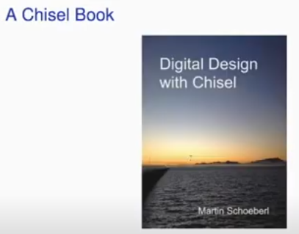
10.38 Chisel Book
https://www.youtube.com/watch?v=u-d1LZMhNFU&list=PLlu0CT-JnSasfpk8tq1ZDiE2G0AK1BhOg&index=10
Chisel Book (26:10-26:31/31:56)
Chisel Book:
https://www.imm.dtu.dk/~masca/chisel-book.pdf

Slide 17
10.39 Free Chinese Chisel Book

Slide 18
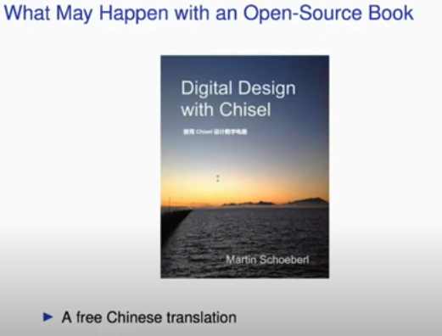
10.39 Free Chinese Chisel Book
https://www.youtube.com/watch?v=u-d1LZMhNFU&list=PLlu0CT-JnSasfpk8tq1ZDiE2G0AK1BhOg&index=10
Free Chinese Chisel Book (26:32-26:42/31:56)
Free Chinese Translation

Slide 19
10.40 Free Japanese Chisel Book

Slide 20
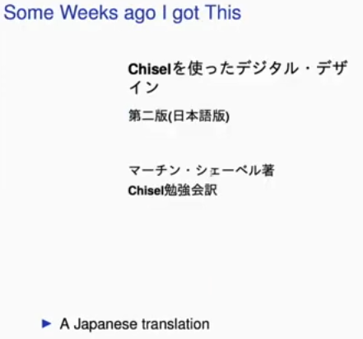
10.40 Free Japanese Chisel Book
https://www.youtube.com/watch?v=u-d1LZMhNFU&list=PLlu0CT-JnSasfpk8tq1ZDiE2G0AK1BhOg&index=10
Free Japanese Chisel Book (26:32-26:53/31:56)
Free Japanese Translation

Slide 21
End

