Slide 1

10.41 More Information
Peter H. Chen

Slide 2
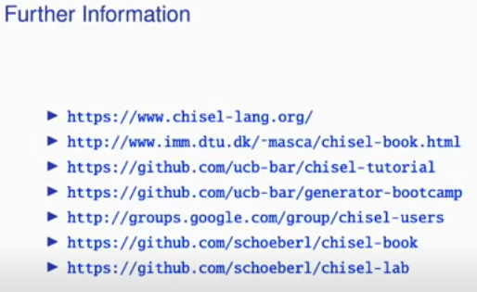
10.41 More Information
https://www.youtube.com/watch?v=u-d1LZMhNFU&list=PLlu0CT-JnSasfpk8tq1ZDiE2G0AK1BhOg&index=10
More Information (26:54-27:01/31:56)

Slide 3
10.42 Summary

Slide 4
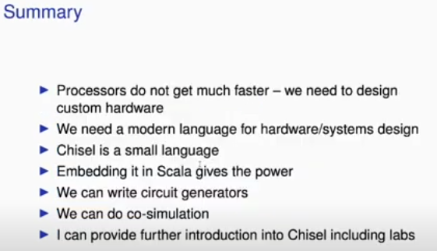
10.42 Summary
https://www.youtube.com/watch?v=u-d1LZMhNFU&list=PLlu0CT-JnSasfpk8tq1ZDiE2G0AK1BhOg&index=10
Summary (27:02-31:56/31:56)
1. Develop processor much faster
2. Modern language for hardware design
3. Chisel is easy language
4. Chisel embedding in Scala power
5. Circuit generation
6. perform co-simulation
7. Chisel lab

Slide 5
End

