Slide 1

5.16 Low Level Machine Code: Target Pass
Peter H. Chen

Slide 2
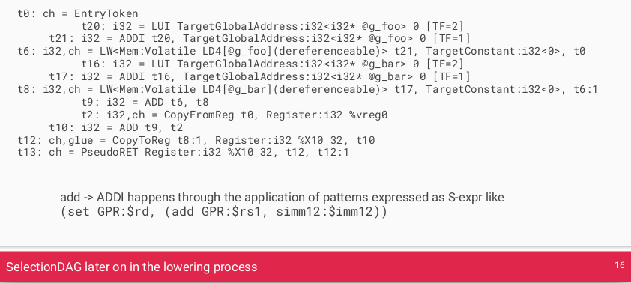
5.16 Low Level Machine Code: Target Pass
https://www.youtube.com/watch?v=eURfE6cTqZE&list=PLlu0CT-JnSasfpk8tq1ZDiE2G0AK1BhOg&index=5
Low Level Machine Code: Target Pass (15:59-15:58/24:34)
Lowering process to the Target Pass: A target implementation tells the legalizer which types are supported (and which register class to use for them) by calling the addRegisterClass method in its TargetLowering constructor.
https://llvm.org/docs/CodeGenerator.html#target-independent-code-generation-algorithms

Slide 3
5.17 Machine Function

Slide 4
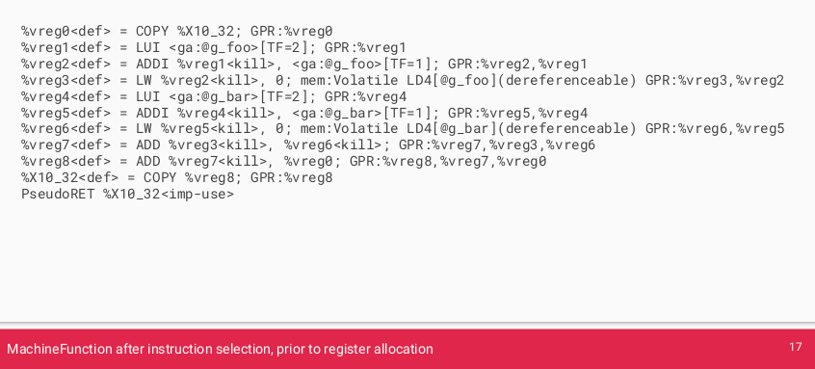
5.17 Machine Function
https://www.youtube.com/watch?v=eURfE6cTqZE&list=PLlu0CT-JnSasfpk8tq1ZDiE2G0AK1BhOg&index=5
Machine Function (15:59-16:15/24:34)
Machine Function after instruction selection.
https://llvm.org/docs/CodeGenerator.html#target-independent-code-generation-algorithms

Slide 5
5.18 Add Leading Zeros

Slide 6
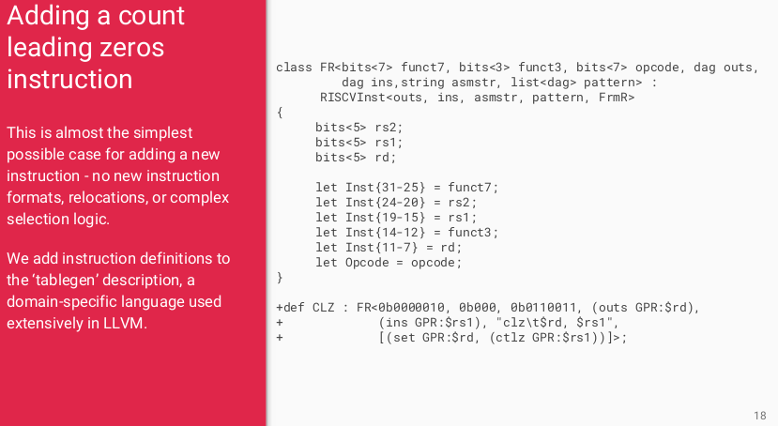
5.18 Add Leading Zeros
https://www.youtube.com/watch?v=eURfE6cTqZE&list=PLlu0CT-JnSasfpk8tq1ZDiE2G0AK1BhOg&index=5
Add Leading Zeros (16:16-16:48/24:34)
Add Leading Zeros
https://llvm.org/docs/CodeGenerator.html#target-independent-code-generation-algorithms

Slide 7
5.19 lowRISC Roadmap

Slide 8
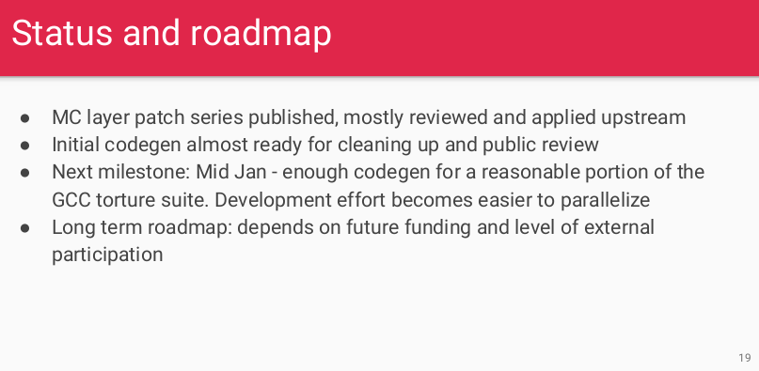
5.19 lowRISC Roadmap
https://www.youtube.com/watch?v=eURfE6cTqZE&list=PLlu0CT-JnSasfpk8tq1ZDiE2G0AK1BhOg&index=5
LowRISC Roadmap (16:49-18:31/24:34)
MC (Machine Core) layer: Generate the Lower level Machine Code and Information.
MC code generation, clean up code, documentation, funding, etc.
https://llvm.org/docs/CodeGenerator.html#target-independent-code-generation-algorithms

Slide 9
5.20 Improve LLVM

Slide 10
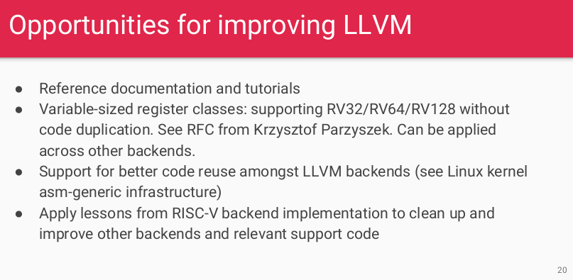
5.20 Improve LLVM
https://www.youtube.com/watch?v=eURfE6cTqZE&list=PLlu0CT-JnSasfpk8tq1ZDiE2G0AK1BhOg&index=5
Improve LLVM (18:32-20:11/24:34)
Improve LLVM Backend.

Slide 11
End

