Slide 1

5.21 RISCV Community
Peter H. Chen

Slide 2
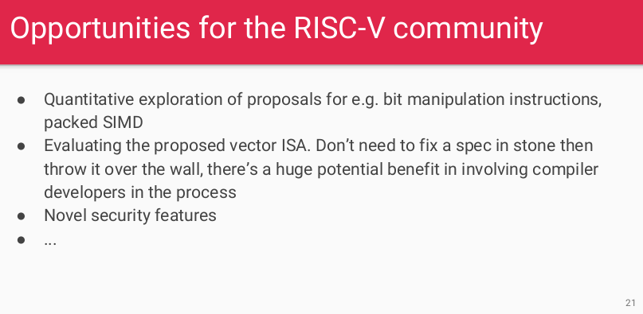
5.21 RISCV Community
https://www.youtube.com/watch?v=eURfE6cTqZE&list=PLlu0CT-JnSasfpk8tq1ZDiE2G0AK1BhOg&index=5
RISCV Community (20:12-21:21/24:34)
Open Source RISCV Community

Slide 3
5.22 lowRISC Status

Slide 4
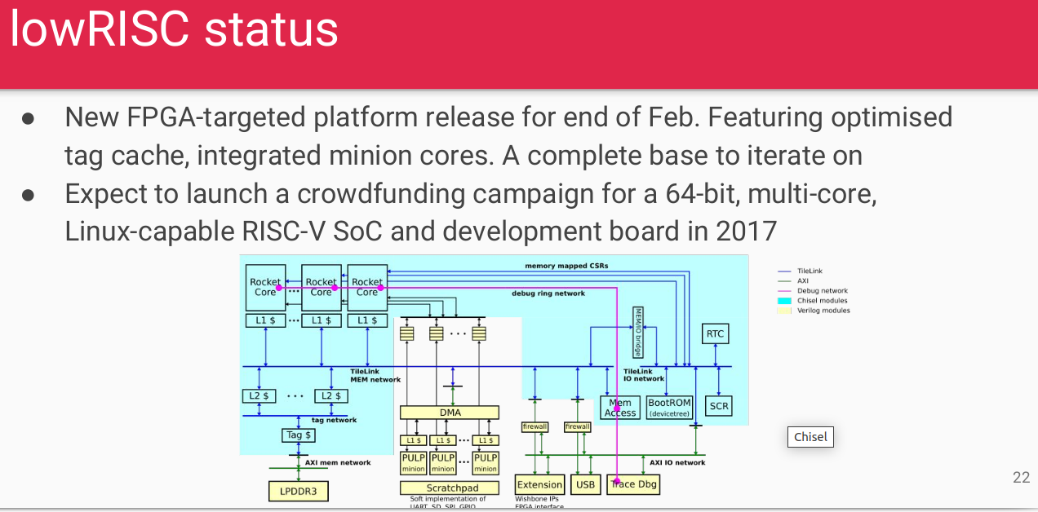
5.22 lowRISC Status
https://www.youtube.com/watch?v=eURfE6cTqZE&list=PLlu0CT-JnSasfpk8tq1ZDiE2G0AK1BhOg&index=5
lowRISC Status (21:22-22:33/24:34)
LowRISC Co-Design Status: FPGA, RISCV SoC development board.

Slide 5
5.23 Conclusion

Slide 6
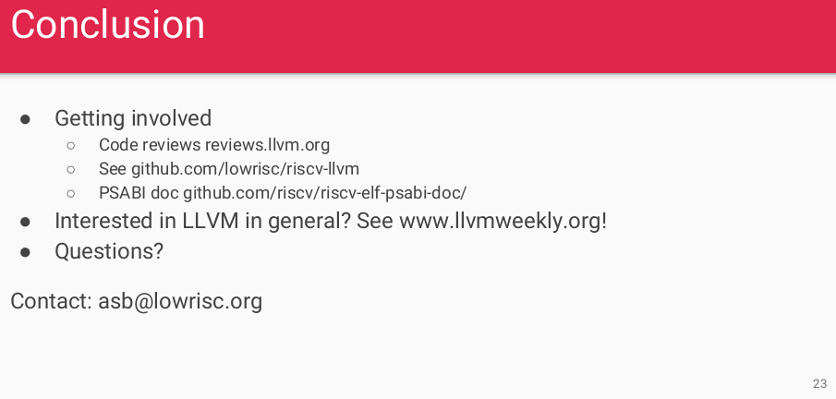
5.23 Conclusion
https://www.youtube.com/watch?v=eURfE6cTqZE&list=PLlu0CT-JnSasfpk8tq1ZDiE2G0AK1BhOg&index=5
Conclusion (22:34-24:34/24:34)
Code Review, GitHub, Document

Slide 7
End

