Slide 1

10 Functional Programming: Map
Peter H. Chen

Slide 2
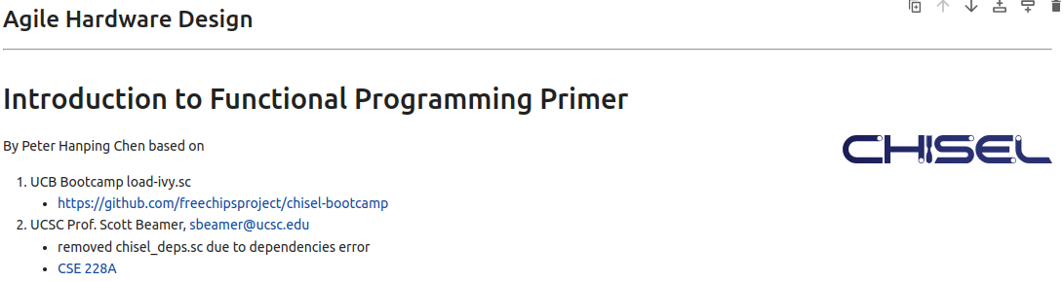
10 Functional Programming: Map
https://www.youtube.com/watch?v=VBR-KovOmiw&list=PLfrN7RIcMe6g2LBRJLTHTdhyj5s8ag0Rg&index=10
Introduction to Functional Programming (0:00-0:24/42:59)
Note: by Peter Hanping Chen
1. Why do I modify?
I cannot use configuration file (chisel_deps.sc) from Prof. Scott Beamer which have error in dependencies on my Ubuntu OS.
2. Instead, I used UCB bootcamp configuration file (load_ivy.sc) below.
Since load-ivy.sc is not 100% compatible in dependencies as chisel.deps.sc, I made some modification to make them work.
3. source/load-ivy.sc (https://github.com/freechipsproject/chisel-bootcamp)

Slide 3
10 Functional Programming: Map
https://www.youtube.com/watch?v=VBR-KovOmiw&list=PLfrN7RIcMe6g2LBRJLTHTdhyj5s8ag0Rg&index=10
Introduction to Functional Programming (0:21-0:25/42:59)
We discus the Functional Programming in Scala/Chisel HDL.
Topics:
1. Setup: jupyter notebook, select scala, and run cells.
2. Both Scala and Chisel HDL use Functional Programming instead of looping in traditional programming.
3. Anonymous Function: In functional programming, we do not need function name.
4. In functional programming, we never use loop, instead, we use map, foreach, and zip to replace loop.
5. _ is a placeholder for all given inputs.
6. We change the 008.Arbiter with four lines of loop into map, zip/foreach in online Functional Programming.

Slide 4
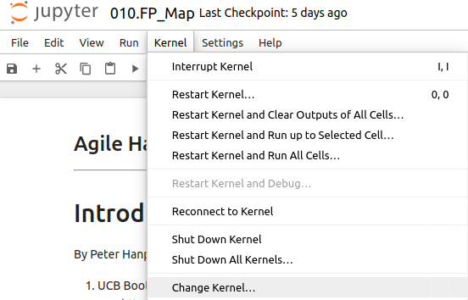
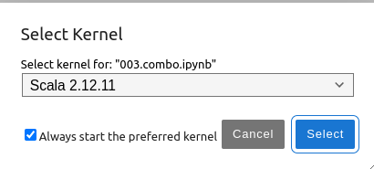
10 Functional Programming: Map
https://www.youtube.com/watch?v=VBR-KovOmiw&list=PLfrN7RIcMe6g2LBRJLTHTdhyj5s8ag0Rg&index=10
Introduction to Functional Programming (0:26-1:36/42:59)
We discuss Chisel Collection.
> jupyter notebook 006.combo.ipynb > Kernel > Change Kernel … > Select Scala2.21.22
> Run All Cells

Slide 5
10.1 Plan

Slide 6
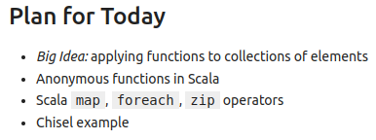
10.1 Plan
https://www.youtube.com/watch?v=VBR-KovOmiw&list=PLfrN7RIcMe6g2LBRJLTHTdhyj5s8ag0Rg&index=10
Plan (1:37-1:55/42:59)
Map, zip, etc.

Slide 7
10.2 Import Chisel Library

Slide 8
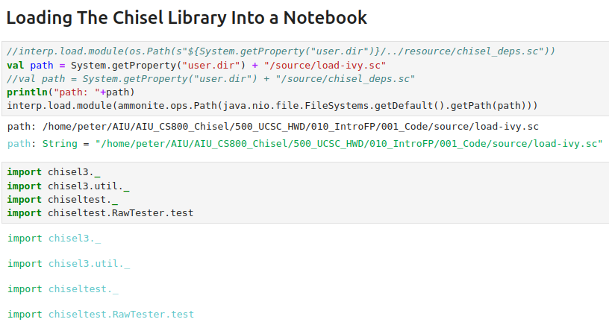
10.2 Import Chisel Library
https://www.youtube.com/watch?v=VBR-KovOmiw&list=PLfrN7RIcMe6g2LBRJLTHTdhyj5s8ag0Rg&index=10
Import Chisel Library (1:56-1:50/42:59)

Slide 9
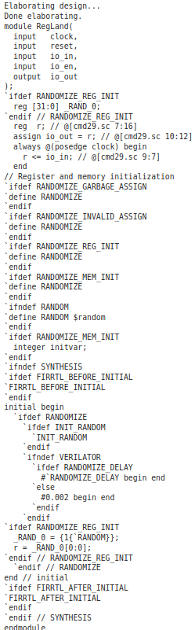
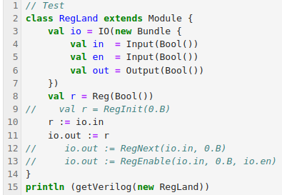
10.2 Import Chisel Library
https://www.youtube.com/watch?v=VBR-KovOmiw&list=PLfrN7RIcMe6g2LBRJLTHTdhyj5s8ag0Rg&index=10
Import Chisel Library (1:51-1:59/42:59)
Test

Slide 10
10.3 Functional Programming in Chisel

Slide 11
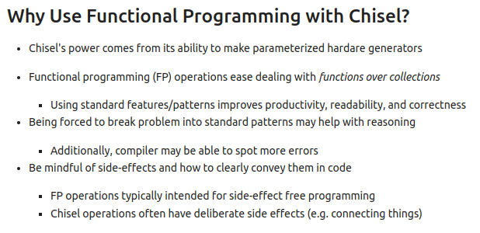
10.3 Functional Programming in Chisel
https://www.youtube.com/watch?v=VBR-KovOmiw&list=PLfrN7RIcMe6g2LBRJLTHTdhyj5s8ag0Rg&index=10
Functional Programming in Chisel (2:00-3:52/42:59)

Slide 12
10.4 Collection

Slide 13
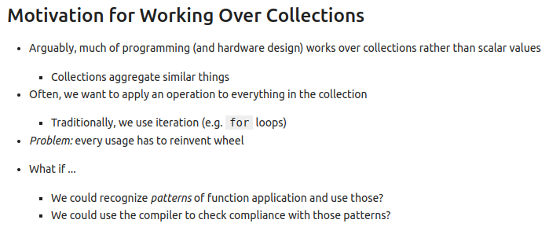
10.4 Collection
https://www.youtube.com/watch?v=VBR-KovOmiw&list=PLfrN7RIcMe6g2LBRJLTHTdhyj5s8ag0Rg&index=10
Collection (3:53-5:57/42:59)
A collection, in this context, simply means a group or set of items.

Slide 14
10.5 Pattern Reuse

Slide 15
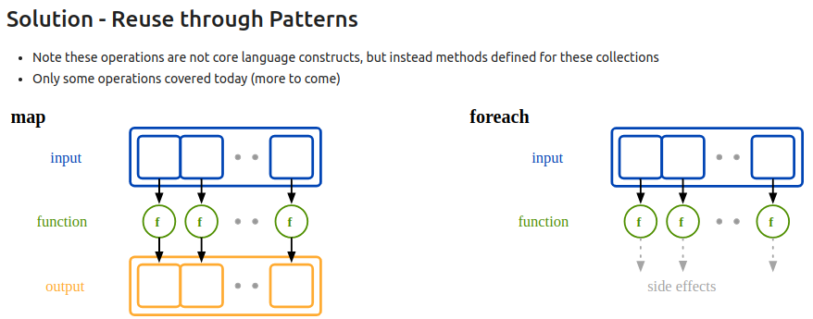
10.5 Pattern Reuse
https://www.youtube.com/watch?v=VBR-KovOmiw&list=PLfrN7RIcMe6g2LBRJLTHTdhyj5s8ag0Rg&index=10
Pattern Reuse (5:58-7:43/42:59)
Pattern map has output. Pattern foreach has side effect.
Q: What are Side Effects?
In Scala, a side effect refers to any behavior of a function beyond simply returning a value; it's an observable change in the program's state or environment.
1. Observable Changes: A side effect is any action that a function performs that has an observable effect on the program's state or environment, other than simply returning a value.
2. Beyond the Return Value: If a function not only returns a value but also modifies a variable, writes to a file, or prints to the console, it's considered to have side effects.
3. Impure Functions: Functions that have side effects are often referred to as "impure" functions, while those that don't are "pure".

Slide 16
10.6 Scala: Anonymous Function

Slide 17
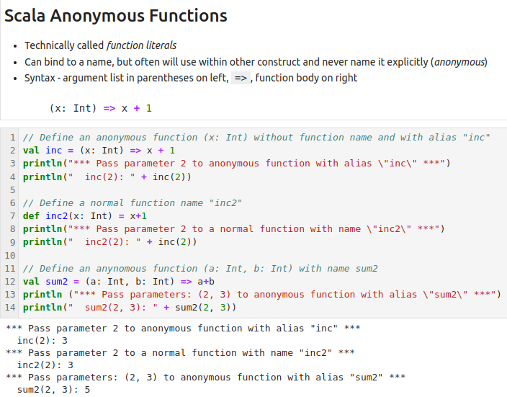
10.6 Scala: Anonymous Function
https://www.youtube.com/watch?v=VBR-KovOmiw&list=PLfrN7RIcMe6g2LBRJLTHTdhyj5s8ag0Rg&index=10
Scala: Anonymous Function (7:44-9:41/42:59)
“No Function Name” () => “function body”
(x: Int) => x +1

Slide 18
10.7 Scala: Map from List to Function

Slide 19
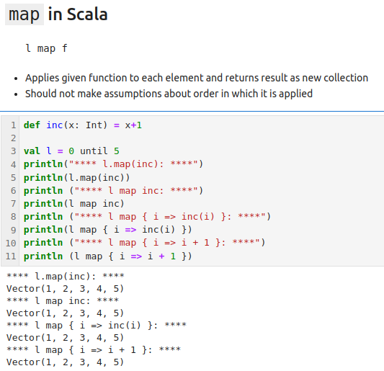
10.7 Scala: map from List to Function
https://www.youtube.com/watch?v=VBR-KovOmiw&list=PLfrN7RIcMe6g2LBRJLTHTdhyj5s8ag0Rg&index=10
Scala: map from List to Function (9:42-15:32/42:59)
Given a list and apply map function.
Function can be: inc, { i => inc (i)} , { i => i + 1 }, etc.

Slide 20
10.8 Scala: foreach Loop

Slide 21
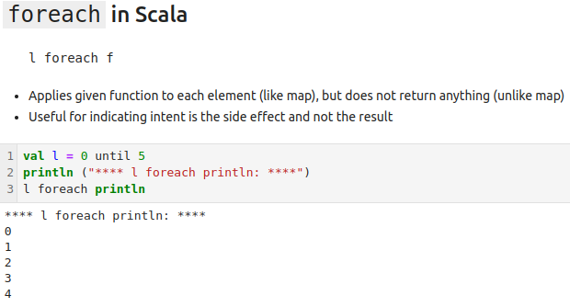
10.8 Scala: foreach Loop
https://www.youtube.com/watch?v=VBR-KovOmiw&list=PLfrN7RIcMe6g2LBRJLTHTdhyj5s8ag0Rg&index=10
Scala: foreach Loop (15:33-16:38/42:59)
Map is loop for us.
If we want to see each individual element, we can use foreach loop.

Slide 22
10.9 Chisel: map and foreach

Slide 23
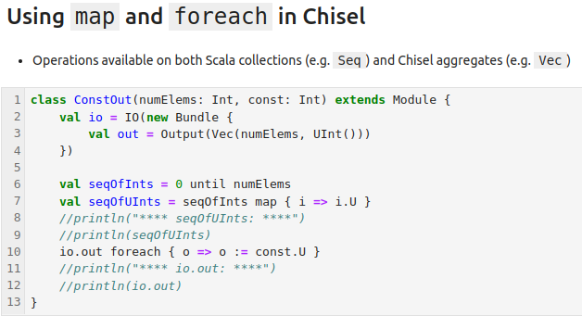
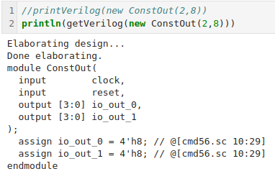
10.9 Chisel: map and foreach Loop
https://www.youtube.com/watch?v=VBR-KovOmiw&list=PLfrN7RIcMe6g2LBRJLTHTdhyj5s8ag0Rg&index=10
Chisel: map and foreach Loop (16:39-19:29/42:59)
Function map is loop for list and calculate with function.
Function foreach is loop for each element in the list.

Slide 24
10.10 Scala: Tuple

Slide 25
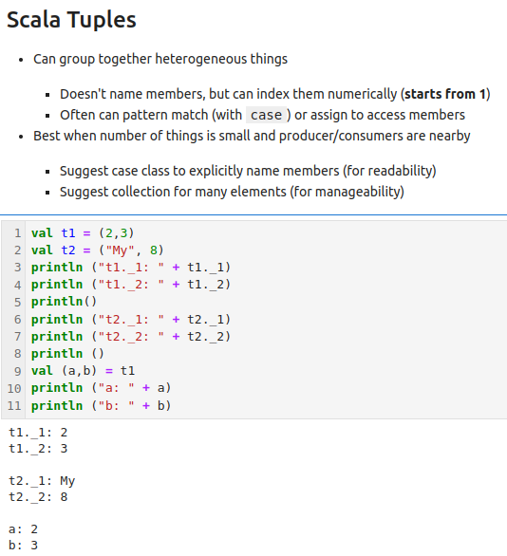
10.10 Scala: Tuple
https://www.youtube.com/watch?v=VBR-KovOmiw&list=PLfrN7RIcMe6g2LBRJLTHTdhyj5s8ag0Rg&index=10
Scala: Tuple (19:30-22:13/42:59)
Index Syntax: t1._1, t1._2, etc.
Note:
Scala Tuple index started from 1, not from 0.

Slide 26
10.11 Scala: zip

Slide 27
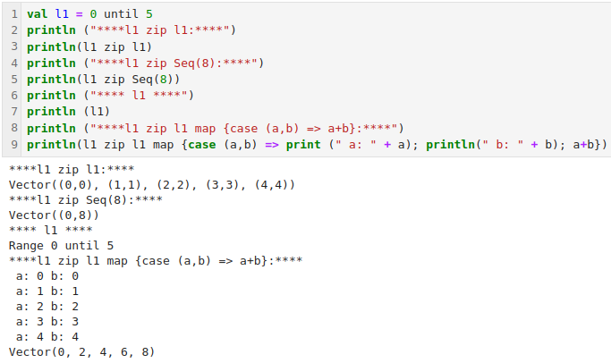
10.11 Scala: zip
https://www.youtube.com/watch?v=VBR-KovOmiw&list=PLfrN7RIcMe6g2LBRJLTHTdhyj5s8ag0Rg&index=10
Scala: zip (22:14-22:19/42:59)
Zip put both l1 and l2 increase the index at the same time.
We take the tuple first and then loop shown as the next two pages.

Slide 28
10.12 zip Diagram

Slide 29
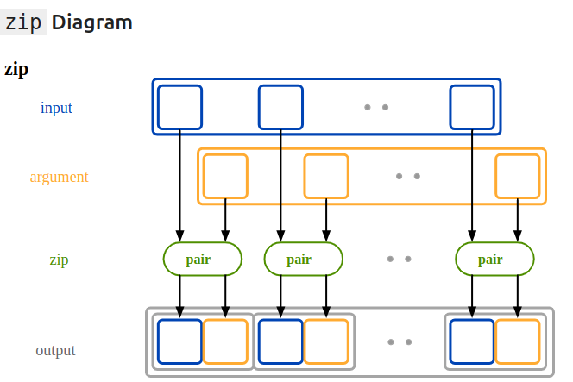
10.12 zip Diagram
https://www.youtube.com/watch?v=VBR-KovOmiw&list=PLfrN7RIcMe6g2LBRJLTHTdhyj5s8ag0Rg&index=10
zip Diagram (22:20-26:41/42:59)
Zip is given two collections. Technically, we call zip on one and the other is argument.
But really, we are given two collections. Zip goes through and pairs up the elements one by one.
Below diagram, we paired up two elements. Now, we have a tuple. Tuple is a pair of these two elements.
We loop pairs with one by one. Usually, we have the pairs with two different names, If pairs have different length, results are in the minimize size.

Slide 30
10.13 Chisel Example: foreach and zip

Slide 31
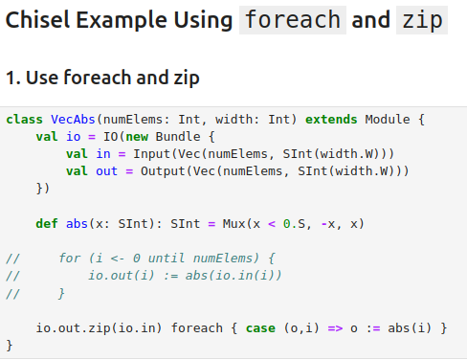
10.13 Chisel Example: foreach and zip
https://www.youtube.com/watch?v=VBR-KovOmiw&list=PLfrN7RIcMe6g2LBRJLTHTdhyj5s8ag0Rg&index=10
Chisel Example: foreach and zip (26:42-28:11/42:59)
1. Given an input of integer vector.
2. We output of integer vector,
3. We define abs function: If the input x is less than 0.5, we negate x.
4. io.out: In the output port
5. io.out.zip: We use zip to loop the output
6. io.out.zip (io.in): We loop through the output vs. input pairs .
7. foreach: for each output vs. input pair (o, i), we take output = abs (input). It is a size effect. It did not return anything.

Slide 32
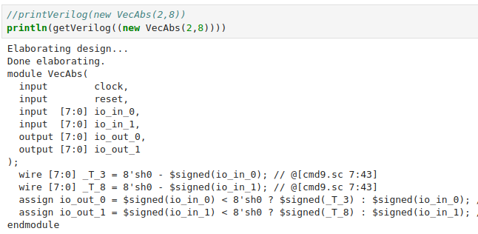
10.13 Chisel Example: foreach and zip
https://www.youtube.com/watch?v=VBR-KovOmiw&list=PLfrN7RIcMe6g2LBRJLTHTdhyj5s8ag0Rg&index=10
Chisel Example: foreach and zip (28:12-28:30/42:59)
Look at the Verilog code.
1. We have two inputs: io_in_0 and io_in_1.
2. We convert two inputs into two outputs: io_out_0 and io_out_1.

Slide 33
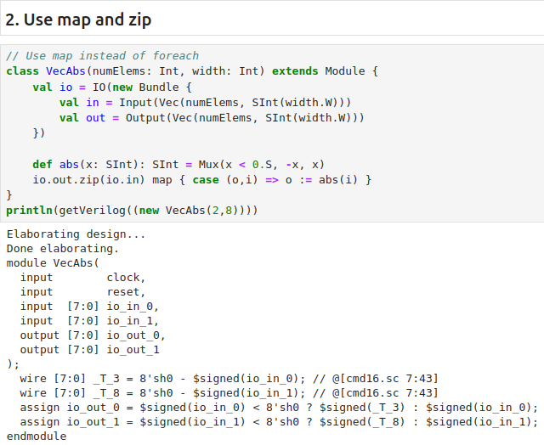
10.13 Chisel Example: foreach and zip
https://www.youtube.com/watch?v=VBR-KovOmiw&list=PLfrN7RIcMe6g2LBRJLTHTdhyj5s8ag0Rg&index=10
Use map and zip (28:31-30:00/42:59)
We change foreach into the map.

Slide 34
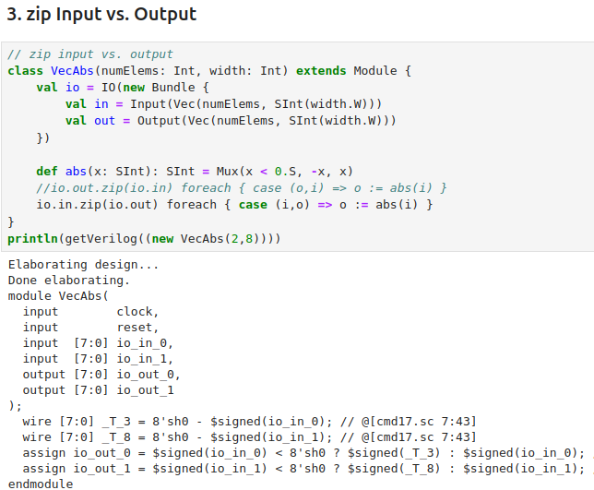
10.13 Chisel Example: foreach and zip
https://www.youtube.com/watch?v=VBR-KovOmiw&list=PLfrN7RIcMe6g2LBRJLTHTdhyj5s8ag0Rg&index=10
Zip Input vs Output (30:01-32:41/42:59)
We can swap the zip input vs output:
// io.out.zip (io.in) foreach { case (o, i) => o = abs (i) }
> io.in.zip (io.out) foreach { case (i, o) => o = abs (i) }

Slide 35
10.14 Scala: Function Placeholder

Slide 36
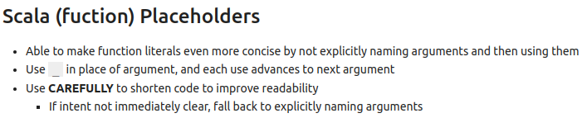
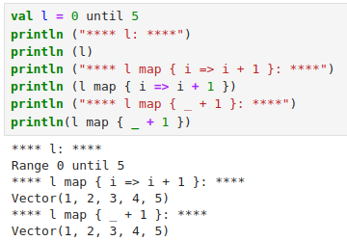
10.14 Scala: Function Placeholder
https://www.youtube.com/watch?v=VBR-KovOmiw&list=PLfrN7RIcMe6g2LBRJLTHTdhyj5s8ag0Rg&index=10
Scala: Function Placeholder (32:42-34:34/42:59)
The Scala Function Placeholder is also called the wild card placeholder.
_ is very concise. Take whatever in the argument and do the operation.

Slide 37
10.15 Arbiter with FP

Slide 38
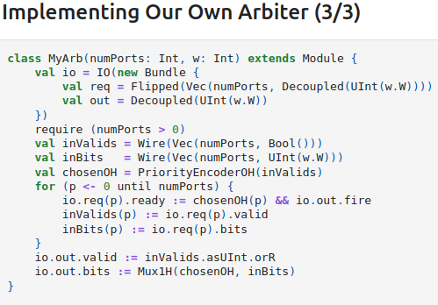
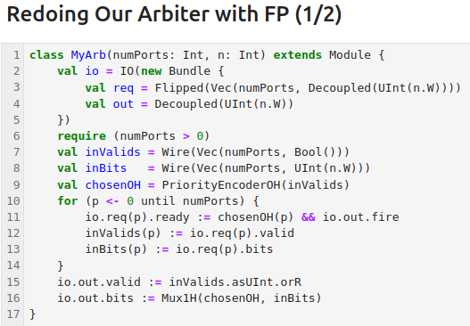
10.15 Arbiter with FP
https://www.youtube.com/watch?v=VBR-KovOmiw&list=PLfrN7RIcMe6g2LBRJLTHTdhyj5s8ag0Rg&index=10
Arbiter with FP (34:35-35:49/42:59)
We copy the class MyArb In the week 8 (008.Arbiter)
Now, we redo Arbiter last week. Now, we modify them with FP.
We have input Vector (numPorts, Width n). We want to collect:
1. loop for each numPorts
  a. input Valid
  b. input bits
  c. Priority Encoder of One-Hot Encoding.
2. set output valid
3. set output bits

Slide 39
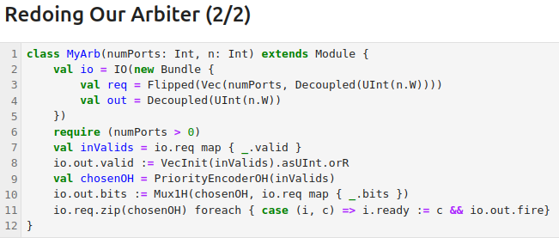
10.15 Arbiter with FP
https://www.youtube.com/watch?v=VBR-KovOmiw&list=PLfrN7RIcMe6g2LBRJLTHTdhyj5s8ag0Rg&index=10
Arbiter with FP (35:49-42:59/42:59)
Now, we change the four lines of loop (0 until numPorts) into one line of zip.
1. input valid = io.req map { _.valid }
2. io.out.valid := VecInit (…)
3. Set chosenOH = ...
4. io.out.bits := MuxIH (chosenOH, io.req map { _.bits})
5. Loop for input to output: io.req.zip (chosenOH) foreach { case (i, c) => i.ready := c && io.out.fire }
In functional programming, we do not have loop and vars. We change the for loop into map and zip with foreach.
5
5

Slide 40
End

